Slide 1

Mathematical modelling for vaccine-preventable diseases
Mathematics lecture 3
Integration
Katy Gaythorpe
School of Public Health
Imperial College London
k.gaythorpe@imperial.ac.uk
With materials contributed by Nik Cunniffe
Notes:
Introduce who we are

Slide 2
Aim
Integration
Reverse of differentiation
Geometric interpretation
Definite and indefinite integrals
Techniques of integration
Rules for basic functions
Sums and differences
Other functions
Applications
Areas under curves
Differential equations
Revision of integration and its applications

Slide 3
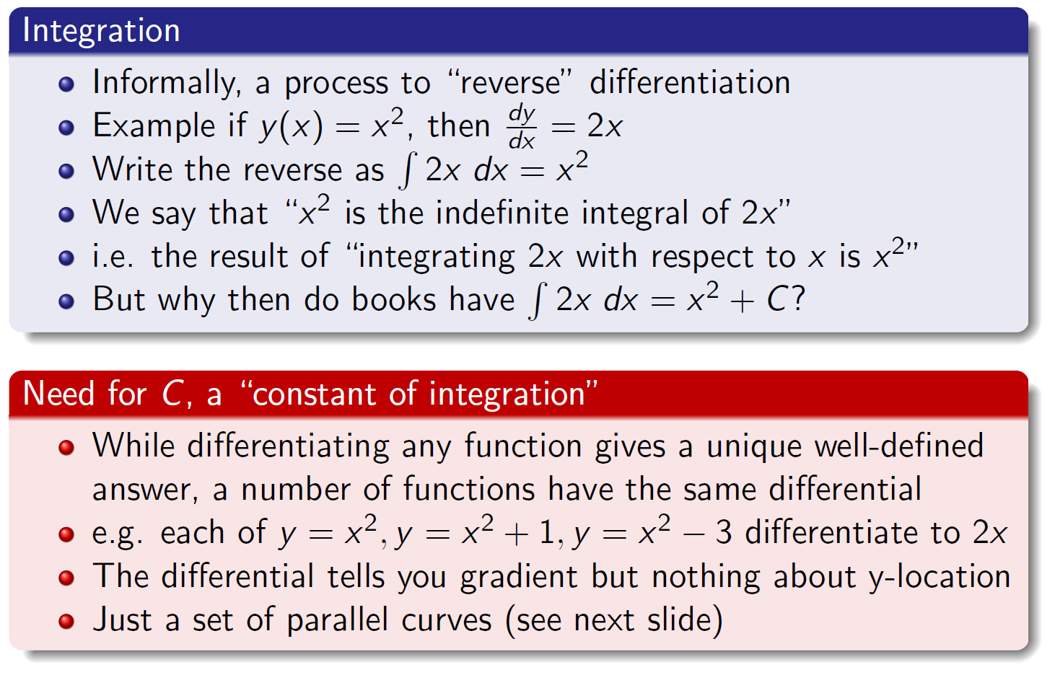
What is differentiation?

Slide 4
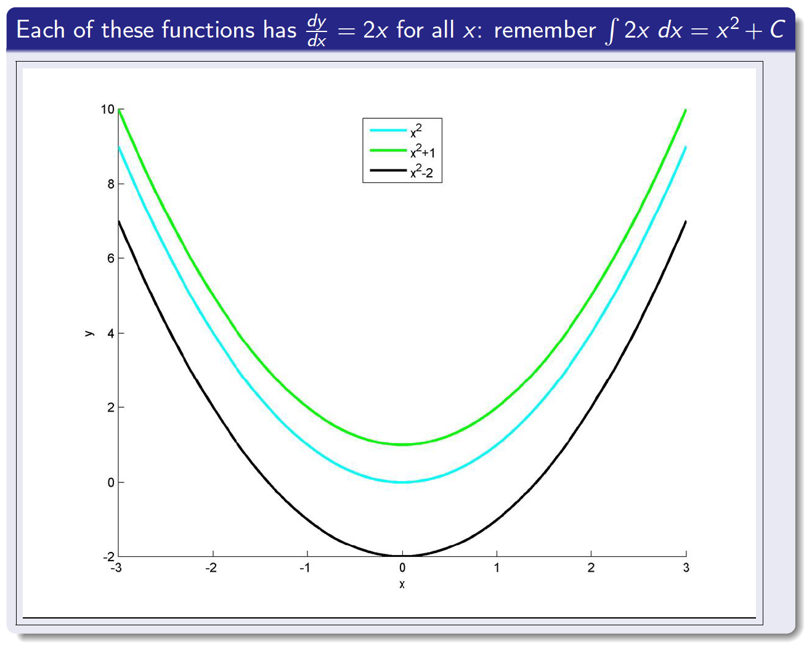
Geometric interpretation

Slide 5
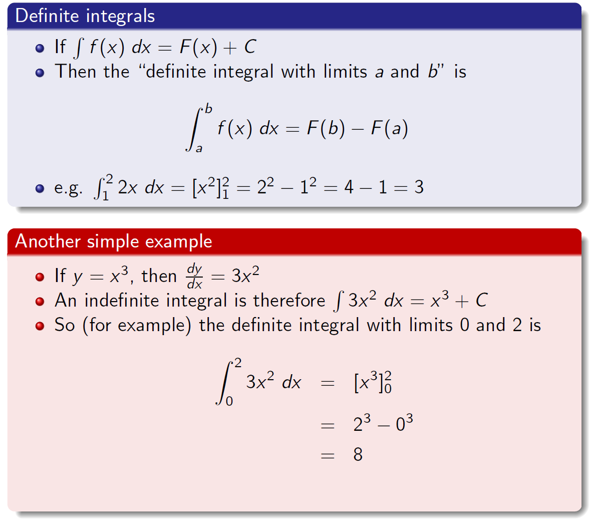
Definite integration

Slide 6
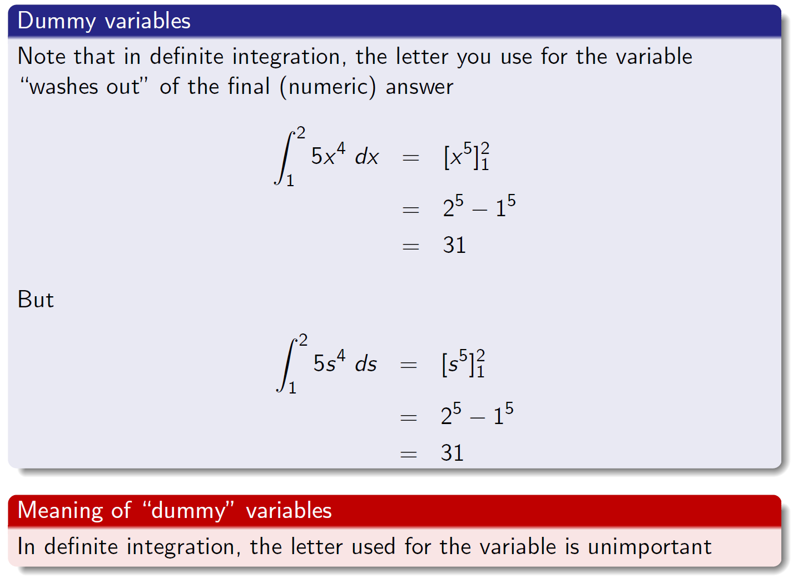
Definite integration and dummy variables

Slide 7
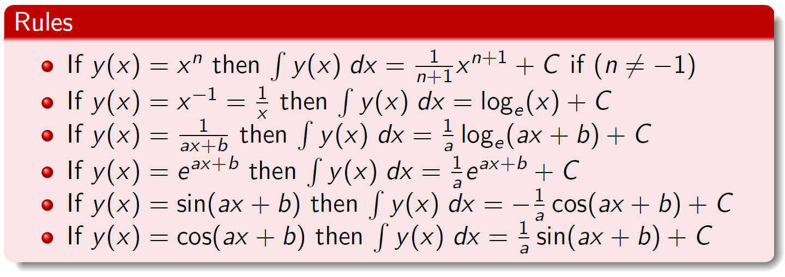
Integrals of basic functions
Another unfortunate reality...
Integrals of certain functions need to be committed to memory
...but now some good news
If you know the above (and a couple of general principles), then you can integrate most things (but not everything)

Slide 8
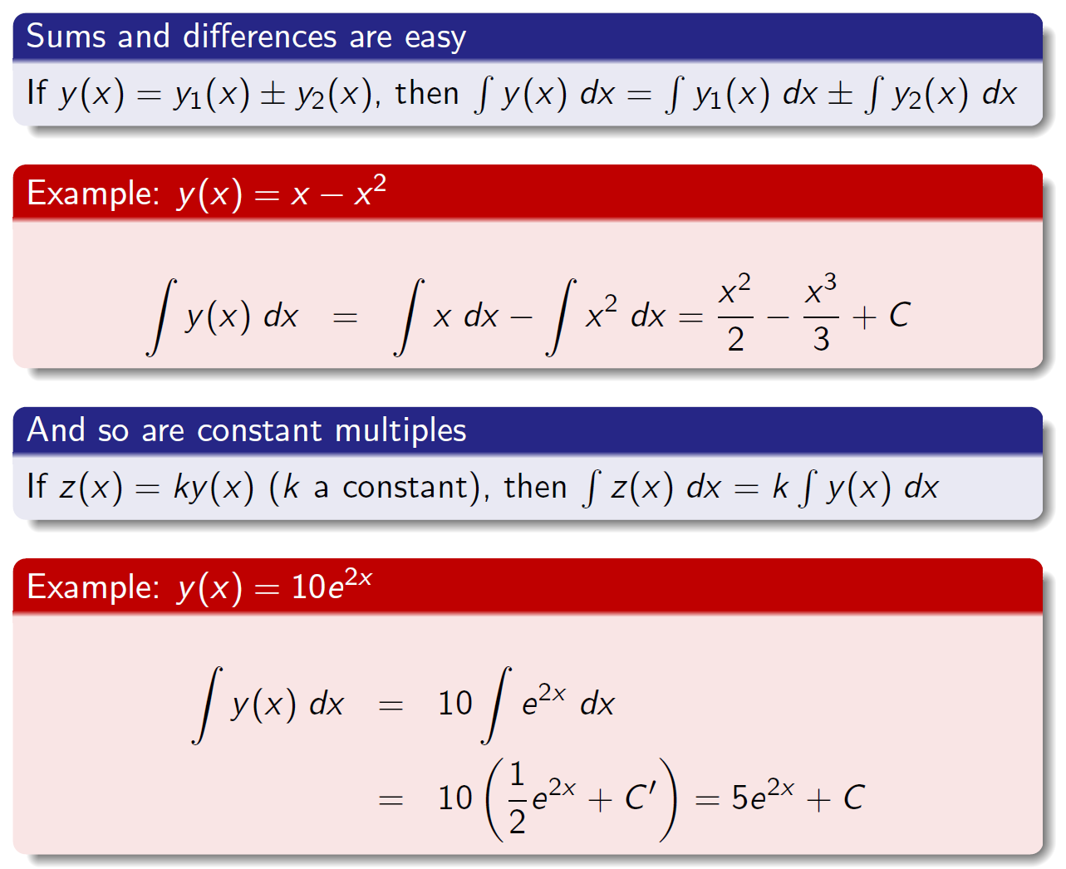
Integrals of sums, differences and constant multiples

Slide 9
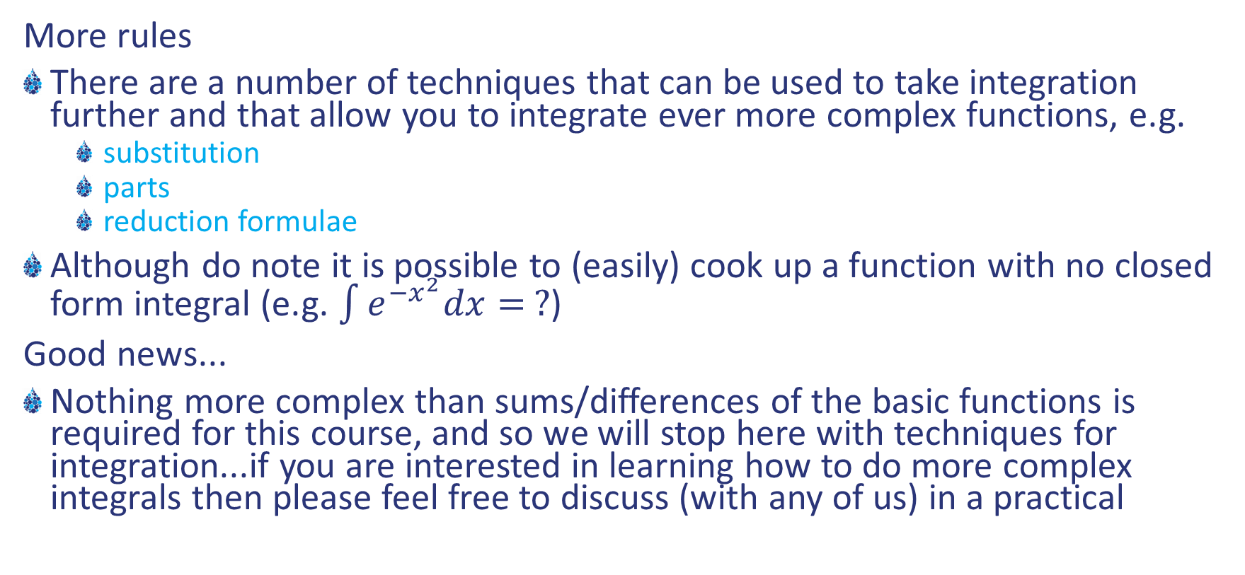
Further techniques
More rules
There are a number of techniques that can be used to take integration further and that allow you to integrate ever more complex functions, e.g.
substitution
parts
reduction formulae
Although do note it is possible to (easily) cook up a function with no closed form integral (e.g. $\int{e^{−x^{2}}dx= ?}$)
Good news...
Nothing more complex than sums/differences of the basic functions is required for this course, and so we will stop here with techniques for integration...if you are interested in learning how to do more complex integrals then please feel free to discuss (with any of us) in a practical

Slide 10
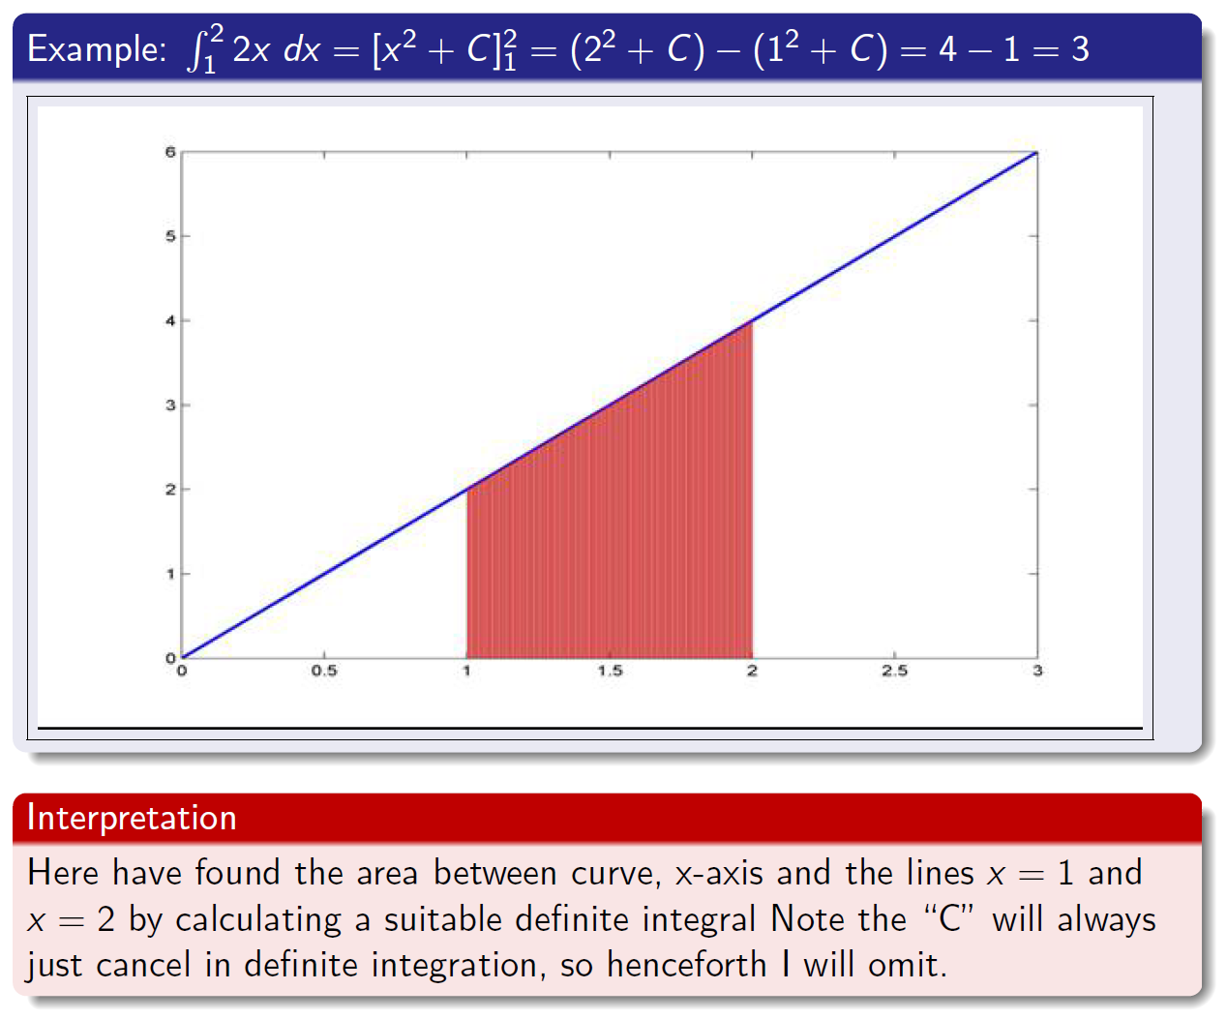
Definite integrals as areas

Slide 11
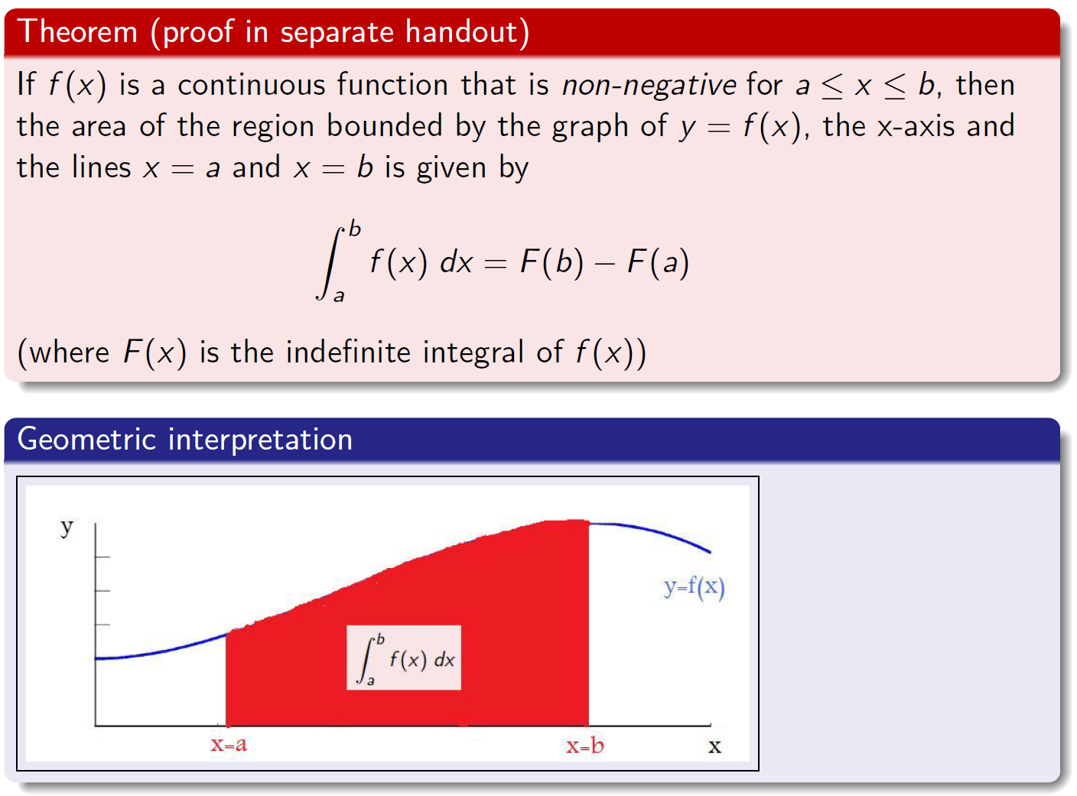
Finding the area under a graph

Slide 12
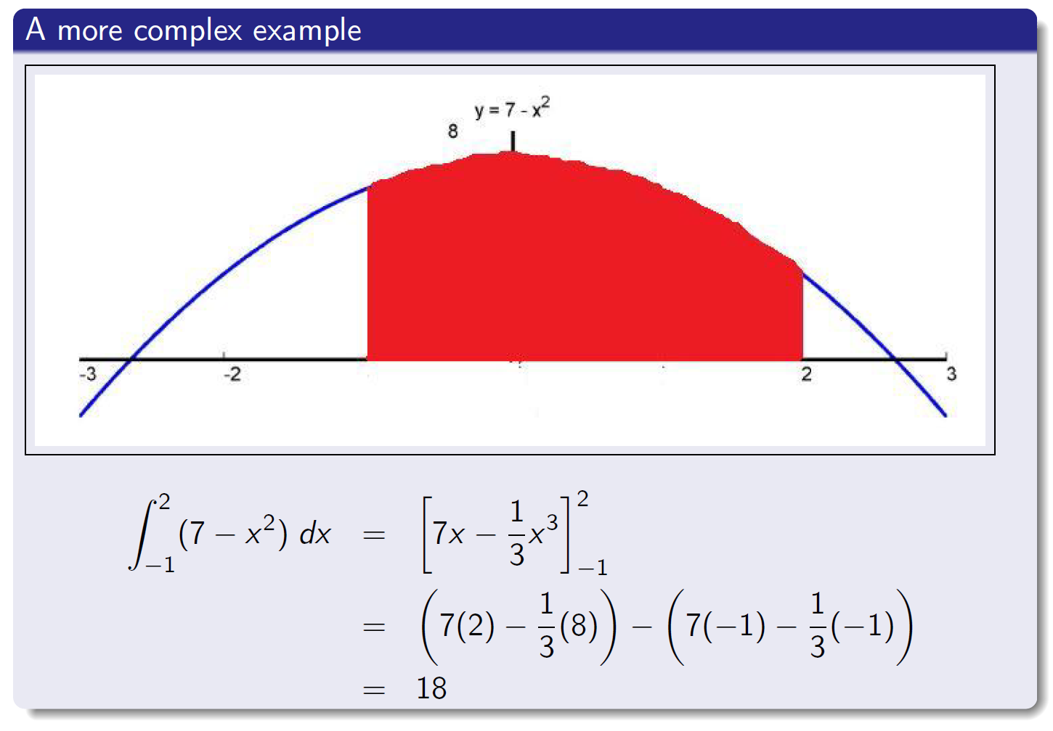
Definite integrals as areas

Slide 13
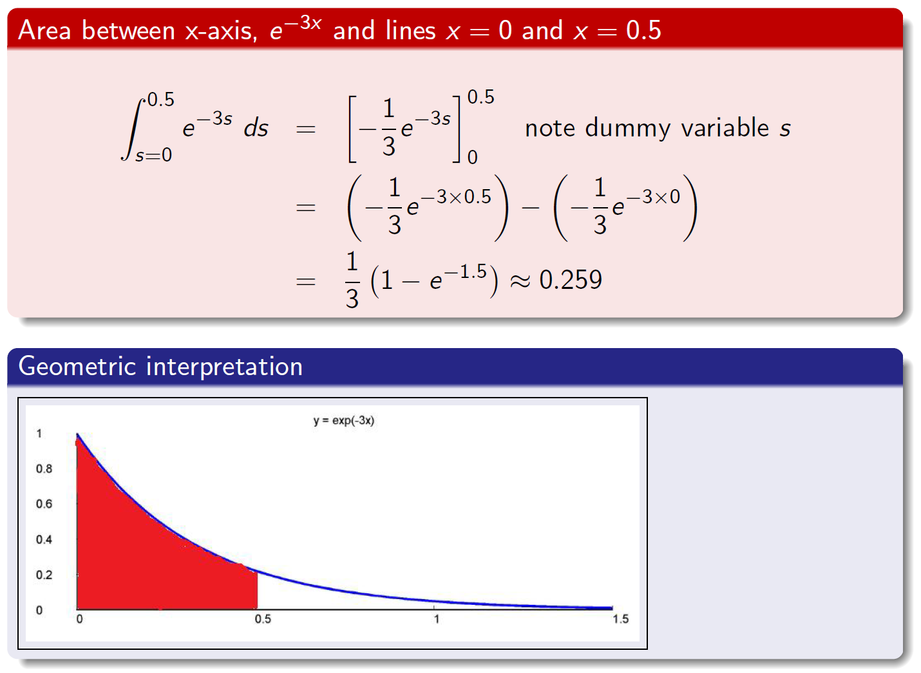
Integral of the exponential function

Slide 14
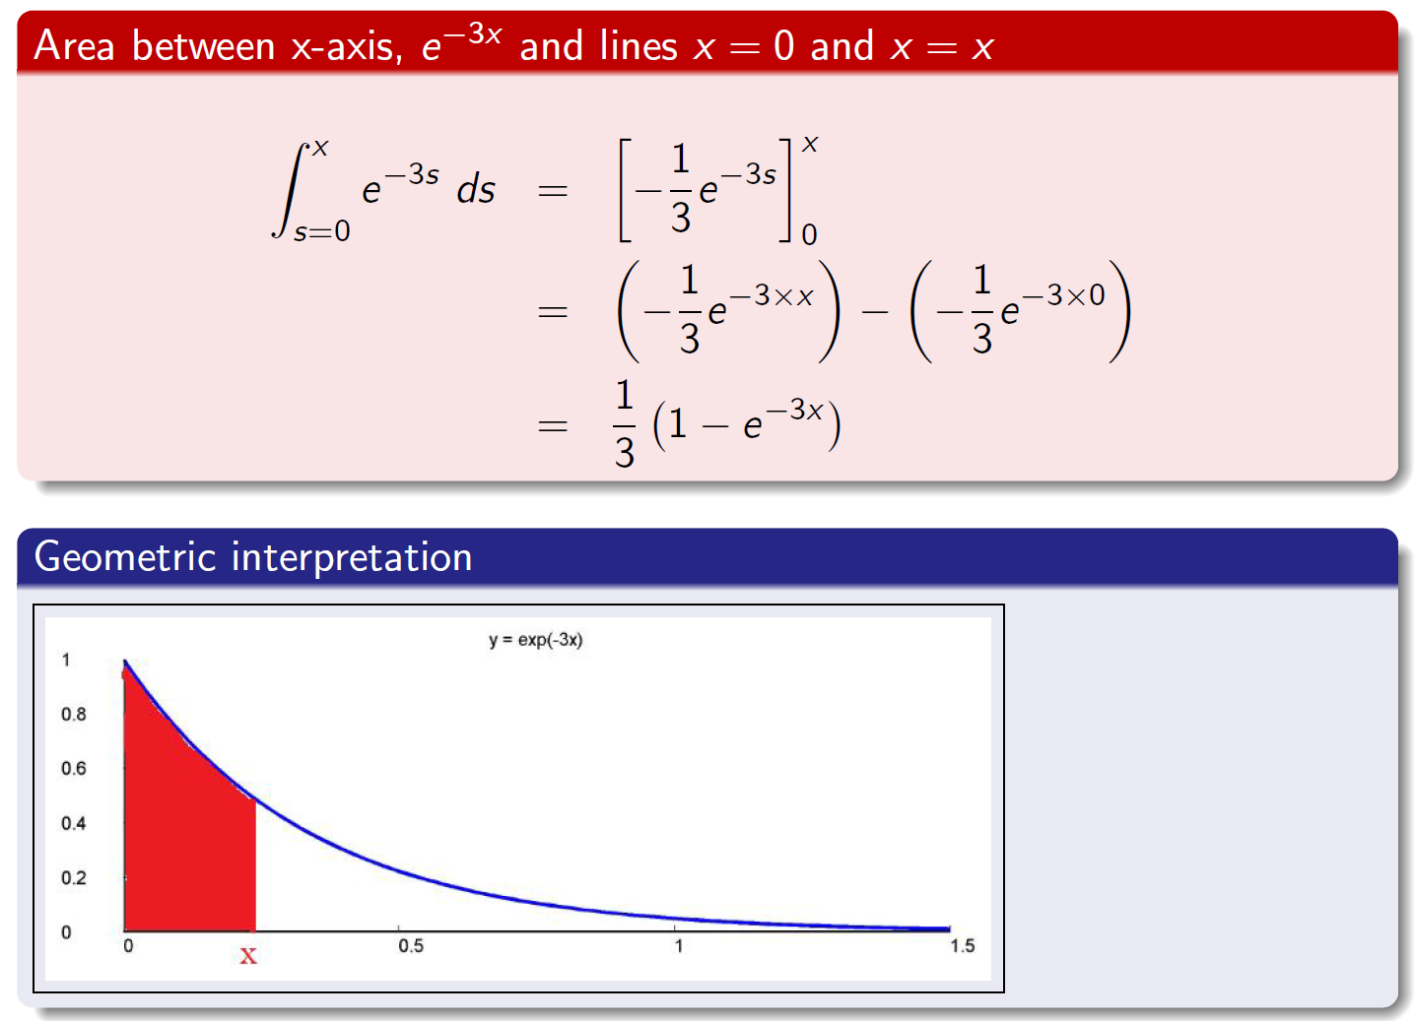
General upper bound: area as a function of x

Slide 15
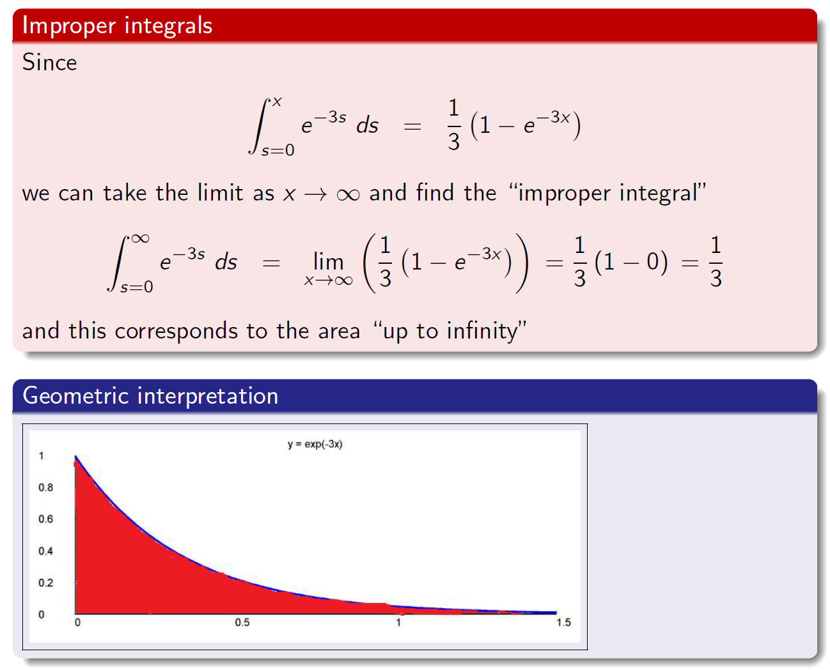
Infinite upper bound

Slide 16
Applications of integration
Finding areas
So we can use definite integration to find areas under curves, and you will see this used in future lectures (for e.g.) in the context of probability density functions
Solving differential equations
However arguably an even more persuasive and pervasive application of integration is to the solution of differential equations, which will be covered in the next lecture, and so we shall stop here...

Slide 17
Summary
Integration
Reverse of differentiation
Geometric interpretation
Definite and indefinite integrals
Techniques of differentiation
Rules for basic functions
Sums and differences
Other functions
Applications
Areas under curves
Differential equations

