Slide 1

Mathematical modelling for vaccine-preventable diseases
Programming 1
Loops
Andrew J K Conlan
University of Cambridge
ajkc2@cam.ac.uk
With contributions from Nik Cunniffe
Notes:
Introduce who we are

Slide 2
Contents
For loops
Nesting loops
Conditional statements: if, else, and else if
Combining conditional statements
While loops
When to use for vs. while

Slide 3
Controlling the flow of a program
At the simplest level a computer program
is just a long list of instructions
Programming languages allow us to
perform long calculations without
explicitly writing out every instruction…
y <- 4 + 5*log(x)
z <- y
quit()
R code
Loops or vector calculations
Perform similar operations on multiple pieces of data
Conditional execution
Execute code only when a specific condition is met

Slide 4
Anatomy of a for loop
index (loop) variable i
Vector containing all values of i to loop over
for(i in i_vals)
{
# do some stuff
# which can
# depend on i
}
e.g.
i_vals = 1:10
Main body of loop
(calculation we want to perform)

Slide 5
Example: printing to the screen
R code
Output
for(i in 1:10)
{
print(i)
}
1
2
3
4
5
6
7
8
9
10

Slide 6
It’s possible to loop over any vector
R code
Output
1
0.9
0.8
0.7
0.6
0.5
0.4
0.3
0.2
0.1
0
# vector v goes from
# 1 to 0 in steps of -0.1
v<-seq(1,0,-0.1)
for(i in v)
{
print(i)
}

Slide 7
Example: calculating factorials
R code
Output
1 fact is 1
2 fact is 2
3 fact is 6
4 fact is 24
5 fact is 120
6 fact is 720
7 fact is 5040
8 fact is 40320
9 fact is 362880
10 fact is 3628800
fact <- 1
for(i in 1:10)
{
fact <- fact * i
print(paste(i,'fact is',fact))
}
Note the variable ‘fact’ must be initialised before the loop

Slide 8
Loops can be nested
R code
Output
i = 1 , j = 1
i = 1 , j = 2
i = 1 , j = 3
i = 1 , j = 4
i = 2 , j = 1
i = 2 , j = 2
i = 2 , j = 3
i = 2 , j = 4
i = 3 , j = 1
i = 3 , j = 2
i = 3 , j = 3
i = 3 , j = 4
for(i in 1:3)
{
for(j in 1:4)
{
print(paste('i = ',i, ', j = ', j))
}
}
Note that the index variables (i and j) need different names

Slide 9
Inner loop can depend on the outer
R code
Output
for(i in 1:3)
{
for(j in 1:i)
{
print(paste('i = ',i, ', j = ', j))
}
}
i = 1 , j = 1
i = 2 , j = 1
i = 2 , j = 2
i = 3 , j = 1
i = 3 , j = 2
i = 3 , j = 3
The inner (j) loop only counts up to current value of i
(outer loop variable), so the end point is different each time

Slide 10
Conditionals: if statement
R code
Output
1 is less than 4
2 is less than 4
3 is less than 4
for(i in 1:10)
{
if(i < 4)
{
print(paste(i, 'is less than 4'))
}
}
Note that argument to if is a logical comparison

Slide 11
Conditionals: else statement
R code
Output
1 is less than 4
2 is less than 4
3 is less than 4
4 is not less than 4
5 is not less than 4
6 is not less than 4
7 is not less than 4
8 is not less than 4
9 is not less than 4
10 is not less than 4
for(i in 1:10)
{
if(i < 4)
{
print(paste(i, 'is less than 4'))
} else {
print(paste(i, 'is not less than 4'))
}
}
Note position
of else relative
to the braces

Slide 12
Conditionals: else if statement
R code
Output
1 is less than 4
2 is less than 4
3 is less than 4
4 is less than 7 but not 4
5 is less than 7 but not 4
6 is less than 7 but not 4
7 is neither
8 is neither
9 is neither
10 is neither
for(i in 1:10)
{
if(i < 4)
{
print(paste(i, 'is less than 4'))
} else if(i < 7) {
print(paste(i, 'is less than 7 but not 4'))
} else {
print(paste(i, 'is neither'))
}
}

Slide 13
Basic logical comparisons
> “Greater than”
>= “Greater than or equal”
!= “Not equal”
== “Equal to”
<= “Less than or equal”
< “Less than”

Slide 14
Combining logical comparisons
A
B
A
B
A & B (AND)
A | B (OR)
A
B
A
B
!(A|B) (Complement)
!A & B

Slide 15
Example of combining conditionals
R code
Output
for(i in 1:10)
{
if(i < 4 | i > 4)
{
print(paste(i, 'is different to 4'))
} else {
print(paste(i, 'is equal to 4'))
}
}
1 is different to 4
2 is different to 4
3 is different to 4
4 is equal to 4
5 is different to 4
6 is different to 4
7 is different to 4
8 is different to 4
9 is different to 4
10 is different to 4
The conditions can get as complex as you want

Slide 16
Anatomy of a while loop
index (loop) variable i
Logical condition
i <- 1
while(i <= 10)
{
# do some stuff
# which can
# depend on i
i <- i + 1
}
… does not have to be in terms of an index variable, but often is…
Main body of loop
(calculation we want to perform)
Typically need to keep track of more with a while loop
- remember to initialise index variable (i here)
- manually update it in loop

Slide 17
Calculating factorials with while
R code
Output
1 fact is 1
2 fact is 2
3 fact is 6
4 fact is 24
5 fact is 120
6 fact is 720
7 fact is 5040
8 fact is 40320
9 fact is 362880
10 fact is 3628800
fact <- 1
i <- 1
while(i <= 10)
{
fact = fact * i
print(paste(i,'factorial is ',fact))
i <- i + 1
}

Slide 18
Can update loop counter anywhere
R code
Output
1 fact is 1
2 fact is 2
3 fact is 6
4 fact is 24
5 fact is 120
6 fact is 720
7 fact is 5040
8 fact is 40320
9 fact is 362880
10 fact is 3628800
fact <- 1
i <- 0
while(i < 10)
{
i <- i + 1
fact = fact * i
print(paste(i,'fact is ',fact))
}
Note changing order of incrementing i wrt calculation
means the loop termination condition must be changed

Slide 19
Need to take care over the order
R code
Output
2 fact is 2
3 fact is 6
4 fact is 24
5 fact is 120
6 fact is 720
7 fact is 5040
8 fact is 40320
9 fact is 362880
10 fact is 3628800
11 fact is 39916800
fact <- 1
i <- 1
while(i <= 10)
{
i <- i + 1 # updating i earlier
# but loop not changed
fact = fact * i
print(paste(i,'fact is ',fact))
}
Note this prints one too many

Slide 20
While loops might not stop
Index not updated
Conditional never evaluates to false
fact <- 1
i <- 1
while(i <= 10)
{
fact = fact * i
print(fact)
}
fact <- 1
i <- 1
while(i > 0)
{
fact = fact * i
print(fact)
i <- i + 1
}
Need to ensure while loops will terminate eventually

Slide 21
For versus while
While loops are more work
Need to remember to
Initialise the index variable
Update the index within the body of the loop
Update the index at the correct place wrt the calculation
Ensure loop finishes
So why would you even bother?
Do you know in advance how often to loop?
Yes: use a for loop
No: use a while loop

Slide 22

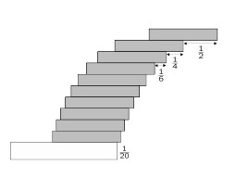
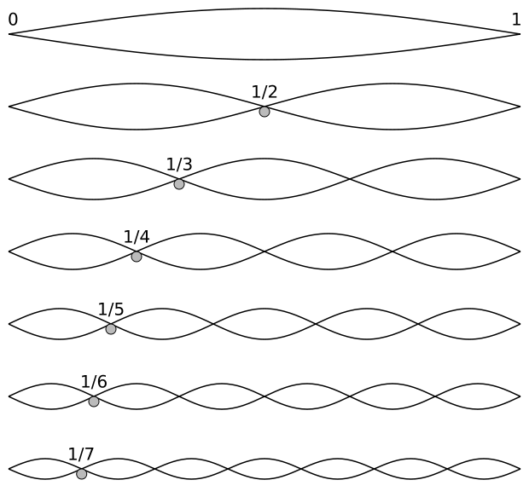

Harmonic series
Musical “harmonics”
Sticker albums + Gachapon
Stacks of books

Slide 23
Harmonic numbers
Two illustrative questions
- What is the 427th harmonic number, H₄₂₇?
- What is the smallest n such that H_{n} > 10?
(i.e. the first harmonic number greater than 10)

Slide 24
What is H₄₂₇?
R code
H <- 0
for(k in 1:427)
{
H <- H + 1/k
}
print(paste(’H427 is',H))
Note in R more natural
to not use a loop at all!
sum(1/(1:427))
Output
H427 is 6.63517018126851

Slide 25
When does H_{n} first exceed 10?
R code
H <- 0
k <- 0
while(H < 10)
{
k <- k+1
H <- H + 1/k
}
print(paste('Hn is',H,'when n is',k))
Output
Hn is 10.0000430082758 when n is 12367

Slide 26
Summary of the major constructs
Logical expressions
Conditional execution
== ‘Equals’
!= ‘Does not Equal’
> ‘Greater than’
>= ‘Greater than or equal to’
<= ‘Less than or equal to’
& ‘Logical AND’
| ‘Logical OR’
if(test)
{
# do this
} else if(test two) {
# do that
} else { # do the other }
for loops
while loops
for(all in vector)
{
# do stuff
}
while(this is true)
{
# do stuff
}

