Slide 1

Mathematical modelling for vaccine-preventable diseases
Programming 2
Functions
Andrew J K Conlan
University of Cambridge
ajkc2@cam.ac.uk
With contributions from Nik Cunniffe
Notes:
Introduce who we are

Slide 2
Contents
Anatomy of a function
Arguments to functions
Default arguments
Unspecified arguments
Returning multiple values
Scope: local vs. global environment

Slide 3
Anatomy of a function
A function is specially written R code
which returns output from input arguments
Name of function
Values of
Arguments
“passed” to function assigned to a,b,…
myfunction <- function(a,b)
{
output <- a^2 - b
return(output)
}
Main body of function calculates output
An R function returns the value of the last statement executed
or the value of the variable passed to return()
R command line
> x <- myfunction(4,2)
Value of x
14

Slide 4
Arguments to functions
myfunction <- function(a,b)
{
output <- a^2 - b
return(output)
}
The order of arguments is important, although can override this using
named arguments
R command line
Value of x
> x<-myfunction(4,2)
14
> x<-myfunction(2,4)
0
> x<-myfunction(4)
Error in a^2 - b : 'b' is missing
> x<-myfunction(b=4,a=2)
0

Slide 5
Default values of arguments
myfunction <- function(a,b=3)
{
output <- a^2 - b
return(output)
}
Can assign default values to arguments at the time of writing the function…can be overridden by the caller if required
R command line
Value of x
> x<-myfunction(4,2)
14
> x<- myfunction(2,4)
0
> x<- myfunction(4)
13
> x<- myfunction(b=4)
Error in a^2 - b : ‘a' is missing
> x<- myfunction(b=4,a=2)
0

Slide 6
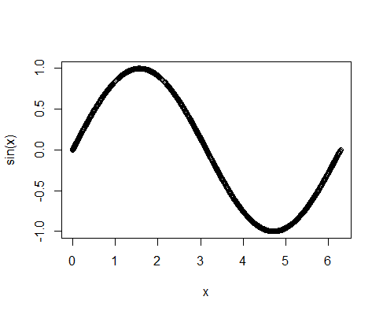
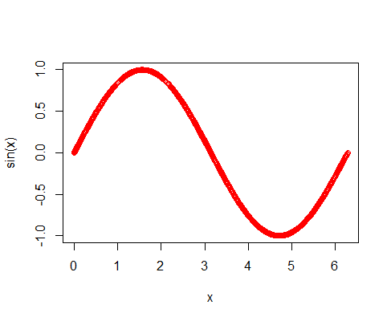
Unspecified values of arguments
plotSin <- function(a,b,...)
{
x<-seq(from=a,to=b,length.out=1000)
plot(x,sin(x),...)
}
Ellipsis (three dots) can be used to mark where extra arguments should be passed through
R command line
R command line
> plotSin(0,2*pi)
> plotSin(0,2*pi,col='red')
Note the extra
argument has
changed colour
of the plot
6/19

Slide 7
Return is not necessary
myfunction <- function(a,b)
{
output <- a^2 - b
return(output)
}
mylazyfunction <- function(a,b)
{
output <- a^2 – b
}
R command line
R command line
> x<-myfunction(4,2)
> x<-mylazyfunction(4,2)
Value of x
14
Value of x
14

Slide 8
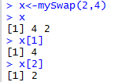
Returning multiple values
mySwap <- function(a,b)
{
output <- c(b,a)
return(output)
}
If the return values are all of the same type, probably simplest to concatenate them into a single vector
R command line
Value of x
> x<-mySwap(2,4)

Slide 9
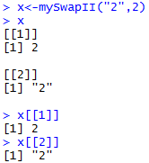
Returning multiple values
mySwapII <- function(a,b)
{
output <- list(b,a)
return(output)
}
If the return values are of different types, then have to return a list…this is more flexible, but needs more typing to extract the values
R command line
Value of x
> x<-mySwapII(“2”,2)

Slide 10
What happens when we define a function?
myfunction <- function(input)
Allocate a section of memory to
hold the list of instructions
Add an entry to “Workspace” linking this memory to a name
output <- input * input
return(output))
myfunction
“Global” Workspace
“Global” Memory
10/19

Slide 11
What happens when we call a function?
myfunction(3)
argument 1
R creates a new and separate “local” memory space, copying to it the values of arguments
output <- input*input
return(output))
“Local” Memory
Adds all of the function’s arguments as variables in a new “local” workspace
input
“Global” Memory
myfunction
“Local”
Workspace
“Global” Workspace

Slide 12
What happens when we call a function?
myfunction(3)
argument 1
R reads instructions from function definition in global memory and executes one-by-one
output <- input*input
return(output))
output
“Local” Memory
Variables created within the function are created in local memory
input
“Global” Memory
output
myfunction
“Local”
Workspace
“Global” Workspace

Slide 13
What happens when we call a function?
myfunction(3)
argument 1
When R reaches a return() statement or the function’s end it returns a value to the main program
output <- input*input
return(output))
output
“Local” Memory
[1] 9
input
“Global” Memory
output
Local memory is destroyed and R returns you to the command prompt
myfunction
“Local”
Workspace
“Global” Workspace

Slide 14
Scope: using ls() to list objects
for(i in 1:100)
{
print(i)
}
ls()
Once created variables will remain in the workspace until explicitly removed
[1] "i"
rm(i)
ls()
character(0)
Note, results of ls() are also shown in
RStudio under Environment tab

Slide 15
Scope: functions are encapsulated
Note the variables temp1 and temp2 are not visible “outside” the function
my_func <- function()
{
temp1 <- 4
temp2 <- 50
return(temp1+temp2)
}
global_var <- 42
ls()
print(my_func())
ls()
[1] "global_var" "my_func"
[1] 54
[1] "global_var" "my_func"

Slide 16
Scope: functions are encapsulated
Can use ls() within a function to printout the “local” memory and name space
my_func <- function()
{
temp1 <- 4
temp2 <- 50
return(ls())
}
global_var <- 42
ls()
print(my_func())
ls()
[1] "global_var" "my_func"
[1] "temp1" "temp2"
[1] "global_var" "my_func"

Slide 17
Scope: a common mistake
Changing the value
of an argument inside
a function doesn’t change its value outside the function
squareValue <- function(toSquare)
{
toSquare <- toSquare^2
return(toSquare)
}
myNum <- 2
myNumSq <- squareValue(myNum)
print(myNum)
print(myNumSq)
[1] 2
[1] 4

Slide 18
Scope: a complication
my_func <- function()
{
temp1 <- 4
temp2 <- 50
global_var <- global_var/2
return(ls())
}
global_var <- 42
ls()
print(my_func())
ls()
global_var
Functions can read variables from the global workspace
But can only assign to the local workspace
Note here only the value of local copy of global_var is changed
[1] "global_var" "my_func"
[1] "global_var" "temp1" "temp2"
[1] "global_var" "my_func"
[1] 42

Slide 19

Scope: setting global variables
my_func <- function()
{
temp1 <- 4
temp2 <- 50
global_var <<- global_var/2
return(ls())
}
global_var <- 42
ls()
print(my_func())
ls()
global_var
The R language defines an operator to save variables to global memory:
<<-
Using <<- gives your function side effects, so best avoided unless have to use it
[1] 21

