Slide 1
13.3 - ETL Project Work Group 9 Movie Characters By Revenue Agustin Gonzales, Anthony Jones, Jeff Wong
4/17/2019

Slide 2
Data Sources
https://www.kaggle.com/fivethirtyeight/fivethirtyeight-comic-characters-dataset and movie data from
https://www.kaggle.com/rounakbanik/the-movies-dataset.
Both datasets are obtainable in "CSV" format.

Slide 3
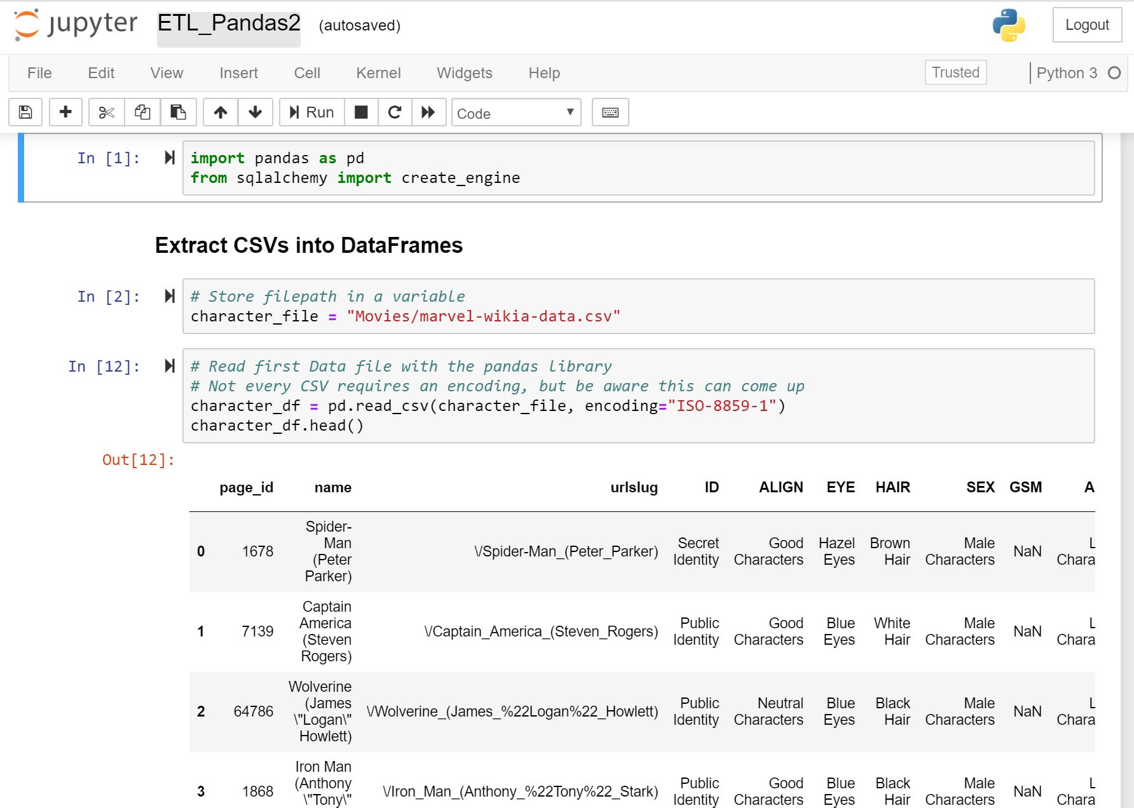

Slide 4
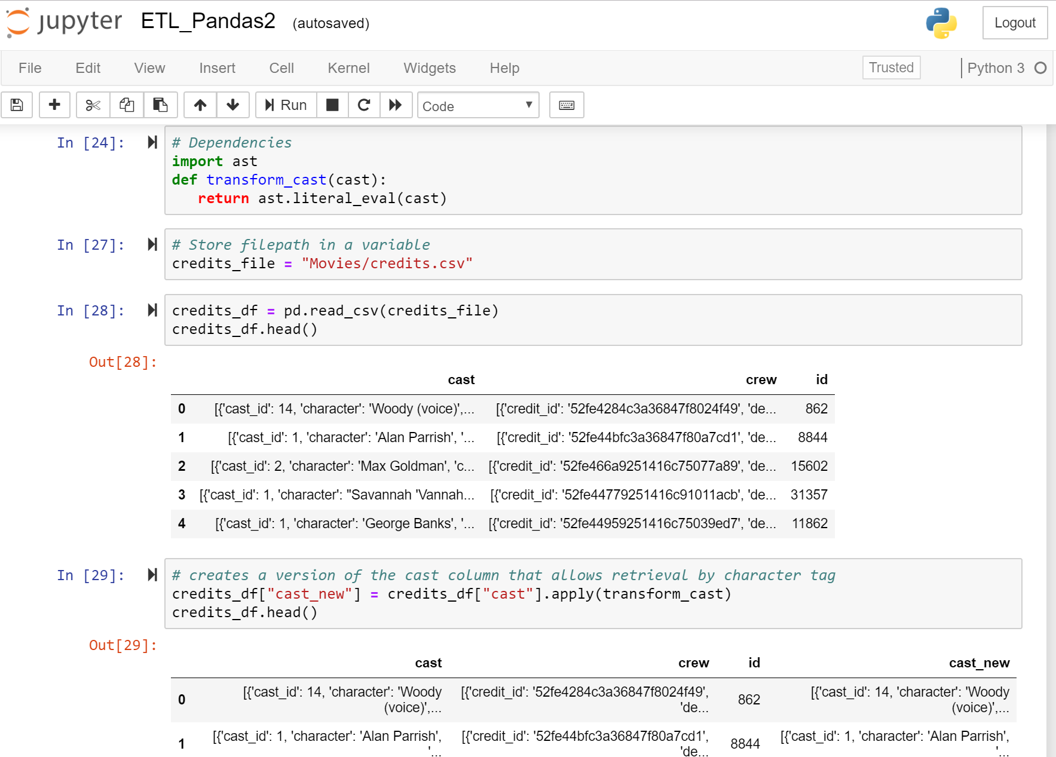

Slide 5
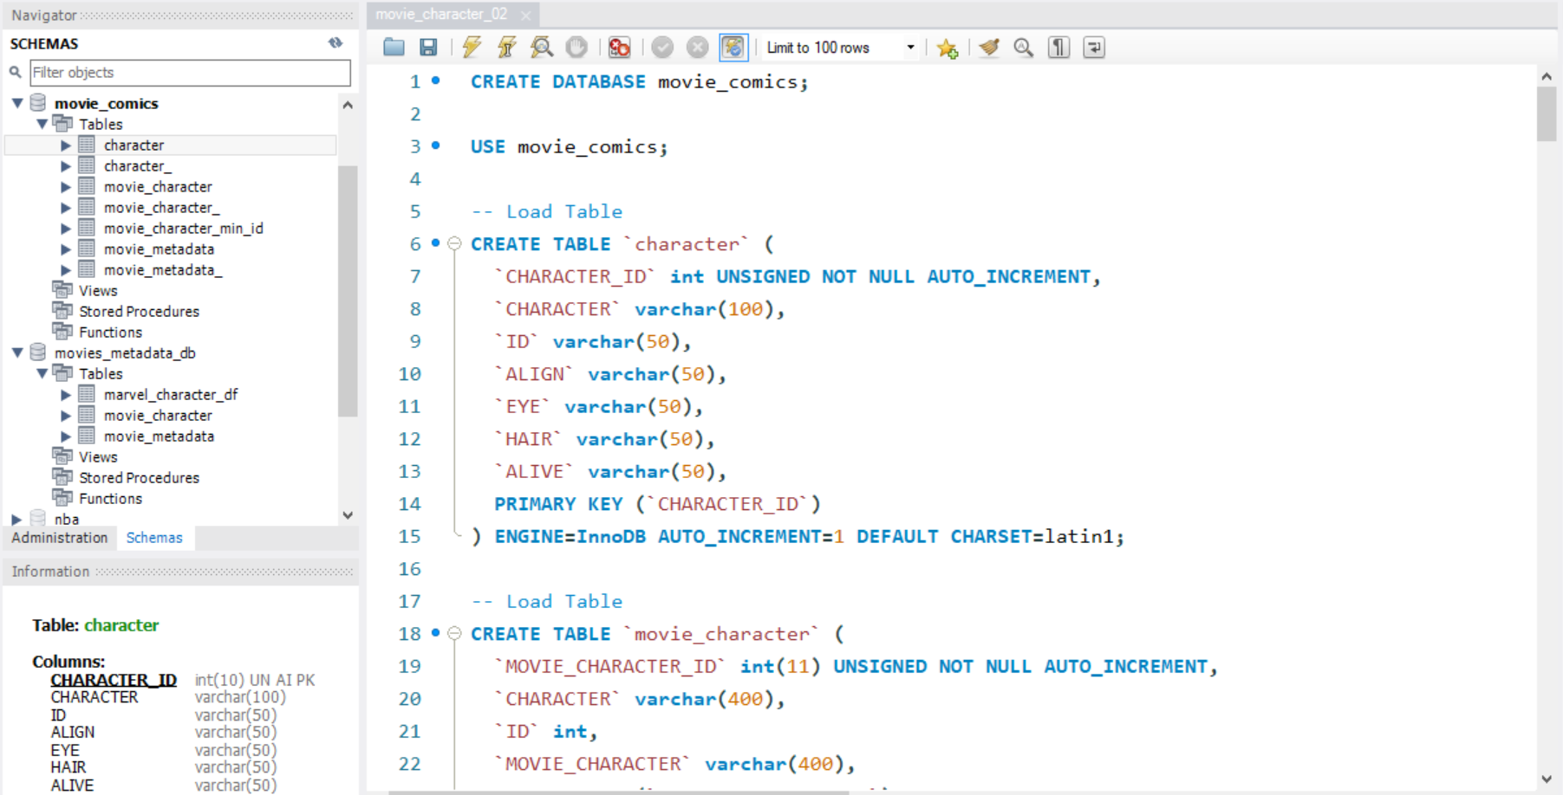
MySQL Workbench

Slide 6
Data Table

Slide 7
Key Challenges:
Extract
Transformation
Load

