Slide 1
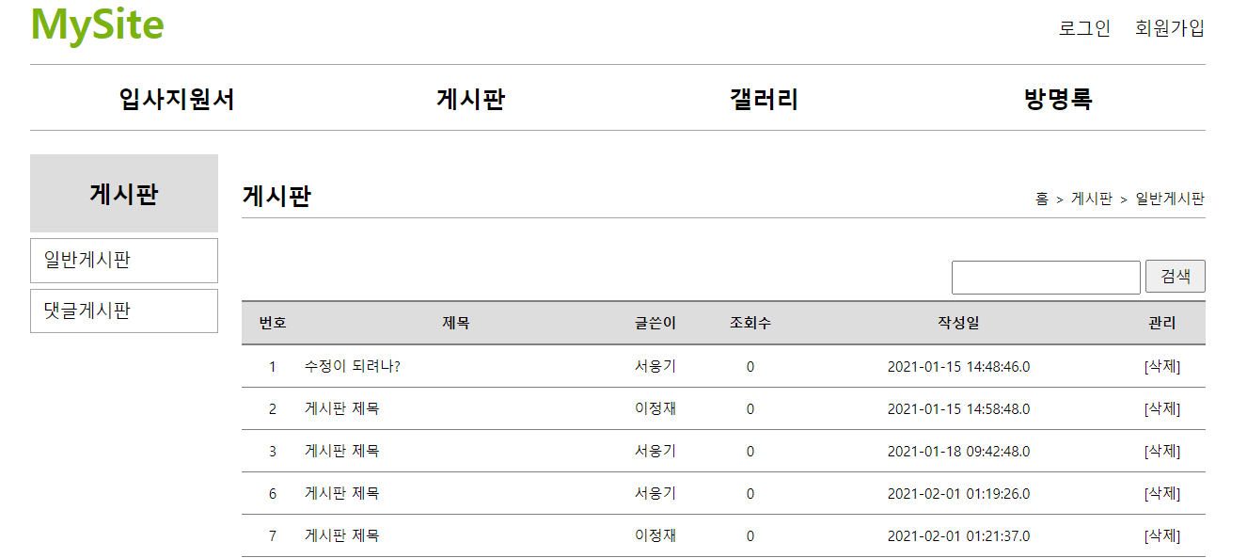
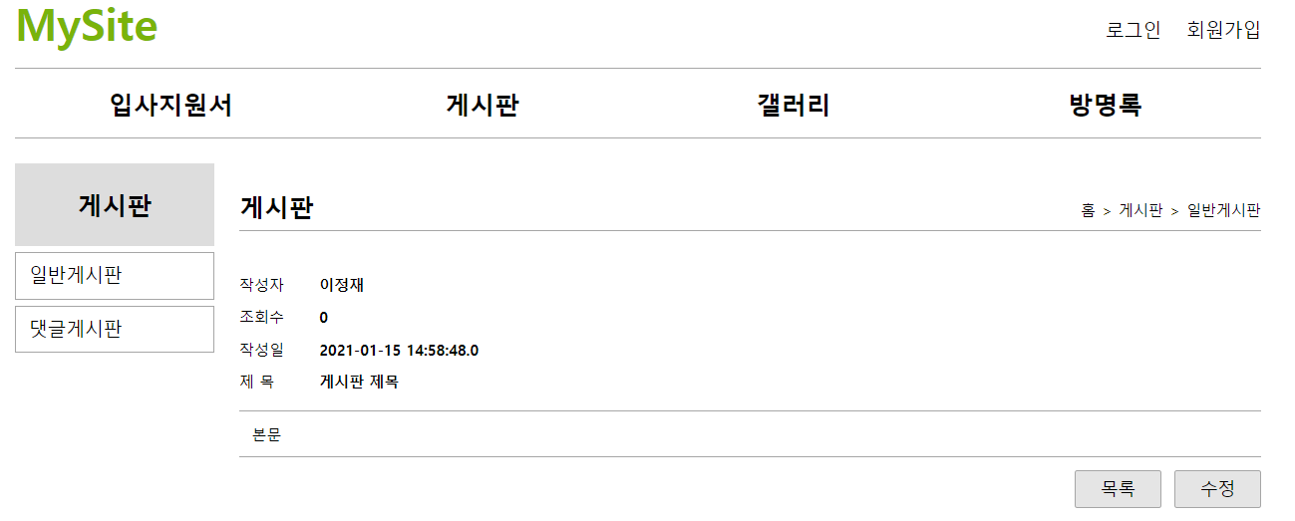
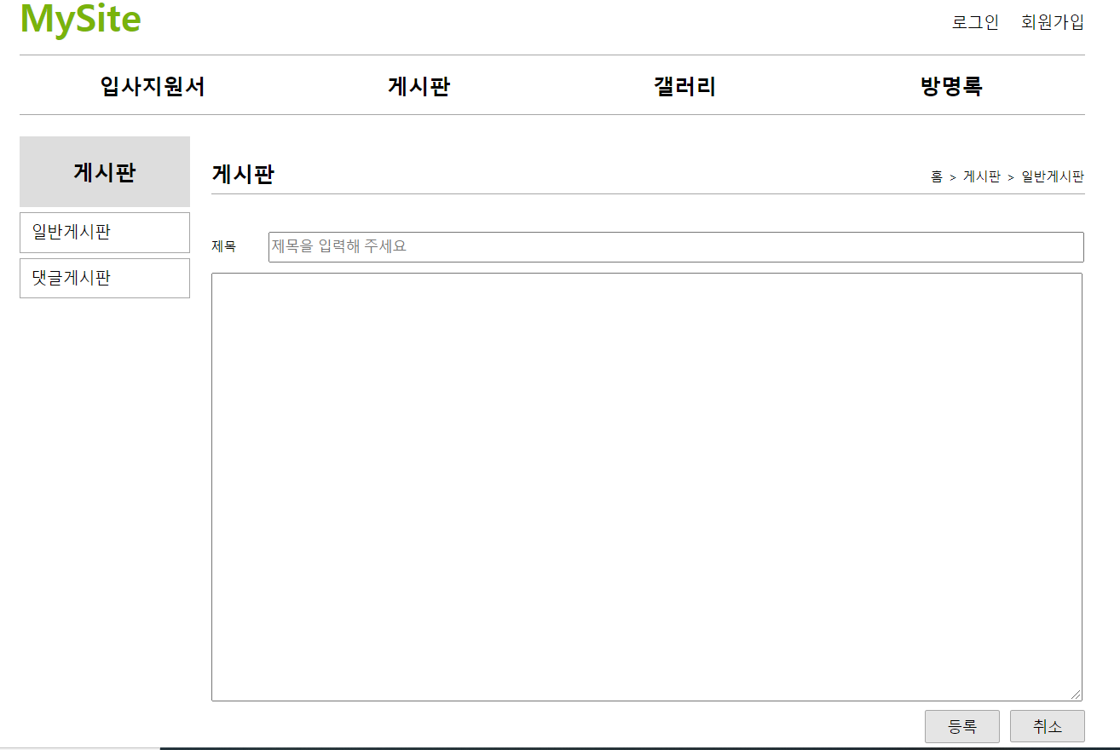
■mysite5 - borad
사용자
jsp
controller
service
dao
sqlSession
xml
■board 리스트
resultType="com.javaex.vo.BoardVo"
http://localhost:8088/mysite5/board/list
/borad/list
(Model model){
}
list()
selectList()
selectList("board.selectList")
id=selectList
요청화면
list.jsp
List<BoardVo>
List<BoardVo>
List<BoardVo>
List<BoardVo>
응답화면
List<BoardVo>
■board 리스트 읽기
parameterType="int"
http://localhost:8088/mysite5/board/read?no=?
/board/read(
@RequestParam("no") int no,
Model model){
}
read(int no)
selectOne(int no)
selectOne("board.selectOne")
id=insert
요청화면
read.jsp
boardVo
boardVo
boardVo
응답화면
boardVo
resultType="com.javaex.vo.BoardVo"
■board 쓰기폼
■board 쓰기폼
http://localhost:8088/mysite5/board/writeForm
http://localhost:8088/mysite5/board/writeForm
board/writeForm(){
}
board/writeForm(){
}
요청화면
요청화면
writeForm.jsp
writeForm.jsp
응답화면
■board 쓰기
parameterType="com.javaex.vo.BoardVo"
http://localhost:8088/mysite5/board/write?title=?&content=?&userNo=?
board/write(@ModelAttribute("boardVo") BoardVo boardVo){
}
write(BoardVo boardVo)
insert(BoardVo boardVo )
insert("board.insert")
id=insert
요청화면
count
count
count
응답화면
redirect: / → main
redirect:/board/list
redirect:/board/list
deleteForm.jsp

Slide 2
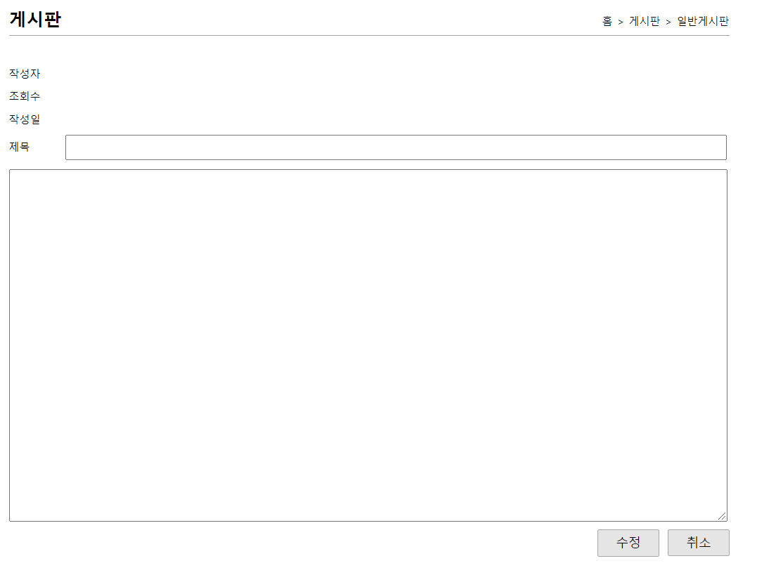
■mysite5 - borad
사용자
jsp
controller
service
dao
sqlSession
xml
■board 수정폼
parameterType="int"
http://localhost:8088/mysite5/board/modifyForm?no=?
board/modifyForm(
@RequestParam("no") int no,
Model model){
}
modifyForm(int no)
selectOne(int no)
selectOne("board.selectOne")
id=selectOne
요청화면
modifyForm.jsp
boardVo
boardVo
boardVo
응답화면
boardVo
resultType="com.javaex.vo.BoardVo"
■ board 수정
parameterType="com.javaex.vo.BoardVo"
http://localhost:8088/mysite5/board/modify?title=?&content=?no=?
/board/modify(@ModelAttribute("boardVo") BoardVo boardVo){
}
modify(BoardVo boardVo)
update(BoardVo boardVo)
update("board.update")
id=update
요청화면
count
count
count
resultType="com.javaex.vo.BoardVo"
응답화면
redirect:/board/list
redirect: / → main
■ board 삭제
parameterType="int"
http://localhost:8088/mysite5/board/delete?no=?
/board/remove(@RequestParam(“no”) int no){
}
remove(int no)
delete(int no)
delete("board.delete")
id=delete
요청화면
count
count
count
응답화면
redirect:/board/list
redirect: / → main
deleteForm.jsp

