Slide 1

PHP and MySQL Session 2: What is MySQL?
Izzy Johnston
izzycjohnston@gmail.com
@izzy_johnston

Slide 2
A brief review
PHP
Variables
Operations
Functions
HTML Forms
Homework
—Conversion and concatenation
--Functions

Slide 3
Relational Databases
Lots of information
Content that is always related
Content that is sometimes related

Slide 4
Why not have one giant table?
Date | Book Title | Author First Name | Author Last Name | Patron First Name | Patron Last Name
January 29, 2011 | Green Eggs and Ham | Dr. | Seuss | Sally | McBride
January 31, 2011 | Stuart Little | E.B. | White | Mario | Batali
February 6, 2011 | Winnie the Pooh | A.A. | Milne | Igor | Salbinski
February 8, 2011 | The Tale of Peter Rabbit | Beatrix | Potter | Maria | Hernandez
February 9, 2011 | Many Moons | James | Thurber | Izzy | Johnston
Thoroughness
Consistency
Human Error
Dynamic Content

Slide 5
Why not have one giant table?
Key | Author First Name | Author Last Name
001 | Beatrix | Potter
002 | James | Thurber
003 | E.B. | White
004 | A.A. | Milne
005 | Dr. | Seuss
Key | Book Title | Author Key
00001 | Green Eggs and Ham | 005
00002 | Many Moons | 002
00003 | Stuart Little | 003
00004 | Tale of Peter Rabbit, The | 001
00005 | Winnie the Pooh | 004
Key | Patron First Name | Patron Last Name
01 | Sally | McBride
02 | Izzy | Johnston
03 | Igor | Salbinski
04 | Mario | Batali
05 | Maria | Hernandez
Key | Date | Book Key | Patron Key
1 | January 29, 2011 | 00001 | 01
2 | January 31, 2011 | 00003 | 04
3 | February 6, 2011 | 00005 | 03
4 | February 8, 2011 | 00004 | 05
5 | February 9, 2011 | 00002 | 02

Slide 6
Who uses these things?
Drupal
Wordpress
Online Retailers
Libraries
Anyone with lots of content!

Slide 7
What does MySQL have to do with it?
MySQL is a relational database
Provides structure for data
Create multiple tables
"Query" driven
Question or request to a database
Select a piece of data
Delete an entry
Etc.

Slide 8
Content Types
VARCHAR—up to 256 characters
INT—Integer of up to 11 characters
FLOAT—Decimal of any size
TEXT—large amounts of text, no limit in size
DATE, etc.—date entries of specific formats

Slide 9
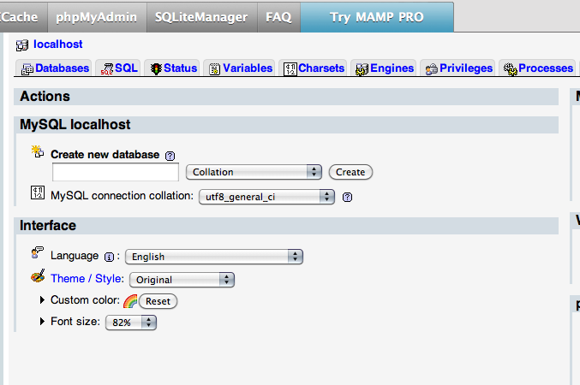
Creating a MySQL database

Slide 10
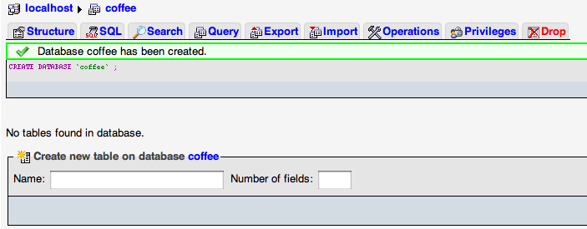
Creating a MySQL database

Slide 11
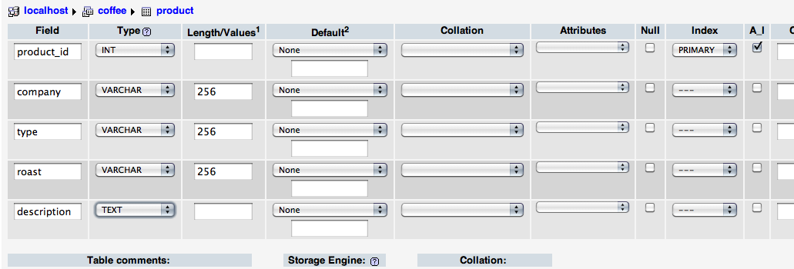
Creating a MySQL database

Slide 12
PHP and MySQL— partners through thick and thin
MySQL is a database
PHP is a language
MySQL stores the data
PHP interacts with it

Slide 13
Connecting to a database
db.inc.php
<?php
$link=mysqli_connect ('localhost', 'root', 'root');
if (!$link){
$output='Unable to connect to the database';
echo $output;
exit();
}
if (!mysqli_set_charset($link,'utf8')) {
$output = 'Unable to set database connection encoding.';
echo $output;
exit();
}
if (!mysqli_select_db($link, 'coffee')){
$output = 'Unable to locate the database.';
echo $output;
exit();
}
?>

Slide 14
Inserting Data
product_insert.html
<form action="product_insert_result.php" method="get">
Company: <input type="text" name="company"/><br/>
Type: <input type="text" name="type"/><br/>
Roast:
<input type="radio" name="roast" value="light">Light</input>
<input type="radio" name="roast" value="medium">Medium </input>
<input type="radio" name="roast" value="dark">Dark</input>
<br/>
<textarea name="description" rows="10" cols="40"></textarea><br/>
<input type="submit" value="Submit"/>
</form>

Slide 15
Inserting Data, cont.
product_insert_result.php
<?php
include 'include/db.inc.php';
$company = mysqli_real_escape_string($link, $_GET['company']);
$type = mysqli_real_escape_string($link, $_GET['type']);
$roast = mysqli_real_escape_string($link, $_GET['roast']);
$description = mysqli_real_escape_string($link, $_GET['description']);

Slide 16
Inserting Data, cont.
product_insert_result.php
<?php
include 'db.inc.php';
$company = mysqli_real_escape_string($link, $_GET['company']);
$type = mysqli_real_escape_string($link, $_GET['type']);
$roast = mysqli_real_escape_string($link, $_GET['roast']);
$description = mysqli_real_escape_string($link, $_GET['description']);
$sql = "INSERT INTO product SET
company='$company',
type='$type',
roast='$roast',
description='$description'";

Slide 17
Inserting Data, cont.
product_insert_result.php
<?php
include 'db.inc.php';
$company = mysqli_real_escape_string($link, $_GET['company']);
$type = mysqli_real_escape_string($link, $_GET['type']);
$roast = mysqli_real_escape_string($link, $_GET['roast']);
$description = mysqli_real_escape_string($link, $_GET['description']);
$sql = "INSERT INTO product SET
company='$company',
type='$type',
roast='$roast',
description='$description'";
if (!mysqli_query($link, $sql)){
$error = 'Error adding submitted data: ' . mysqli_error($link);
echo $error;
exit();
}
header('Location:product_show.php');
?>

Slide 18
Showing Data
product_show.php
<?php
include 'include/db.inc.php';
$sql='SELECT product_id, company, type, roast, description FROM product ORDER BY company DESC';
$result = mysqli_query($link, $sql);
if (!$result) {
$error = 'Error fetching data: ' . mysqli_error($link);
echo $error;
exit();
}

Slide 19
Showing Data, cont.
product_show.php
<?php
include 'db.inc.php';
$sql='SELECT id, company, type, roast, description FROM product ORDER BY id DESC';
$result = mysqli_query($link, $sql);
if (!$result) {
$error = 'Error fetching data: ' . mysqli_error($link);
echo $error;
exit();
}
while($recording=mysqli_fetch_array($result)){
$product_id=htmlspecialchars($recording['product_id'], ENT_QUOTES, 'UTF-8');
$company= htmlspecialchars($recording['company'], ENT_QUOTES, 'UTF-8');
$type=htmlspecialchars($recording['type'], ENT_QUOTES, 'UTF-8');
$roast=htmlspecialchars($recording['roast'], ENT_QUOTES, 'UTF-8');
$description=htmlspecialchars($recording['description'], ENT_QUOTES, 'UTF-8');

Slide 20
Showing Data, cont.
product_show.php
<?php
include 'db.inc.php';
$sql='SELECT id, company, type, roast, description FROM product ORDER BY id DESC';
$result = mysqli_query($link, $sql);
if (!$result) {
$error = 'Error fetching data: ' . mysqli_error($link);
echo $error;
exit();
}
while($recording=mysqli_fetch_array($result)){
$id=htmlspecialchars($recording[id'], ENT_QUOTES, 'UTF-8');
$company= htmlspecialchars($recording['company'], ENT_QUOTES, 'UTF-8');
$type=htmlspecialchars($recording['type'], ENT_QUOTES, 'UTF-8');
$roast=htmlspecialchars($recording['roast'], ENT_QUOTES, 'UTF-8');
$description=htmlspecialchars($recording['description'], ENT_QUOTES, 'UTF-8');
echo $company;
echo $type;
echo $roast;
echo $description;
}
?>

Slide 21
Showing Data with Style
while($recording=mysqli_fetch_array($result)){
echo "<p>Company: " . $company . "<br/>";
echo "Type: " . $type. "<br/>";
echo "Roast: " . $roast . "<br/>";
echo "Description: " . $description . "<br/>
</p>";
}

Slide 22
Showing Data with Style
while($recording=mysqli_fetch_array($result)){
echo "<div class='product'>
<div class='company'>" . $company . "--";
echo "<span class='type'> " . $type . "</span></div>";
echo "<div class='roast'>Roast: " . $roast . "</div>"
echo "<div class='description'> " . $description . "</div>
</div>";
}

Slide 23
Homework
Build a table in the coffee database with 4 fields
company_id, name, country, website
Based on the product_insert.html, create an insert form for the table named company_insert.html
Based on the product_insert_result.php create a php file named company_insert_result.php to insert data from the form
Add at least three coffee companies
BONUS
Based on the product_show.php create a php, create a php file named company_show.php that will show the companies you entered.

Slide 24
Next week— Build a better database
Edit and delete data
Relate tables
Create search functions
PHP in the real world

Slide 25
Questions?
?

