Slide 1

DIRECT INDEXING EMAIL CAMPAIGN
A/B Test Results
Insights & Recommendations
Prepared by: Travis Ohm
VANGUARD | CHIEF DATA & ANALYTICS OFFICE
Financial Advisor Services

Slide 2
BACKGROUND
A 50/50 Randomized Email Test to Drive DI Enrollment
Situation: Two email creatives were randomly assigned to eligible advisors to encourage enrollment in Vanguard’s Direct Indexing (DI) service.
Hypothesis: The creative an advisor receives makes no difference.
7/30/2020 – 8/29/2020
50 / 50
3 Datasets
Measurement window — the one-month emails were sent
Randomized split between Email A and Email B creatives
Demographics, enrollment status, and web traffic, joined on advisor ID
An advisor who visited the sign-up section (reaching the “welcome” page) was considered to have at least tried to start enrollment.
It is not possible for an advisor to receive both creatives — groups are mutually exclusive.
Two outcomes are of interest: did the creative affect: (1) access to the sign-up process, and (2) enrollment in DI?
VANGUARD · CDAO – FINANCIAL ADVISOR SERVICES
2

Slide 3
CONTEXT
Before Declaring Success: Questions & Criteria
Questions We’d Ask the Business
How We’d Measure Success
Is DI enrollment the end goal, or a proxy for AUM / revenue capture?
How was the email randomly distributed to advisors in this time-period?
What is the content of each email narrative, and did they have the same objective (send advisors to the sign-up link)?
Is there a minimum sample size or duration the business would consider necessary before acting on a result like this?
What are the other methods of encouraging advisors to enroll in the DI program?
Evidence the randomization produced genuinely comparable groups, a precondition for trusting either result . Utilizing Welch’s T. (slide 5)
No meaningful drop in advisors accessing the sign-up page — a sign the creative isn’t off-putting. Utilizing two-proportion Z test. (slide 6)
A statistically significant increase in DI enrollment for Email B vs. Email A, measured within the campaign window. Utilizing two-proportion Z test. (slide 7)
VANGUARD · CDAO – FINANCIAL ADVISOR SERVICES
3

Slide 4
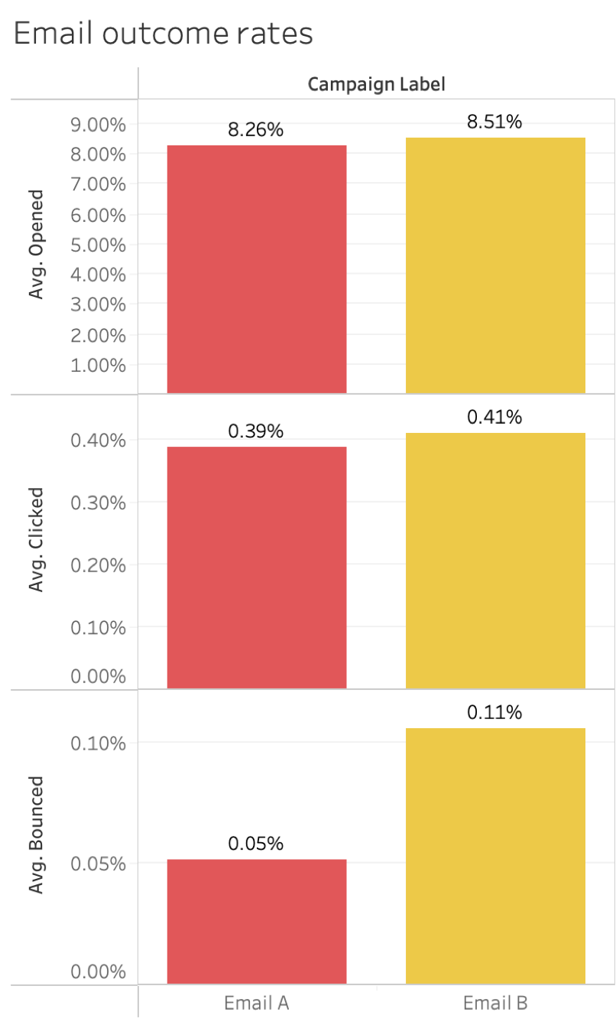
ENGAGEMENT
Code in step 8 of notebook
How Many Advisors Opened the Email and Clicked the Link?
For Emails opened, there was a total of 3,136.
Email A had 1280 and email B had 1856.
For links clicked, there was a total of 149.
Email A had 60 and email B had 89.
Additionally, for bounced emails, there was a total of 31. Email A had 8 and Email B had 23
VANGUARD · CDAO – FINANCIAL ADVISOR SERVICES
4

Slide 5
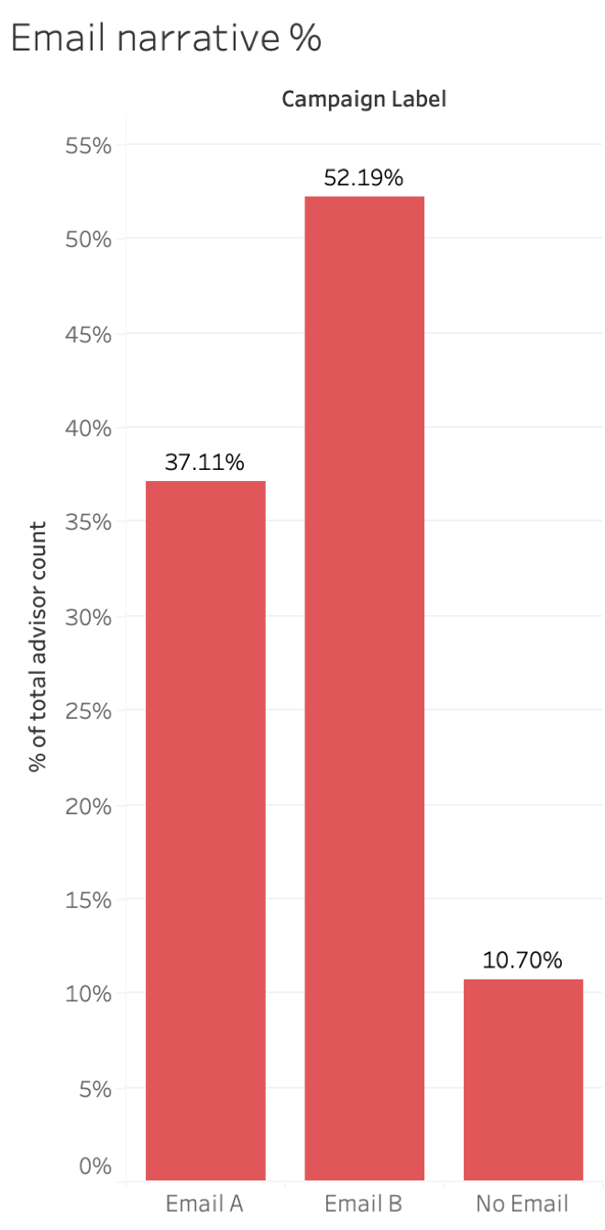
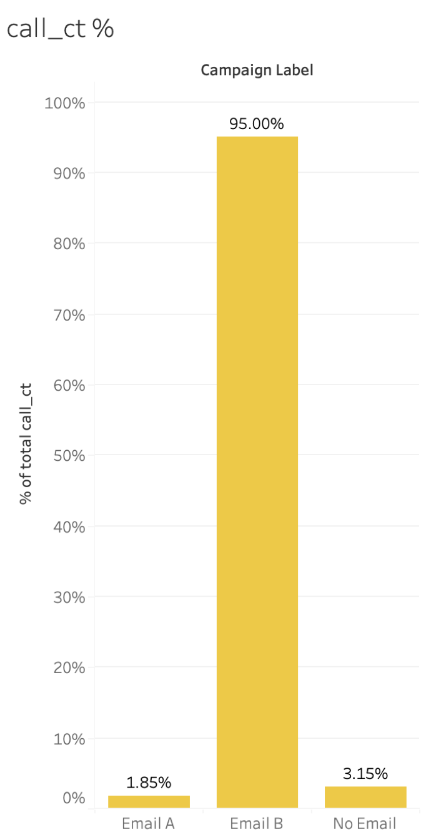
DESIGN
Code in step 9 of notebook
Was the Experiment Design Sound?
Email A narratives: 15499
Email B narratives: 21799
call_ct is dramatically imbalanced: Email A averages 0.06 calls per advisor vs. 2.09 for Email B (Welch’s t = –599.9, p < 0.0001).
This isn’t random noise — it’s a near-perfect split on call_ct.
Treat the Slide 5 enrollment result with real caution until this is explained.
Every other demographic checks out (fund_ct, logon_ct, balance, tenture, age, and gender) (shown in step 9 of notebook)
VANGUARD · CDAO – FINANCIAL ADVISOR SERVICES
5

Slide 6
RESULTS
Code in step 7 of notebook
Does the Creative Affect Access to Sign-Up?
Two-proportion z-test on advisors who reached the “welcome” page
EMAIL A – 65 of 15,499 advisors
EMAIL B – 92 of 21,799 advisors
0.42%
0.42%
z = –0.04 p ≈ 0.97 → No statistically significant difference.
The creative does not impact whether an advisor accesses the sign-up.
VANGUARD · CDAO – FINANCIAL ADVISOR SERVICES
6

Slide 7
RESULTS
Code in steps 6 & 7 of notebook
Does the Creative Affect Enrollment?
Two-proportion z-test, restricted to enrollments within the 7/30–8/29 measurement window
0.007%
0.041%
EMAIL A – 1 of 15,499 advisors
EMAIL B – 9 of 21,799 advisors
z = –2.03 p ≈ 0.043 → Statistically significant.
However built on only 10 enrollment events combined.
26 total enrollment during this period, 16 out of 26 came from no email.
VANGUARD · CDAO – FINANCIAL ADVISOR SERVICES
7

Slide 8
MEASUREMENT
So, What Was the Outcome?
Access to sign-up: no difference between creatives, the email isn’t what drives (or blocks) advisors from starting enrollment.
Enrollment: Email B shows a real, statistically significant lift, but on a base of only 10 total events.
The randomization itself shows a real imbalance in prior call activity between email creative advisors. All other demographic are statistically equivalent between creatives.
Final-Conclusion: Directionally positive for Email B. However, not yet strong enough on its own to declare a confident winner. A longer email testing window would be able to show a more conclusive outcome.
VANGUARD · CDAO – FINANCIAL ADVISOR SERVICES
8

Slide 9
INSIGHT
A deeper dive into the testing window
VANGUARD · CDAO – FINANCIAL ADVISOR SERVICES
9

Slide 10
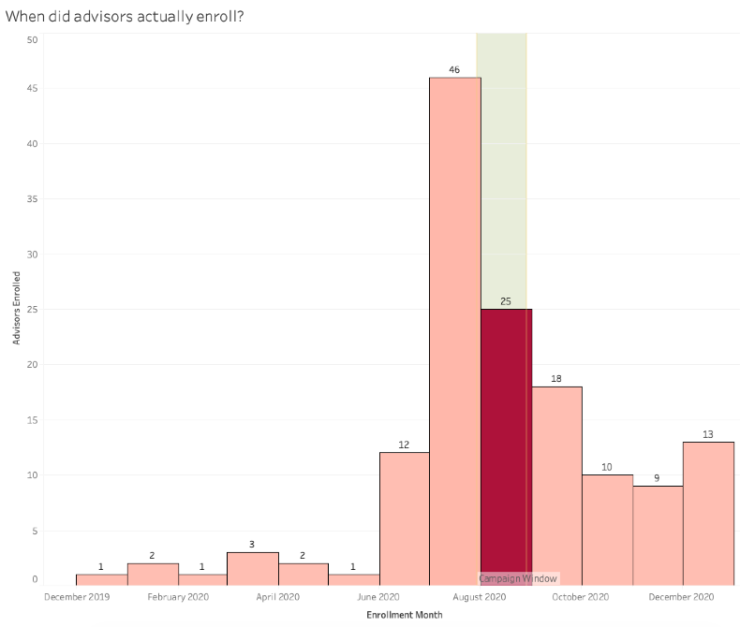
INSIGHT
Code in steps 3 & 10 of notebook
Enrollment Extends Well Beyond the Campaign Window
117 of 143
enrollments (82%) happened outside the 1-month campaign window
A longer testing period shows larger affect a creative would have on both the enrollment process and sign-up. It would also give a greater population to measure the difference the creatives show.
VANGUARD · CDAO – FINANCIAL ADVISOR SERVICES
10

Slide 11
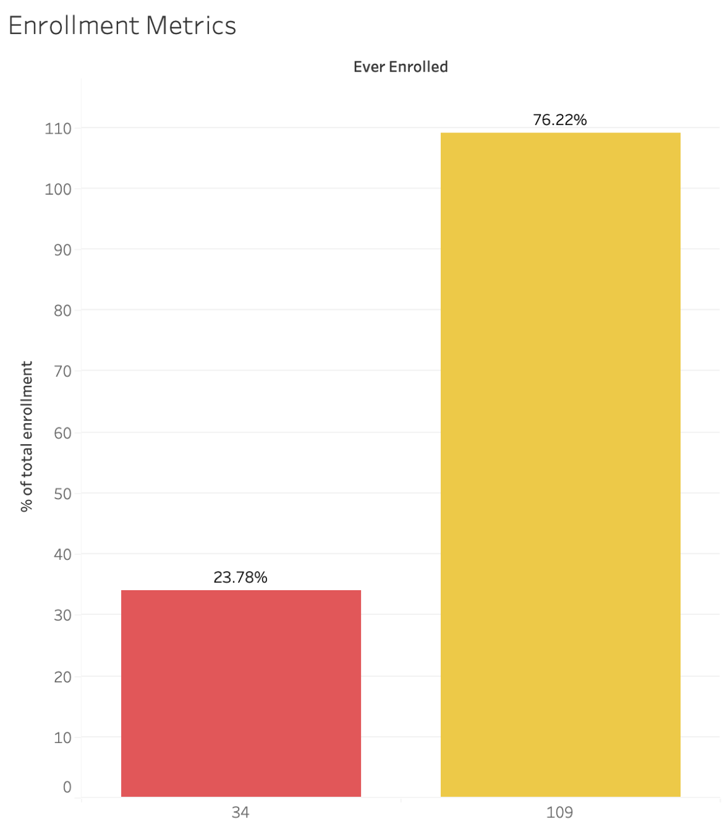
INSIGHT
Code in steps 6 & 10 of notebook
Most Enrolled Advisors Have No Tracked Web Visit
24%
of the 143 enrolled advisors (34) show any tracked web activity in the measurement window
The email creatives use web tracking to determine the outcome of an email and the enrollment process. A longer testing period would provide a greater web tracking statistic. During the testing period only 61.5% came outside the web tracking.
VANGUARD · CDAO – FINANCIAL ADVISOR SERVICES
11

Slide 12
RECOMMENDATIONS
Given These Results
Email B is not a conclusive winner — the in-window result is real but by a thin margin.
If a creative must be chosen today, while not conclusive, Email B is a better performer than Email A
Before scaling Email B, re-run the comparison once the current cohort has had more time to enroll — most enrollment happens well after initial contact.
Separately investigate the sign-ups without a tracked web usage.
VANGUARD · CDAO – FINANCIAL ADVISOR SERVICES
12

Slide 13
RECOMMENDATIONS
What Other Data Would Help
Timestamped (not just dated) web hits, to reconstruct real session paths and true funnel timing.
A record of phone, app, and call-center enrollments, so that channel can be attributed to a campaign arm from non-web users.
Clarity on how the campaign assignment process ran, to confirm whether the call_ct imbalance was random noise or a targeting issue.
Understanding the call to action of each email narrative.
A longer post-campaign observation window (90+ days), since enrollment is a slow, lagging outcome relative to a 1-month send window.
VANGUARD · CDAO – FINANCIAL ADVISOR SERVICES
13

Slide 14
RECOMMENDATIONS
Recommendations for the Next Experiment
Stratify randomization by prior engagement (call_ct, logon_ct) so groups start balanced, rather than relying on chance with a large-but-rare outcome.
Extend the enrollment measurement window, or track enrollment continuously post-send rather than tying it to the 1-month send window.
Tag non-web enrollments with a source/channel so they can be attributed back to the email campaign.
Plan for a larger sample or longer test duration: at a ~0.01–0.04% enrollment rate, tens of thousands of advisors barely produces double-digit events.
VANGUARD · CDAO – FINANCIAL ADVISOR SERVICES
14

Slide 15
METHODOLOGY
How the Analysis Was Built
SQL (SQLite): extract → clean → join the three source files into per-advisor tables.
Python (pandas, scipy, statsmodels): two-proportion z-tests, confidence intervals, and Welch’s t-tests for the randomization check.
Tableau: visualizations built directly on the cleaned, joined export.
VANGUARD · CDAO – FINANCIAL ADVISOR SERVICES
15

Slide 16
Thank You
Questions & Discussion
VANGUARD | CHIEF DATA & ANALYTICS OFFICE

