Slide 1
Identifying Undiagnosed Type 2 Diabetics
Team 3c
Alizeh Murtaza, Tyson Johnson, Nithila Neethi Devan, Tariq Abdulhak
2026.05.03
CDS-492 | Spring 2026 | Dr. Slamani

Slide 2
Link to Project Folder
Link to online class folder
https://github.com/tjohns94/cds492-team-3c
Link to Colab team notebook
https://colab.research.google.com/github/tjohns94/cds492-team-3c/blob/main/code/notebooks/t2d_screening_tutorial.ipynb

Slide 3
Meeting Minutes - Tasks
Task No. | Task Name | Description | Owner | Date | Status
T01 | Collect Potential Sources | Each team member will find 1 reliable source and complete our literature review and synthesis matrix on | Tyson, Nithila, Alizeh | 01/31/2026 | 02/05/2026
T02 | Research Data Options | Find Data that tracks a unique identifier information, data that would allow for time series methods to be used | Tyson, Nithila, Alizeh | 02/05/2026 | 02/05/2026
T03 | Workflow Diagram | Creating the workflow diagram through Xmind | Nithila | 02/05/2026 | 02/08/2026
T04 | Black Box Diagram | Creating the back box diagram through Canva | Alizeh | 02/05/2026 | 02/08/2026
T05 | Class Folder Structure | Created and shared class folder | Alizeh | 02/05/2026 | 02/08/2026
T06 | Fishbone Diagram | Creating the black box diagram through Canva | Alizeh | 02/05/2026 | 02/08/2026
T07 | Business Understanding | Completing the business understanding slide | Tariq, Alizeh, Tyson, Nithila | 02/05/2026 | 02/05/2026
T08 | Data Search | Completing the data source slides | Tyson | 02/05/2026 | 02/08/2026
T09 | Analytic Problem | Completing the analytic problem slide | Tariq | 02/05/2026 | 02/08/2026

Slide 4
Meeting Minutes - Tasks (cont.)
Task No. | Task Name | Description | Owner | Date | Status
T10 | Review Previous Slides | Review formatting and content on previous slides based on in-class feedback | Nithila | 02/10/2026 | 02/10/2026
T11 | Project Workflow Diagram Slides | Recreate project workflow diagram to resemble a more time based flow and update it with new information | Nithila | 02/12/2026 | 02/16/2026
T12 | Code Workflow Diagram Slides + Business Understanding Slides | Create code workflow diagram slides + business understanding and analytic slides | Tariq | 02/12/2026 | 02/16/2026
T13 | Analytic Problem | Complete/revised analytic problem slides and making changes to fishbone diagram | Alizeh | 02/12/2026 | 02/16/2026
T14 | Data Understanding and Preparation Slides | Complete data understanding and preparation slides | Tyson | 02/12/2026 | 02/16/2026
T15 | Project Purpose and Questions Slides | Complete project purpose and questions slides | Alizeh | 02/12/2026 | 02/16/2026
T16 | Matching Parameters and Objectives Slides | Complete matching parameters and objectives slides | Nithila | 02/12/2026 | 02/16/2026

Slide 5
Meeting Minutes - Tasks (cont.)
Task No. | Task Name | Description | Owner | Date | Status
T17 | Project Workflow Diagram | Recreate/update workflow diagram structure | Nithila | 02/19/2026 | 02/23/2026
T18 | Code Workflow Diagram | Update code workflow diagram | Tariq | 02/19/2026 | 02/23/2026
T19 | Business Understanding & Project Purpose | Update business understanding & project purpose slides | Tariq | 02/19/2026 | 02/23/2026
T20 | Objectives and SMART (1) | Objectives and SMART slide completion | Nithila, Tyson, Tariq, Alizeh | 02/19/2026 | 02/19/2026
T21 | Analytic Problem (Blackbox) | Update analytic problem slides | Alizeh | 02/19/2026 | 02/23/2026
T22 | Data Preparation | Create data preparation slide based on what has been completed | Tyson | 02/19/2026 | 02/23/2026
T23 | EDA Correlations | Create correlation graphs and complete slides | Tariq | 02/19/2026 | 02/23/2026
T24 | EDA Imbalance | Complete imbalance slides | Nithila | 02/19/2026 | 02/23/2026
T25 | EDA Statistical Significance | Complete statistical significance slides | Alizeh | 02/19/2026 | 02/23/2026
T26 | Project Objectives & Parameters | Complete project objectives and parameters slide | Nithila, Tyson, Tariq, Alizeh | 02/19/2026 | 02/19/2026
T27 | Revisions | Added “(cont.)” to slide titles as needed | Tyson | 02/23/2026 | 02/23/2026

Slide 6
Meeting Minutes - Tasks (cont.)
Task No. | Task Name | Description | Owner | Date | Status
T28 | Updating Project & Code Workflow | Update project and code workflow to reflect current status | Nithila, Tariq | 02/26/2026 | 03/02/2026
T29 | Project Objectives & Parameters | Update/develop new business objectives | Nithila, Tariq, Tyson, Alizeh | 02/26/2026 | 02/26/2026
T30 | Coding Screenshots | Finish and screenshot our code | Tyson | 02/26/2026 | 03/02/2026
T31 | Logistic Regression Model | Complete specific model code | Tariq | 02/26/2026 | 03/16/2026
T32 | Decision Tree | Complete specific model code | Nithila | 02/26/2026 | 03/02/2026
T33 | Support Vector Machine | Complete specific model code | Alizeh | 02/26/2026 | 03/02/2026
T34 | Survey | Complete the survey slide | Nithila, Tariq, Tyson, Alizeh | 03/02/2026 | 03/02/2026
T35 | Update Project & Code Workflow | Update project workflow diagram and code workflow diagram | Nithila, Tariq | 03/12/2026 | 03/16/2026
T36 | Update Class Folder & Colab | Update class folder and colab content in links on revisions slide | Alizeh, Tyson | 03/12/2026 | 03/16/2026
T37 | Update Goals, Objectives, Parameters | Discuss and update changes in objectives, parameters, and goals for project | Nithila, Tariq, Tyson, Alizeh | 03/16/2026 | 03/16/2026
T38 | Update Code SS | Update content of code screenshot slides, including performance | Tyson | 03/16/2026 | 03/16/2026

Slide 7
Meeting Minutes - Tasks (cont.)
Task No. | Task Name | Description | Owner | Date | Status
T39 | Algorithms Slide | Fill out algorithms slide for Logistic Regression Model | Tariq | 03/12/2026 | 03/16/2026
T40 | Algorithms Slide | Fill out algorithms slide for Decision Tree Model | Nithila | 03/12/2026 | 03/16/2026
T41 | Algorithms Slide | Fill out algorithms slide for SVM Model | Alizeh | 03/12/2026 | 03/16/2026
T42 | Project Workflow | Update and upload project workflow | Nithila | 03/19/2026 | 03/16/2026
T43 | ANN Model Slides | Complete ANN modeling & complete algorithm slides | Tyson | 03/19/2026 | 03/23/2026
T44 | Abstract Part 1 | Complete abstract problem and objectives section | Tyson, Nithila, Alizeh, Tariq | 03/19/2026 | 03/23/2026
T45 | Abstract Part 2 | Complete abstract modeling results and significance section | Tyson, Nithila, Alizeh, Tariq | 03/23/2026 | 03/23/2026
T46 | Confusion Matrix Update | Update confusion matrices to use percentages | Nithila, Alizeh, Tariq | 03/19/2026 | 03/23/2026
T47 | Project Workflow Slide | Update project workflow slide | Nithila | 04/01/2026 | 04/06/2026
T48 | Code Workflow Slide | Update project workflow slide | Tariq | 04/01/2026 | 04/06/2026
T49 | Confusion Matricies | Update confusion matrices to use percentages | Tyson, Nithilam Alizeh, Tariq | 04/01/2026 | 04/06/2026

Slide 8
Meeting Minutes - Tasks (cont.)
Task No. | Task Name | Description | Owner | Date | Status
T50 | Compare Model Results | Compile all visuals and metrics into structure that allows for easy comparison | Tyson, Nithila, Alizeh, Tariq | 04/01/2026 | 04/06/2026
T51 | Algorithm Slides | Restructure algorithms slide to utilize table formatting | Tariq | 04/01/2026 | 04/06/2026
T52 | Confusion Matrix | Create the confusion matrix slide with updated percentages | Alizeh | 04/01/2026 | 04/06/2026
T53 | Abstract Revision | Significance section updated utilizing feedback | Alizeh, Tyson, Nithila, Tariq | 04/01/2026 | 04/06/2026
T54 | Screening Tool | Brainstorming and basic planning for the screening tool | Tyson | 04/01/2026 | 04/06/2026
T55 | Project Workflow | Update project workflow diagram | Nithila | 04/08/2026 | 04/13/2026
T56 | Code Workflow Diagram | Update code workflow diagram | Tariq | 04/08/2026 | 04/13/2026
T57 | Final Algorithm | Finish final algorithms slide | Tariq | 04/08/2026 | 04/13/2026
T58 | Final Performance | Complete final performance slides with graphics | Tyson | 04/08/2026 | 04/08/2026
T59 | Final Abstract | Complete final abstract slide | Tyson, Nithila Alizeh, Tariq | 04/08/2026 | 04/08/2026
T60 | Poster Introduction | Complete introductions | Alizeh | 04/08/2026 | 04/08/2026

Slide 9
Meeting Minutes - Tasks (cont.)
Task No. | Task Name | Description | Owner | Date | Status
T61 | Poster Methodology | FInish poster methodology slide, ensure description of catboost model | Tariq | 04/08/2026 | 04/13/2026
T62 | Poster Results | Complete poster results slide | Tyson | 04/08/2026 | 04/13/2026
T63 | Poster Discussion | Complete poster discussion slide | Nithila | 04/08/2026 | 04/13/2026
T64 | Poster References | Complete poster references | Nithila | 04/08/2026 | 04/13/2026
T65 | Poster Acknowl. | Complete poster acknowledge | Nithila | 04/08/2026 | 04/13/2026
T66 | Compare Datasets | Compare datasets slide | Tyson | 04/08/2026 | 04/13/2026
T67 | Project Poster FInal Work | Put all content together on separate poster slide | Tyson, Nithila, Alizeh, Tariq | 04/13/2026 | 04/13/2026
T68 | Project Workflow Update | Fix and update the project workflow diagram | Nithila | 04/16/2026 | 04/16/2026
T69 | Code Workflow Update | Fix and update the code workflow diagram | Tariq | 04/16/2026 | 04/19/2026
T70 | Update Project Poster Content | Peer evaluate sections and improve based on feedback for cohesivity | Tyson, Nithila, Alizeh | 04/16/2026 | 04/19/2026
T71 | Normalize Font for Project Poster | Ensure project appearance is uniform | Tyson, Nithila, Alizeh | 04/16/2026 | 04/19/2026

Slide 10
Meeting Minutes - Tasks (cont.)
Task No. | Task Name | Description | Owner | Date | Status
T72 | Tutorial Code Cleaning | FInish poster methodology slide, ensure description of catboost model | Tyson | 04/01/2026 | 04/03/2026
T73 | Tutorial Code Assigned Sections 1 | Complete sections assigned | Nithila | 04/01/2026 | 04/03/2026
T74 | Tutorial Code Assigned Sections 2 | Complete sections assigned | Alizeh | 04/01/2026 | 04/03/2026
T75 | Tutorial Code Assigned Sections 3 | Complete sections assigned | Tariq | 04/01/2026 | 04/03/2026
T76 | Module 14 Compressed Slides Deck | Create compressed project slides file based on given instructions | Tyson, Nithila, Alizeh, Tariq | 04/01/2026 | 04/01/2026

Slide 11
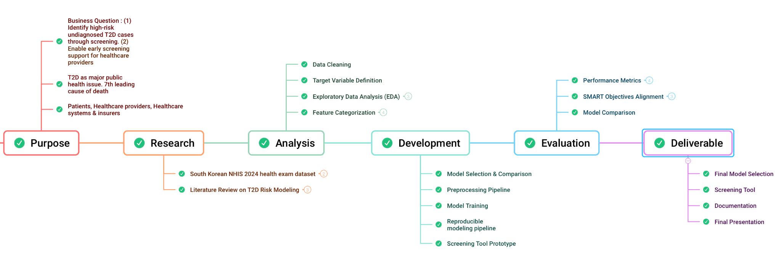
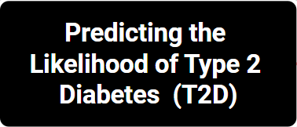
Project Workflow Diagram
Below is our project Workflow Diagram as of 2026.05.01

Slide 12
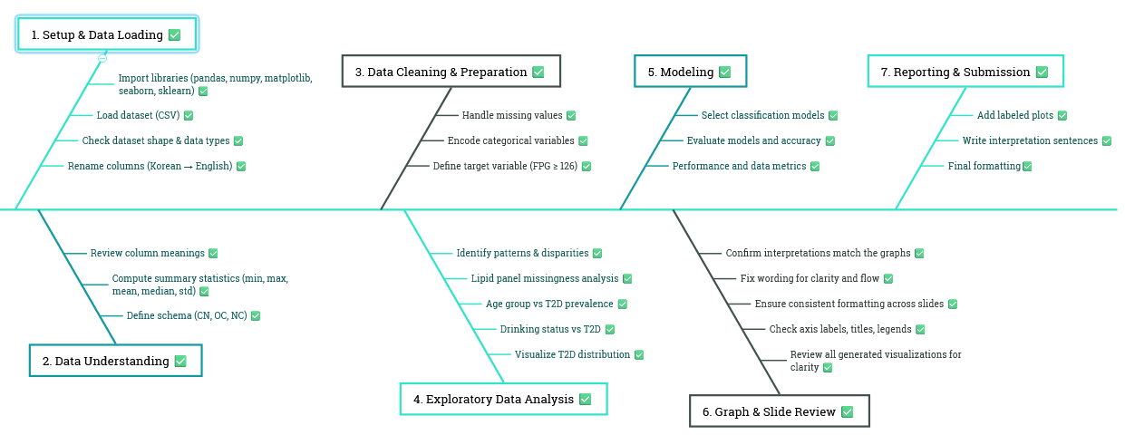
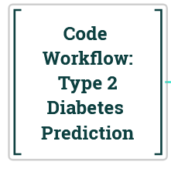
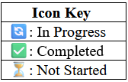
Code Workflow Diagram
Below is our code Workflow Diagram as of 2026.05.01

Slide 13
Business Understanding
Question | Detail
Business problem and question(s) | What patient health exam data can be used to estimate the likelihood of T2D? What is the most effective way to deploy the T2D risk model for real-world screening use?
Problem importance | T2D is a significant problem that impacts the general population with serious health consequences Diabetes is the 7th leading cause of death in the US (https://www.cdc.gov/nchs/fastats/diabetes.htm)
Stakeholders | Patients Doctors/Health care providers Insurance companies
Motivation | Provide early screening to identify T2D test candidates
Suggested title for the project | Predicting the Likelihood of Type 2 Diabetes (T2D)
Possible challenges with the problem topic | Model may struggle with generalization due to population bias in data (South Korean)

Slide 14
Objectives and SMART
Objective 1 | Identify high-risk undiagnosed T2D cases through screening
Specific | Create model that can identify undiagnosed patients with high risk of having T2D
Measurable | Statistically outperforms all other tested models considered during planning
Achievable | Experience with ML-based and statistical-based modeling in supervised training
Relevant | Aligns with motivation to identify T2D test candidates
Time-bound | To be completed by the end the first week of May
Objective 2 | Release screening tool for practical application
Specific | Release tool implementing developed screening model online providing patient T2D risk score
Measurable | Accessible from any computer with internet access/publishing
Achievable | Sufficient python-based program or webpage knowledge within team
Relevant | Aligns with motivation to provide screening to identify T2D test candidates
Time-bound | To be completed by the end the first week of May

Slide 15
Data Search
Category | Details
Data provider | South Korea’s National Health Insurance Service (NHIS)
Data link | https://www.data.go.kr/en/data/15007122/fileData.do
Data description | Health records from 1 million randomly selected Korean patients’ exams throughout one calendar year
Time span | 2002-2024
Key variable | Resting plasma glucose
Variable categories | Anthropometric measurements (e.g. height, weight) Lab measurements (e.g. AST/ALT, GGT) Lipid panel (e.g. total cholesterol, triglycerides) Lifestyle reporting (e.g. smoking status, alcohol consumption)
Challenges | Patients are completely anonymized, removing ability to track one individual over multiple years/visits High rate of missing lipid panel records (~66% missingness) Some variables are rounded (e.g. age in groups, weight/height rounded down to multiple of 5) Data recorded in Korean, requiring translation

Slide 16
Data Description
Category | Details
Number of records | 1 million
Population | South Koreans patients aged 20+
Year | 2024
Target variable | fasting plasma glucose
Features | age, height, weight, waist circumference, systolic BP, diastolic BP, total cholesterol, triglycerides, HDL cholesterol, LDL cholesterol, hemoglobin, serum creatinine, serum GOT AST, serum GPT ALT, gamma GTP, sex, vision (left), vision (right), hearing (left), hearing (right), urine protein, smoking status, alcohol consumption, dental exam, dental caries, plaque
Variable types | Numeric (16), ordinal (3), nominal (8)
File metadata | File type: CSV File size: 87.74 MB Encoding: cp949

Slide 17
Data Description (cont.)
Feature | Minimum | Maximum | Mean | Median | St. Deviation
age_group_code* | 5 | 18 | 10.64 | 11 | 3.05
height** | 130 | 195 | 162.78 | 165 | 9.34
weight** | 30 | 135 | 64.60 | 65 | 14.03
waist_circumference | 6.8 | 210 | 81.55 | 81.1 | 10.94
systolic_blood_pressure | 60 | 271 | 122.69 | 121 | 14.59
diastolic_blood_pressure | 11 | 182 | 75.22 | 75 | 10.36
fasting_blood_sugar | 17 | 991 | 100.98 | 96 | 23.00
total_cholesteral | 25 | 2204 | 196.79 | 195 | 43.42
triglycerides | 1 | 4622 | 129.32 | 105 | 99.46
hdl_cholesterol | 1 | 908 | 57.09 | 55 | 15.48
ldl_cholesterol | 0 | 2174 | 114.47 | 113 | 39.31
hemoglobin | 0.1 | 25 | 14.22 | 14.2 | 1.53
serum_creatinine | 0.06 | 87.2 | 0.84 | 0.8 | 0.37
*Grouped as 5 years (ex. 20-24). **Rounded down to nearest 5.

Slide 18
Data Description (cont.)
Feature | Minimum | Maximum | Mean | Median | St. Deviation
serum_got_ast | 1 | 7540 | 26.97 | 23 | 22.644
serum_gpt_alt | 1 | 5310 | 26.53 | 21 | 25.52
gamma_gtp | 1 | 9999 | 34.88 | 22 | 58.61
Non-numeric features recorded:
sex_code (bool)
vision_left/vision_right (has exception values)
hearing_left/hearing_right (bool)
urine_protein (categorical)
smoking_status (categorical)
alcohol_consumption (bool)
oral_exam_status (bool)
dental_caries_presence (bool)
plaque_presence (categorical)

Slide 19
Data Schema
Column Name | Data Type | Domain | Details
sex_code | int (NC) | {1, 2} | 1=female, 2=male
city_code | int (NC) | {11, 26-31, 36, 41-49} | unique codes for cities/regions
hearing_left | int (NC) | {1, 2} | 1=normal, 2=abnormal
hearing_right | int (NC) | {1, 2} | 1=normal, 2=abnormal
alcohol_consumption | int (NC) | {0, 1} | 0=does not drink, 1=does drink
oral_exam | int (NC) | {0, 1} | 0=not received, 1=received
caries_presence | int (NC) | {0, 1} | 0=absent, 1=present
plaque_presence | int (NC) | {0, 1} | 0=absent, 1=present
age_group_code | int (OC) | {5-18} | 5: [20-24], …, 18: 85+
smoking_status | int (OC) | {1, 2, 3} | 1=never, 2=former, 3=current
urine_protein | int (OC) | {1-6} | 1: ( − ), 2: ( ± ). 3: (+1), ..., 6: (+4)
height | int (CN) | [100, 230] | round down to nearest 5cm
weight | int (CN) | [20, 250] | round down to nearest 5kg
waist_circumference | float (CN) | [30, 250] | round to nearest 0.1cm
NC: Nominal Category OC: Ordinal Category CN: Continuous Numeric

Slide 20
Data Schema (cont.)
Column Name | Data Type | Domain | Details
systolic_bp | int (CN) | [60, 300] | mmHg
diastolic_bp | int (CN) | [30, 200] | mmHg
vision_left | float (CN) | [0.1, 2.5] | 9.9 for blindness
vision_right | float (CN) | [0.1, 2.5] | 9.9 for blindness
fpg | int (CN) | [30, 1000] | mg/dL
total_cholesterol | int (CN) | [50, 1000] | mg/dL
triglycerides | int (CN) | [10, 5000] | mg/dL
hdl_cholesterol | int (CN) | [5, 200] | mg/dL
ldl_cholesterol | int (CN) | [5, 700] | mg/dL
hemoglobin | float (CN) | [3, 25] | g/dL
serum_creatinine | float (CN) | [0.1, 30] | mg/dL
serum_got_ast | int (CN) | [1, 5000] | U/L
serum_gpt_alt | int (CN) | [1, 5000] | U/L
gamma_gtp | int (CN) | [1, 5000] | U/L
NC: Nominal Category OC: Ordinal Category CN: Continuous Numeral

Slide 21
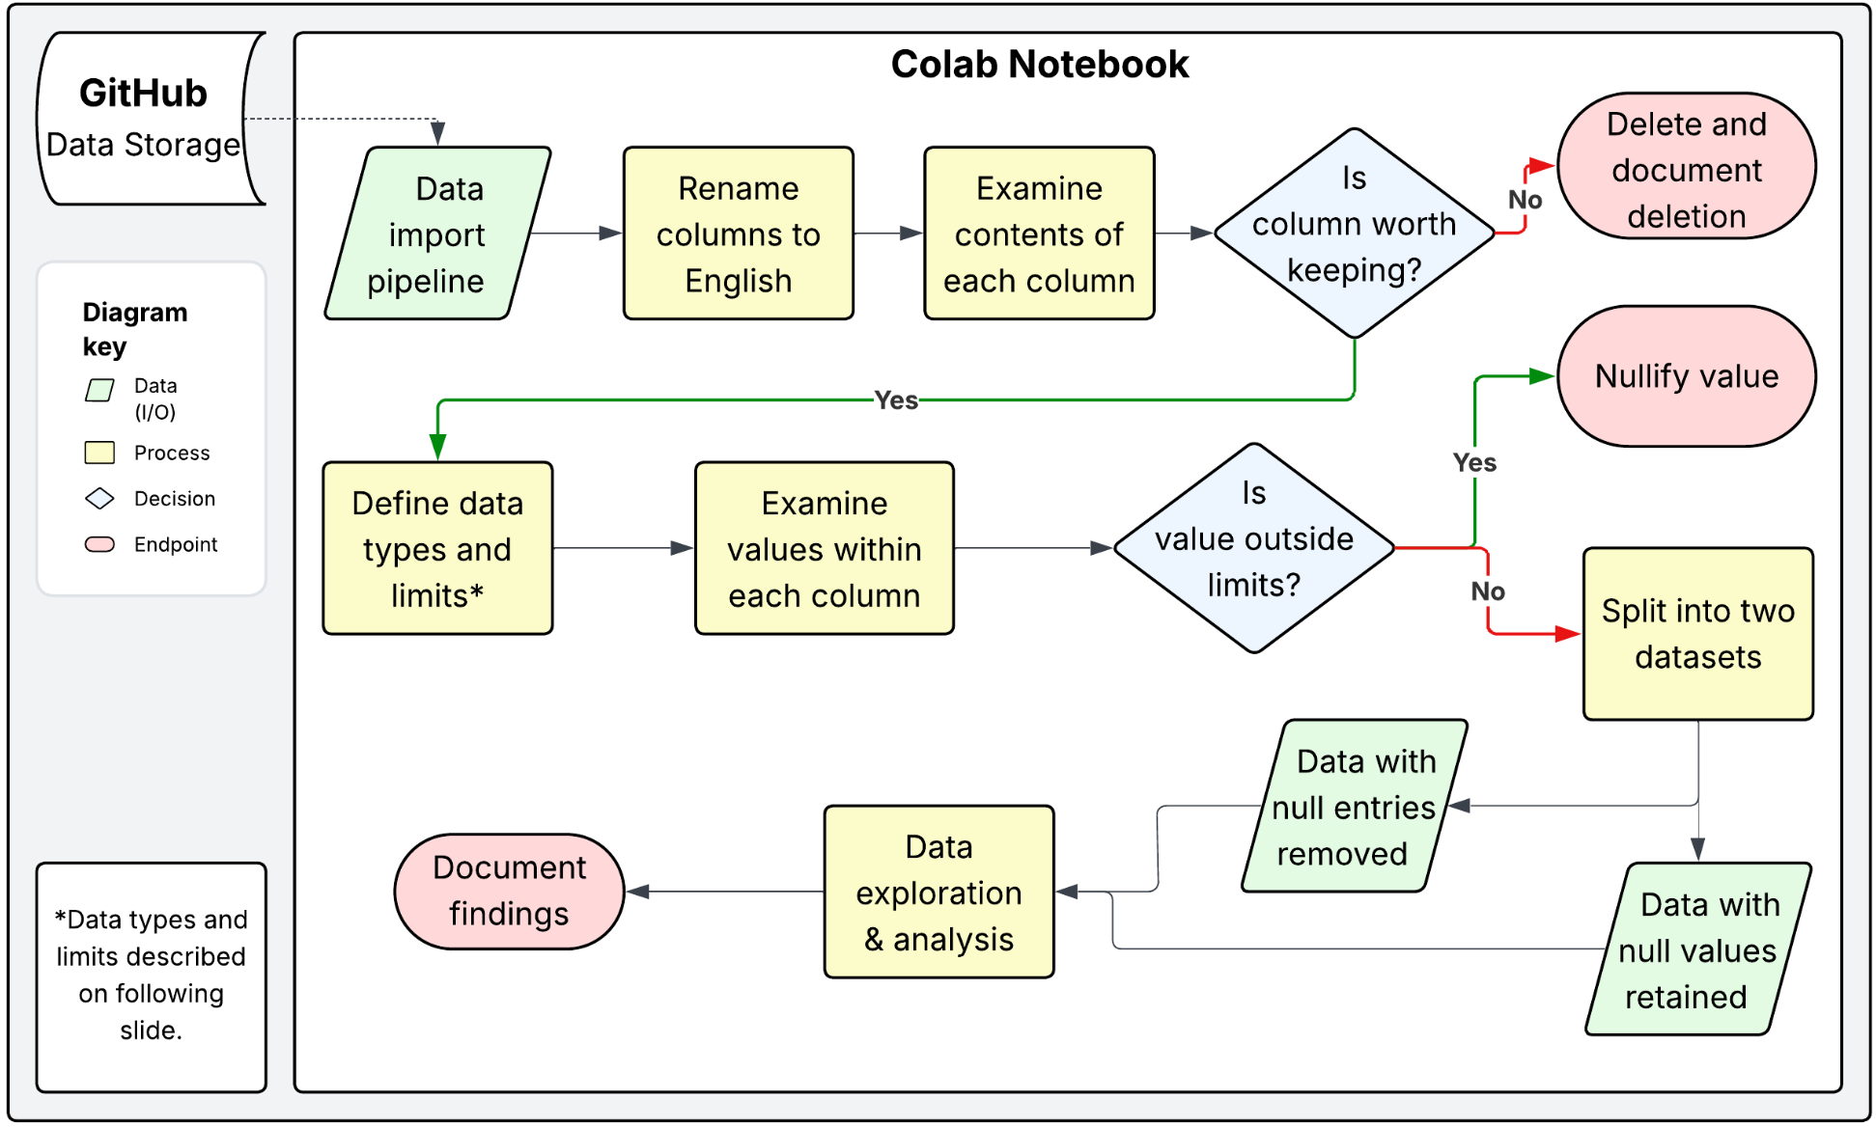
Data Cleaning

Slide 22
Project Objectives and Parameters
 | Business Objective | Analytic Objective | Parameters
1 | Identify high-risk undiagnosed T2D cases through screening | Identify any relationships between higher rates of T2D and demographic/lifestyle reporting | sex, age group, drinking status, smoking status
 |  | Identify clinical measurements that can indicate higher risk of T2D | AST/ALT ratio, GGT, total cholesterol, HDL cholesterol, LDL cholesterol, waist-weight index (WWI)
2 | Release screening tool for practical application | Provide transparency that allows physicians to trust the model outputs | risk tier, adjusted probability

Slide 23
Feature Engineering
Feature | Description
BMI | waist / (height^2)
Waist-to-Height Ratio | waist / height
Weight-Adjusted Waist Index | waist / (weight^(½))
Pulse Pressure | systolic - diastolic BP
Mean Arteria; Pressure | diastolic + (pulse pressure / 3)

Slide 24
Algorithms - SVM / Decision Tree / Logistic Regression
What are the input parameters (i.e., features) to your algorithm | Age, height, weight, waist circumference, body mass index, waist-to-height ratio, weight-adjusted waist index, systolic/diastolic blood pressure, pulse pressure, mean arterial pressure, urine protein, sex, smoking status, alcohol consumption, hemoglobin, serum creatinine, AST, ALT, GGT, AST-ALT ratio, total cholesterol, HDL/LDL cholesterol, triglycerides
What are the output parameters (i.e., objectives) | T2D risk score, binary testing recommendation
What algorithm(s) are you using | SVM (Support Vector Machine) Model, Decision Tree Model, Logistic Regression Model
What settings are you using to train and test each of your algorithm(s) | 60/20/20 split, median imputation, standardization, embedding encodings for categorical
What does your code model | Likelihood a patient has T2D given provided input parameters
What output do you expect to get | A probability and a binary decision whether or not to recommend testing

Slide 25
Algorithms - ANN / CatBoost
What are the input parameters (i.e., features) to your algorithm | Age, height, weight, waist circumference, body mass index, waist-to-height ratio, weight-adjusted waist index, systolic/diastolic blood pressure, pulse pressure, mean arterial pressure, urine protein, sex, smoking status, alcohol consumption, hemoglobin, serum creatinine, AST, ALT, GGT, AST-ALT ratio, total cholesterol, HDL/LDL cholesterol, triglycerides
What are the output parameters (i.e., objectives) | T2D risk score, risk category (low, medium, high, very high), binary testing recommendation
What algorithm(s) are you using | MLPClassifier, PyTorch Tabular, CatBoost model
What settings are you using to train and test each of your algorithm(s) | 60/20/20 split, standardization, embedding encodings for categorical
What does your code model | Likelihood a patient has T2D given provided input parameters
What output do you expect to get | A probability and a binary decision whether or not to recommend testing

Slide 26
Performance - SVM / Decision Tree / Logistic Regression
What performance measures are you using and why
ROC-AUC: Used to measure how well model ranks higher-risk over lower-risk
Average Precision (AP): Used to show tradeoff between precision and recall
Brier Score: Lower score indicates better predicted probabilities
Precision, Recall, Specificity, F1
Screen Positive Rate: Measures burden of screening policy
Performance results
 | SVM | Decision Tree | Logistic Regression
ROC-AUC | 0.792 | 0.780 | 0.792
PR-AUC | 0.227 | 0.214 | 0.227
Brier Score | 0.067 | 0.067 | 0.067
Screen Positive Rate | 0.447 | 0.503 | 0.447
Precision | 0.150 | 0.138 | 0.150
Recall | 0.852 | 0.879 | 0.852
Specificity | 0.588 | 0.529 | 0.587
F1 | 0.256 | 0.238 | 0.256

Slide 27
Performance - ANN / CatBoost
What performance measures are you using and why
ROC-AUC: Used to measure how well model ranks higher-risk over lower-risk
Average Precision (AP): Used to show tradeoff between precision and recall
Brier Score: Lower score indicates better predicted probabilities
Precision, Recall, Specificity, F1
Screen Positive Rate: Measures burden of screening policy
Performance results
 | MLPClassifier | CatBoost | PyTorch Tabular
ROC-AUC | 0.812 | 0.816 | 0.816
PR-AUC | 0.263 | 0.274 | 0.269
Brier Score | 0.065 | 0.064 | 0.064
Screen Positive Rate | 0.419 | 0.411 | 0.412
Precision | 0.161 | 0.163 | 0.163
Recall | 0.852 | 0.850 | 0.852
Specificity | 0.619 | 0.627 | 0.626
F1 | 0.270 | 0.274 | 0.274

Slide 28
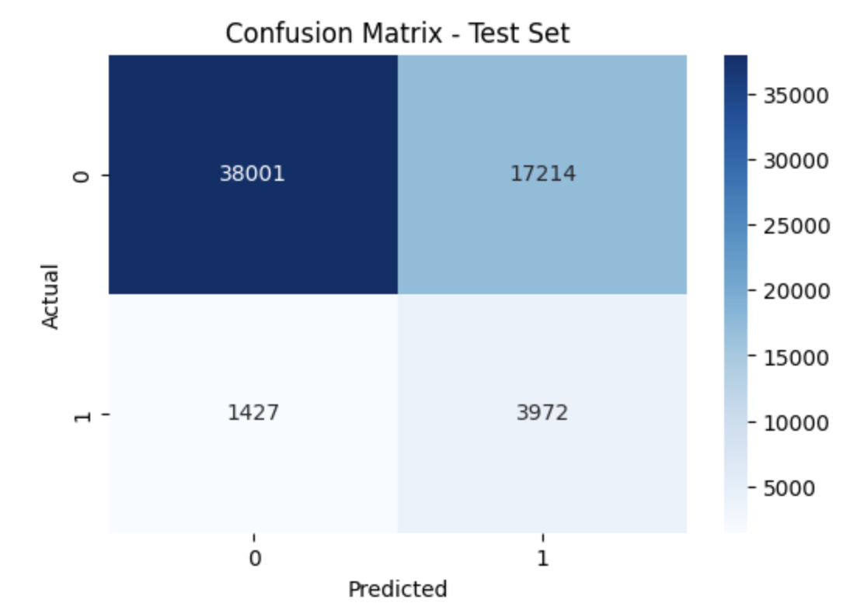
Confusion Matrix- SVM Model

Slide 29
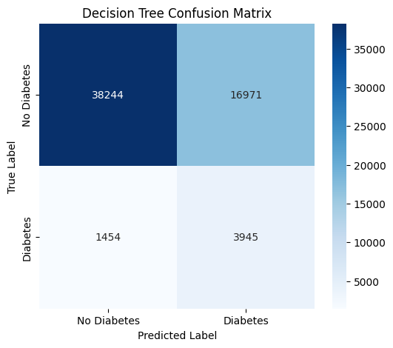
Confusion Matrix- Decision Tree Model

Slide 30
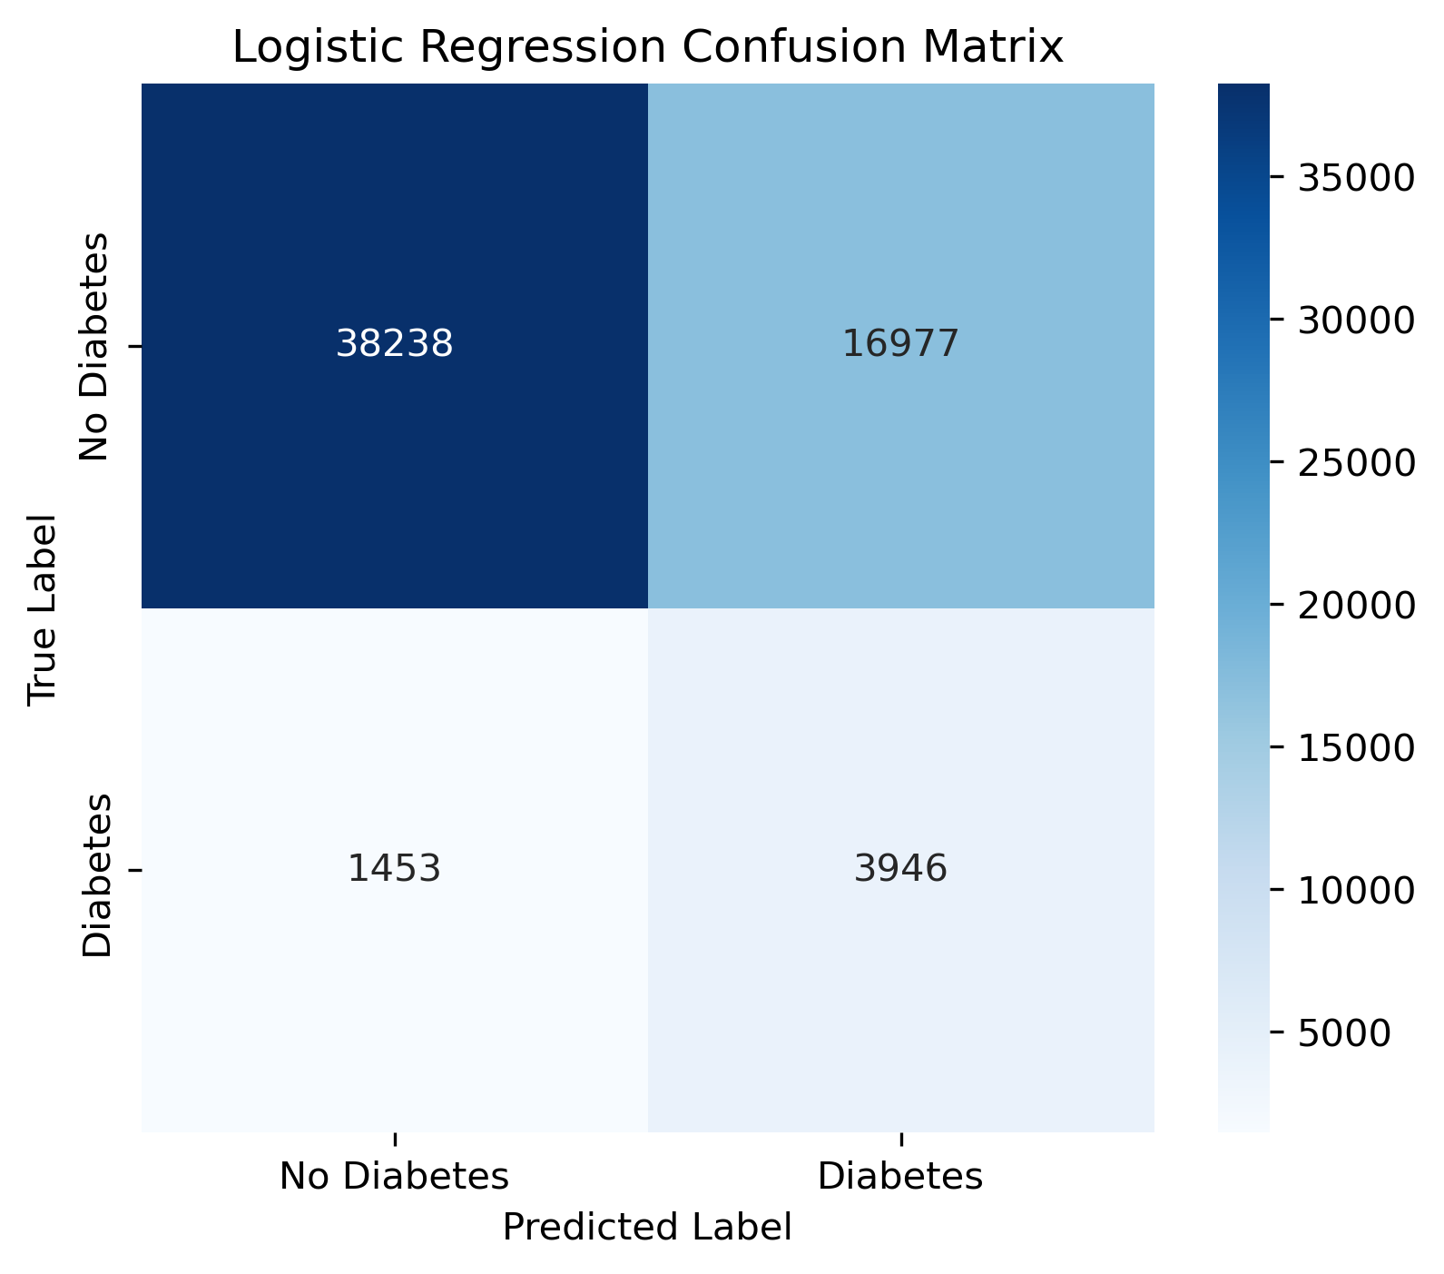
Confusion Matrix- Logistic Regression

Slide 31
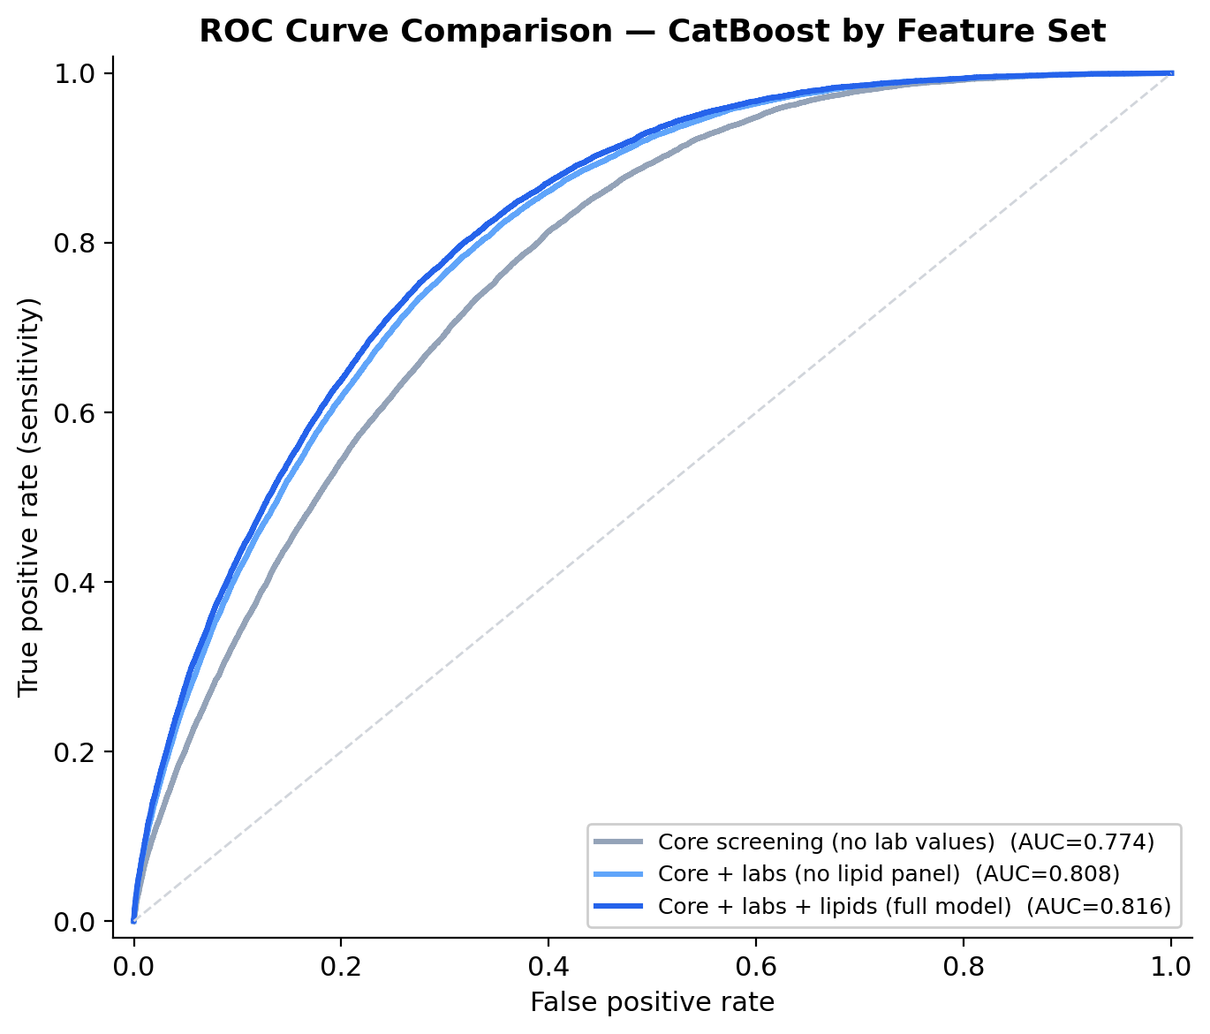
CatBoost by Feature Set (ROC Curve Comparison)
ROC-AUC improves from 0.774 (core only) to 0.808 (+ labs) to 0.816 (+ lipids). The largest gain comes from adding laboratory features.

Slide 32
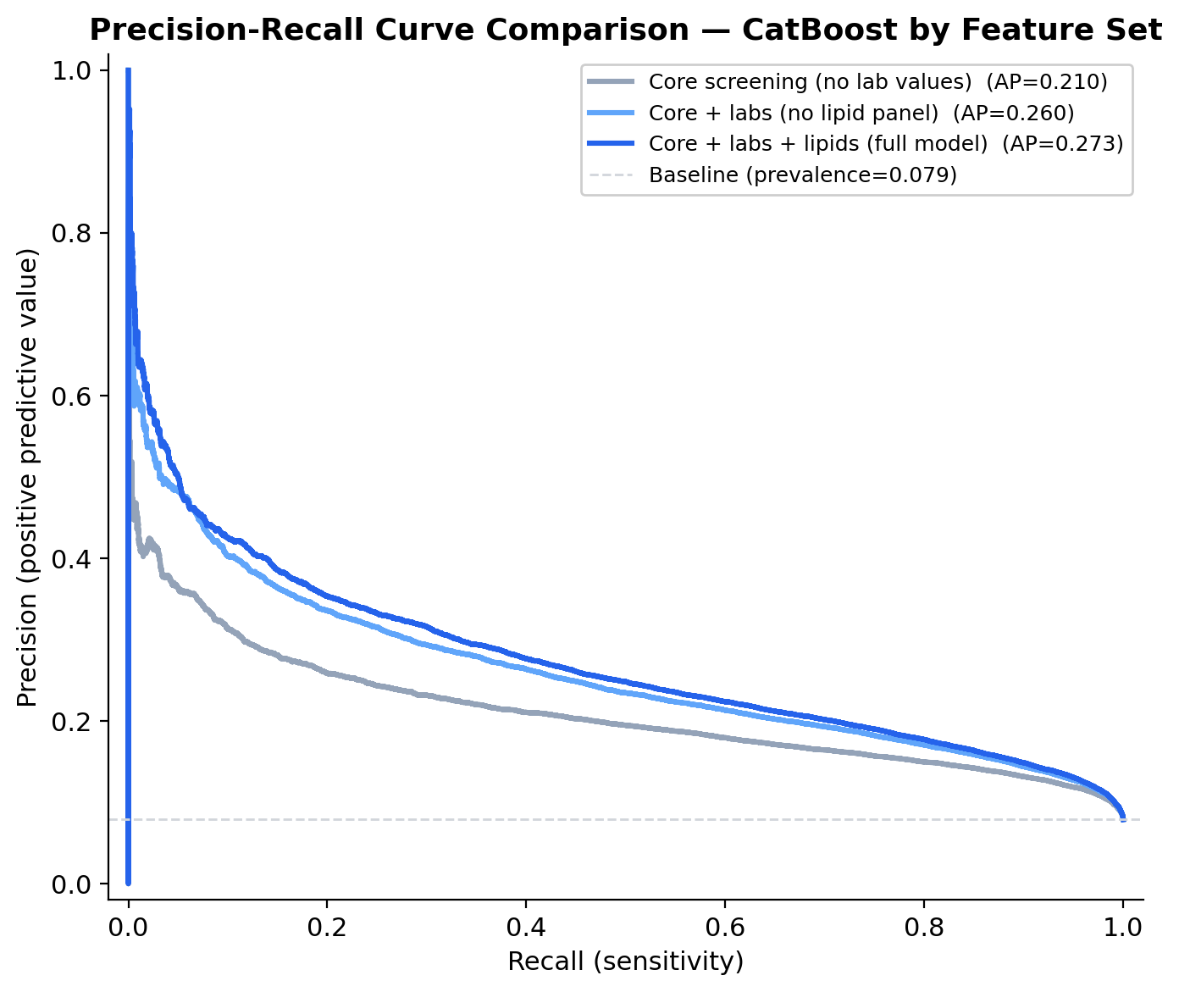
CatBoost by Feature Set (Precision-Recall Comparison)
Average precision rises from 0.210 to 0.260 to 0.273. The core-only model's precision drops more steeply at higher recall levels compared to the lab-inclusive models.

Slide 33
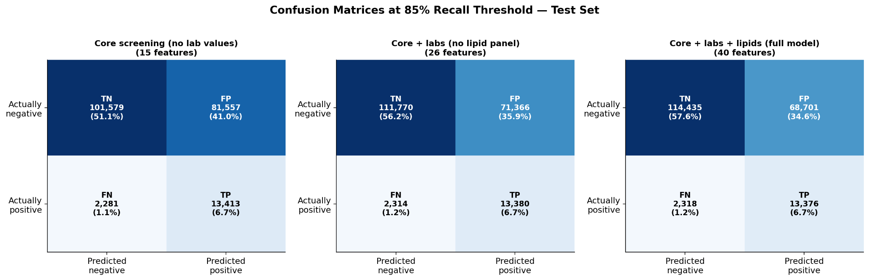
CatBoost by Feature Set (Confusion Matrices)
True positive counts are similar across all three models (~13,100–13,300). False positives drop from 83,957 (core only) to 68,791 (full model) — fewer unnecessary referrals for the same detection rate.

Slide 34
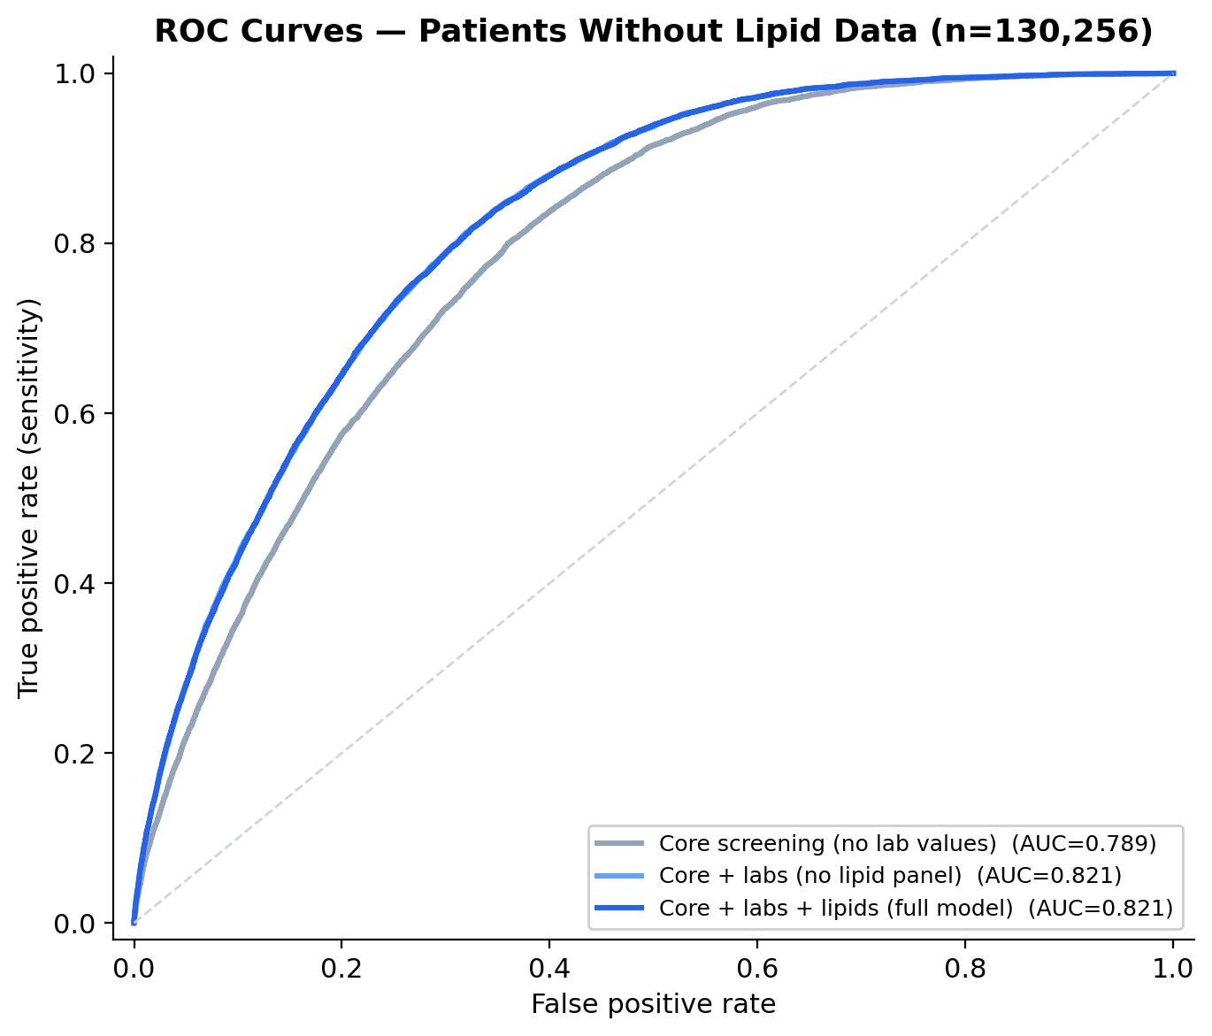
CatBoost by Feature Set (ROC — Missing Lipid Subgroup)
On the 130,256 test patients with no lipid data (66% of test set), the full model matches core+labs at 0.821 AUC. Including lipid columns does not degrade performance when those values are absent.

Slide 35
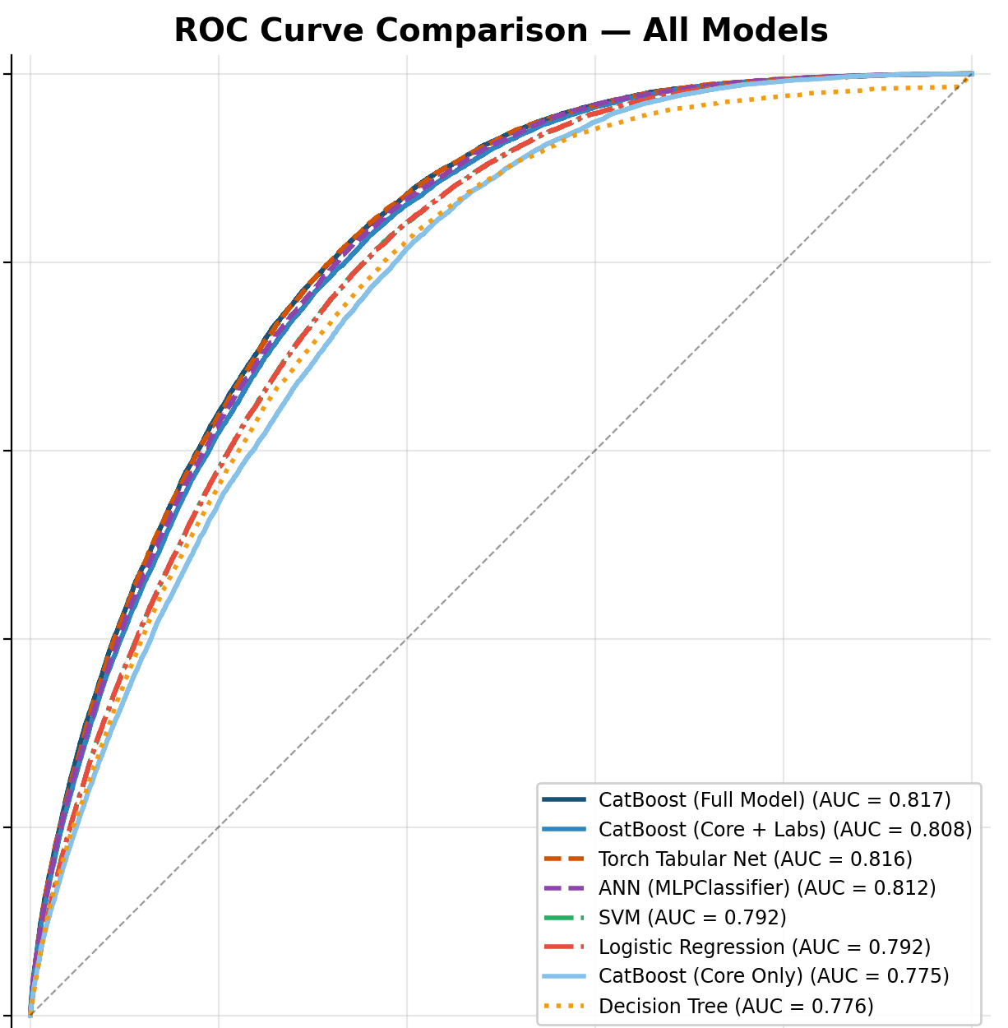
Model Selection (CatBoost)
CatBoost approximately ties PyTorch in ROC-AUC
CatBoost having built-in SHAP analysis compatibility makes it the clear winner

Slide 36
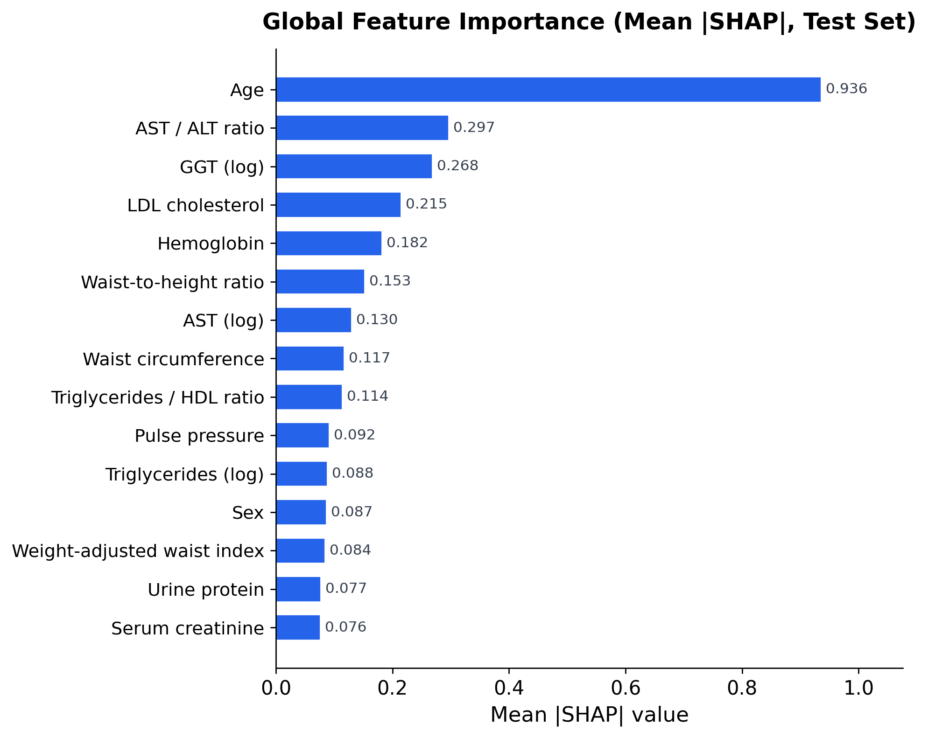
SHAP Analysis
Why SHAP?
Model Interpretability is essential in clinical deployment as medical professionals need to understand why a prediction has been made
SHAP assigns each feature a contribution value per individual prediction
SHAP works well with CatBoost (tree-based models) for global and local explanations
Key Findings
Age is the dominant predictor and has shown consistent across all feature sets
BMI and waist circumference rank 2 and 3 respectively. This indicates body composition as a risk signal
AST/ALT ratio, GGT, LDL cholesterol, hemoglobin, and triglyceride measure align with known T2D risk factors
Clinical Implications
All top SHAP features are measured during routine health checkups; No additional testing required to deploy
Global feature importance by mean |SHAP| on the test set

Slide 37
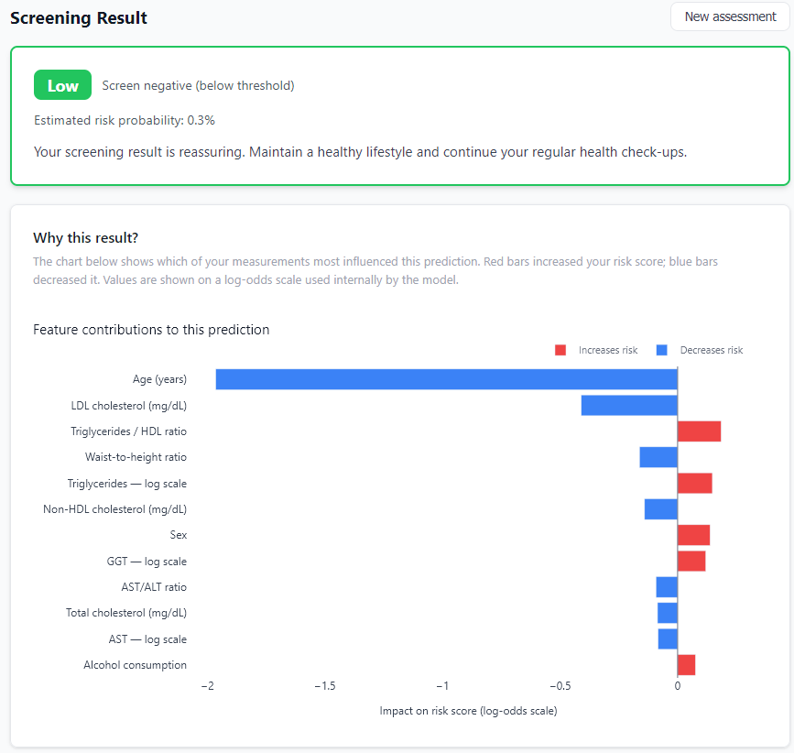
Deployment
FastAPI backend loads the CatBoost model and Platt calibrator, accepts patient data, and returns a calibrated probability plus a risk tier.
UI allows clinicians enter available data and receive one of four risk classifications (Low, Moderate, High, Very High)

