Slide 1




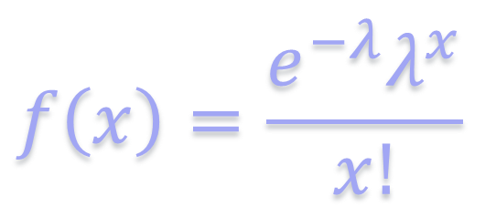
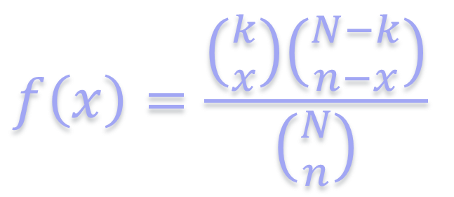

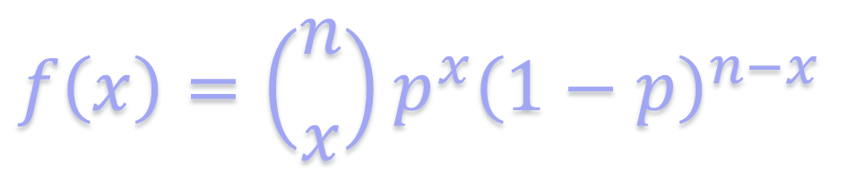

$$Variable Discreta$$
$$Poisson$$
$$Variable Continua$$
$$Ingrese λ$$
$$f\left(x\right)=\left({n \atop x}\right)p^{x}{\left(1−p\right)}^{n−x}$$
$$Binomial$$
$$f\left(x\right)=\frac{\left({k \atop x}\right)\left({N−k \atop n−x}\right)}{\left({N \atop n}\right)}$$
$$Hipergeométrica$$
$$f\left(x\right)=\frac{e^{−λ}λ^{x}}{x!}$$

Slide 2
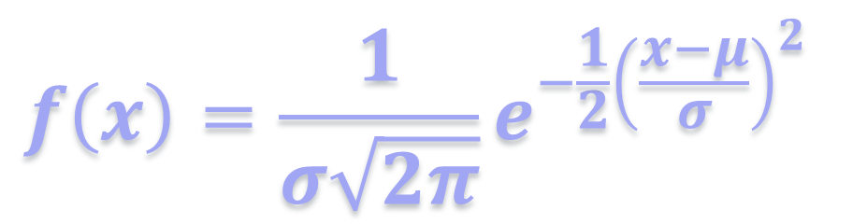

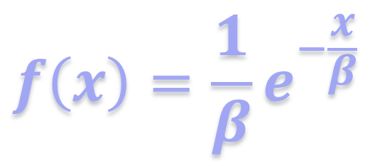


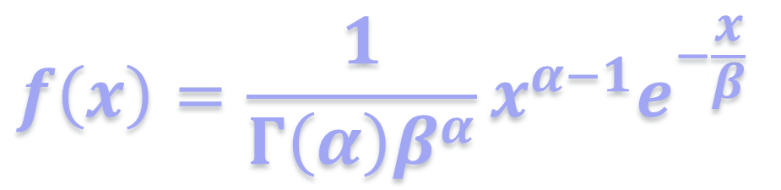
$$f\left(x\right)=\frac{1}{σ\sqrt{2π}}e^{−\frac{1}{2}{\left(\frac{x−μ}{σ}\right)}^{2}}$$
$$Normal$$
$$Exponencial$$
$$f\left(x\right)=\frac{1}{β}e^{−\frac{x}{β}}$$
$$Gamma$$
$$f\left(x\right)=\frac{1}{Γ\left(α\right)β^{α}}x^{α−1}e^{−\frac{x}{β}}$$

Slide 3




