Slide 1
COM开发
潘爱民
2003-11-7
http://www.icst.pku.edu.cn/CompCourse2003/

Slide 2
内容
Win32 SDK和MFC介绍
MFC对COM的支持
用MFC开发COM组件
ATL对COM的支持
用ATL开发COM组件
布置作业

Slide 3
Win32 SDK： Windows程序结构
入口函数WinMain
应用初始化
主窗口的创建及显示
消息分发循环
程序结束处理

Slide 4
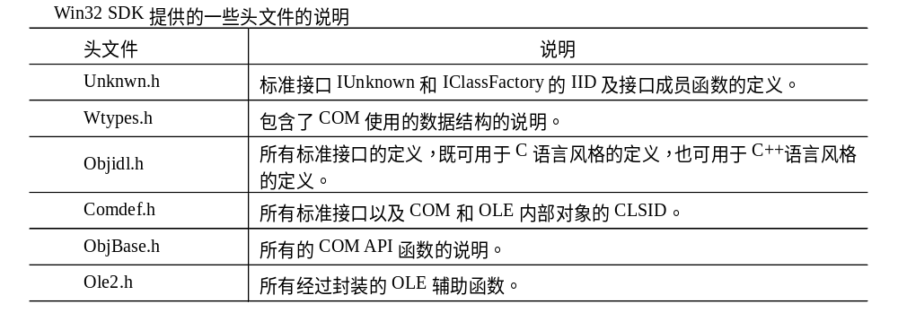
Win32 SDK对COM的支持
Win32 SDK包括COM库函数的支持

Slide 5
利用宏描述接口
DECLARE_INTERFACE_(IClassFactory, IUnknown)
{
STDMETHOD(QueryInterface) (THIS_
REFIID riid,
LPVOID FAR* ppvObj) PURE;
STDMETHOD_(ULONG,AddRef) (THIS) PURE;
STDMETHOD_(ULONG,Release) (THIS) PURE;
STDMETHOD(CreateInstance) (THIS_
LPUNKNOWN pUnkOuter,
REFIID riid,
LPVOID FAR* ppvObject) PURE;
STDMETHOD(LockServer)(THIS_
BOOL fLock) PURE;
};

Slide 6
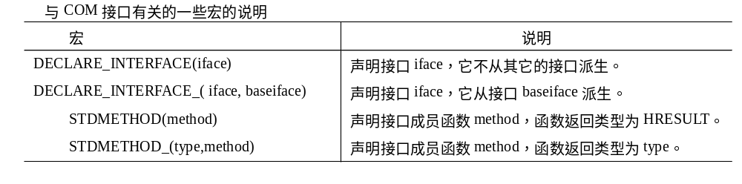
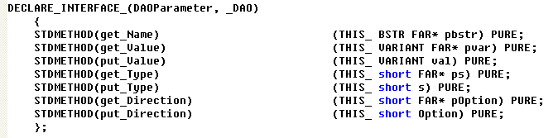
VC提供的用于描述接口的宏

Slide 7
MFC基础
应用类
  AfxGetApp
  CWinApp::InitInstance
  CWinApp::ExitInstance
  CWinApp::OnIdle
  CWinApp::Run
  CWnd *m_pMainWnd
窗口类
  AfxGetMainWnd

Slide 8
MFC的消息处理机制
——消息映射表
在CWnd派生类定义中加入声明：
  DECLARE_MESSAGE_MAP()
在类的实现文件中加入表和表项的定义：
  BEGIN_MESSAGE_MAP(theClass, baseClass)
  ......
  END_MESSAGE_MAP

Slide 9
消息映射表示例
BEGIN_MESSAGE_MAP(theClass, baseClass)
//{{AFX_MSG_MAP(theClass)
ON_WM_SETFOCUS()
ON_WM_CREATE()
ON_WM_DESTROY()
ON_WM_CLOSE()
ON_WM_SIZE()
ON_MESSAGE(WM_COMMANDHELP, OnCommandHelp)
ON_MESSAGE(WM_HELPHITTEST, OnHelpHitTest)
ON_UPDATE_COMMAND_UI(ID_VIEW_STATUS_BAR, OnUpdateControlBarMenu)
ON_NOTIFY_EX_RANGE(TTN_NEEDTEXTW, 0, 0xFFFF, OnToolTipText)
//}}AFX_MSG_MAP
END_MESSAGE_MAP

Slide 10
MFC应用类型
常规应用：MDI应用、SDI应用、基于对话框程序
DLL应用：静态连接MFC库的正规DLL、动态连接MFC库的正规DLL、MFC扩展DLL
其他应用：
  支持OLE服务或者包容器的SDI应用
  支持OLE服务或者包容器的MDI应用
  支持自动化(Automation)服务的SDI或者MDI程序
  ActiveX控制应用(OCX应用)

Slide 11
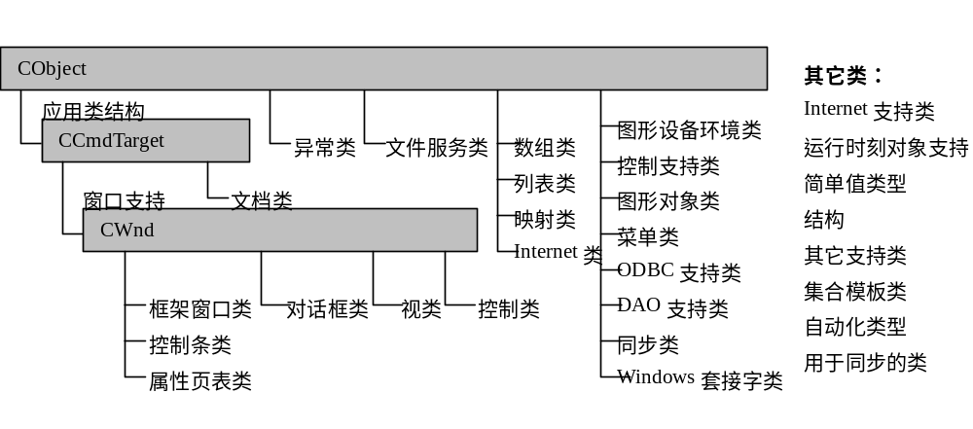
MFC库结构(参照4.2版本)

Slide 12
MFC对COM应用的支持

Slide 13
用嵌套类实现COM接口
class CDictionary
{
…… //构造函数和析构函数
HRESULT __stdcall QueryInterface(REFIID iid, void** ppvObj);
ULONG __stdcall AddRef();
ULONG __stdcall Release();
class XDictionaryObj : public IDictionary {
public:
CDictionary * m_pParent;
virtual HRESULT __stdcall QueryInterface(REFIID iid, void** ppvObj);
virtual ULONG __stdcall AddRef();
virtual ULONG __stdcall Release();
virtual BOOL __stdcall Initialize();
…...
virtual void __stdcall FreeLibrary();
} m_dictionaryObj;
未完

Slide 14
用嵌套类实现COM接口(续一)
续
class XSpellCheckObj : public ISpellCheck {
public:
CDictionary * m_pParent;
virtual HRESULT __stdcall QueryInterface(REFIID iid, void** ppvObj);
virtual ULONG __stdcall AddRef();
virtual ULONG __stdcall Release();
virtual BOOL __stdcall CheckWord (String word, String *);
} m_spellCheckObj;
private :
struct DictWord *m_pData;
char *m_DictFilename[128];
int m_Ref ;
int m_nWordNumber, m_nStructNumber;
};

Slide 15
用嵌套类实现COM接口(续二)
CDictionary::CDictionary()
{
....... // Initializtion
m_dictionaryObj. m_pParent = this;
m_spellCheckObj. m_pParent = this;
}

Slide 16
用嵌套类实现COM接口(续三)
HRESULT CDictionary::QueryInterface(const IID& iid, void **ppvObj)
{
if (iid == IID_IUnknown || iid == IID_Dictionary) {
*ppvObj = &m_dictionaryObj;
AddRef();
return S_OK;
} else if (iid == IID_SpellCheck) {
*ppvObj = &m_spellCheckObj;
AddRef();
return S_OK;
}
*ppv = NULL;
return E_NOINTERFACE ;
}

Slide 17
用嵌套类实现COM接口(续四)
ULONG CDictionary::XDictionaryObj::QueryInterface(const IID& iid,
void **ppvObj)
{
return m_pParent->QueryInterface(iid, ppvObj);
}
ULONG CDictionary::XDictionaryObj::AddRef()
{
return m_pParent->AddRef();
}
ULONG CDictionary::XDictionaryObj::Release ()
{
return m_pParent->Release ();
}

Slide 18
“用嵌套类实现COM接口”原理
CDictionary
Vtable for IDictionary
vptr
m_pData
m_DictFilename[128]
m_Ref
m_nWordNumber
m_nStructNumber
QueryInterface
AddRef
Release
……
m_dictionaryObj
vptr
m_spellCheckObj
Vtable for ISpellCheck
QueryInterface
AddRef
Release
……
QueryInterface
AddRef
Release
…….
CDictionary的非虚函数

Slide 19
MFC：接口映射表
CCmdTarget类
CCmdTarget::m_dwRef为引用计数
接口映射表与消息映射表非常类似
接口映射表：记录了CCmdTarget类中每一个嵌套类的接口ID以及接口vtable与父类this指针之间的偏移量
offsetof宏：成员类与父类之间的偏移值

Slide 20
DECLARE_INTERFACE_MAP
#define DECLARE_INTERFACE_MAP() \
private: \
static const AFX_INTERFACEMAP_ENTRY _interfaceEntries[]; \
protected: \
static AFX_DATA const AFX_INTERFACEMAP interfaceMap; \
static const AFX_INTERFACEMAP* PASCAL _GetBaseInterfaceMap(); \
virtual const AFX_INTERFACEMAP* GetInterfaceMap() const; \
struct AFX_INTERFACEMAP_ENTRY
{
const void* piid;
size_t nOffset;
};
struct AFX_INTERFACEMAP
{
#ifdef _AFXDLL
const AFX_INTERFACEMAP* (PASCAL* pfnGetBaseMap)();
#else
const AFX_INTERFACEMAP* pBaseMap;
#endif
const AFX_INTERFACEMAP_ENTRY* pEntry;
};

Slide 21
接口映射表定义
BEGIN_INTERFACE_MAP(CDictionary, CCmdTarget)
INTERFACE_PART(CDictionary, IID_IDictionary, Dictionary)
INTERFACE_PART(CDictionary, IID_ISpellCheck, SpellCheck)
END_INTERFACE_MAP()

Slide 22
接口映射表的宏定义
#define BEGIN_INTERFACE_MAP(theClass, theBase) \
const AFX_INTERFACEMAP* PASCAL theClass::_GetBaseInterfaceMap() \
{ return &theBase::interfaceMap; } \
const AFX_INTERFACEMAP* theClass::GetInterfaceMap() const \
{ return &theClass::interfaceMap; } \
AFX_COMDAT const AFX_DATADEF \
AFX_INTERFACEMAP theClass::interfaceMap = \
{ &theClass::_GetBaseInterfaceMap, &theClass::_interfaceEntries[0], }; \
AFX_COMDAT const AFX_DATADEF
AFX_INTERFACEMAP_ENTRY theClass::_interfaceEntries[] = \
{ \
#define INTERFACE_PART(theClass, iid, localClass) \
{ &iid, offsetof(theClass, m_x##localClass) }, \
#define END_INTERFACE_MAP() \
{ NULL, (size_t)-1 } \
}; \

Slide 23
MFC版本的字典对象类定义
class CDictionary : public CCmdTarget
{
DECLARE_DYNCREATE(CDictionary)
CDictionary(); // protected constructor used by dynamic creation
DECLARE_INTERFACE_MAP()
......
// IDictionary
BEGIN_INTERFACE_PART(Dictionary, IDictionary)
INIT_INTERFACE_PART(CDictionary, Dictionary)
STDMETHOD_(BOOL, Initialize)();
……
STDMETHOD_(void, FreeLibrary)();
END_INTERFACE_PART_STATIC(Dictionary)
// ISpellCheck
BEGIN_INTERFACE_PART(SpellCheck, ISpellCheck)
INIT_INTERFACE_PART(CDictionary, SpellCheck)
STDMETHOD_(BOOL, CheckWord)(LPOLESTR, LPOLESTR *);
END_INTERFACE_PART_STATIC(SpellCheck)
};

Slide 24
MFC版本的字典对象类实现
STDMETHODIMP_(ULONG) CDictionary::XDictionary::AddRef()
{
METHOD_PROLOGUE_EX_(CDictionary, Dictionary)
return pThis->ExternalAddRef();
}
METHOD_PROLOGUE_EX_宏定义：
#define METHOD_PROLOGUE_EX(theClass, localClass) \
theClass* pThis = ((theClass*)((BYTE*)this - m_nOffset)); \
AFX_MANAGE_STATE(pThis->m_pModuleState) \
pThis; // avoid warning from compiler \

Slide 25
CCmdTarget类实现IUnknown
public:
// data used when CCmdTarget is made OLE aware
long m_dwRef;
LPUNKNOWN m_pOuterUnknown; // external controlling unknown if != NULL
DWORD m_xInnerUnknown; // place-holder for inner controlling unknown
public:
// advanced operations
void EnableAggregation(); // call to enable aggregation
void ExternalDisconnect(); // forcibly disconnect
LPUNKNOWN GetControllingUnknown();
// get controlling IUnknown for aggregate creation

Slide 26
CCmdTarget类实现IUnknown(续)
public:
// these versions do not delegate to m_pOuterUnknown
DWORD InternalQueryInterface(const void*, LPVOID* ppvObj);
DWORD InternalAddRef();
DWORD InternalRelease();
// these versions delegate to m_pOuterUnknown
DWORD ExternalQueryInterface(const void*, LPVOID* ppvObj);
DWORD ExternalAddRef();
DWORD ExternalRelease();

Slide 27
CCmdTarget中QueryInterface实现
DWORD CCmdTarget::InternalQueryInterface(const void* iid, LPVOID* ppvObj)
{
// check local interfaces
if ((*ppvObj = GetInterface(iid)) != NULL) {
// interface was found -- add a reference
ExternalAddRef();
return S_OK;
}
// check aggregates
if ((*ppvObj = QueryAggregates(iid)) != NULL)
return S_OK;
// interface ID not found, fail the call
return (DWORD)E_NOINTERFACE;
}

Slide 28
CCmdTarget中ExternalXXX成员实现
DWORD CCmdTarget::ExternalAddRef()
{
// delegate to controlling unknown if aggregated
if (m_pOuterUnknown != NULL)
return m_pOuterUnknown->AddRef();
return InternalAddRef();
}
DWORD CCmdTarget::ExternalRelease() // …...
// QueryInterface that is exported to normal clients
DWORD CCmdTarget::ExternalQueryInterface(const void* iid, LPVOID* ppvObj)
{
// delegate to controlling unknown if aggregated
if (m_pOuterUnknown != NULL)
return m_pOuterUnknown->QueryInterface(*(IID*)iid, ppvObj);
return InternalQueryInterface(iid, ppvObj);
}

Slide 29
嵌套类内部实现IUnknown的成员函数
STDMETHODIMP_(ULONG) CDictionary::XDictionary::QueryInterface (
const void* iid, LPVOID* ppvObj)
{
METHOD_PROLOGUE_EX_(CDictionary, Dictionary)
return pThis->ExternalQueryInterface (iid, ppvObj);
}

Slide 30
COM引出函数和类厂实现
在AppWizard中选中“Automation”检查框
STDAPI DllGetClassObject(REFCLSID rclsid, REFIID riid, LPVOID* ppv)
{
AFX_MANAGE_STATE(AfxGetStaticModuleState());
return AfxDllGetClassObject(rclsid, riid, ppv);
}
STDAPI DllCanUnloadNow(void)
{
AFX_MANAGE_STATE(AfxGetStaticModuleState());
return AfxDllCanUnloadNow();
}
// by exporting DllRegisterServer, you can use regsvr.exe
STDAPI DllRegisterServer(void)
{
AFX_MANAGE_STATE(AfxGetStaticModuleState());
COleObjectFactory::UpdateRegistryAll();
return S_OK;
}

Slide 31
COleObjectFactory
通用的类厂，实现了IClassFactory2接口
COleObjectFactory的主要信息是对象的CLSID和对象的类型信息。
它利用MFC的动态对象创建机制：
  DECLARE_DYNCREATE
对象方面的支持：
  DECLARE_OLECREATE(...)，定义如下
  #define DECLARE_OLECREATE(class_name) \
  public: \
  static AFX_DATA COleObjectFactory factory; \
  static AFX_DATA const GUID guid; \

Slide 32
MFC中组件对象的创建支持
DECLARE_OLECREATE(...)
IMPLEMENT_OLECREATE
  #define IMPLEMENT_OLECREATE(class_name, external_name, l, w1, w2, b1, b2, b3, b4, b5, b6, b7, b8) \
  AFX_DATADEF COleObjectFactory class_name::factory(class_name::guid, \
  RUNTIME_CLASS(class_name), FALSE, _T(external_name)); \
  AFX_COMDAT const AFX_DATADEF GUID class_name::guid = \
  { l, w1, w2, { b1, b2, b3, b4, b5, b6, b7, b8 } }; \
状态结构：AFX_MODULE_STATE，除了一些基本的全局信息，还包括一个类厂表。
DllGetClassObject-〉AfxDllGetClassObject-〉AfxGetModuleState进一步得到类厂表
类厂对象的构造函数和析构函数维护类厂表

Slide 33
用MFC开发COM应用
利用AppWizard创建COM程序工程框架
利用ClassWizard添加COM对象类

Slide 34
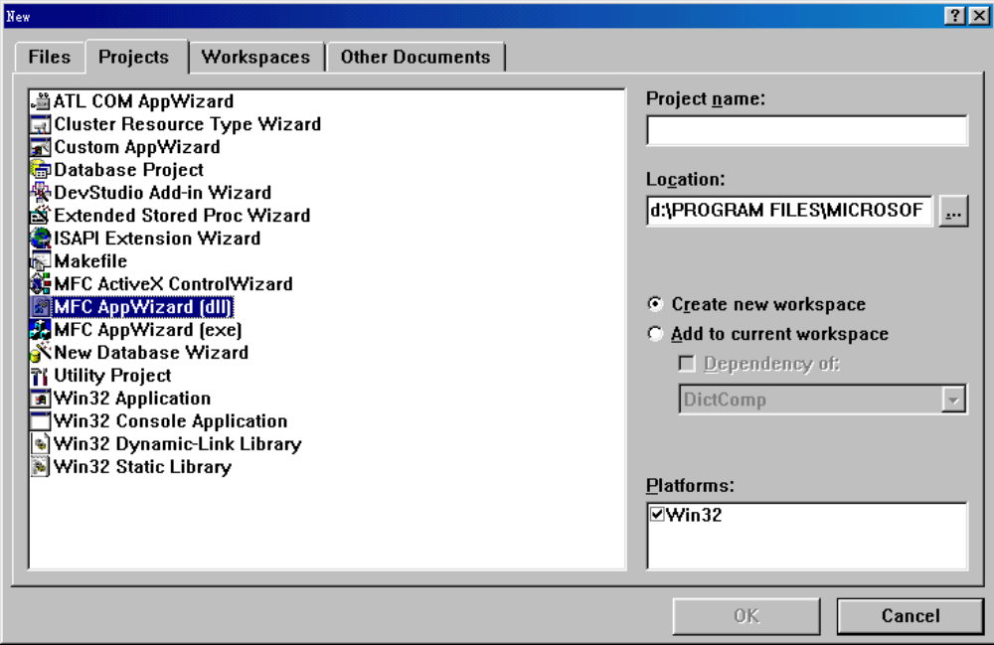
AppWizard创建COM工程(一)

Slide 35
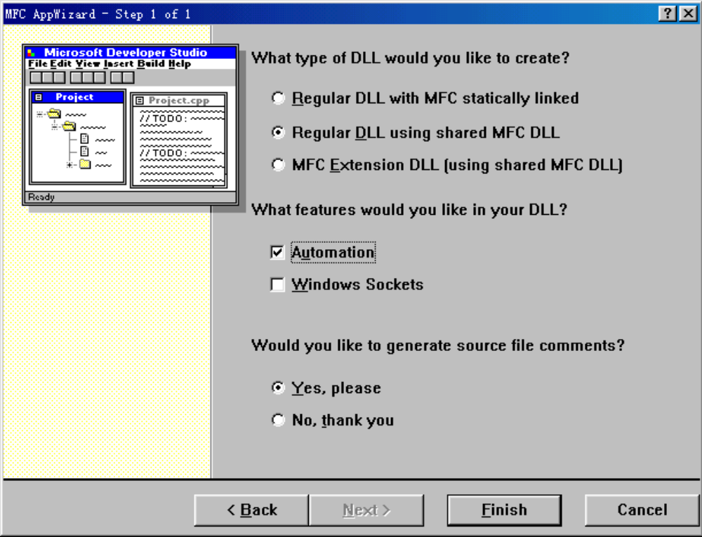
AppWizard创建COM工程(二)

Slide 36
AppWizard创建COM工程(三)
BOOL CDictCompApp::InitInstance()
{
// Register all OLE server (factories) as running.
// This enables the
// OLE libraries to create objects from other applications.
COleObjectFactory::RegisterAll();
return TRUE;
}

Slide 37
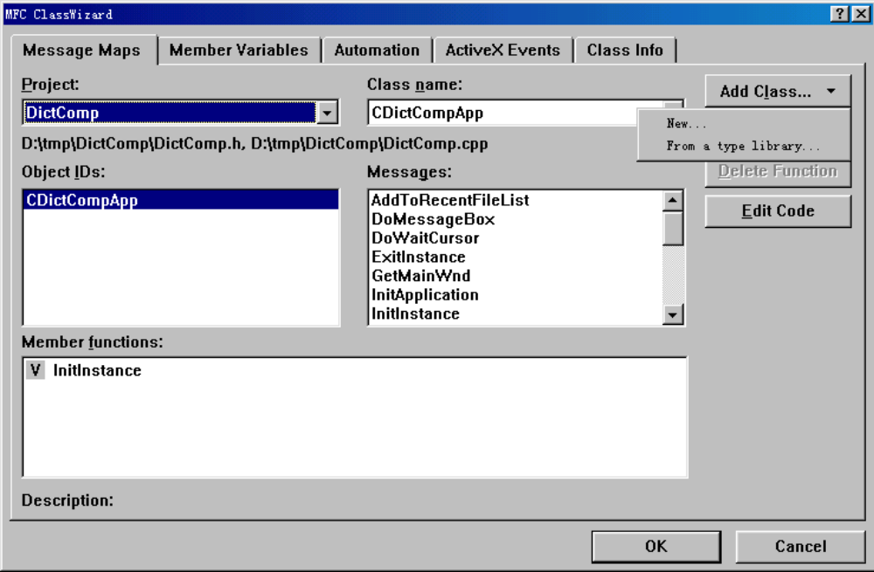
ClassWizard添加COM对象类(一)

Slide 38
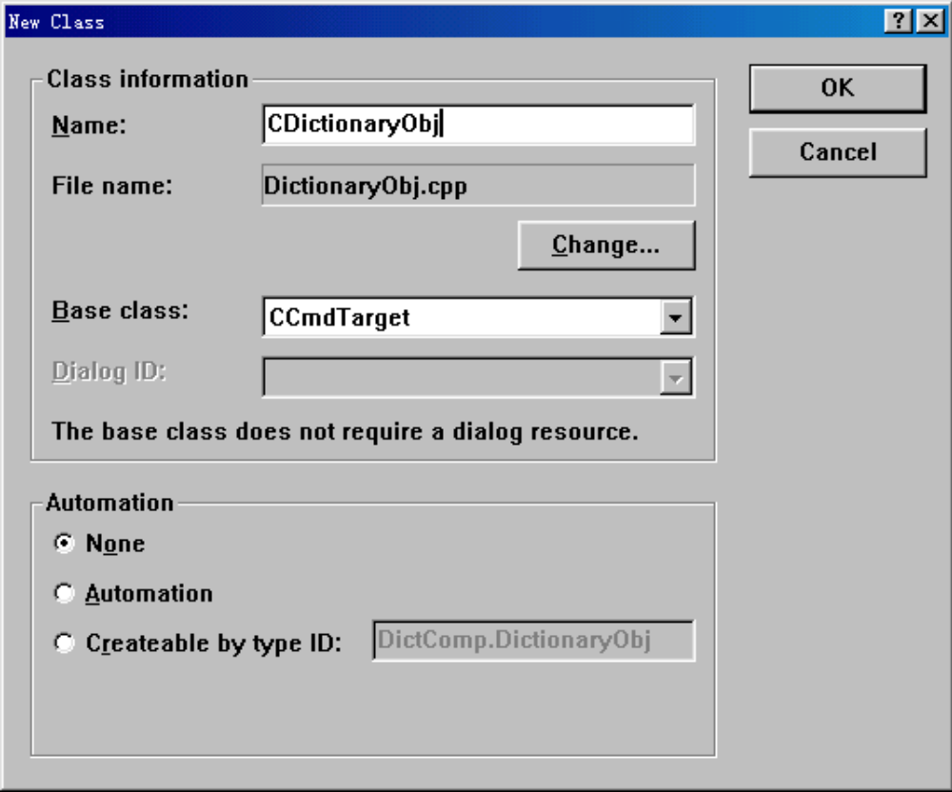
ClassWizard添加COM对象类(二)

Slide 39
CDictionaryObj声明中加入接口定义
BEGIN_INTERFACE_PART(Dictionary, IDictionary)
INIT_INTERFACE_PART(CDictionary, Dictionary)
STDMETHOD_(BOOL, Initialize)();
STDMETHOD_(BOOL, LoadLibrary)(LPOLESTR);
STDMETHOD_(BOOL, InsertWord)(LPOLESTR, LPOLESTR);
STDMETHOD_(void, DeleteWord)( LPOLESTR);
STDMETHOD_(BOOL, LookupWord)(LPOLESTR, LPOLESTR *);
STDMETHOD_(BOOL, RestoreLibrary)(LPOLESTR);
STDMETHOD_(void, FreeLibrary)();
END_INTERFACE_PART_STATIC(Dictionary)
// ISpellCheck
BEGIN_INTERFACE_PART(SpellCheck, ISpellCheck)
INIT_INTERFACE_PART(CDictionary, SpellCheck)
STDMETHOD_(BOOL, CheckWord)(LPOLESTR, LPOLESTR *);
END_INTERFACE_PART_STATIC(SpellCheck)
DECLARE_INTERFACE_MAP()

Slide 40
CDictionaryObj类实现文件中
加入相应的定义
extern "C" const IID IID_Dictionary =
{ 0x54bf6568, 0x1007, 0x11d1,
{ 0xb0, 0xaa, 0x44, 0x45, 0x53, 0x54, 0x00, 0x00} } ;
extern "C" const IID IID_SpellCheck =
{ 0x54bf6569, 0x1007, 0x11d1,
{ 0xb0, 0xaa, 0x44, 0x45, 0x53, 0x54, 0x00, 0x00} } ;
BEGIN_INTERFACE_MAP(CDictionaryObj, CCmdTarget)
INTERFACE_PART(CDictionaryObj, IID_IDictionary, Dictionary)
INTERFACE_PART(CDictionaryObj, IID_ISpellCheck, SpellCheck)
END_INTERFACE_MAP()

Slide 41
类厂支持
在CDictionaryObj声明中加入：
  DECLARE_OLECREATE(CDictionaryObj)
在CDictionaryObj实现文件中加入：
  // {54BF6567-1007-11D1-B0AA-444553540000}
  IMPLEMENT_OLECREATE(CDictionaryObj,
  "Dictionary.Object ",
  0x54bf6567, 0x1007, 0x11d1, 0xb0, 0xaa, 0x44,
  0x45, 0x53, 0x54, 0x00, 0x00)

Slide 42
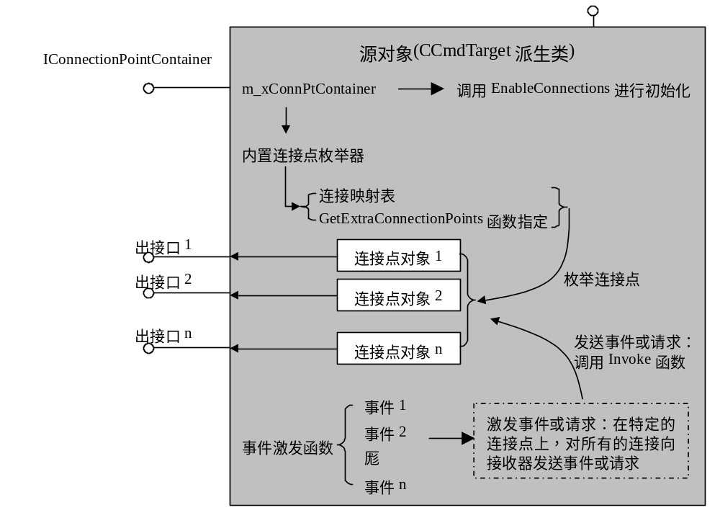
MFC对连接和事件的支持

Slide 43
用MFC实现源对象
创建工程——支持COM
定义出接口——编辑.odl文件
利用MFC宏加入连接点声明以及连接点对象的定义
在对象构造函数中调用EnableConnections();
在接口映射表中加入接口IConnectionPointContainer的表项，再加入连接映射表
定义连接点类的虚函数(至少为GetIID)
加入事件激发函数

Slide 44
用MFC在客户程序中实现接收器
初始化 —— AfxOleInit
定义出接口成员类
实现出接口成员类
创建源对象
建立连接和取消连接
完成可触发事件的动作

Slide 45
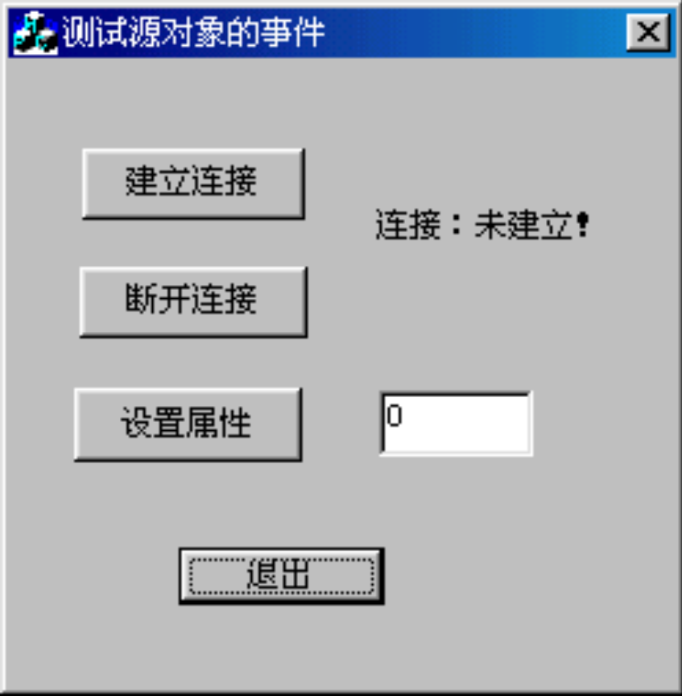
用MFC实现的例子

Slide 46
ATL介绍
ATL实现COM的机制完全不同于MFC
使用多继承技术实现多个接口
支持多线程
实现QueryInterface用到了特殊的技术
创建对象机制不同于以往的技术
优化

Slide 47
ATL概况
封装了一些数据类型
  CComBSTR、CComVariant、CComPtr，等
实现COM接口和COM对象
  接口映射表、对象映射表，等
窗口的支持
  CWindow、CWindowImpl、CDialogImpl，等
其他COM特征的支持
  永久性支持
  连接点支持
  集合对象和枚举器对象
  ActiveX control and container
  等

Slide 48
CComBSTR
封装了BSTR类型
提供了大量便利的字符串操作
  构造函数
  各种操作符以及一般的字符串操作
  对于流(stream)的支持
在需要BSTR的地方，都可以用CComBSTR来代替
注意owership

Slide 49
CComVariant
封装了VARIANT属性
提供了常用的操作
  构造函数
  各种操作符以及一般的管理操作
  对于流(stream)的支持
在需要VARIANT的地方，都可以用CComVARIANT来代替

Slide 50
CComPtr、CComQIPtr
Smart pointer
  template<class T> template<class T, const IID* piid = &__uuidof(T)>
  class CComPtr class CComQIPtr
  { {
  public: public:
  T* p; T* p;
  … ...
  }; };
优点：
  自动管理AddRef/Release
  在大多数情况下，可以当作接口指针来使用
注意：禁止调用“->Release”和“->AddRef”

Slide 51
CComDispatchDriver
封装了IDispatch接口
除了对接口指针的管理之外，有下面的功能：
  属性访问函数：
    GetIDOfName/ GetProperty/ PutProperty
    GetPropertyByName/ PutPropertyByName
  方法访问函数：
    by DISPID：Invoke0/Invoke1/Invoke2/InvokeN
    by Name：Invoke0/Invoke1/Invoke2/InvokeN
  两个静态函数：
    By DISPID：GetProperty/PutProperty

Slide 52
ATL的类层次
CComObjectRootBase
CComXxxThreadModel
IXxxImpl
CComObjectRootEx<TM>
IMyItf1
IMyItf2
CMyClass
CComObject<T>等

Slide 53
CComObjectRootBase
ObjectMain
static InternalQueryInterface
OuterAddRef/OuterRelease/OuterQueryInterface
InternalFinalConstructAddRef/
InternalFinalConstructRelease
其他一些静态函数
联合：
  union
  {
  long m_dwRef;
  IUnknown* m_pOuterUnknown;
  };

Slide 54
ATL对象的线程模型
用到了trait技术
通过编译时刻的类型提供just thread-safe enough
CComSingleThreadModel
CComMultiThreadModel
CComMultiThreadNoCS
提供了两个静态成员函数和三个typedef
  Increment、Decrement
  AutoCriticalSection、CriticalSection、ThreadModelNoCS

Slide 55
ATL对象实现引用计数
CComObjectRootEx
  InternalAddRef
  InternalRelease
  作用在匿名联合的m_dwRef成员上
CComObjectRootEx定义了一把锁
  锁的类型为AutoCriticalSection
  对锁的封装ObjectLock，wrapper
用于未被聚合的情况下

Slide 56
ATL对象实现QueryInterface
Table-driven QueryInterface
Interface Map
  BEGIN_COM_MAP(class)
  COM_INTERFACE_ENTRY(itf)
  END_COM_MAP
表中每一项
  struct _ATL_INTMAP_ENTRY {
  const IID* piid;
  DWORD dw;
  _ATL_CREATORARGFUNC *pFunc;
  };

Slide 57
ATL实现的接口类
IDispatchImpl
IPersistStreamInitImpl
IConnectionPointContainerImpl
举例：
  template<class T, const IID* piid, …> class IDispatchImpl : public T {…};
  template <class T> class IConnectionPointContainerImpl : public IConnectionPointContainer{...};
  class CMyObject :
  public IDispatchImpl<IMyDispInterface,&IID_IMyDispInterface,... >,
  public IConnectionPointContainerImpl< CMyObject >
  {…};

Slide 58
真正的ATL对象类
决定这个COM对象如何被分配，是否被聚合等
区别：
  线程模型是以每个类为基础的，per-class，可以封装到基类中
  对象的生命周期和身份标识是以每个对象实例为基础的，per-object，要延后到最终的派生类做出决定
CComObject类：
  template <class Base> CComObject : public Base {…};
  支持聚合：class CComAggObject;
  支持聚合： class CComPolyObject;
  template <class Base> CComObjectCached : public Base {…};
  template <class Base> CComObjectNoLock : public Base {…};
  template <class Base> CComObjectGlobal : public Base {…};
  template <class Base> CComObjectStack : public Base {…};

Slide 59
ATL对象的创建
两个步骤：
  使用CRT的构造器
  FinalConstruct
对应于FinalConstruct有FinalRelease
举例：
  CMyClassFactory::CreateInstance() {
  ……
  CComObject<CMyObject> *pObj = new CComObject<CMyObject>;
  …...
  pObj->InternalFinalConstructAddRef();
  HRESULT hr = FinalConstruct();
  pObj->InternalFinalConstructRelease();
  ……
  }

Slide 60
ATL Creators
每个creator类有一个静态CreateInstance函数：
  HRESULT WINAPI CreateInstance(void* pv, REFIID riid, LPVOID* ppv);
举例：
  template <class T> class CComCreator {
  public:
  static HRESULT WINAPI CreateInstance(void* pv, REFIID riid, LPVOID* ppv) {
  ……
  T *pObj = new T(pv);
  …...
  pObj->InternalFinalConstructAddRef();
  HRESULT hr = FinalConstruct();
  pObj->InternalFinalConstructRelease();
  ……
  hr = p->QueryInterface(riid, ppv);
  ……
  }
  };

Slide 61
ATL Creators(续)
其他的creator类有
  CComCreator2 —— 根据pv参数是否为null从两个对象类中择一
  CComFailCreator —— 假的创建类
在CMyObject类中定义一个类型_CreatorClass，例如
  typedef CComCreator<CComObject<CMyObject>> _CreatorClass;
CComCoClass定义：
  template<class T, const CLSID* pclsid = &CLSID_NULL>
  class CComCoClass {
  public:
  ……
  template<class Q> static HRESULT CreateInstance(IUnknown* punkOuter, Q** pp)
  { return T::_CreatorClass::CreateInstance(punkOuter, __uuidof(Q), (void **)pp); }
  ……
  };

Slide 62
聚合情况下对象结构图
CComObjectRootBase
CComXxxThreadModel
IXxxImpl
CComObjectRootEx<TM>
IMyItf1
IMyItf2
CMyClass
非委托IUnknown
IUnknown
CComContainedObject
CComAggObject
委托IUnknown

Slide 63
ATL中对象聚合的实现
template <class contained>
class CComAggObject :
public IUnknown,
public CComObjectRootEx< contained::_ThreadModel::ThreadModelNoCS >
{
public :
STDMETHOD_(ULONG, AddRef)() {…}
STDMETHOD_(ULONG, Release)() {…}
STDMETHOD(QueryInterface)(REFIID iid, void ** ppvObject){…}
……
CComContainedObject<contained> m_contained;
};
非委托IUnknown
委托IUnknown

Slide 64
ATL中对象聚合的实现(续)
template <class Base> //Base must be derived from CComObjectRoot
class CComContainedObject : public Base
{
public:
typedef Base _BaseClass;
CComContainedObject(void* pv) {m_pOuterUnknown = (IUnknown*)pv;}
STDMETHOD_(ULONG, AddRef)() {return OuterAddRef();}
STDMETHOD_(ULONG, Release)() {return OuterRelease();}
STDMETHOD(QueryInterface)(REFIID iid, void ** ppvObject)
{ …… // 调用 OuterQueryInterface(iid, ppvObject); }
……
IUnknown* GetControllingUnknown() { … }
};
// CComObjectRootBase基类中联合成员m_pOuterUnknown起作用

Slide 65
接口映射表项类型
COM_INTERFACE_ENTRY
COM_INTERFACE_ENTRY_IID(iid, x)
COM_INTERFACE_ENTRY2(x, x2)
COM_INTERFACE_ENTRY2_IID(iid, x, x2)
COM_INTERFACE_ENTRY_FUNC(iid, dw, func)
COM_INTERFACE_ENTRY_FUNC_BLIND(dw, func)
COM_INTERFACE_ENTRY_TEAR_OFF(iid, x)
COM_INTERFACE_ENTRY_CACHED_TEAR_OFF(iid, x, punk)
COM_INTERFACE_ENTRY_AGGREGATE(iid, punk)
COM_INTERFACE_ENTRY_AGGREGATE_BLIND(punk)
COM_INTERFACE_ENTRY_CHAIN(classname)

Slide 66
ATL Servers
功能
  Register and Unregister all class
  exposing class object
  managing server’s lifetime
ATL实现结构
  object map
  CComModule

Slide 67
Object Map
示例
  BEGIN_OBJECT_MAP(ObjectMap)
  OBJECT_ENTRY(CLSID_DictionaryObj, CDictionaryObj)
  OBJECT_ENTRY_NON_CREATEABLE(COtherObj)
  END_OBJECT_MAP()
宏定义：
  #define BEGIN_OBJECT_MAP(x) static _ATL_OBJMAP_ENTRY x[] = {
  #define END_OBJECT_MAP() {NULL, NULL, NULL, NULL, NULL, NULL, NULL, NULL}};

Slide 68
_ATL_OBJMAP_ENTRY定义
  struct _ATL_OBJMAP_ENTRY
  {
  const CLSID* pclsid;
  HRESULT (WINAPI *pfnUpdateRegistry)(BOOL bRegister);
  _ATL_CREATORFUNC* pfnGetClassObject;
  _ATL_CREATORFUNC* pfnCreateInstance;
  IUnknown* pCF;
  DWORD dwRegister;
  _ATL_DESCRIPTIONFUNC* pfnGetObjectDescription;
  _ATL_CATMAPFUNC* pfnGetCategoryMap;
  void (WINAPI *pfnObjectMain)(bool bStarting);
  };

Slide 69
OBJECT_ENTRY定义
#define OBJECT_ENTRY(clsid, class) {&clsid, class::UpdateRegistry, class::_ClassFactoryCreatorClass::CreateInstance, class::_CreatorClass::CreateInstance, NULL, 0, class::GetObjectDescription, class::GetCategoryMap, class::ObjectMain },
#define OBJECT_ENTRY_NON_CREATEABLE(class) {&CLSID_NULL, class::UpdateRegistry, NULL, NULL, NULL, 0, NULL, class::GetCategoryMap, class::ObjectMain },

Slide 70
类的注册
OBJECT_ENTRY中的class::UpdateRegistry项
  要求每个类都要提供UpdateRegistry成员
  宏：
    DECLARE_NO_REGISTRY()
    DECLARE_REGISTRY(class, pid, vpid, nid, flags)
    DECLARE_REGISTRY_RESOURCE(x)
    DECLARE_REGISTRY_RESOURCEID(x)
缺省生成的工程使用资源进行注册
  Registry Script File

Slide 71
类 厂
OBJECT_ENTRY宏包含：
  class::_ClassFactoryCreatorClass::CreateInstance
DECLARE_CLASSFACTORY_EX宏定义：
  #define DECLARE_CLASSFACTORY_EX(cf) \
  typedef CComCreator< CComObjectCached< cf > > \
  _ClassFactoryCreatorClass;
  #define DECLARE_CLASSFACTORY() \
  DECLARE_CLASSFACTORY_EX(CComClassFactory)
CComCoClass定义中包含
  DECLARE_CLASSFACTORY()

Slide 72
类实例的创建
OBJECT_ENTRY宏包含：
  class::_CreatorClass::CreateInstance
DECLARE_AGGREGATABLE(x)宏定义：
  #define DECLARE_AGGREGATABLE(x) public:\
  typedef CComCreator2< CComCreator< CComObject< x > >, \
  CComCreator< CComAggObject< x > > > _CreatorClass;
CComCoClass定义中包含
  DECLARE_AGGREGATABLE(T)

Slide 73
类厂与类实例的连接
类厂的初始化
  in-proc server，DllGetClassObject
  out-of-proc server，RegisterClassObject
把实例创建函数传递给类厂
  CComClassFactory类具有以下成员：
  _ATL_CREATORFUNC* m_pfnCreateInstance;
类厂的CreateInstance方法调用m_pfnCreateInstance

Slide 74
CComModule
全局变量
  ATL inproc server：CComModule _Module;
  ATL local server：CExeModule _Module;
  service-base server：CServiceModule _Module;
Init/Term函数
注册功能
提供全局锁功能

Slide 75
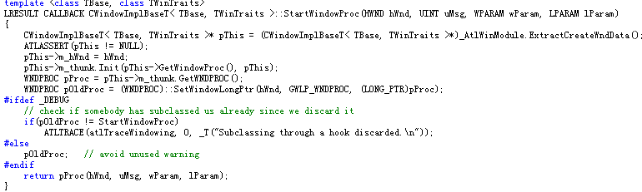
ATL实现窗口类的技术
第一次窗口过程为

Slide 76
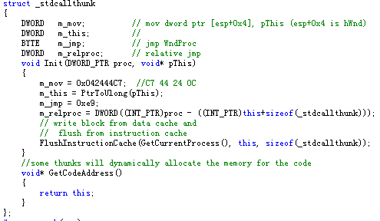
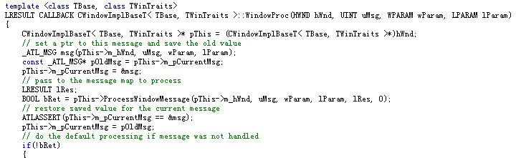
ATL窗口类

Slide 77
编译优化
ATL_NO_VTABLE
  阻止在构造/析构过程中调整vptr，由于纯虚基类的vtable引用只是被构造/析构函数访问，所以这会导致链接器优化掉纯虚函数的vptr
_ATL_MIN_CRT
  不链接标准C/C++运行库
_ATL_DLL
  动态链接atl.dll
_ATL_STATIC_REGISTRY
  静态链接组件注册功能

Slide 78
字典类的ATL对象
class CDictionary :
public CComObjectRootEx<CComSingleThreadModel>,
public CComCoClass<CDictionary, &CLSID_Dictionary>,
public IDictionary,
public ISpellCheck
{
public:
CDictionary() { }
DECLARE_REGISTRY_RESOURCEID(IDR_DICTIONARY)
DECLARE_PROTECT_FINAL_CONSTRUCT()
BEGIN_COM_MAP(CDictionary)
COM_INTERFACE_ENTRY(IDictionary)
COM_INTERFACE_ENTRY(ISpellCheck)
END_COM_MAP()

Slide 79
字典类的ATL对象(续)
public:
// IDictionary
STDMETHOD_(BOOL, Initialize)();
STDMETHOD_(BOOL, LoadLibrary)(LPOLESTR);
STDMETHOD_(BOOL, InsertWord)(LPOLESTR, LPOLESTR);
STDMETHOD_(void, DeleteWord)( LPOLESTR);
STDMETHOD_(BOOL, LookupWord)(LPOLESTR, LPOLESTR *);
STDMETHOD_(BOOL, RestoreLibrary)(LPOLESTR);
STDMETHOD_(void, FreeLibrary)();
// ISpellCheck
STDMETHOD_(BOOL, CheckWord)(LPOLESTR, LPOLESTR *);
private:
……
};

Slide 80
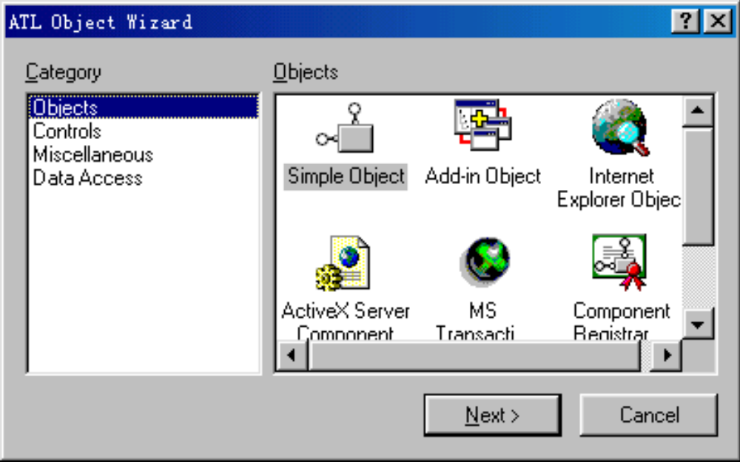
通过 ATL Object Wizard创建对象

Slide 81
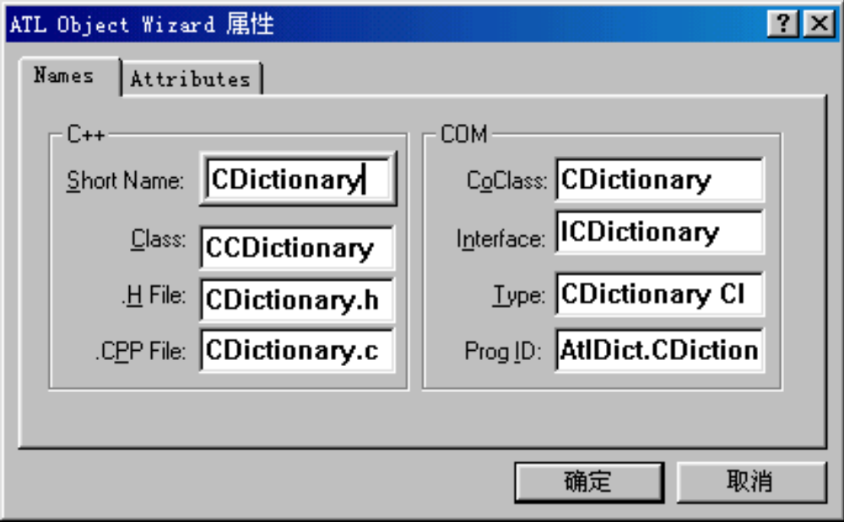
通过 ATL Object Wizard设置对象名字

Slide 82
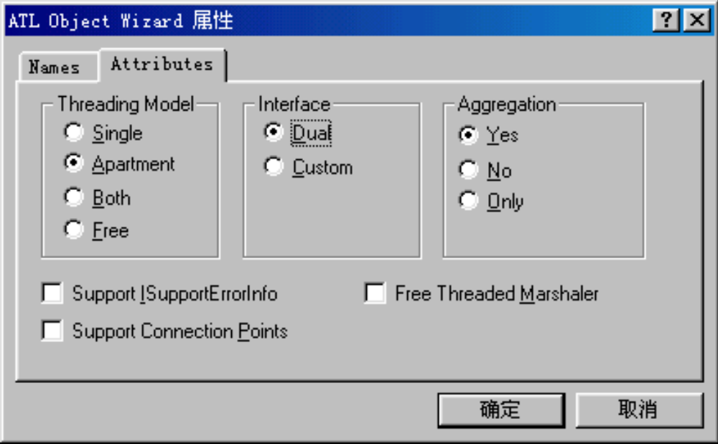
通过 ATL Object Wizard设置对象属性

Slide 83
ATL实现可连接对象
在IDL中
  定义一个用作出接口的automation接口
  在coclass中加入出接口，含source属性
增加IConnectionPointContainer接口
  在基类列表中增加
  IConnectionPointConntainerImpl<CMyClass>
  在COM MAP中加入
  COM_INTERFACE_ENTRY(IConnectionPointConntainer)

Slide 84
模板类IConnectionPointImpl
CMyClass继承IConnectionPointImpl一次或多次
  IConnectionPointImpl实现了独立的引用计数
  用法：在基类列表中增加
  IConnectionPointImpl<CMyClass, &DIID__IEventSet>
加入connection point map，如下
  BEGIN_CONNECTION_POINT_MAP(CMyClass)
  CONNECTION_POINT_ENTRY(DIID__IEventSet)
  END_CONNECTION_POINT_MAP()

Slide 85
激发事件辅助函数
手工激发事件
  IConnectionPointImpl包含一个m_vec成员，内含所有已经建立的接收器连接
  遍历m_vec数组，逐一调用Invoke函数
利用VC IDE提供的源码产生工具
  ATL连接点代理生成器，启动对话框Implement Connection Point
  产生名为CProxy_<SinkInterfaceName>的模板类
    例如CProxy_IEventSet，它从IConnectionPointImpl派生
    对于每一个事件或者请求，都有一个对应的Fire_Xxx成员函数
  用模板类代替IConnectionPointImpl基类

Slide 86
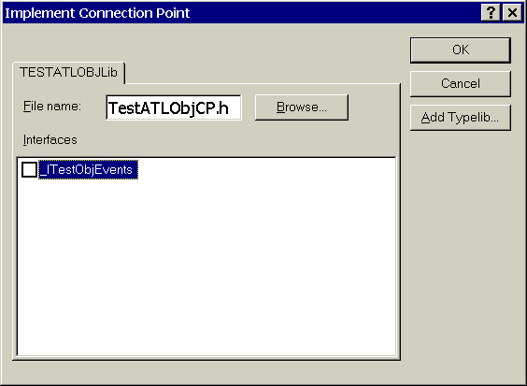
Implement Connection Point对话框
创建对象时选择Connection Point
ClassView中，在对象类上右键点击选择此项功能

Slide 87
ATL实现连接点：最后的工作
在需要激发事件的地方
  调用CProxy_<Xxxx>提供的辅助函数
增加对IProvideClassInfo2接口的支持
  需要typelib的支持
  加入基类IProvideClassInfo2Impl
  在COM MAP中加入：
  COM_INTERFACE_ENTRY(IProvideClassInfo2)
  COM_INTERFACE_ENTRY(IProvideClassInfo)

Slide 88
ATL实现接收器sink
IDispEventSimpleImpl
  轻量，不需要typelib的支持
IDispEventImpl
  需要typelib的支持
Event Sink Map
  BEGIN_SINK_MAP(CMyCLass)
  SINK_ENTRY_EX(...) // 适合用于non-UI object
  SINK_ENTRY(...) // 适合用于UI object
  END_SINK_MAP

Slide 89
ATL：建立sink和source之间的连接
IDispEventSimpleImpl成员
  DispEventAdvise
  DispEventUnadvise
AtlAdviseSinkMap
  建立sink与source缺省源接口的连接

