Slide 1

软件设计模式(一)
潘爱民
2003-12-12
http://www.icst.pku.edu.cn/CompCourse2003/

Slide 2
Why Patterns?
Notes:
每一个库或者软件都有自己独特的地方, 有自己优劣的地方, 不能因为劣而看轻了这些技术,而要客观地看待这些成果,它们有其自己的背景,有其自己的用途,那么,沉淀下来的是什么呢? 这就是patterns，这是值得我们学习和研究的

Slide 3
内容
从一个例子看模式
关于模式的研究情况
介绍一些重要的模式(部分)
第三次作业

Slide 4
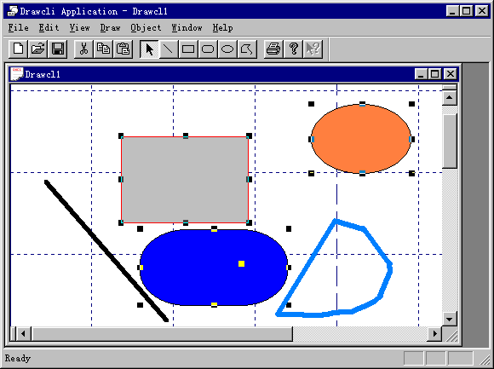
一个设计例子
VC/Samples/MFC/OLE/DrawCli

Slide 5
DrawCli的基础
MFC提供的基础
  Doc/View结构
    Doc提供了强大的数据管理功能
    View提供了强大的显示功能
    splitwnd功能
  CWinApp/CMainFrame
    提供了一套命令处理流程
  对OLE的封装
    Active Container
    OLE Clipboard
    Property Page
  数据结构管理功能
    CObject/CObList

Slide 6
我们的设计焦点
用C++对象来表示每一个图元
  定义图元的公共接口
如何处理用户的操作
  鼠标的动作
图元对象的创建和管理

Slide 7
图元基类
class CDrawObj : public CObject
{
// Attributes
CDrawDoc* m_pDocument; // owner
virtual int GetHandleCount();
virtual CPoint GetHandle(int nHandle);
virtual HCURSOR GetHandleCursor(int nHandle);
virtual void SetLineColor(COLORREF color);
virtual void SetFillColor(COLORREF color);
// Operations
virtual void Draw(CDC* pDC);
virtual void DrawTracker(CDC* pDC, TrackerState state);
virtual void MoveTo(const CRect& positon, CDrawView* pView = NULL);
virtual int HitTest(CPoint point, CDrawView* pView, BOOL bSelected);
virtual BOOL Intersects(const CRect& rect);
virtual void MoveHandleTo(int nHandle, CPoint point, CDrawView* pView = NULL);
virtual void OnOpen(CDrawView* pView);
virtual void OnEditProperties();
virtual CDrawObj* Clone(CDrawDoc* pDoc = NULL);
virtual void Remove();
virtual void Serialize(CArchive& ar);
// ……
};

Slide 8
图元层次结构
CDrawObj
CDrawRect
CDrawPoly
CDrawOleObj
……
CDrawObj
CDrawRect
CDrawPoly
CDrawOleObj
……

Slide 9
图元的创建
永久支持：
  CDocument::Serialize->CObList::Serialize
  ->CObject::Serialize
CDrawObj::Clone
DrawTool：创建图元对象

Slide 10
交互操作
键盘和菜单命令
  MFC内部机制
鼠标操作
  在CDrawView的鼠标处理函数中处理
  工具箱：工具链，有一个当前活动工具
  转交给当前活动工具来处理

Slide 11
工具箱和CDrawTool
class CDrawTool
{
// Constructors
public:
CDrawTool(DrawShape nDrawShape);
// Overridables
virtual void OnLButtonDown(CDrawView* pView, UINT nFlags, const CPoint& point);
virtual void OnLButtonDblClk(CDrawView* pView, UINT nFlags, const CPoint& point);
virtual void OnLButtonUp(CDrawView* pView, UINT nFlags, const CPoint& point);
virtual void OnMouseMove(CDrawView* pView, UINT nFlags, const CPoint& point);
virtual void OnEditProperties(CDrawView* pView);
virtual void OnCancel();
// Attributes
DrawShape m_drawShape;
static CDrawTool* FindTool(DrawShape drawShape);
static CPtrList c_tools;
static DrawShape c_drawShape;
// ……
};

Slide 12
DrawTool层次结构
CDrawTool
CSelectTool
CRectTool
CPolyTool
……
CDrawTool
CSelectTool
CRectTool
CPolyTool
……

Slide 13
例子中的模式
CDrawObj和CDrawTool合起来构成了Factory Method模式
CDrawTool::Clone用到了原型创建模式
每一个CDrawTool都是一个singleton
Adapter模式：把OLE对象封装成CDrawObj
* 可以增加Composite模式
facade模式：通过CDrawDoc/View与MFC通信
chain of responsibility：如鼠标处理工作
* 用Command模式增加undo/redo功能

Slide 14
patterns
定义：
  A physical arrangement of elements
  Repeating;with some degree of correspondence in successive trials or observations
  典范、范例，事物的标准样式
  In the book “Design Patterns”, the design patterns are descriptions of communicating objects and classes that are customized to solve a general design problem in a particular context
  Design patterns represent solutions to problems that arise when developing software within a particular context
几个近义词
  idiom、technique、paradigm
Notes:
前三个定义来自字典

Slide 15
About patterns
About patterns
  Documentation of expert software engineers' "behavior"
  Documentation of specific reoccurring problems (and solutions)
  Abstraction of common design occurrences
Properties of design patterns
  A pattern addresses a recurring design problem that arises in specific design situations, and presents a solution to it.
  Patterns document existing, well-proven design experience.
  Patterns provide a common vocabulary and understanding for design principles.
  Patterns are a means of documenting software architectures.
  Patterns support the construction of software with define properties.
  Patterns help you to manage software complexity.

Slide 16
pattern与framework
frameworks支持细节设计和代码的重用
  framework是一组组件的综合，这些组件相互协作，为一族相关应用提供了一个可重用的框架结构
  例如：MMC、MS Script Engine
Patterns支持软件结构和设计的重用
  抓住了特定领域中问题的成功解决方案中的静态、动态结构和相互之间的协作关系
    Patterns capture the static and dynamic structure and collaboration among key participants in software designs
  patterns与开发语言无关，但是建立在一定的环境基础上
  例如：经典的MVC、Factory Method
两者结合起来， design patterns and frameworks有助于提高软件的质量
  比如：重用性，扩展性，性能，可维护性

Slide 17
Design pattern与framework(续)
a framework supplies the infrastructure and mechanisms that execute a policy for interaction between abstract components with open implementations.
frameworks are often said to abide by the Hollywood Principle ("Don't call us, we'll call you.")
比较：
  Design patterns are more abstract than frameworks
  Design patterns are smaller architectural elements than frameworks
  Design patterns are less specialized than frameworks
framework与class library(toolkit)

Slide 18
Pattern的研究情况
关于pattern研究的历史
  A Pattern Language，Christopher Alexander，1977
  “Advanced C++：Programming Styles and Idioms”，James Coplien，1992
  “Design Patterns: Elements of Reusable Object-Oriented Software”，GOF，1995
  “Pattern-Oriented Software Architecture: A System of Patterns” (简称为“POSA”) ，GoV，1996
  …...

Slide 19
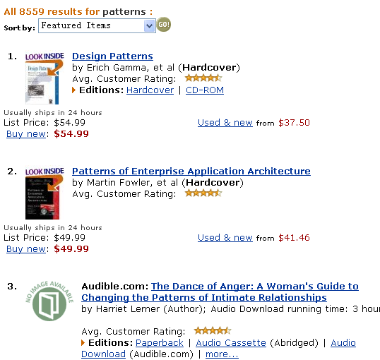
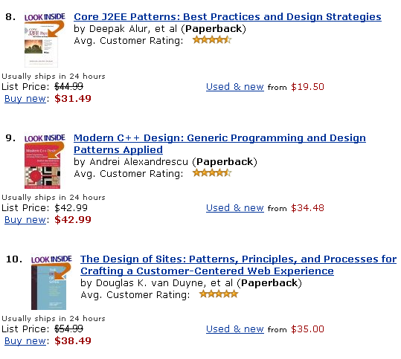
Pattern is a hot topic
在amazon上查找包含patterns的书(2002.12.12)

Slide 20
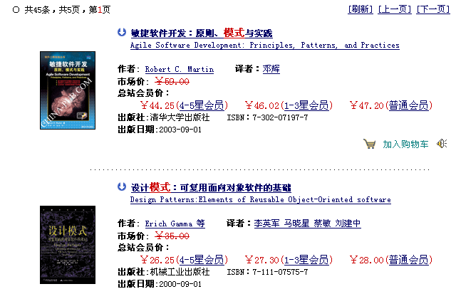
Pattern is a hot topic
在china-pub.com上查找包含“模式”的图书(2003.12.12)

Slide 21
Pattern的研究现状
pattern与Java
pattern与CORBA
pattern与系统结构
pattern与generic programming结合
Anti-pattern
其他(例如UML等)

Slide 22
POSA中的模式分类
Architectural Patterns
  表达了软件系统的基本结构组织形式或者结构方案
  它包含一组预定义的子系统，规定了这些子系统的责任，同时还提供了用于组织和管理这些子系统的规则和向导
Design Patterns
  为软件系统的子系统、组件或者组件之间的关系提供一个精炼之后的解决方案
  它描述了在特定环境下，用于解决通用软件设计问题的组件以及这些组件相互通信时的可重现结构
Idioms
  是一个与编程语言相关的低级模式
  它描述了如何实现组件的某些功能，或者利用编程语言的特性来实现组件内部要素之间的通信功能

Slide 23
POSA: Architectural Patterns(1)
Architectural Patterns are very high-level structural patterns.
Also called “Conceptual Patterns ”
From Mud to Structure: Organize components.
  Layers: Organize components into layers where layer i's services are only used by layer i+1.
  Pipes and Filters: Divide the task into several sequential processing steps -- the output of task i is the input of task i+1.
  Blackboard: Several independent programs work cooperatively on a common data structure.
Distributed Systems :Handle distributed computation.
  Broker: Introduce a broker component to to achieve better decoupling of clients and servers -- brokers accept requests from clients and forward the requests to servers, then return the results back to the clients.

Slide 24
POSA: Architectural Patterns(2)
Interactive Systems: Keep a program's functional core independent of the user interface
  Model - View - Controller: Divides the application into processing, output, and input. View and controller parts are usually observers of the model via the observer pattern
  Presentation - Abstract - Control: Divides the application up to heirarchies or MVC-like components. Each component is dependent upon and provides functionality for the a higher-level component. There is only one top-level component
Adaptable Systems : Design for change
  Microkernel Encapsulate the fundamental services of the application
  Reflection Divide the application into a meta-level and a base level to make the application "self-aware". The meta level encapsulates knowledge of the system; the base level encapsulates knowledge about the problem domain

Slide 25
POSA: Design Patterns(1)
Structure Decomposition: Decompose subsystems and complex components into cooperating parts.
  Whole - Part: Define a component that encapsulates smaller objects. Prevent clients from directly accessing the contained objects, but provide an interface for the aggregate.
Organization of Work : Components collaborate to solve complex problems.
  Master - Slave The master divides a task among identical (but independent) slaves, the combines the slave's partial results to arrive a solution.
Access Control : Guard and control access to services and components.
  Proxy: Clients communicate with a representative (proxy) rather than the target object itself. The proxy can perform pre- and post-processing to provide validation checking, access control, remote object access, extra computation, etc. See also Gamma et al's proxy pattern

Slide 26
POSA: Design Patterns(2)
Management: Handle homogenous collections of objects, services and components in their entirety.
  Command Processor: Extends Gamma et al's command pattern by adding an explicit command processor
  View Handler: Separate the the management of views from the code required to present or control specific views. Similar to Gamma et al's Abstract Factory and Mediator.
Communication :Organize communication between components.
  Forward - Receiver: Contain all system-specific communication functionality in separate components so distributed peers can communicate without loosing portability
  Client - Dispatcher - Server: A dispatcher acts as an intermediate layer between clients and servers. The dispatcher provides the communication channel and a name service to hide physical locations.
  Publisher - Subscriber: Same as Gamma et al's Observer pattern.

Slide 27
Idioms
Also called “Programming Patterns”
Idioms are low-level patterns specific to a programming language.
  Counted Pointer: Simplifies memory management of shared objects providing reference counting.
其他
  Virtual constructor
  smart pointer
  handle/body

Slide 28
关于“Design Pattern”
对已有模式的整理、分类
一套描述模式的词汇，可用于交流和文档化
为软件设计总结了宝贵的经验，这些设计经验可以被重用，但不是简单的代码重用
分类：
  Creational Patterns
  Structural Patterns
  Behavioral Patterns
在软件设计模式领域，起到先驱的作用

Slide 29
重提：指导模式设计的三个概念
重用(reuse)：是目标
  两种重要的重用手段
    Inheritance & composition
接口与实现分离
  接口保持不变，分离带来灵活性
  多态性(polymorphism)
Decouple
  降低复杂性

Slide 30
如何描述一个模式
关键要素
  Design pattern name，Aliases or Also Known As
  Problem，Intent or Goal
  Constraints, Motivation
  Context， Applicability
  Solution
    Structure
    Participants
    Collaboration
    Implementation
  Evaluation，Resulting Context，Consequences
  Related Patterns
  Examples，Known uses

Slide 31
creational patterns
Abstract Factory(kit)
Builder
Factory Method(virtual constructor)
Prototype
Singleton
* Finder

Slide 32
模式 1：Factory Method (一)
Aliases：virtual constructor
Intent
  Define an interface for creating an object, but let subclasses decide which class to instantiate. Factory Method lets a class defer instantiation to subclasses.
Motivation
  Frameworks use abstract classes to define and maintain relationships between objects. A framework is often responsible for creating these objects as well.

Slide 33
Factory Method模式(二)
Applicability：Use the Factory Method pattern when
  a class can't anticipate the class of objects it must create.
  a class wants its subclasses to specify the objects it creates.
  classes delegate responsibility to one of several helper subclasses, and you want to localize the knowledge of which helper subclass is the delegate.

Slide 34
插：virtual constructor
intent：
  在一个类层次中，客户在runtime要创建一个对象，对象的子类型未确定，根据客户的需要和环境情况，确定对象的类型
problem：
  只知道对象的一般类型，不知道确切类型(需要从环境中获取类型信息)
Forces ：
  隐藏对象的类型层次，只发布基接口
  如何确定最合适的派生类
  客户必须有办法使用派生类的服务

Slide 35
插：virtual constructor(续)
solution：
  使用Envelope/Letter或者Handle/Body pattern
  由envelope或者handle根据环境信息选择适当的派生类型
例子：
  1 根据stream动态创建对象
  2 COM对象

Slide 36
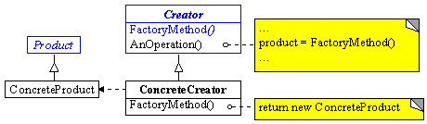
Factory Method模式(三)
struct
Participants
  Product、ConcreteProduct、Creator、ConcreteCreator
Collaborations

Slide 37
Factory Method模式(四)
Evaluation
  多态性：客户代码可以做到与特定应用无关，适用于任何实体类
  缺点：需要Creator和相应的子类作为factory method的载体，如果应用模型确实需要creator和子类存在，则很好；否则的话，需要增加一个类层次
  优点：
    (1) Provides hooks for subclasses。基类为factory method提供缺省实现，子类可以重写新的实现，也可以继承父类的实现。
    体现了：加一层间接性，增加了灵活性
    (2) Connects parallel class hierarchies

Slide 38
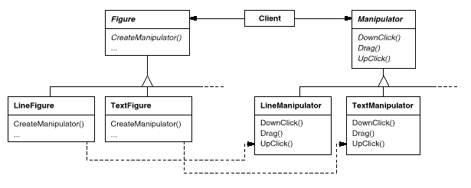
Factory Method模式(五)
Connects parallel class hierarchies

Slide 39
Factory Method模式(六)
Implementation
  (1) 父类是否提供缺省的实现
  (2) factory method的参数
  (3) Language-specific variants and issues
    SmallTalk，使用类型
    C++，使用lazy initialization技术
  (4) Using templates to avoid subclassing

Slide 40
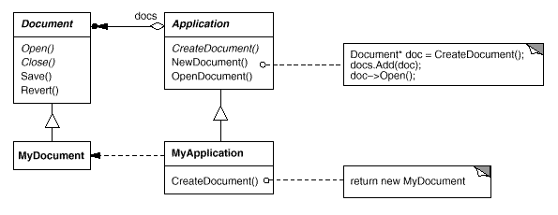
Factory Method模式(七)
Related Patterns
  Abstract factory
  Prototype
Examples

Slide 41
模式 2 ：Abstract Factory(一)
Aliases：Kit
Intent
  Provide an interface for creating families of related or dependent objects without specifying their concrete classes.
Motivation
  为了解决一族相关或者相依对象的创建工作，专门定义一个用于创建这些对象的接口(基类)。客户只需与这个基接口打交道，不必考虑实体类的类型。

Slide 42
Abstract Factory(二)
Applicability，Use the Abstract Factory pattern when
  a system should be independent of how its products are created, composed, and represented.
  a system should be configured with one of multiple families of products.
  a family of related product objects is designed to be used together, and you need to enforce this constraint.
  you want to provide a class library of products, and you want to reveal just their interfaces, not their implementations.

Slide 43
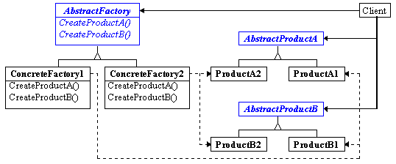
Abstract Factory(三)
Struct
Participants：
  Client、AbstractFactory、ConcreteFactory、AbstractProduct、ConcreteProduct
Collaborations

Slide 44

Abstract Factory(四)
Evaluation
  与factory method的关系
    多个factory method合在一起
    factory method一定是virtual的

Slide 45
Abstract Factory(五)
Evaluation(续)
  优点：
    factory把product的类型封装起来，分离了具体的类
    易于变换product族
    保证不同族之间的product相互不会碰撞，即保证products的一致性
  缺点：
    factory对象的方法数目对应product数目，增加新的product种类比较困难，要影响到factory的基类，进而影响到所有的子类

Slide 46
Abstract Factory(六)
Implementation
  Factories as singletons, 每个product族往往只需要一个factory对象就可以了
  Creating the products, 对于product族比较多的情况，可以使用prototype模式来实现这些factories，而不必对于每一个具有细微差别的product族都使用一个concrete factory class
  Defining extensible factories，针对Evaluation中提到的缺点，通过参数化技术提高factory的适应能力和扩展性
    问题在于，返回给客户什么样的类型？

Slide 47
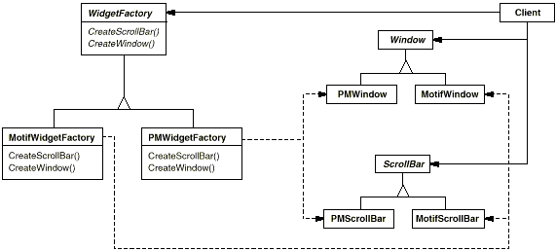
Abstract Factory(七)
Related Patterns
  Factory Method、Prototype 、Singleton
Examples
  WidgetFactory

Slide 48
插：COM中的class factory
兼有两种模式：factory method和abstract factory
  IClassFactory是abstract factory的接口
  CreateInstance是factory method
  对于每一个coclass，class object就是Concrete Factory，
  每一个产品的抽象接口为IUnknown，COM对象是真正的concrete product
  IPSFactoryBuffer也是abstract factory的接口
通过factory method创建对象
  比客户直接创建对象，要灵活
  ConcreteFactory也是一个concrete product，所以可以重用底层的许多机制，如套间机制、跨进程机制等

Slide 49
模式三：Builder (一)
Intent
  Separate the construction of a complex object from its representation so that the same construction process can create different representations
Motivation
  在复杂对象的构造过程中，允许同样的构造过程能够加入新的被构造元素
  “结构化构造过程”
Applicability, Use the Builder pattern when
  the algorithm for creating a complex object should be independent of the parts that make up the object and how they're assembled.
  the construction process must allow different representations for the object that's constructed.

Slide 50
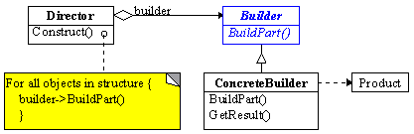
Builder (二)
Structure
Participants
  Director、 Builder、ConcreteBuilder、 Product

Slide 51
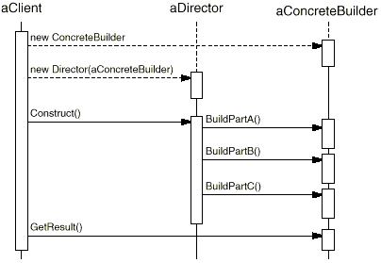
Builder (三)
Collaborations

Slide 52
Builder (四)
Evaluation
  It lets you vary a product's internal representation
  It isolates code for construction and representation
  It gives you finer control over the construction process
Implementation
  Builder interface(Assembly and construction)
  Why no abstract class for products?
  Empty methods as default in Builder.
Related patterns
  Abstract Factory
    区别：(1) builder重在构造过程，最后一步返回结果;
    (2) builder构造复杂对象

Slide 53
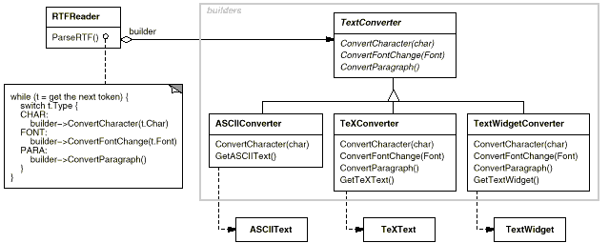
Builder (五)
Examples
  readers、parsers、converters
  the persistence of OLE documents

Slide 54
模式四：Prototype(一)
Intent
  Specify the kinds of objects to create using a prototypical instance, and create new objects by copying this prototype.
Motivation
  以一个已有的对象作为原型，通过它来创建新的对象。在增加新的对象的时候，新对象的细节创建工作由自己来负责，从而使新对象的创建过程与框架隔离开来
Applicability
  当产品的创建过程要独立于系统时
  当产品的类型是在runtime被指定的情况下
  避免创建一个与product层次平行的factory层次时

Slide 55
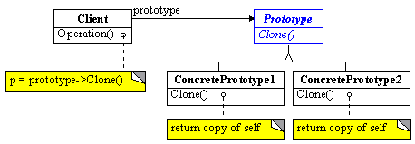
Prototype(二)
Structure
Participants
  Prototype、ConcretePrototype、Client
Collaborations

Slide 56
Prototype(三)
Evaluation
  Adding and removing products at run-time
  Specifying new objects by varying values，降低系统中类的数目
  Configuring an application with classes dynamically
  要求：每一个product类都必须实现Clone操作
  对于C++语言特别有意义：C++的class不是first-class objects
Implementation
  Using a prototype manager
  Implementing the Clone operation
    shallow copy versus deep copy
    Save & Load
  Initializing clones
    两阶段构造

Slide 57
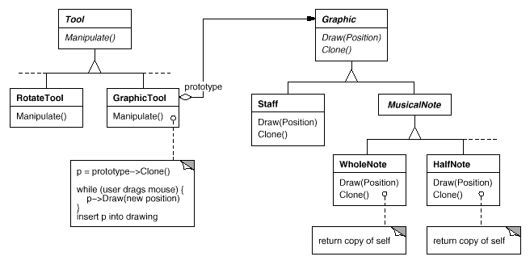
Prototype(四)
Related patterns
  Prototype与Abstract Factory往往是相互竞争的
  factory method
Examples
  DrawCli，music editor

Slide 58
模式五：Singleton(一)
Intent
  Ensure a class only has one instance, and provide a global point of access to it.
Motivation
  It's important for some classes to have exactly one instance.
  Instance-controlled class
Applicability, Use the Singleton pattern when
  there must be exactly one instance of a class, and it must be accessible to clients from a well-known access point.
  when the sole instance should be extensible by subclassing, and clients should be able to use an extended instance without modifying their code.

Slide 59
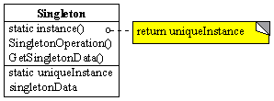
Singleton(二)
Structure
Participants
  Singleton
Collaborations
  Clients access a Singleton instance solely through Singleton's Instance operation.

Slide 60
Singleton(三)
Evaluation
  Controlled access to sole instance
  Reduced name space
  Permits refinement of operations and representation，允许子类化
  Permits a variable number of instances
  More flexible than class operations (static member functions in C++ )
  这种思想比较适用于Object-Based中的许多情形
Implementation
  Ensuring a unique instance
    考虑使用lazy initialize
    使用global/static object的缺点
      静态对象不能保证只有一个实例
      在对象初始化的时候未必有足够的信息
      C++没有定义全局对象的构造函数的调用顺序
  Subclassing the Singleton class

Slide 61
Singleton(四)
Related patterns
  Singleton与其他创建型模式并不矛盾，可以用singleton来实现其他模式中的对象。包括Abstract Factory、Builder、Prototype等。
  多个实例对于构造过程往往并无意义，所以在许多情况下singleton模式比较符合应用背景
Examples
  MFC中的CWinApp派生类实例theApp
  ……

Slide 62
增加模式六：Finder(一)
Intent
  利用环境信息，根据客户的请求，找到已有的、符合要求的对象，返回给客户
Alias
  Object-retriever
Motivation
  在有些情况下，客户希望连接到一个对象上，它提供一些状态标识信息，由Finder返回已经被创建的对象，或者重新创建新的对象(如果当前不存在满足条件的对象)
Applicability, Use the Finder pattern when
  当需要在软件不同部分之间建立Client/Object连接时
  把获取对象的过程隐藏起来
  view finder：The application demands user customizability of the actions taken when a particular file format is encountered in the browser.

Slide 63
Finder(二)
Structure
Participants
  client、finder、product-table、constructor、product
Collaborations
Finder
GetObject
table
Lookup
client
product
create
product
constructor
product

Slide 64
Finder(三)
Evaluation
  避免同样的对象被实例化两次，从而提高资源利用率，避免发生资源竞争
  把连接对象的过程与客户隔离开
  带来的问题：多个客户共享同样的资源，如何有效管理对象的所有权？
Implementation
  实现product table以及相应的管理设施，保证查找过程的有效性
  每一个product的生命周期管理
  如何标识product的类型，客户如何多态地提供状态标识信息
  Finder对象本身可以是一个singleton

Slide 65
Finder(四)
Related patterns
  与Singleton的区别：singleton是一个类的单个实例；而Finder是避免相同的对象(通常是类型和状态信息都相同)被创建两次。
  与Prototype的区别
  在创建product子步骤中，需要与其他创建型模式结合使用
Examples
  moniker in COM
  在Netscape浏览器中，根据MIME类型，找到插件，然后创建view

Slide 66
第三次作业
写出你认为理解最深刻的一个pattern，
可以是你自己学习、工作中体会出来的，
也可以是书上已经总结好的。
请使用给定的pattern格式书写作业！

