Slide 1
OS Research Trends and Elastos Overview
Koretide Corp., Shanghai
Rong Chen
3/2/2005

Slide 2
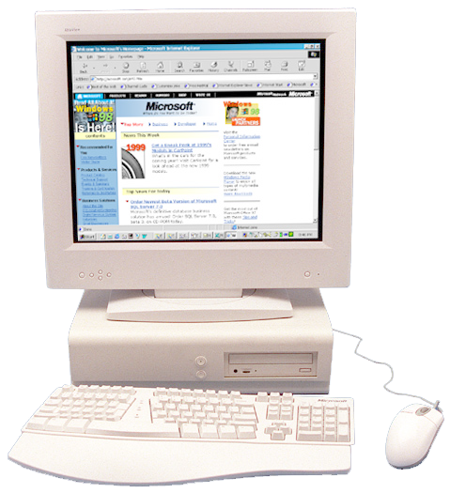
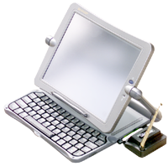
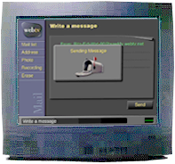
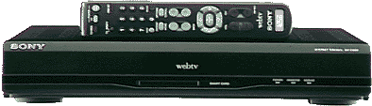
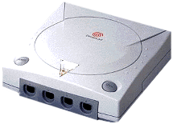
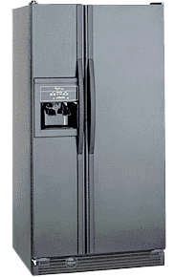


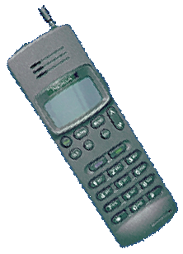
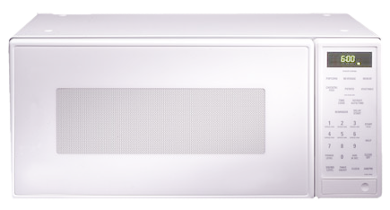
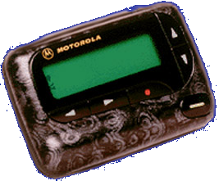
Opportunities and Challenges
Building the next generation OS
Start afresh
Device as WEB Service
Complements JAVA, C#
State of art & industry standard
PC
Web Services
Web Appliances
Smart Devices

Slide 3
3rd Generation Internet
Focus: WEB Services
  Transparent information sharing
  Transparent device inter-operations
Big Movers:
  Microsoft: .NET
  SUN: JAVA
  IBM, HP, Oracle
Core Technologies：
  Platform for information exchange
  Platform for device plug and play
  Platform for software manufacturing
WEB Service Standards: XML, SOAP, UDDI, etc.

Slide 4
Operating System: a Relative Concept
OS：between hardware and applications
  Controls hardware resources and devices
  Dictates how applications are executed
Fundamental：sustains software infrastructure
Powerful: provide user experience
Critical: guarantees data safety and security
Multimedia
ERP
Database
WEB Browser
email
Office
software
Operating System
CPU
Memory
Devices
Motherboard

Slide 5
Evolutions of Operating Systems
Windows 3.1
Windows 2000
DOS
.NET
Longhorn
Windows 2000

Slide 6
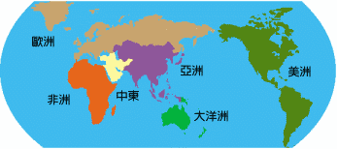
On Demand Computing (Pan URL)
URL based binary executables
No software installation required
Incrementally download what is necessary
code
data
computer
code
data
computer
code
data
code
data
Browser Model
(URL address HTML data)
Elastos Model
(URL address code & data)

Slide 7
Internet Storage Hierarchy
Internet Computer
Computer Architectures
  Stand-alone Computer
  Internet Computer (Grids)
Programming Paradigm
  Independent of Connection Technology
  Must be TCP/IP free
Stand-alone Computer
Registers
North Bridge, South Bridge…
Memory
IDE, SCSI, PCI…
Hard Disk
TCP/IP, NETBIOS, HTTP…
Internet Storage

Slide 8
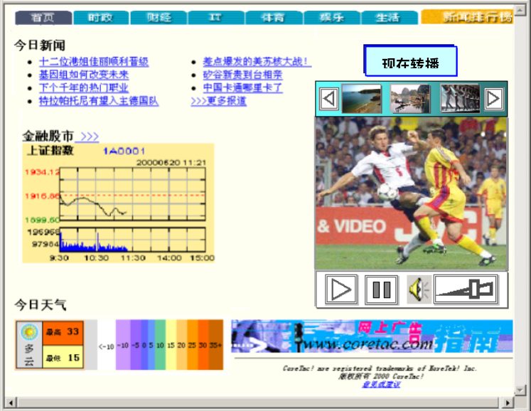
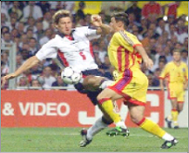
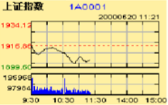
Platform for Secure Executions
Programmable secure native execution environment
Customized by operation providers
Digital signatures and sandboxing
Domain C
Domain B
Domain A

Slide 9


Platform for Secure Executions (2)

Slide 10






Platform for Information Exchange
Satellite
Microwave
… …
Copper wire
Phone Co. A
Phone Co. B
Under-sea cable
Telephone exchange：
  Provide switching service
  Users don’t care media involved
  Users unaware of surveillance, encryption, roaming, etc.
Information exchange：
  Provide alternative protocols
  Users focus only on their code
  Transparent encryption, load- balancing, transactions
Comparisons

Slide 11
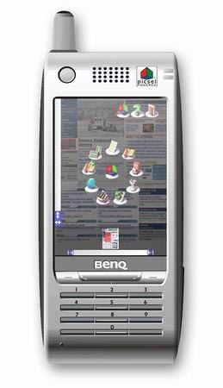
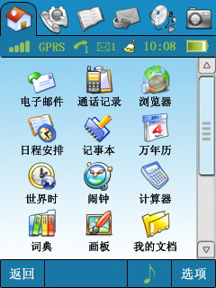
XML Based Graphics User Interface
Superset of HTML 4.01, extending tags include Button, Icon, etc.
Dynamically bind to user defined native executable modules
Bypassing scripting languages, such as JAVA scripts

Slide 12
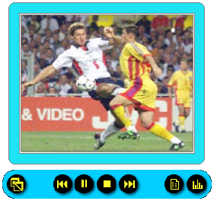
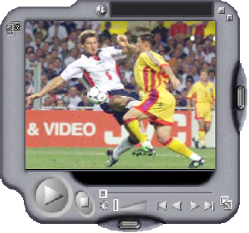
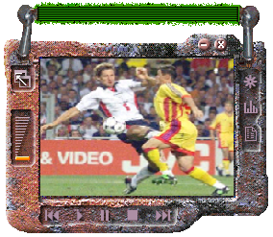
Components Plug and Play
Swappable
Dynamic
Seamless
Components are swapped dynamically at run-time

Slide 13

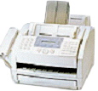



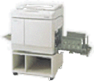
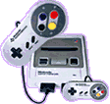
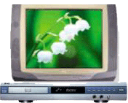

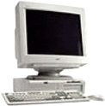
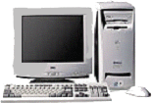



Platform for Device Plug and Play
Office
Home
Public
True plug and play
Devices are self-describing
No awareness of device drivers

Slide 14
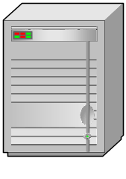
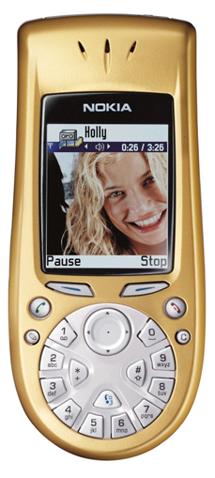

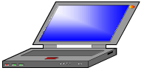
Operation & Server Paradigm
Terminal to server
Peer to peer

Slide 15
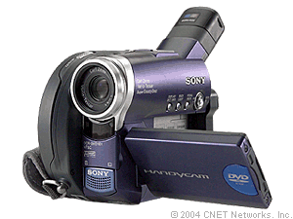
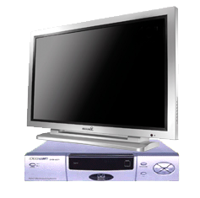
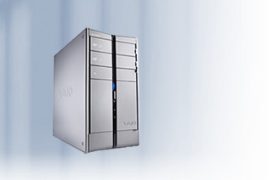
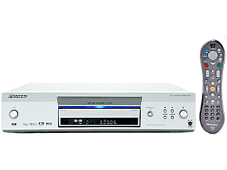
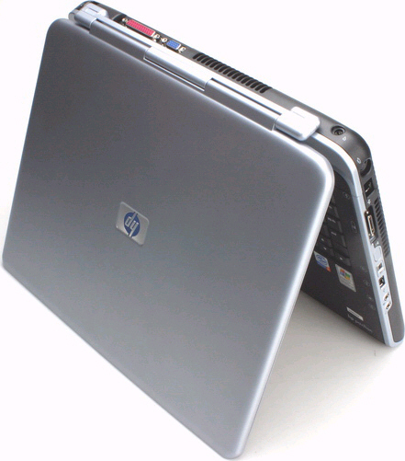
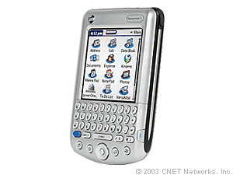
Pervasive & P2P Computing

Slide 16
Technology Trends
Application development
Operating System
Programming Paradigm
Comparing with major players
Stand-alone APPs
WEB Services
Desktop/Server
(MS Windows)
Grid Computing
(Microsoft .Net)
Object-oriented
Middleware
Sun Java &
Microsoft .Net
Elastos
Language
CAR API
Going in the same direction but with complementary technology
Comp. Library
CAR Library
VM
Elastos OS

Slide 17
Elastos:Internet OS for Embedded
An embedded real time OS
  Programmable secure native execution environment
  Transparent marshaling between execution environments
CAR (Component Assembly Runtime) technology
  Use URL to address code, data, Web pages and everything
  Trinity of language, components and machine
  Interop with .NET, JAVA via XML and SOAP
XML based browser and GUI shell
Cross development SDK on Win2000/XP
CAR binaries run on both Elastos and Win2000/XP

Slide 18
Visions: No Software for Consumers
Express key concepts of JAVA in C++
  Implementing metadata engine
  Avoiding byte-code
Merge Metadata Engine with OS Kernel
  Let CPU fence off virus, facilitate fault-tolerance
Virtual CPU instead of Virtual Machine
  Cross multiple OSes with native CPU speed
No Device Drivers for External Devices
  Devices as WEB services

Slide 19
3G Mobile Software Platforms
CDMA2000
WCDMA
TD-SCDMA
BREW
Symbian
Elastos
Elastos + TD-SCDMA = 3G

Slide 20
Strategic Plan of Koretide
Long term: to provide an OS platform for WEB service
Age
Catching the Next Wave
OS products and standards
Internet
Value added app. development
Service and consulting
Mid term: (3 – 5 years)
Participate in standard committees
Be part of local software industry
Information Exchange
Grow with local manufacturing base
Device plug and play
Gain local software vender supports
Software components

