Slide 1
ENGI 301 <PlotterProj> PCB Proposal
<4/11/2022>
<Tyler Pitts>

Slide 2
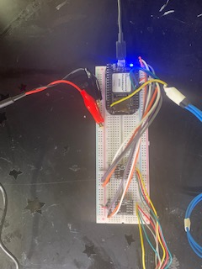
Background Information
What is being proposed?
Replacing my breadboard prototype with a PCB
What changes (if any) are you going to make based on your prototype?
Possibly adding wiring for LCD screen if complexity needed

Slide 3
System Block Diagram
P2_2,4,6,8 ->1,2,3,4 on DRV8833 #1 P2_18,20,22,24 ->1,2,3,4 on DRV8833 #2 P1_36 -> PWM pin for servo Power adapter -> Breadboard + and - Breadboard + -> VCC for DRV8833 #1 and #2 Breadboard - -> GND for DRV8833 #1 and #2
DRV8833 MOTOR DRIVER
NEMA 17 STEPPER MOTOR
DRV8833 MOTOR DRIVER
NEMA 17 STEPPER MOTOR
PocketBeagle
Pen Movement
Micro Servo
Drawing

Slide 4
Mechanical Drawing
100mm
Pwr IN
Servo Pin
Pocket Beagle
DRV8833
DRV8833
USB
40mm
FRONT
DRV8833
BACK
26 x18 mm

Slide 5
Components Required
Create a list of all the components that you require for the PCB
Example List:
2.1mm Barrel Jack (Female), https://www.adafruit.com/product/373
DRV8833 x2
3-pin 100-mil servo connector
4-pin 100-mil x2 (for connecting DRV8833)

Slide 6
Backup

