Slide 1

AE Final Project Beer reviews from Beer Advocate
Edgar Paka; Jon Monnig; Tanner Papenfuss
Prof. Bart Van Parys
15.071 – The Analytics Edge Fall 2022

Slide 2
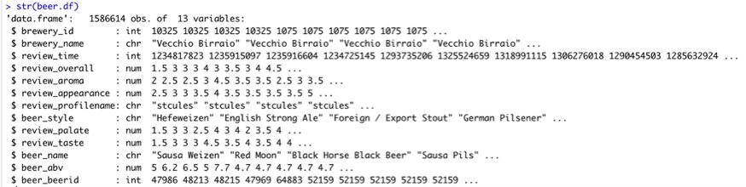
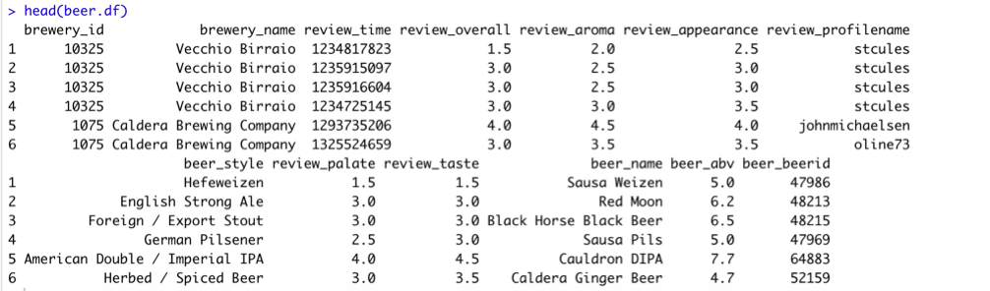
Data structure

Slide 3
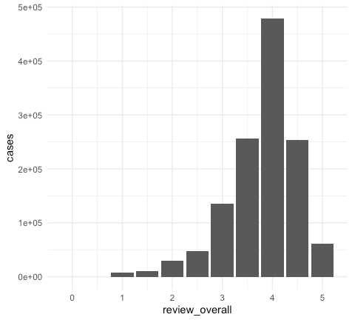
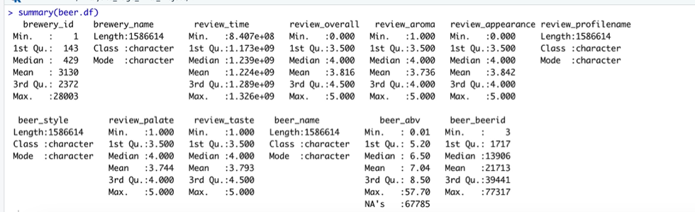
Background of our process
Talk about reducing our datasets for our training pipelines.
Talk about build the AWS instance to run our regressors. They all take anywhere from 30mins to a couple hours.
Talk about how we kept getting negative R2 values. We had to reduce our breweries. Reduce beer reviews. Reduce reviewers.
List the regressors that had most luck to least luck.

Slide 4
Logistic regression

Slide 5
CART

Slide 6
Random Forest

Slide 7
Recommender

