Slide 1
Predicting Investments in Renewable Energy for African Nations
Thomas Pink

Slide 2
Problem Scope
As third world countries develop and grow in population, the demand for energy will increase, making it imperative that renewable energy infrastructure is optimally
Research from multiple sources shows the primary concern of investors of these projects is the political stability of these nations
Predictors such as total population, urban population (as % of total population), political instability, yearly change in GDP, and yearly power generated by solar from 1960-2018 were used with the response variable being the amount of money invested by foreign agencies in successful renewable energy projects (this amount was divided by the population)

Slide 3
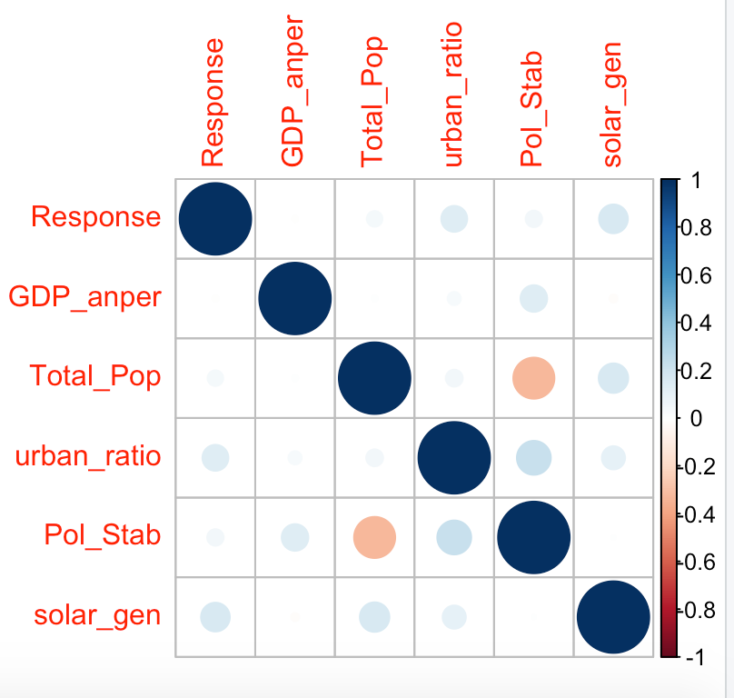
The Dataset
Missing values were replaced using a variety of methods depending on the the values of the dataset, the data was then scaled appropriately
By looking at the trends in the raw data, South Africa and Morocco had the highest response values, response seemed to correlate with high urban population and positive change in GDP, not political stability
A Correlation plot shows solar generation and
urban population correlate with the response

Slide 4
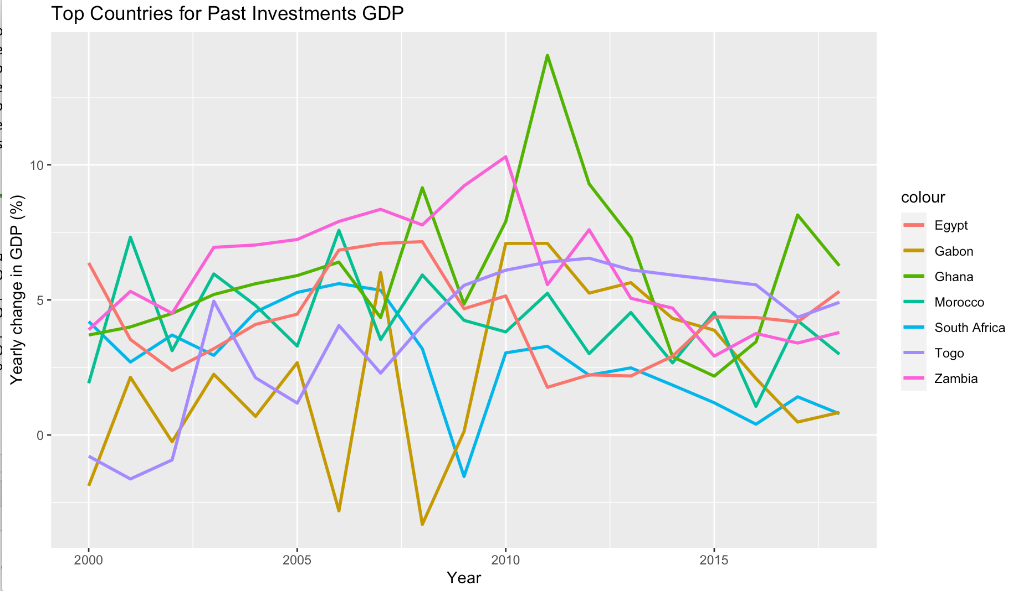
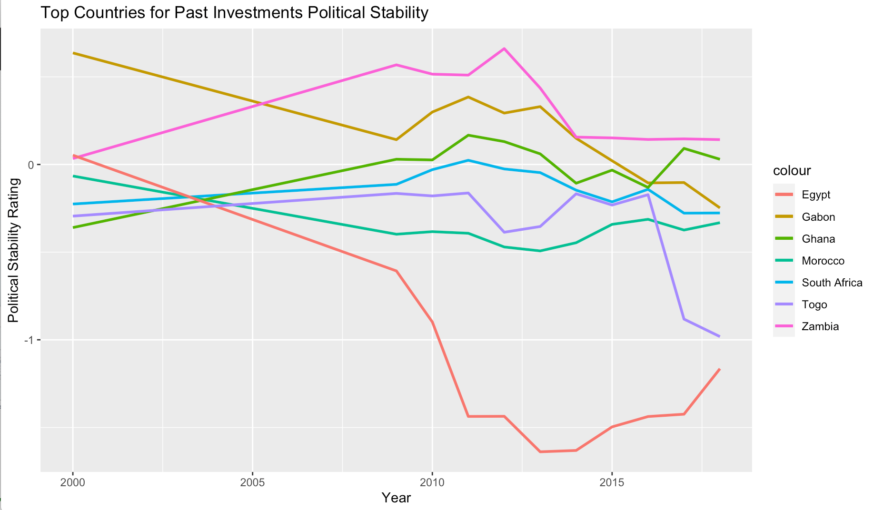
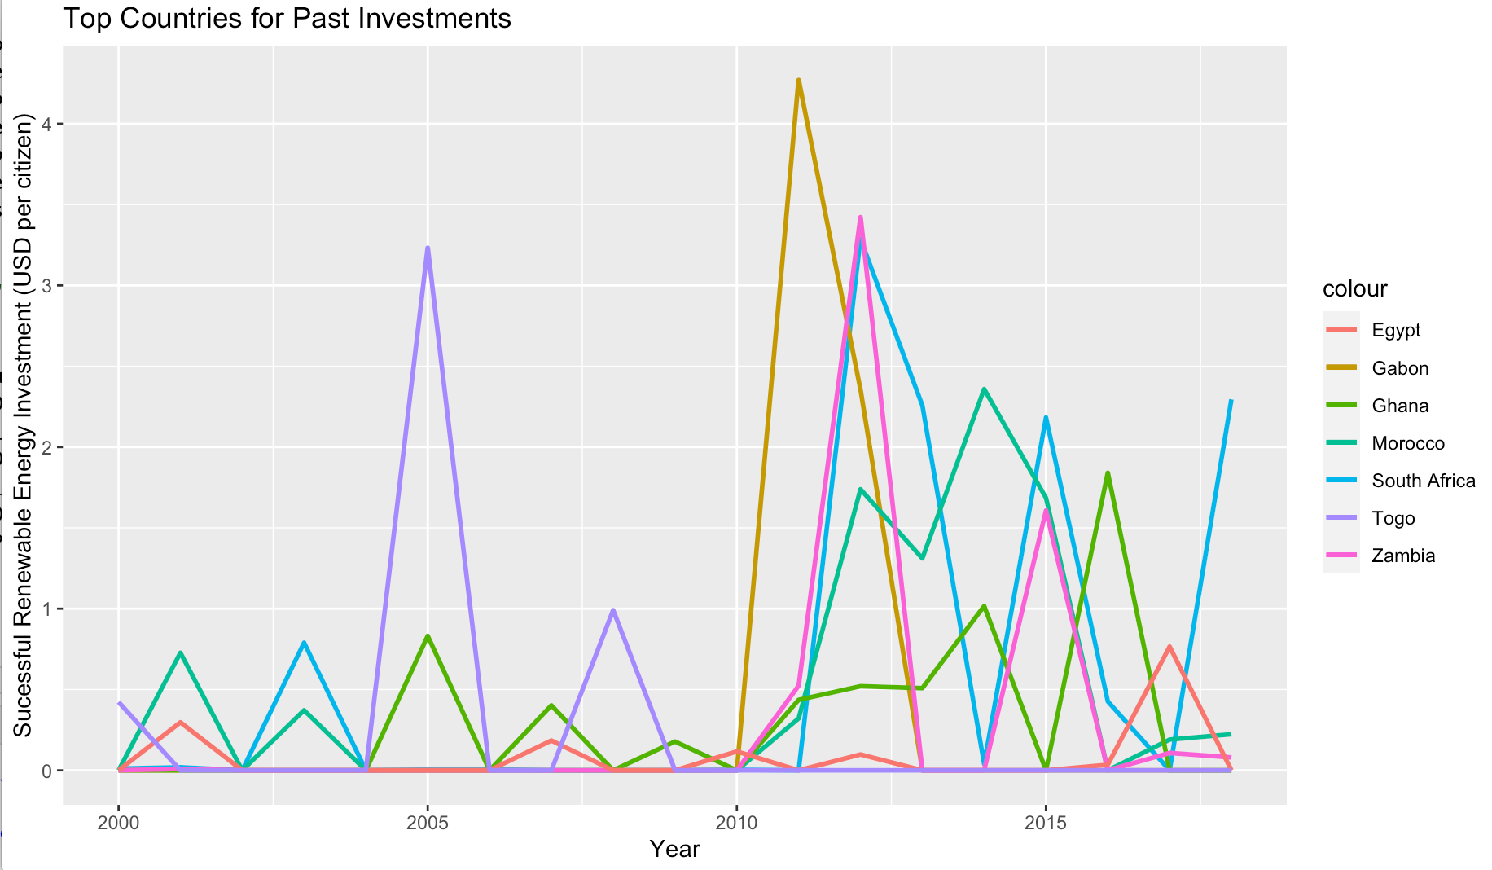
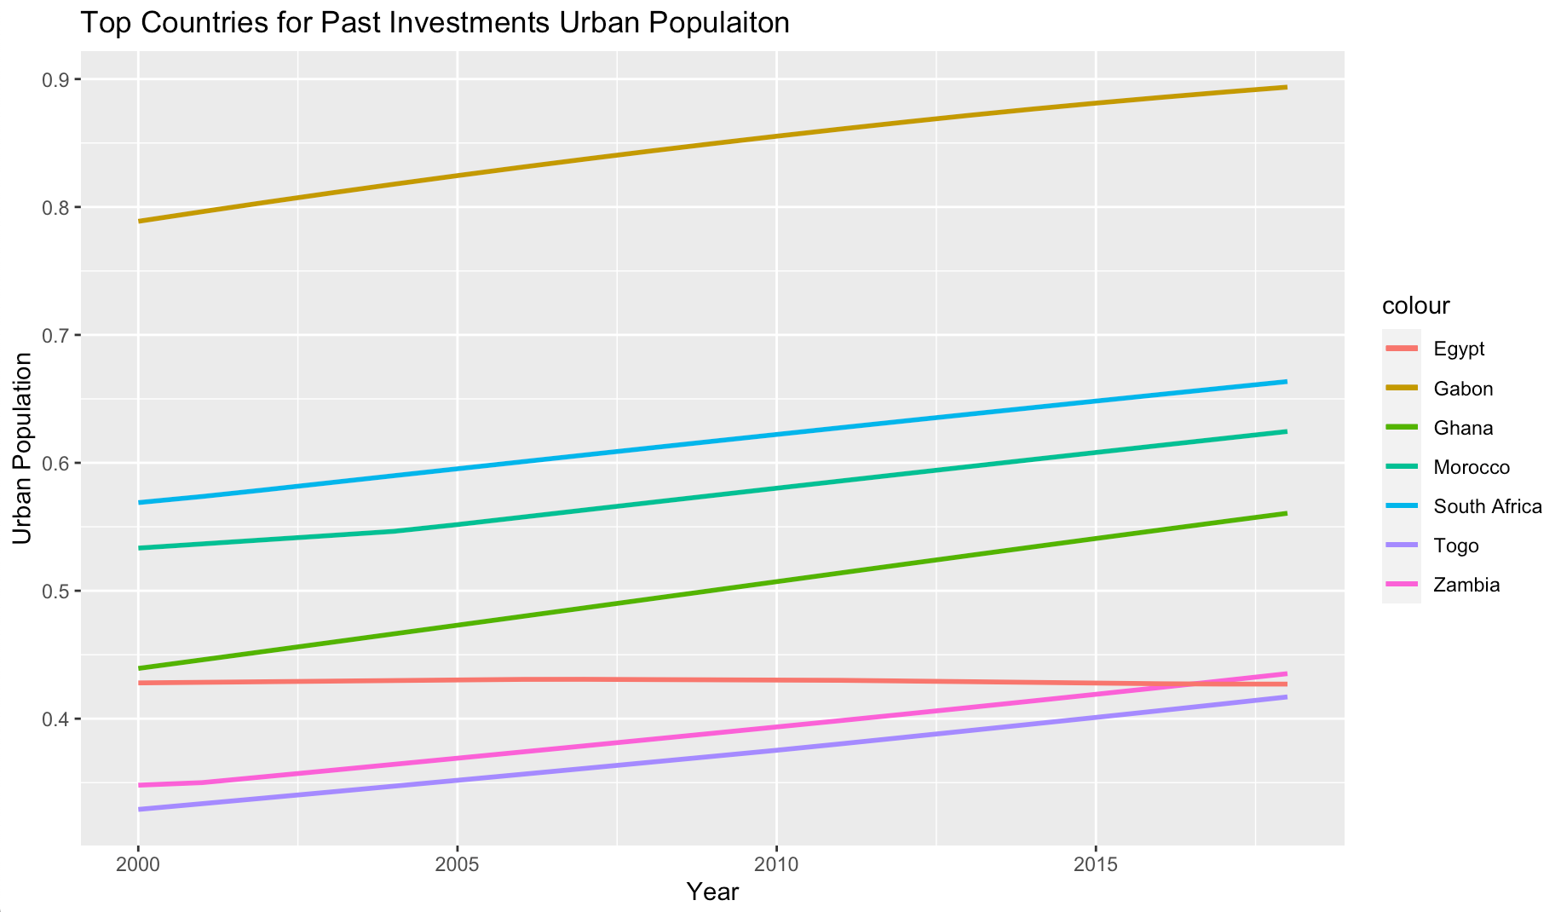

Slide 5
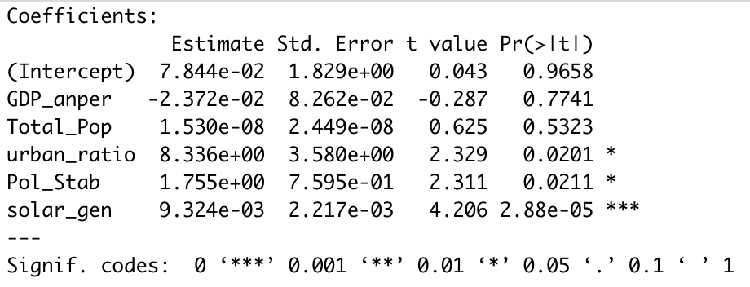
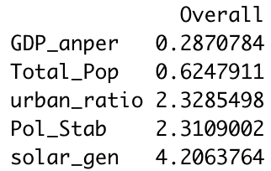
Linear Model
The linear model run with all of the predictors on the response had an RMSE of 0.250 with 3.85 % of the variance explained
solar generation as the best predictor, followed by political stability and urban population

Slide 6
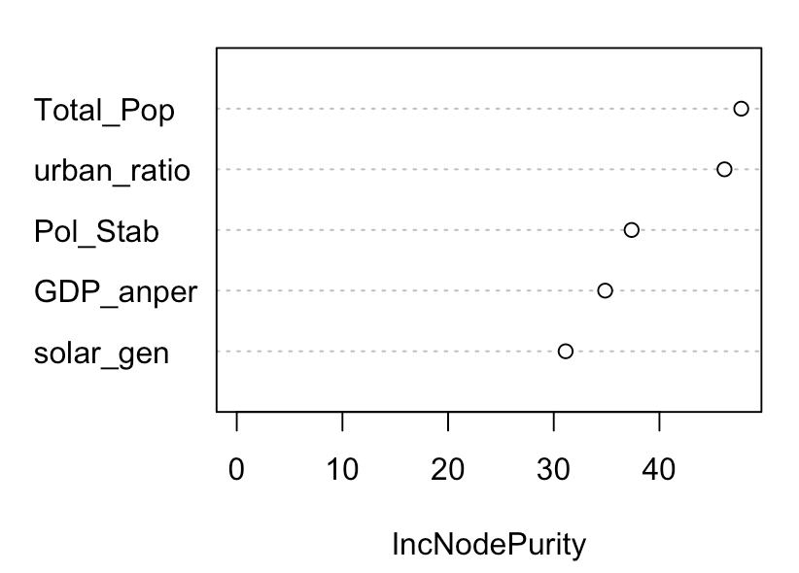
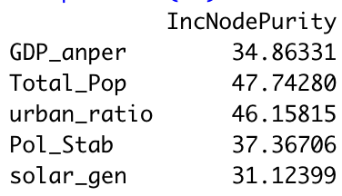
Random Forest Model
The random forest model run with all of the predictors on the response using n.trees 4,000 had an RMSE of 0.299 with 1.57% of the variance explained
Total population , urban population and political stability were the best predictors

Slide 7
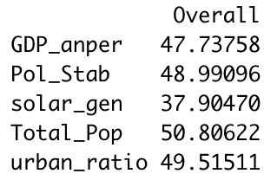
Bagging Model
The bagging model run with all of the predictors on the response had an RMSE of 0.339, using n.trees 3,000, nbagg = 500, minsplit =2
All predictors seem to have similar importance, except solar generation had the lowest importance

Slide 8
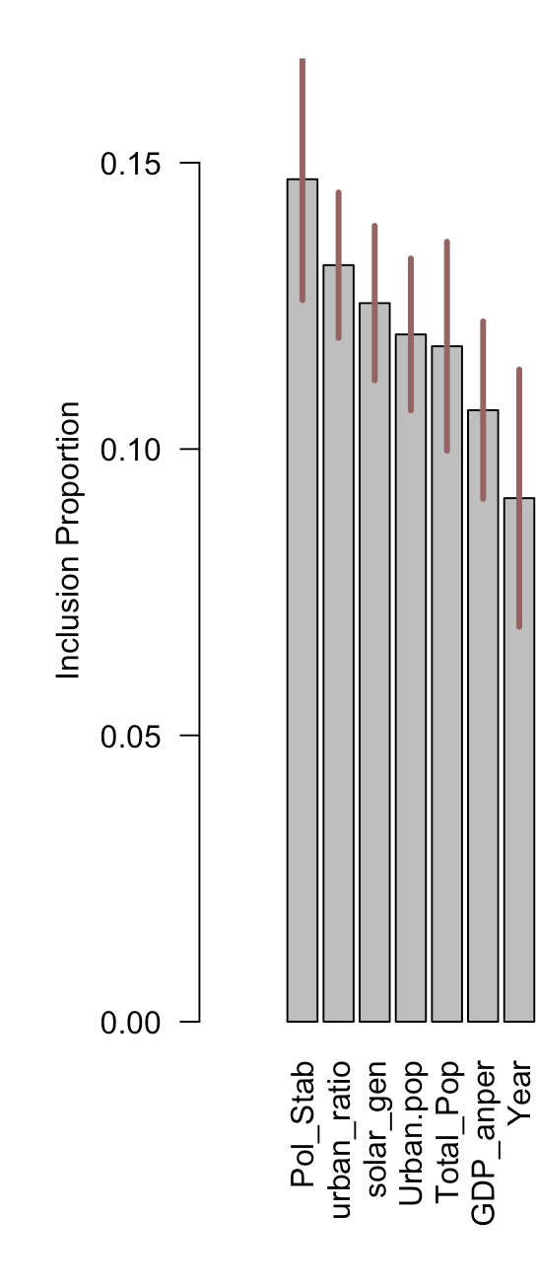
BART
The BART model was run using 4 cores, it had an RMSE of 0.507
Political stability and urban population were the most
Important predictors

Slide 9
Limitations
There are no publicly available time series datasets on yearly wind and solar data for African nations
Datasets on energy and economics from third world countries tend to be missing a lot of datapoints, limiting possible analysis
Some important predictors can not be represented numerically
Attempts to do forecasting models on the time series to predict the response for future years were not successful

Slide 10
Conclusions
The models presented seem to point to a high urban population as the most important predictor to foreign investments, I was surprised to see it as being more important than GDP or political stability.
It seems past investors invest in renewable energy in the countries with the largest cities regardless of the socioeconomic condition of the city
If this is true, it is possible that an increase in socioeconomic condition could follow from large investments in renewable energy infrastructure.
Further analysis should be done using more predictors to find stronger correlations

Slide 11
Sources
https://data.worldbank.org/indicator/IE.PPI.ENGY.CD
https://data.worldbank.org/indicator/sp.pop.totl
Komendantova, Nadejda, et al. “Perception of Risks in Renewable Energy Projects: The Case of Concentrated Solar Power in North Africa.” Energy Policy, Elsevier, 31 Dec. 2009, www.sciencedirect.com/science/article/pii/S0301421509009458?via%3Dihub.`

