Slide 1
Principal Components Analysis

Slide 2
The Problem
There are simply too many variables to make the application of the graphical techniques successful in providing an informative initial assessment of the data.
And having too many variables can also cause problems for other multivariate techniques that the researcher may want to apply to the data.

Slide 3
Principal Component Analysis
A multivariate technique with the central aim of reducing the dimensionality of a multivariate data set while accounting for as much of the original variation as possible present in the data set.

Slide 4
Principal Component Analysis
Is achieved by transforming to a new set of variables, the principal components, that are linear combinations of the original variables, which are uncorrelated and are ordered so that the first few of them account for most of the variation in all the original variables.
The result of a principal components analysis would be the creation of a small number of new variables that can be used as a replacement for the originally large number of variables and consequently provide a simpler basis for, say, graphing or summarizing the data, and perhaps when undertaking further multivariate analyses of the data.

Slide 5
Principal Component Analysis
Used as a means of constructing an informative graphical representation of the data or as input to some other analysis. Orincipal components may be useful here when:
. There are too many explanatory variables relative to the number of observations.
. The explanatory variables are highly correlated.

Slide 6


The Method
We have a set of correlated variables.
We express it in terms of a new set of uncorrelated variables,
Each of which is a linear combination of the x variables.

Slide 7
The property of the new variables
The new variables are derived in decreasing order of importance.
y1 accounts for as much as possible of the variation in the original data amongst all linear combinations of x
y2 is chosen to account for as much as possible of the remaining variation subject to being uncorrelated with y1, and so on.
The new variables defined by this process, y1, y2, … are the principal components.
The general hope od PCA is that the first few components will account for a substantial proportion of the variation in the original variables. This can be used to provide a convenient lower-dimension summary of these variables.

Slide 8
Example 1
A set of data consisting of examination scores for several different subjects for each of several students.
How best to construct an informative index of overall examination performance.
the mean score for each student, although if the possible or observed range of examination scores varied from subject to subject.
weight the scores in some way before calculating the average, or
alternatively standardize the results for the separate examinations before attempting to combine them. In this way, it might be possible to spread the students out further and so obtain a better ranking.
The same result could often be achieved by applying principal components to the observed examination results and using the student's scores on the first principal components to provide a measure of examination success that maximally discriminates between them.

Slide 9
Example 2. Economics
Complex economics data are often summarized by some kind of index number, for example, indices of prices, wage rates, cost of living, and so on. When assessing changes in prices over time, the economist will wish to allow for the fact that prices of some commodities are more variable than others, or that the prices of some of the commodities are considered more important than others; in each case the index will need to be weighted accordingly. In such examples, the first principal component can often satisfy the investigator's requirements.

Slide 10
Example 3: Taxonomy
But it is not always the first principal component that is of most interest to a researcher. A taxonomist, for example, when investigating variation in morphological measurements on animals for which all the pairwise correlations are likely to be positive, will often be more concerned with the second and subsequent components since these might provide a convenient description of aspects of an animal's shape. The latter will often be of more interest to the researcher than aspects of an animal's size" which here, because of the positive correlations, will be reflected in the first principal component.

Slide 11
Example 4: Psychiatry
The first principal component derived from, say, clinical psychiatric scores on patients may only provide an index of the severity of symptoms, and it is the remaining components that will give the psychiatrist important information about the pattern of symptoms

Slide 12


Finding The Sample Principal Components
The first principal component of the observations, y1, is the linear combination
Where
Using Lagrange Multiplier, it is found that a₁ is the eigenvector of the sample covariance S corresponding to the matrix’s largest eigenvalue.

Slide 13
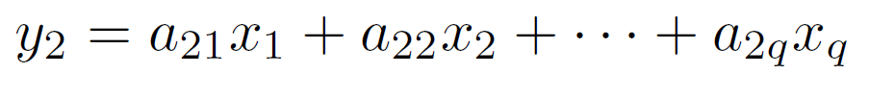
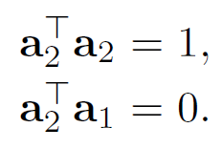
Finding The Sample Principal Components
The second principal component, y2, is defined to be the linear combination
That has the greatest variance subject to the following two conditions:
The second condition ensures that y1 and y2 are uncorrelated, i.e., that the sample correlation is zero.

Slide 14
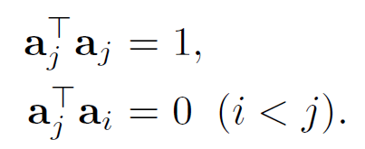
Finding The Sample Principal Components
Similarly, the j^{th} principal component is that linear combination y_{j} = a^{T}j_{x} that has the greatest sample variance subject to the conditions

Slide 15
Eigenvalues and Eigenvectors
Application of the Lagrange multiplier technique demonstrates that the vector of coefficients defining the jth principal component, a_{j}, is the eigenvector of S associated with its jth largest eigenvalue.

Slide 16


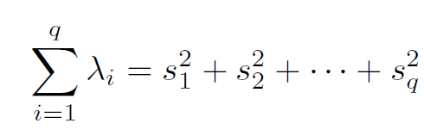
Eigenvalues and Eigenvectors
If the q eigenvalues of S are denoted by
Then by requiring that
it can be shown that the variance of the ith principal component is given by λ_{i}. The total variance of the q principal components will equal the total variance of the original variables so that

Slide 17
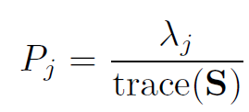
Eigenvalues and Eigenvectors
Consequently, the jth principal component accounts for a proportion Pj of the total variation of the original data, where

Slide 18
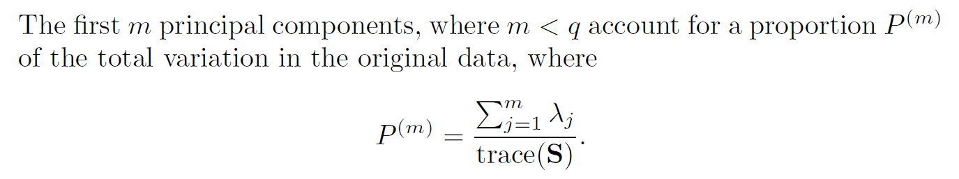
Eigenvalues and Eigenvectors
In geometrical terms, it is easy to show that the first principal component defines the line of best fit (in the sense of minimizing residuals orthogonal to the line) to the q-dimensional observations in the sample.

Slide 19
Should principal components be extracted from the covariance or the correlation matrix?
If we imagine a set of multivariate data where the variables are of completely different types, for example length, temperature, blood pressure, or anxiety rating, then the structure of the principal components derived from the covariance matrix will depend upon the essentially arbitrary choice of units of measurement; for example, changing the length from centimeters to inches will alter the derived components. Additionally, if there are large differences between the variances of the original variables, then those whose variances are largest will tend to dominate the early components.

Slide 20
Should principal components be extracted from the covariance or the correlation matrix?
Principal components should only be extracted from the sample covariance matrix when all the original variables have roughly the same scale. But this is rare in practice and consequently, in practice, principal components are extracted from the correlation matrix of the variables, R.
Extracting the components as the eigenvectors of R is equivalent to calculating the principal components from the original variables after each has been standardized to have unit variance.

Slide 21
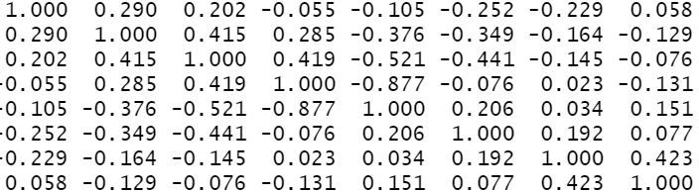
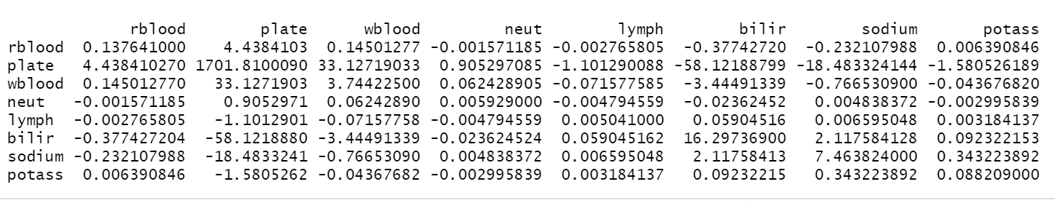
Example: The following is a covariance matrix and the corresponding correlation matrix

Slide 22
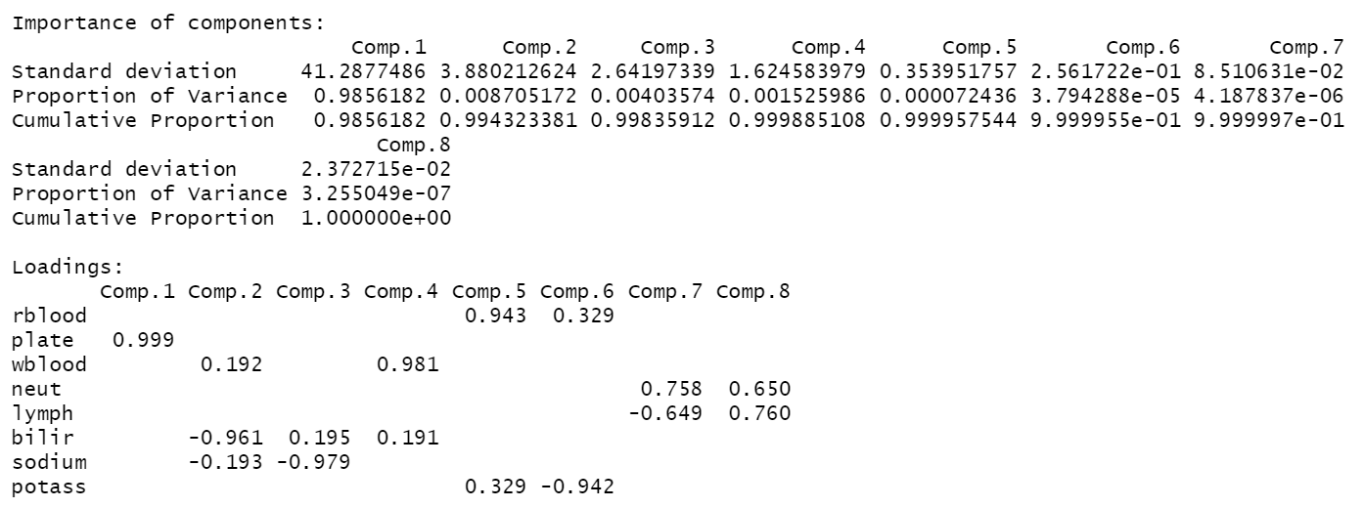
Importance of Components from the covariance matrix

Slide 23
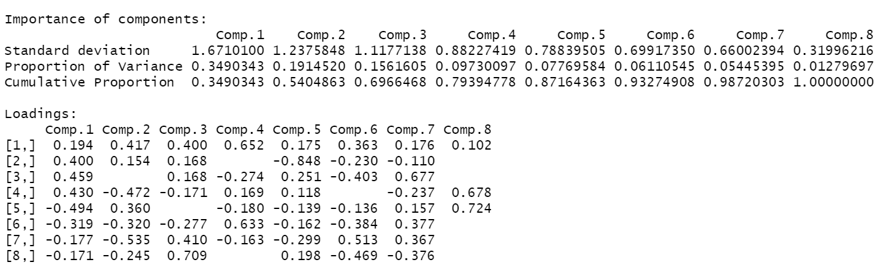
Importance of Components from the correlation matrix

Slide 24
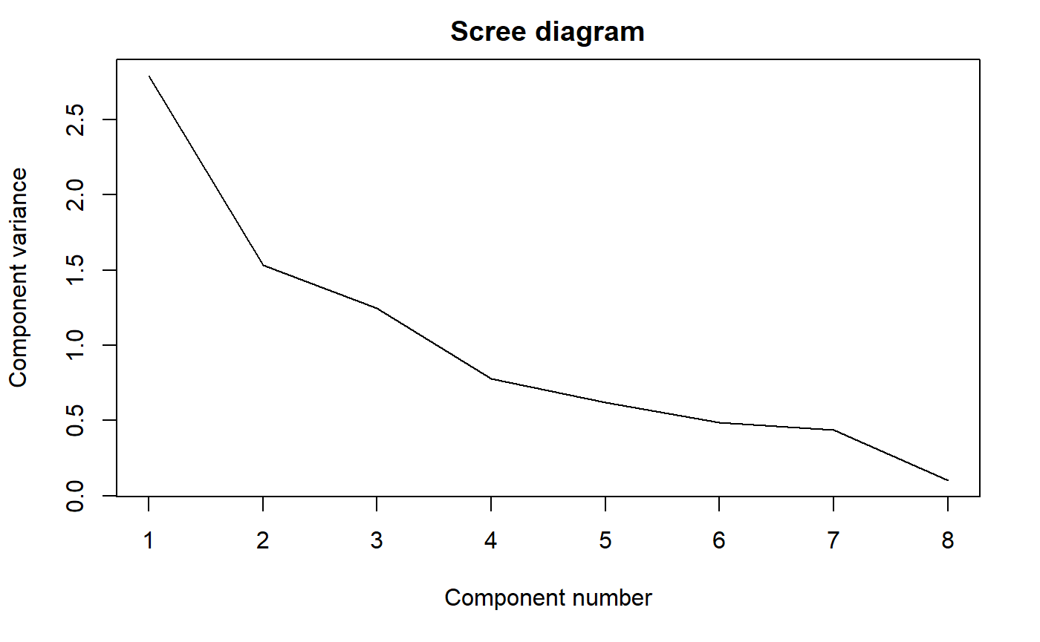
Scree Diagram

