Slide 1
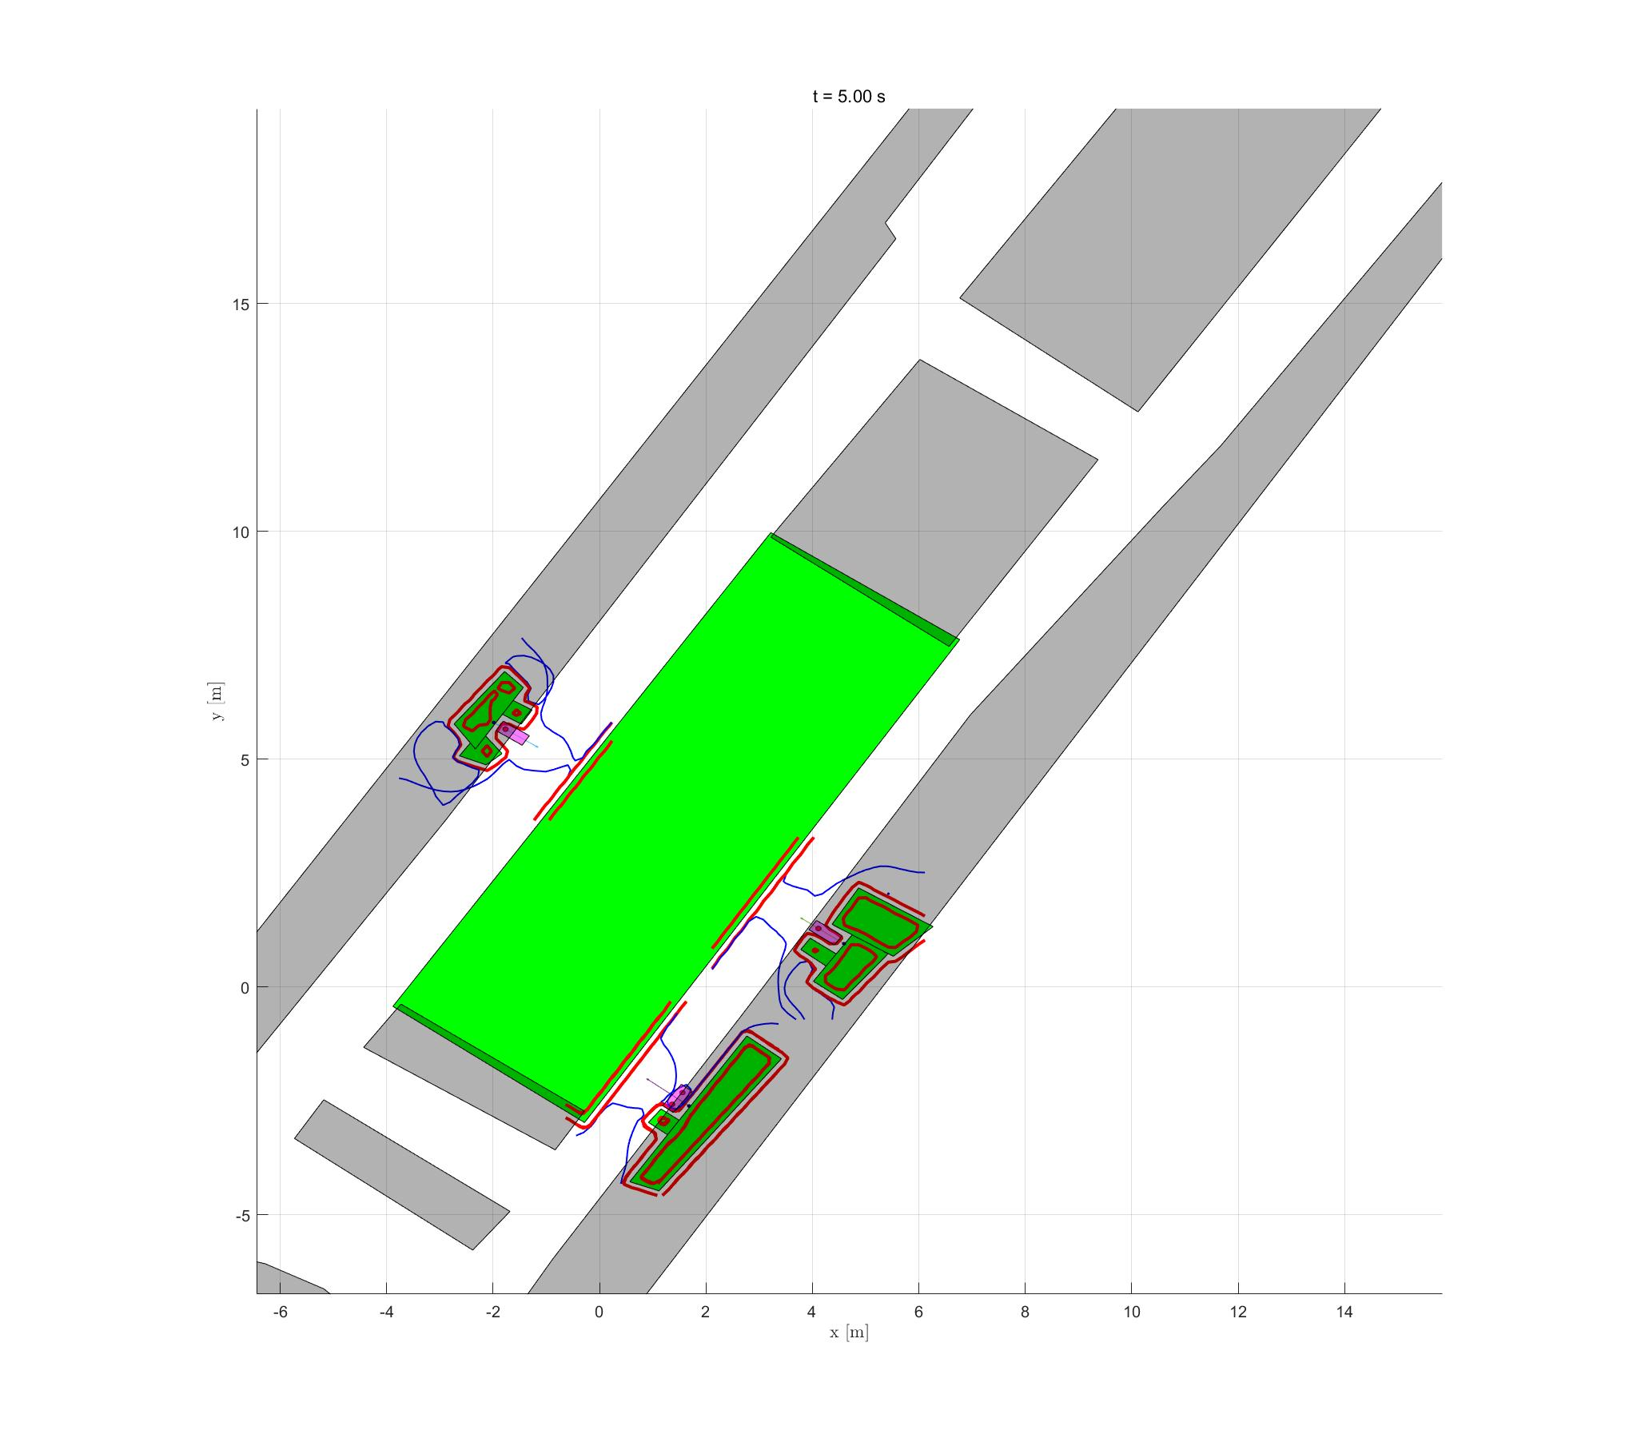
Not very safe
(inflate = width/2)
In this order:
Parallel parking
Yaw = 0.925099
Check: goal = (1.364167, -2.576810, 0.925099)
Pick (x, y) sw. near the red arrow, same below
Forward parking
Yaw = 0.960000
Goal = (4.113389, 1.283579, -0.610796)
Reverse parking
Yaw = -2.150392
Goal = (-1.766760, 5.659301, -0.579596)

Slide 2
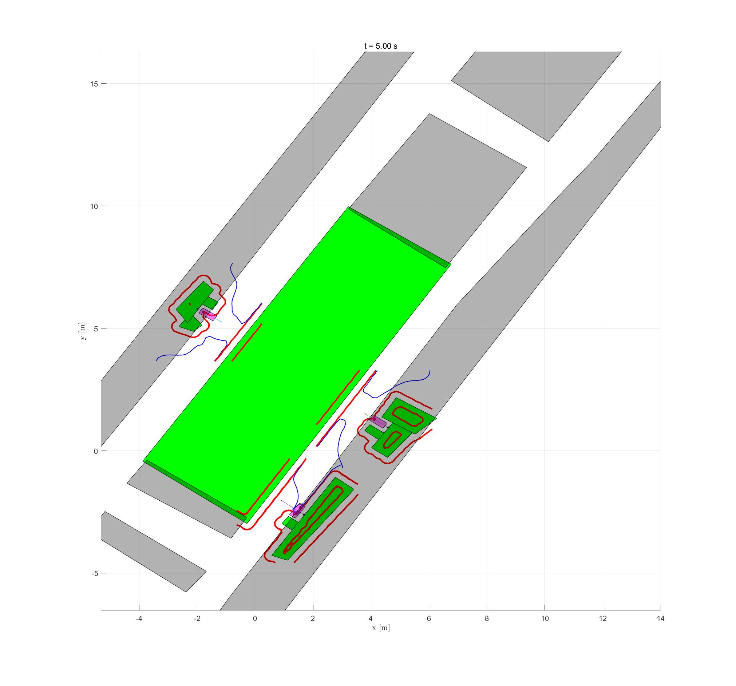
safer
(inflate = width)
Same order, yaw angles and goal points as last page.
But select different (x, y)!

Slide 3
How to select (x, y)?
Open .fig file with MATLAB, just click sw in the reachable set!
fullMap 2021-12-17 084412 w w_map.fig
Inflate = width
fullMap 2021-12-17 090904 w_2 w_map.fig
Inflate = width/2

