Slide 1
TCS & AMD AI Hackathon

Slide 2
Basic Information
Team name:
DN Innovators
Names of the team members / role in the team for the Hackathon
RAM: Lead Architect
RAJU:Design, frontend
DHINESH: Backend
Project Title:
DN Agentic KYC Intelligence Platform
Short Description:
An autonomous, AI-driven CDD platform using a LangGraph pipeline of 5 specialized agents to perform data extraction, verification, screening, and financial profiling with complete explainability and human oversight.

Slide 3
Problem & Context
Problem statement
Build an agentic KYC platform where multiple specialized agents collaborate to perform end-to-end customer due diligence while maintaining explainability and human oversight.
Target users / stakeholders
- Primary: KYC Analysts, Compliance Officers, Risk Managers
- Secondary: Operations Execs, Audit Teams
- Stakeholders: Banks, Fintechs, Crypto Exchanges
Why this problem matters
- Regulatory: Solves the AI 'Black Box' problem with auditable PDF evidence trails.
- Operational: Slashes manual review bottlenecks and onboarding times.
- Risk Mitigation: Detects complex, sophisticated fraud heuristics.
Mapped hackathon challenge
- Agentic Orchestration (LangGraph)
- Explainable Risk Scoring (LLM narratives)
- Human-in-the-Loop Design (Escalation queue)
- AMD ROCm Integration

Slide 4
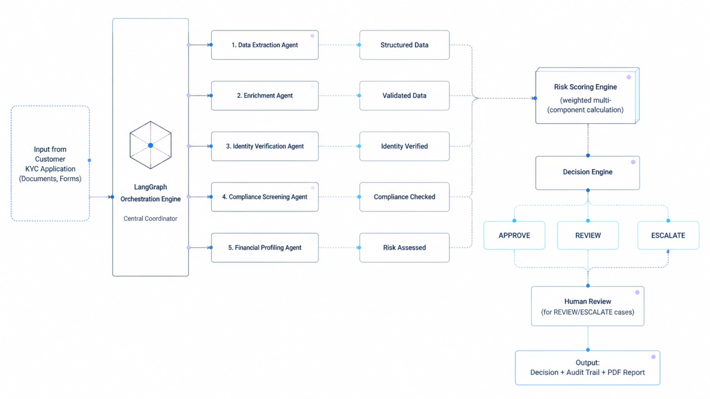
Solution Architecture

Slide 5
Solution Overview
- Multi-Agent GenAI (5 independent specialized LLMs)
- Agentic Orchestration (LangGraph state flow)
- Explainable AI (LLM narrative generation)
AI approach used
- Frontend: Streamlit, Plotly, FPDF2.
- Backend: FastAPI, LangGraph, LangChain.
- Infrastructure: AMD ROCm ecosystem, vLLM.
Key technologies / frameworks leveraged
- End-to-End KYC Platform
- Live Risk Dashboard
- Human-in-the-Loop Analyst Queue
- Automated PDF Evidence Generation
- Global Precision/Recall Metrics Engine
What was built during the hackathon

Slide 6
AMD ROCm & vLLM Stack
Technical Details
Models used
Llama-3-8B-Instruct and served via vLLM.
Number of tokens used for a couple of example scenarios
Average full pipeline: ~3,500 input tokens distributed across 5 agents. ~800 output tokens.
Complete pipeline resolves in ~4-6 seconds per customer due to fast-inference via AMD ROCm + vLLM.
End-to-end latency
GPU usage including memory
Runs comfortably on a single AMD GPU (e.g., Radeon RX 7900 XTX or Instinct MI210) requiring ~16-24GB VRAM.

Slide 7
Impact & Demo Summary
80% reduction in manual KYC workload.
Instant onboarding for low-risk customers.
100% auditability through downloadable PDF evidence trails.
Scalable to millions of onboarding requests with AMD ROCm local inference.
Expected impact or value
1. First system to use LangGraph multi-agent collaboration for KYC.
2. Replaces black-box AI scores with LLM-generated plain-English narratives.
3. AMD ROCm-optimized local inference - no third-party cloud required.
4. Real-time Precision/Recall tracking of AI vs. Human Analyst decisions.
Key differentiators / innovation
1. ONBOARDING: Submit customer form -> watch 5 agents run in real-time.
2. RISK DASHBOARD: View AI risk score, band, and evidence flags.
3. HUMAN REVIEW QUEUE: Download PDF evidence report -> override AI decision.
4. GLOBAL METRICS: Check AI Precision/Recall vs Human Analyst accuracy.
Demo flow overview (what the jury should notice)

Slide 8
Learnings & Future Work
💡 What We Learned
🚀 Future Work
🔗 LangGraph Orchestration
📄 Document Upload & Vision AI
Mastered stateful, multi-agent graph pipelines where each agent independently enriches a shared KYCState object. Learned to handle conditional branching and graceful fallbacks when LLM calls fail.
Integrate multimodal vision models to directly scan uploaded Aadhaar/Passport images, extract fields automatically, and perform liveness/face-match detection without manual data entry.
AMD Cloud Platform (ROCm Developer Environment)
📚 RAG-Based Regulatory Lookup
Leveraged AMD's free cloud GPU environment to deploy and run our vLLM inference server on AMD Instinct GPUs. Gained hands-on experience with AMD ROCm stack, HIP programming model, and AMD's developer toolchain — understanding how AMD's cloud is a powerful, cost-effective alternative to NVIDIA for AI workloads.
Add a Retrieval-Augmented Generation (RAG) layer connected to a live regulatory database (FATF, RBI, FinCEN). Agents will cite the exact regulation that triggered a compliance flag.
🧠 Explainable AI Design
📱 Mobile KYC App
Discovered that using a dedicated 'narrator' LLM agent to synthesize findings into plain-English stories is far more effective for compliance than raw numeric scores or flag lists.
Build a React Native mobile application where customers can complete KYC in under 60 seconds through guided document capture, face scan, and real-time agent feedback.
🔄 Human-in-the-Loop Integration
🌐 Multi-Jurisdiction Compliance
Learned how to design escalation thresholds, evidence trails, and PDF generation workflows that empower human analysts rather than replacing them.
Extend the screening agent to support configurable rule-sets per country (GDPR, MiCA, DPDPA), enabling a single platform to serve global banking and crypto customers.
DN Agentic KYC Intelligence Platform | TCS × AMD AI Hackathon 2026

Slide 9
Thank you

