Slide 1


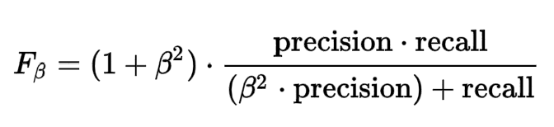
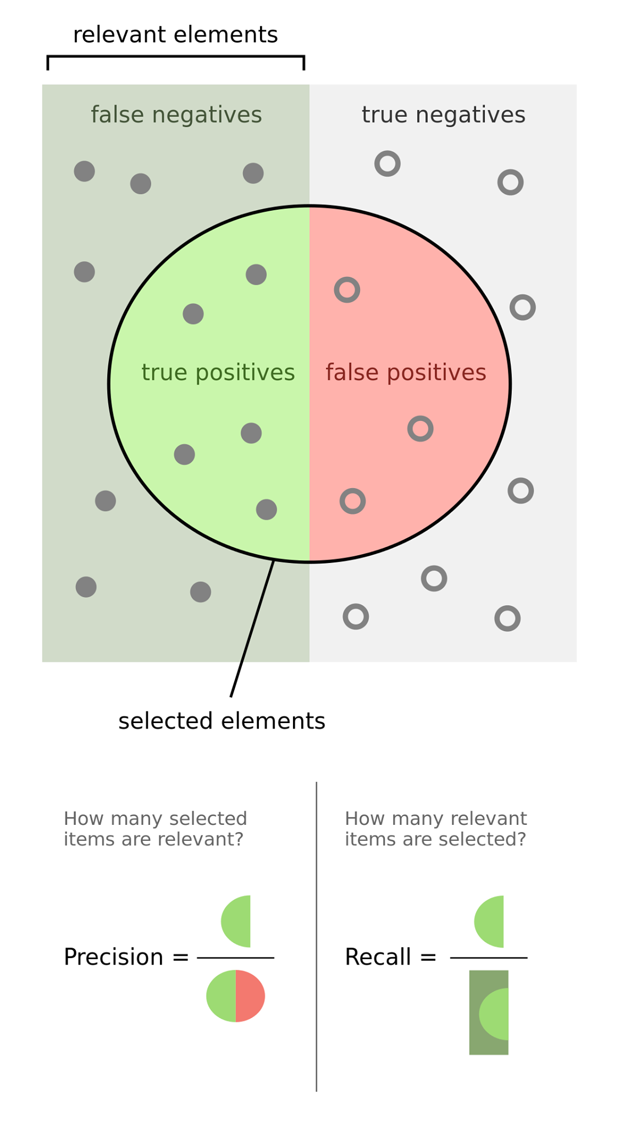
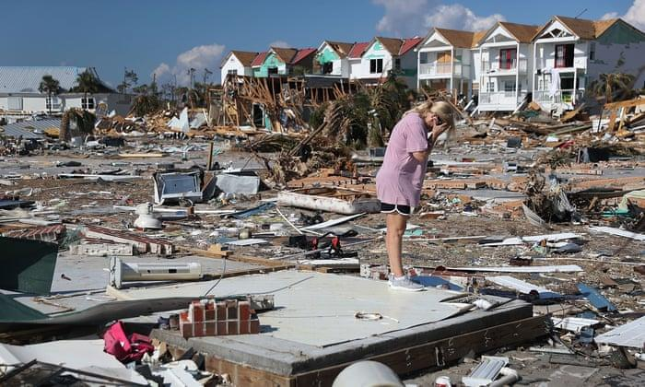

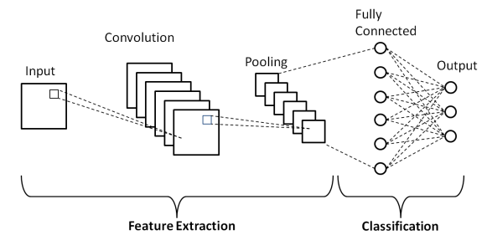

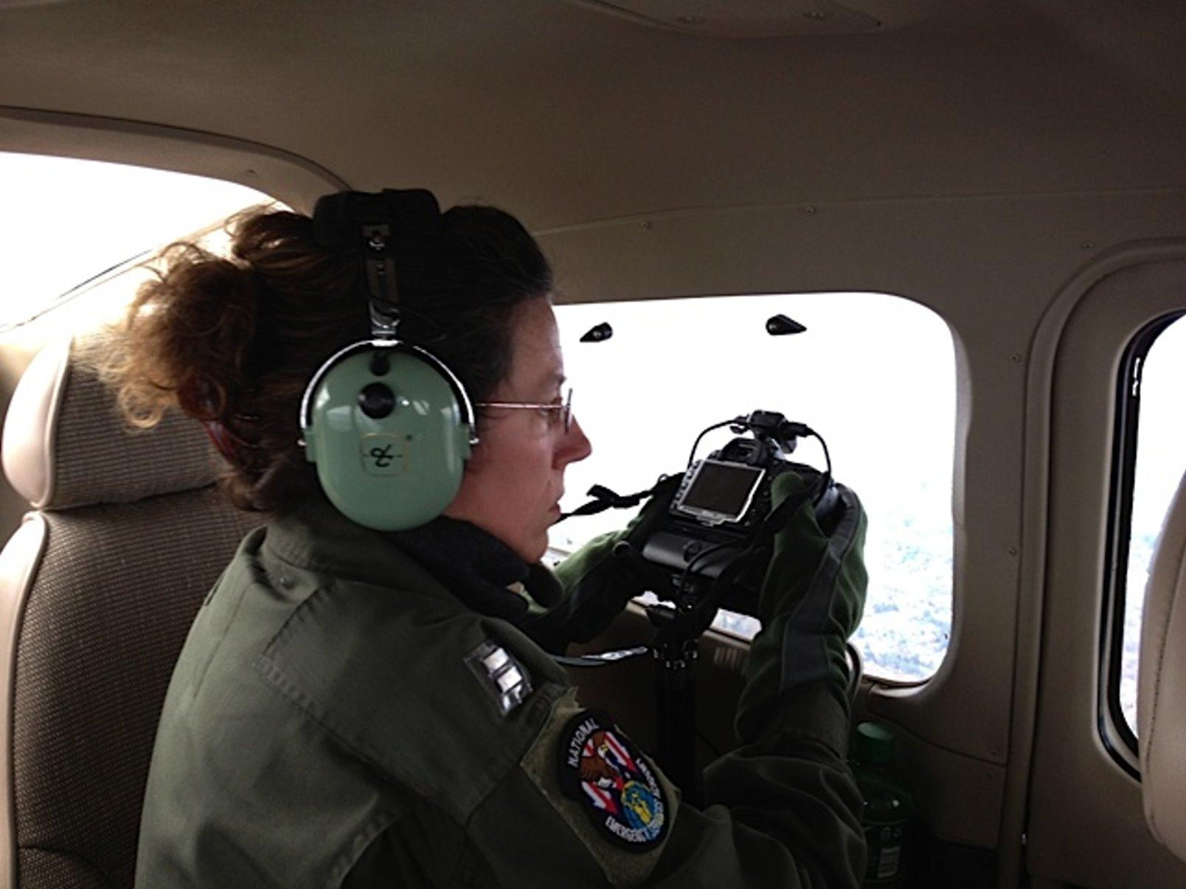

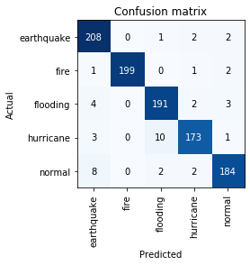
Background
Disaster Autotations
By Joseph Lee and Connor Grimberg
Computer Systems Research Lab
disaster_autotations.sites.tjhsst.edu
Multi-label CNN Results
Within the last 20 years, natural disasters have killed 1.3 million people and impacted 4.4 billion people, and 56% have been caused by earthquakes and tsunamis. While these stats are alarming, they may potentially be on the rise in the future, as the rate of natural disasters continues to grow. As a result of this eminent danger, disaster response has grown as a field. The federal government has become involved with the establishment of the Federal Emergency Management Agency (FEMA), whose primary job is to give funding to disaster team organizations. One such organization is the Civil Air Patrol (CAP). CAP is a non-profit, public service organization focused around carrying out emergency services and disaster relief mission nationwide while serving as a supplement to the United States Air Force. Their other two specializations include aerospace education in support of STEM-related careers and a cadet program to transform the American youth into leaders and aerospace engineers with fitness and character.
CAP trains American soldiers to fly aircraft to take representative aerial photos of areas surrounding natural disasters for the purposes of disaster assessment and potentially to figure out which locations have priority status in resource allotment (e.g. how many people are sent, how much food is sent, and how much time is spent there.)
We trained our multilabel CNN to get a great accuracy. However, due to imbalances in the dataset, this metric does not hold much value. We used the fbeta score to more properly evaluate the NN, which fluctuated between 0.5 and 0.6 throughout the training session. An ideal score would be between 0.9 and 1.0.
Therefore, we established a re-training feature so that the fbeta score could go up higher. Though this may cause more imbalance in the short run, in the long term, we believed all the user-inputted images would balance out.
Methodology
We implemented an Artificial Intelligence program (in Python) where the input is an image taken on aerial aircraft of a certain disaster, and the output is annotations of each photo inputted. All possible annotations were: earthquake, flooding, fire, hurricane, normal, structural damage, road, low vegetation, high vegetation, river, and rough terrain. We used Convolutional Neural Networks (CNNs). We trained the networks using Google Images, Google Drive, the “Download all Images” Chrome extension, Google Colaboratory, and fast.ai. Essentially, it works by training on certain data imagery so that it can learn to recognize various, subtle, and nuanced patterns in certain types of images to classify relevant details in them correctly. In this case, our CNN learned to recognize the type of disaster in each image (i.e. whether the photo is normal or has one of the following disasters: earthquake, flooding, fire, or hurricane.)
Hurricane Michael aftermath in the Florida Panhandle as a category 4 storm.
Conclusion and Discussion
Overall, we were pleasantly surprised with the results of our CNN training. Reaching down to a mere 4.40% error was quite the feat. During the first training session, the CNN reached down to a 30% error and stagnated at that level. However, on the second training session, it decreased down to 13% in a linear fashion, then magically reached down to 4.40% error. We were quite skeptical of this result, but after extensive testing, the percentage error truly demonstrated itself.
Single-label CNN Results
References
AllGov. (2016). Federal Emergency Management Agency (FEMA). Retrieved January 24, 2020, from http://www.allgov.com/ website: http://www.allgov.com/departments/department-of-homeland-security/federal-emergency-management-agency-fema?agencyid=7345
Associated Press. (2018, October 15). United Nations Report Says 1.3 Million Killed by Natural Disasters in Last 20 Years as Costs of Climate Disasters Rise Dramatically [Press release]. Retrieved from https://weather.com/science/environment/news/2018-10-15-united-nations-earthquakes-tsunamis-climate-disasters#3
Civil Air Patrol. (n.d.). WHO WE ARE. Retrieved January 24, 2020, from https://www.gocivilairpatrol.com/ website: https://www.gocivilairpatrol.com/about/who-we-are
Hui, J. (2018, March 6). mAP (mean Average Precision) for Object Detection. Retrieved April 6, 2020, from https://medium.com/@jonathan_hui/map-mean-average-precision-for-object-detection-45c121a31173
Milman, O. (2018, October 16). From Harvey to Michael: how America's year of major hurricanes unfolded. The Guardian. Retrieved from https://www.theguardian.com/world/2018/oct/15/us-year-of-hurricanes-extreme-michael-irma-florence
Penven, M. D. (2012, November 9). NC Wing, CAP Completes First Wave of Aerial Photo Missions. Retrieved February 3, 2020, from Civil Air Patrol, North Carolina Wing website: https://www.ncwgcap.org/index.cfm?fuseaction=article.display&articleID=359&page=1
Phung, V. H., & Rhee, E. J. (2019, October 23). [schematic diagram of a basic convolutional neural network (CNN) architecture]. Retrieved from https://www.researchgate.net/figure/Schematic-diagram-of-a-basic-convolutional-neural-network-CNN-architecture-26_fig1_336805909
Pokhrel, S. (2019, September 19). [Illustration of a convolution layer]. Retrieved from https://miro.medium.com/max/2292/1*u2el-HrqRPVk7x0xlvs_CA.png
[Pooling layer example]. (n.d.). Retrieved from https://qph.fs.quoracdn.net/main-qimg-cf2833a40f946faf04163bc28517959c
Riggio, C. (2019, Nov 1). What's the deal with Accuracy, Precision, Recall and F1? Retrieved April 7, 2020, from https://towardsdatascience.com/whats-the-deal-with-accuracy-precision-recall-and-f1-f5d8b4db1021
Wang, T. (2020, January 24). Annual number of natural disaster events globally from 2000 to 2019 [Fact sheet]. Retrieved April 6, 2020, from https://www.statista.com/statistics/510959/number-of-natural-disasters-events-globally/
Wildfires. (n.d.). Retrieved February 9, 2020, from Esri website: https://www.esri.com/en-us/disaster-response/disasters/wildfires
Zhang, G. (2018, Nov 26). How To Evaluate Your Machine Learning Models? — Classification Evaluation Metrics. Retrieved April 6, 2020, from https://medium.com/@zxr.nju/how-to-evaluate-your-machine-learning-models-classification-evaluation-metrics-4670aef877ec
CAP Pilot taking aerial photos of Hurricane Sandy.
Motivation
Lives are on the line here; every second counts in a disaster response. We believed that Artificial Intelligence had potential to speed up the disaster response. More specifically, we envisioned an autonomous system (i.e. drones or any autonomous aircraft) can then leverage that Artificial Intelligence to detect priority locations for disaster teams such as the Civil Air Patrol to go, based on the interest of maximizing the number of people saved. Currently, humans have be the ones analyzing the state of a disaster in aircraft and in the ground for further inspection, but this can cause harm, especially for inspectors on the ground. Autonomy can therefore bring in further safety for disaster response as well.
This CNN ended up having a 4.40% error. This means that there is a 95.6% probability that our CNN classifies a given image correctly. This confusion matrix shows the results of one testing session of our CNN to determine its general accuracy. For example, out of all earthquake photos tested to the CNN, 208 out of the 208 + 0 + 1 + 2 + 2 = 213 (add first row) images were classified correctly by the CNN, and the rest of the numbers in that correspondent row shows how many earthquake photos did our CNN classify as another disaster type.

