Slide 1

When should Spacecraft Launches happen?
By Junyan Peng

Slide 2
Motivation
Space travel has been a human interest both for resources and for discovery
Calculations needed for determining conditions for spacecraft launches are complex and inefficient to compute by hand
Modeling algorithms for spacecraft are usually time-step processes that are convenient for computer computation

Slide 3
Proposal
By programming time-step algorithms and applying it to spacecraft and planets over a time period, the closest to present date and angle for a launch that takes you to a specified planet in the minimum amount of time can be accurately and efficiently calculated.

Slide 4
Orbit Calculation
Newton-Raphson Method that uses Keplerian elements as parameters to calculate the angular change of an object in orbit relative to the object its orbiting
Used starting position from NASA’s database to find starting angular position of a planet in its orbit relative to the sun

Slide 5
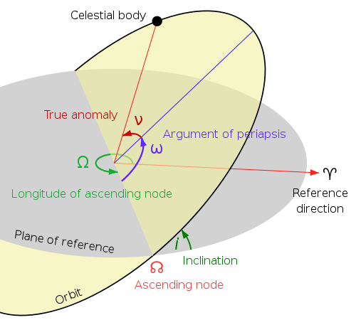
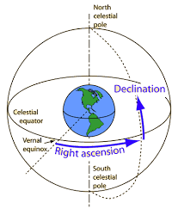

Slide 6
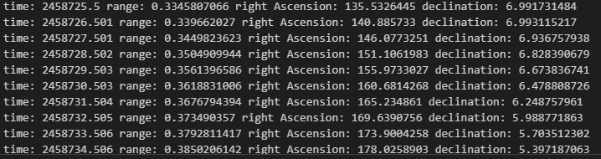
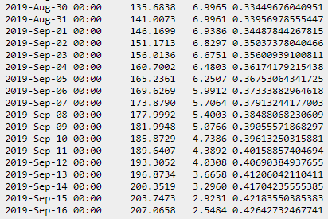

Slide 7
Spacecraft Calculation
Initial speed of spacecraft on verge of leaving a planet found from Apollo moon mission data along with gravitational field at that point
This strength of that g field will be used to determine if a rocket has reached a planet
In cases where the g field is at a point inside the planet, the radius of the planet will be used
Fourth-order runge-kutta method of numeric integration allows for greater accuracy than just using the universal law of gravitation

Slide 8
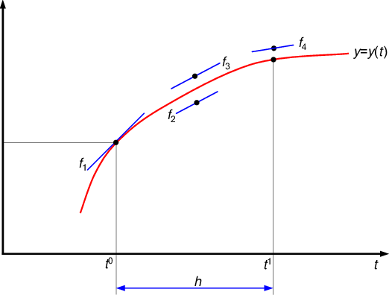

Slide 9
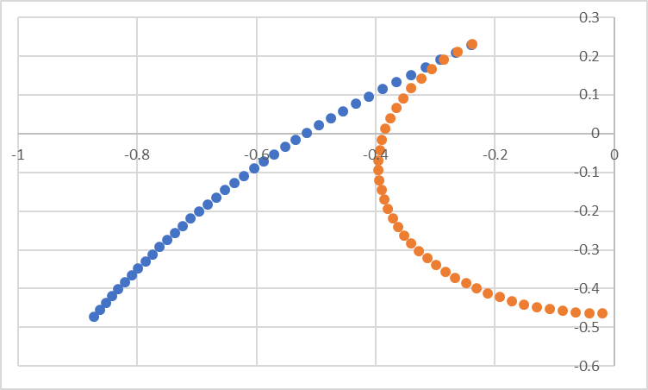

Slide 10
Parallel Computing
Divided cores based on time frame
Further divisions based on various angles of launch

Slide 11
Future Tasks
Finding a better way to determine the mean anomaly for the current position of a planet as current method only works for Mercury
Implementing time variable and UI
Eliminating unnecessary angles and adding parallel for efficiency

Slide 12
References
Background
https://photos.com/featured/earth-view-from-outer-space-background-cybrain.html?product=acrylic-print
Runge-Kutta for spacecraft
https://www.researchgate.net/figure/Geometric-interpretation-of-the-fourth-order-Runge-Kutta-method_fig13_299354655
Orbital Data on planets
https://www.planetary.org/multimedia/space-images/charts/diagram_orbit_ephemeris_definitions.html

Slide 13
References
Newton-Raphson for orbit calculation
M. Capderou, Handbook of Satellite Orbits: From Kepler to GPS
O. Montenbruck, E. Gill, Satellite Orbits
Data on Saturn V
https://www.nasa.gov/centers/johnson/rocketpark/saturn_v_third_stage.html
Reference for planetary positions
https://ssd.jpl.nasa.gov/horizons.cgi#results

Slide 14
References
Images
https://paulplusx.wordpress.com/2016/03/02/rtpts_azalt/
http://hyperphysics.phy-astr.gsu.edu/hbase/eclip.html

