Slide 1
Improving Sports Analysis of a Basketball Game
By Praneeth Reddygari

Slide 2
Motivation
$37,400 a year
Mistakes are common
Bias

Slide 3
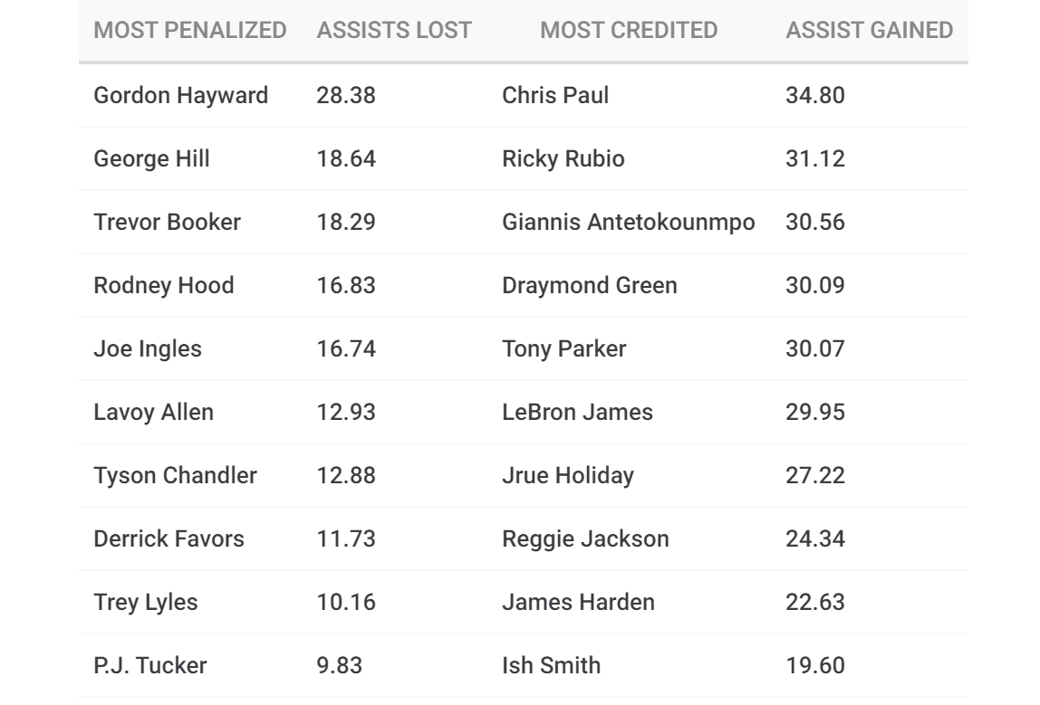
Motivation

Slide 4
Solution
I will use Computer Vision to autonomously conduct scorekeeping and sports analysis of a basketball game.

