Slide 1


Predicting and Simulating Asylum Seeker Flow to Improve the Operations Efficiency of the US Department of Homeland Security
Sarah Luthra

Slide 2

The Problem

Slide 3
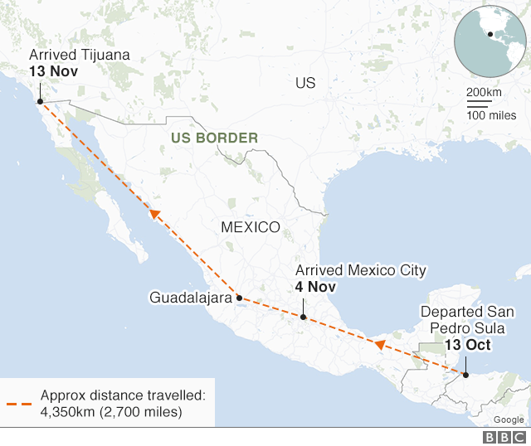
The Problem
Under the defensive asylum process, applicants must go through the immigration system, which faces significant backlogs.
Just in the courts along, as of July 2018, there were over 733,000 pending immigration cases and the average wait time for an immigration hearing was 721 days.
The backlog has been worsening over the past decade as the funding for immigration judges has failed to keep pace with an increasing case load.

Slide 4
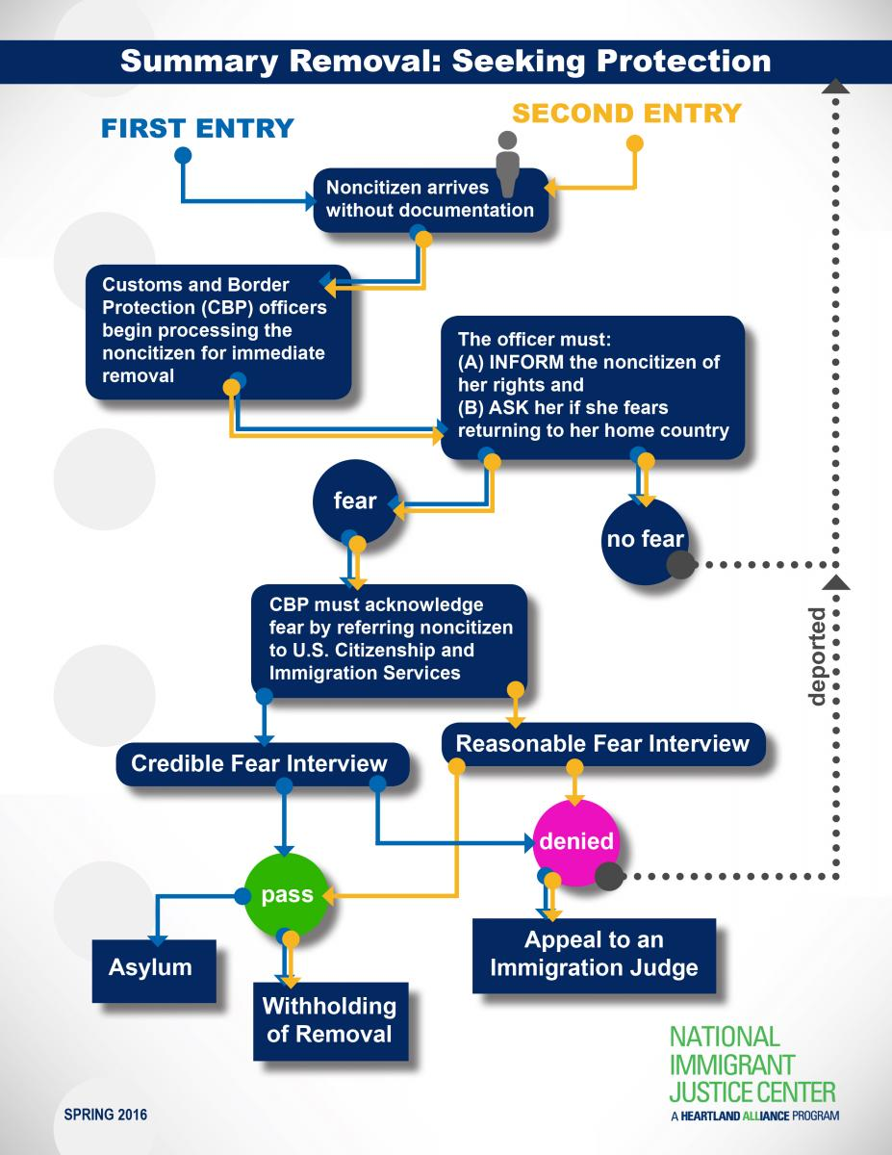
Several steps to the process, which each requires its own staff and resources
Even if one section of the process is available, they may still not be operating at maximum efficiency because of hold-up on a previous step

Slide 5
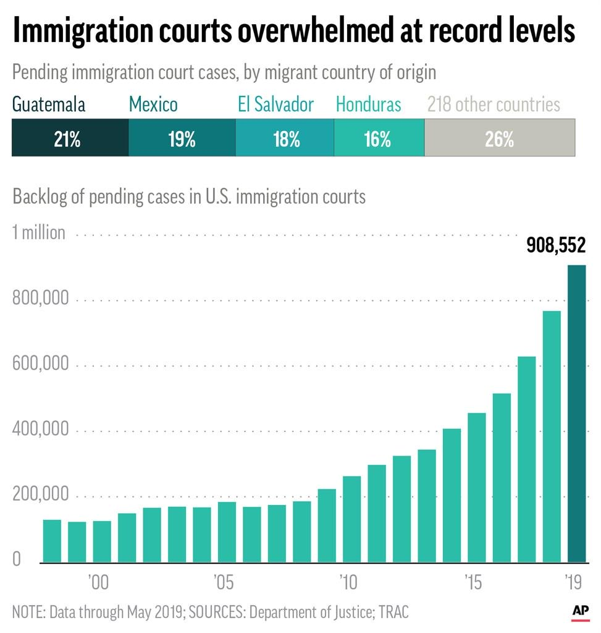
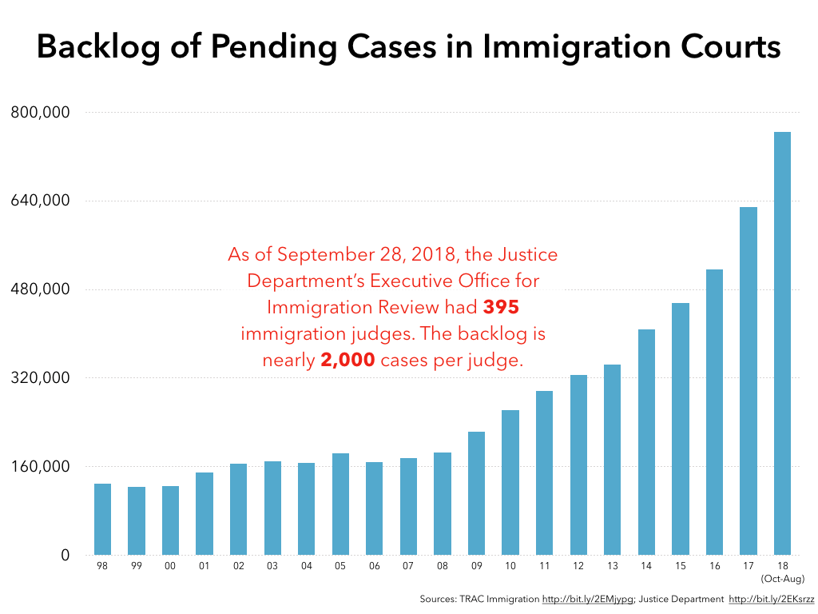

Slide 6
Proposal
My project will predict yearly arrival rates for El Salvadorian asylum seekers at US land ports and produce a simulation that uses this predicted data to display migrant flow and produce staffing and resource allocation requirements for the US DHS.

