Slide 1
Multitask Graph Convolutional Networks for Molecular Property Prediction
Sohom Paul and Emily Ye

Slide 2
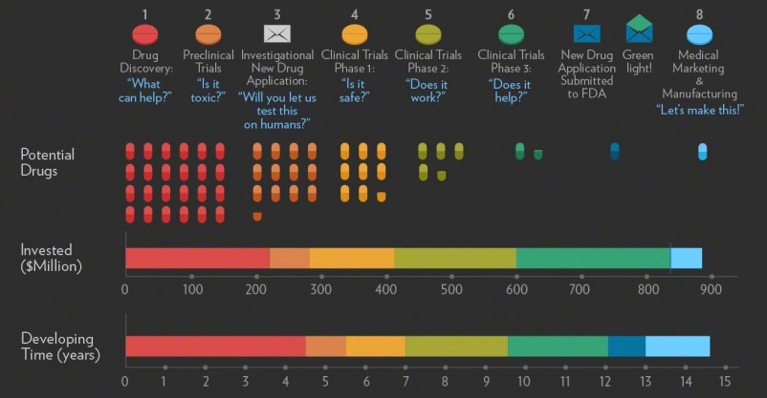
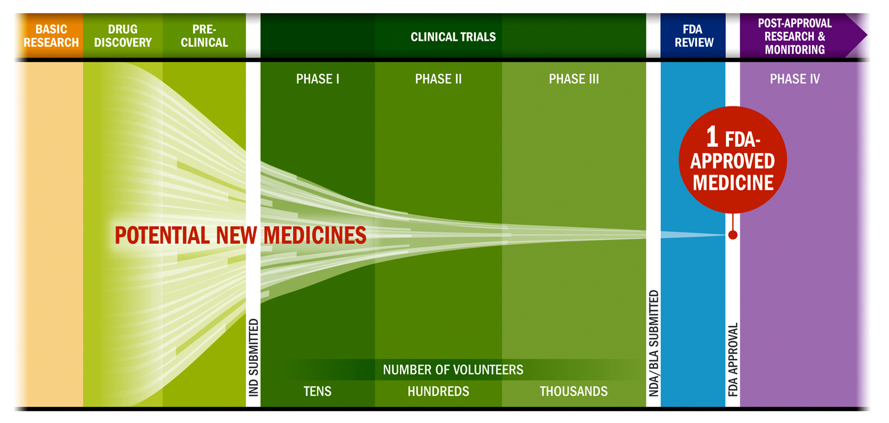
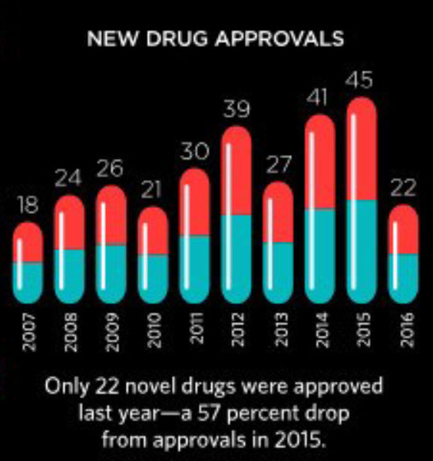
Drug Research
Notes:
https://visual.ly/community/infographic/health/drug-discovery-letdown
https://www.phrma.org/Advocacy/Research-Development/Clinical-Trials
https://www.the-scientist.com/infographics/infographic-the-cost-of-drug-development-32088

Slide 3

Drug Discovery
Time-consuming and expensive
Prediction of properties
Schrödinger’s equation
Density functional theory (DFT)
Notes:
https://en.wikipedia.org/wiki/Quinine

Slide 4
Proposal
Our project will use machine learning in order to provide more accurate and efficient predictions of potential new medicines’ molecular properties.

Slide 5
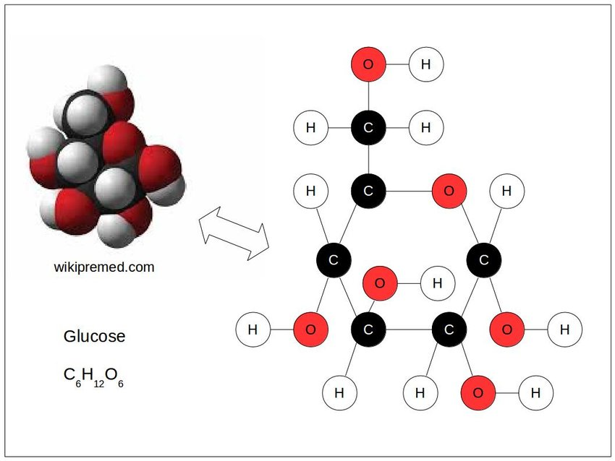
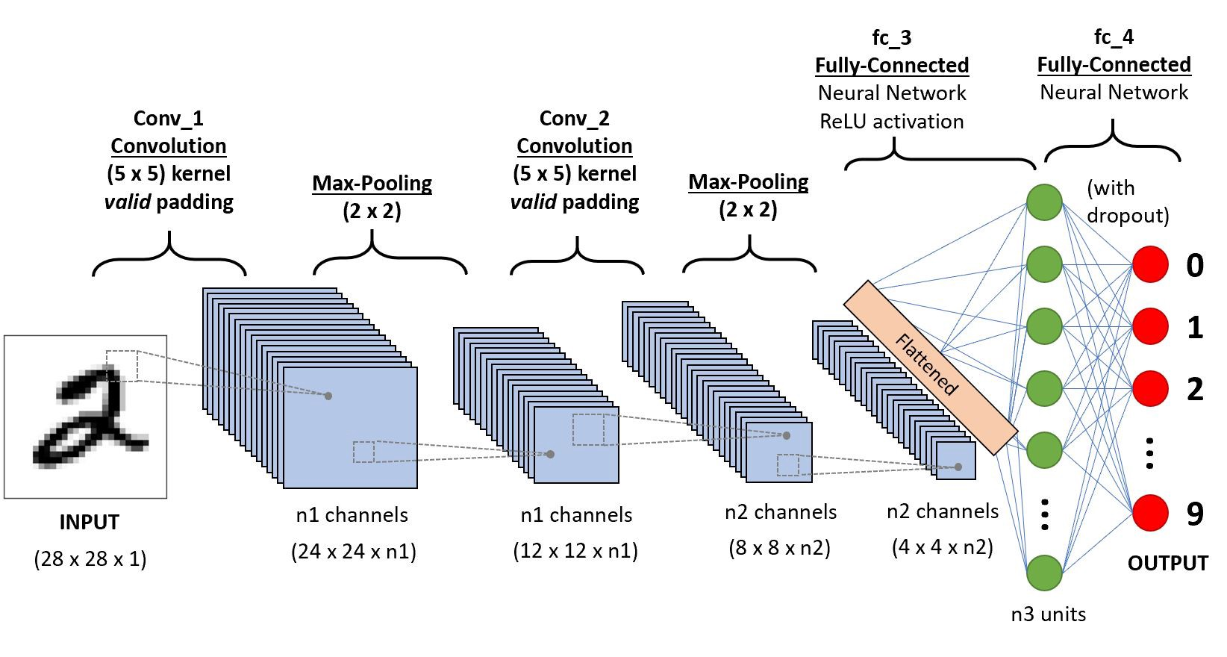
Graph Convolutional Networks

Slide 6
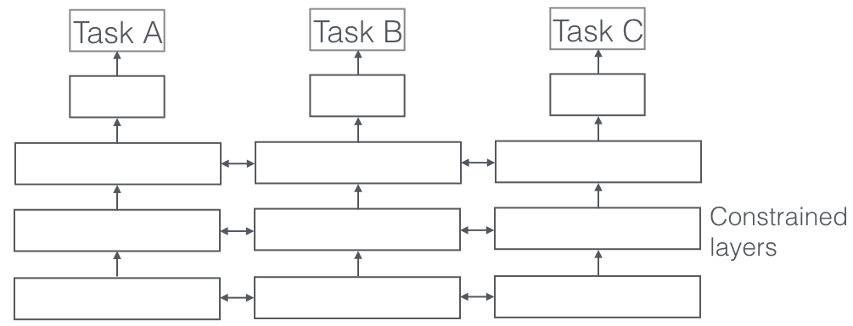
Multitask Learning

Slide 7
Dataset
Quantum Machine 9 (QM9)
134k molecules
Dipole moment (mu)
HOMO / LUMO / energy gap

Slide 8
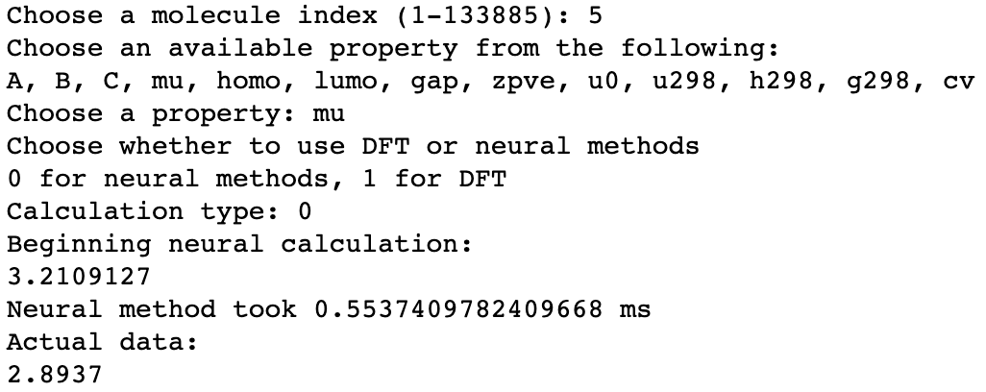
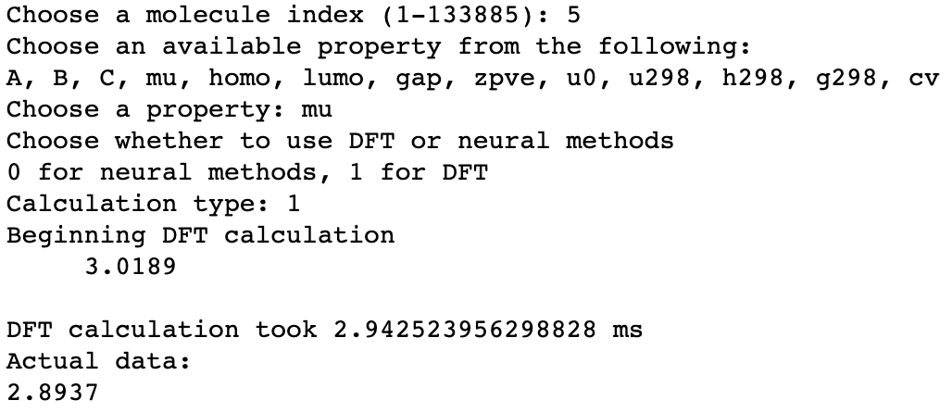

Results

Slide 9
Future Improvements
Integration of multitask and graph convolutional networks
Continue improving accuracy
Molecule input

