Slide 1
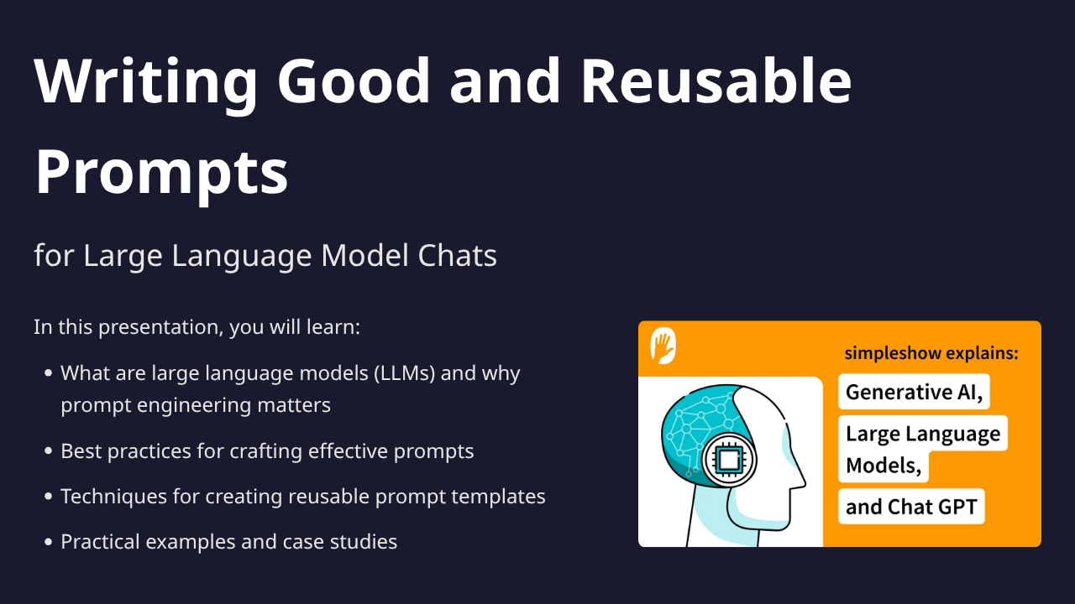
1

Slide 2
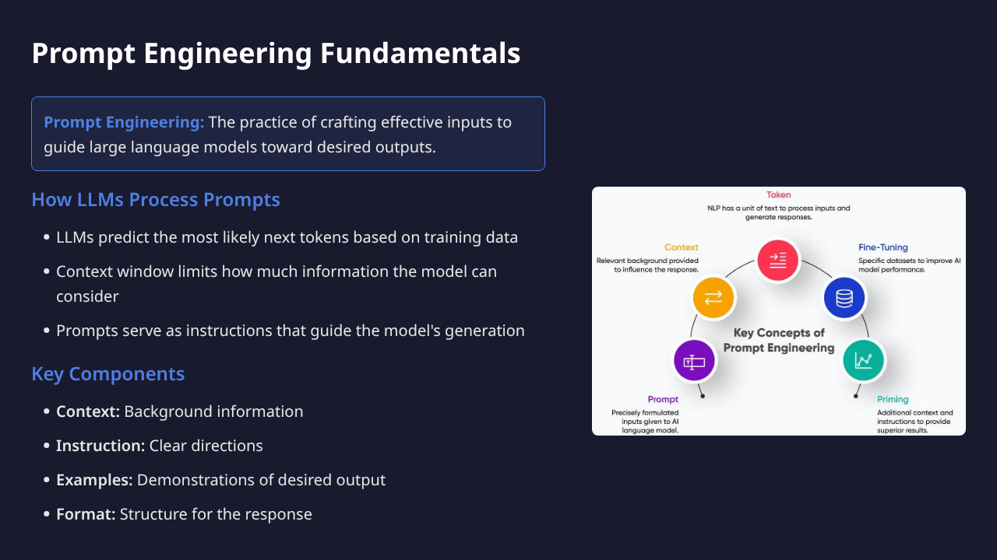
2

Slide 3
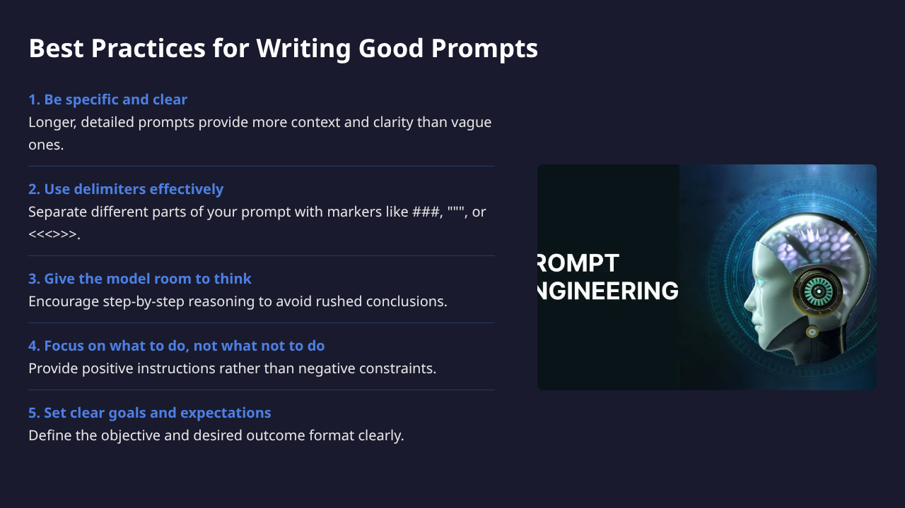
3

Slide 4
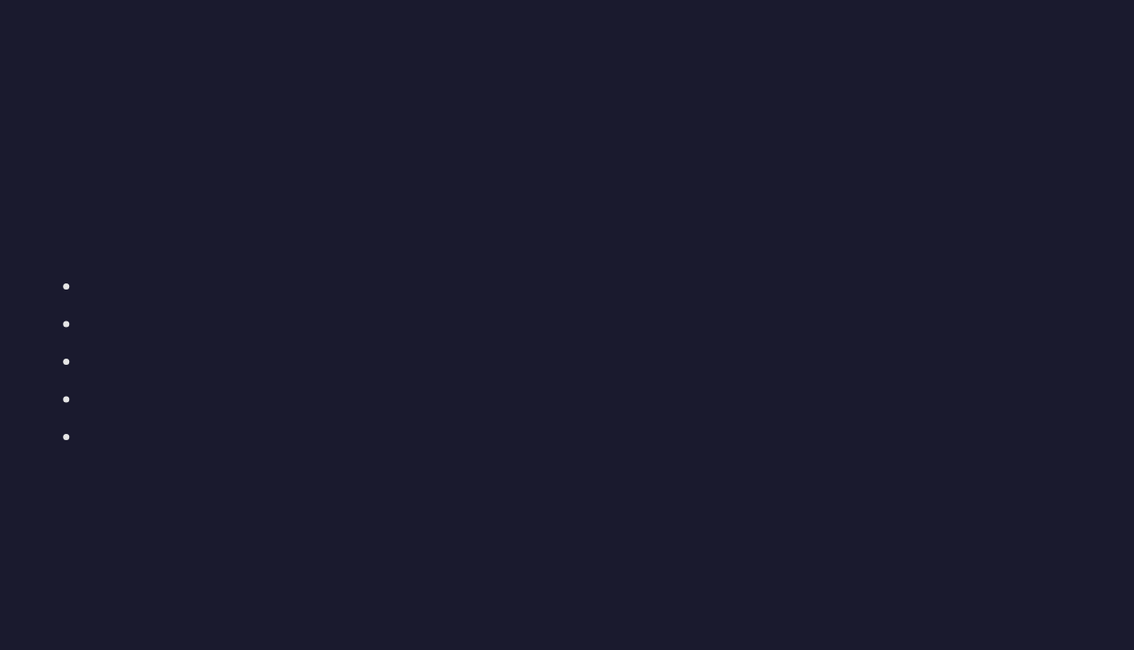
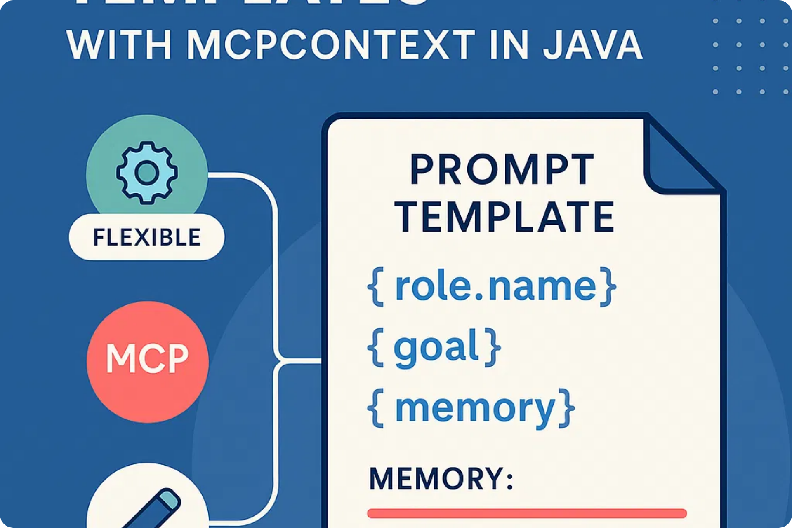
Designing Reusable Prompt Templates
LangGPT Framework
A dual-layer structured prompt design framework for improved generalization and reusability.
Modular Structure:
Profile
: Role definition
Goal
: Objectives to achieve
Constraints
: Limitations
Skills
: Capabilities
Output Format
: Response structure
Benefits of Templates
Consistency across multiple interactions
Easier maintenance and version control
Shareable across teams and applications
4

Slide 5

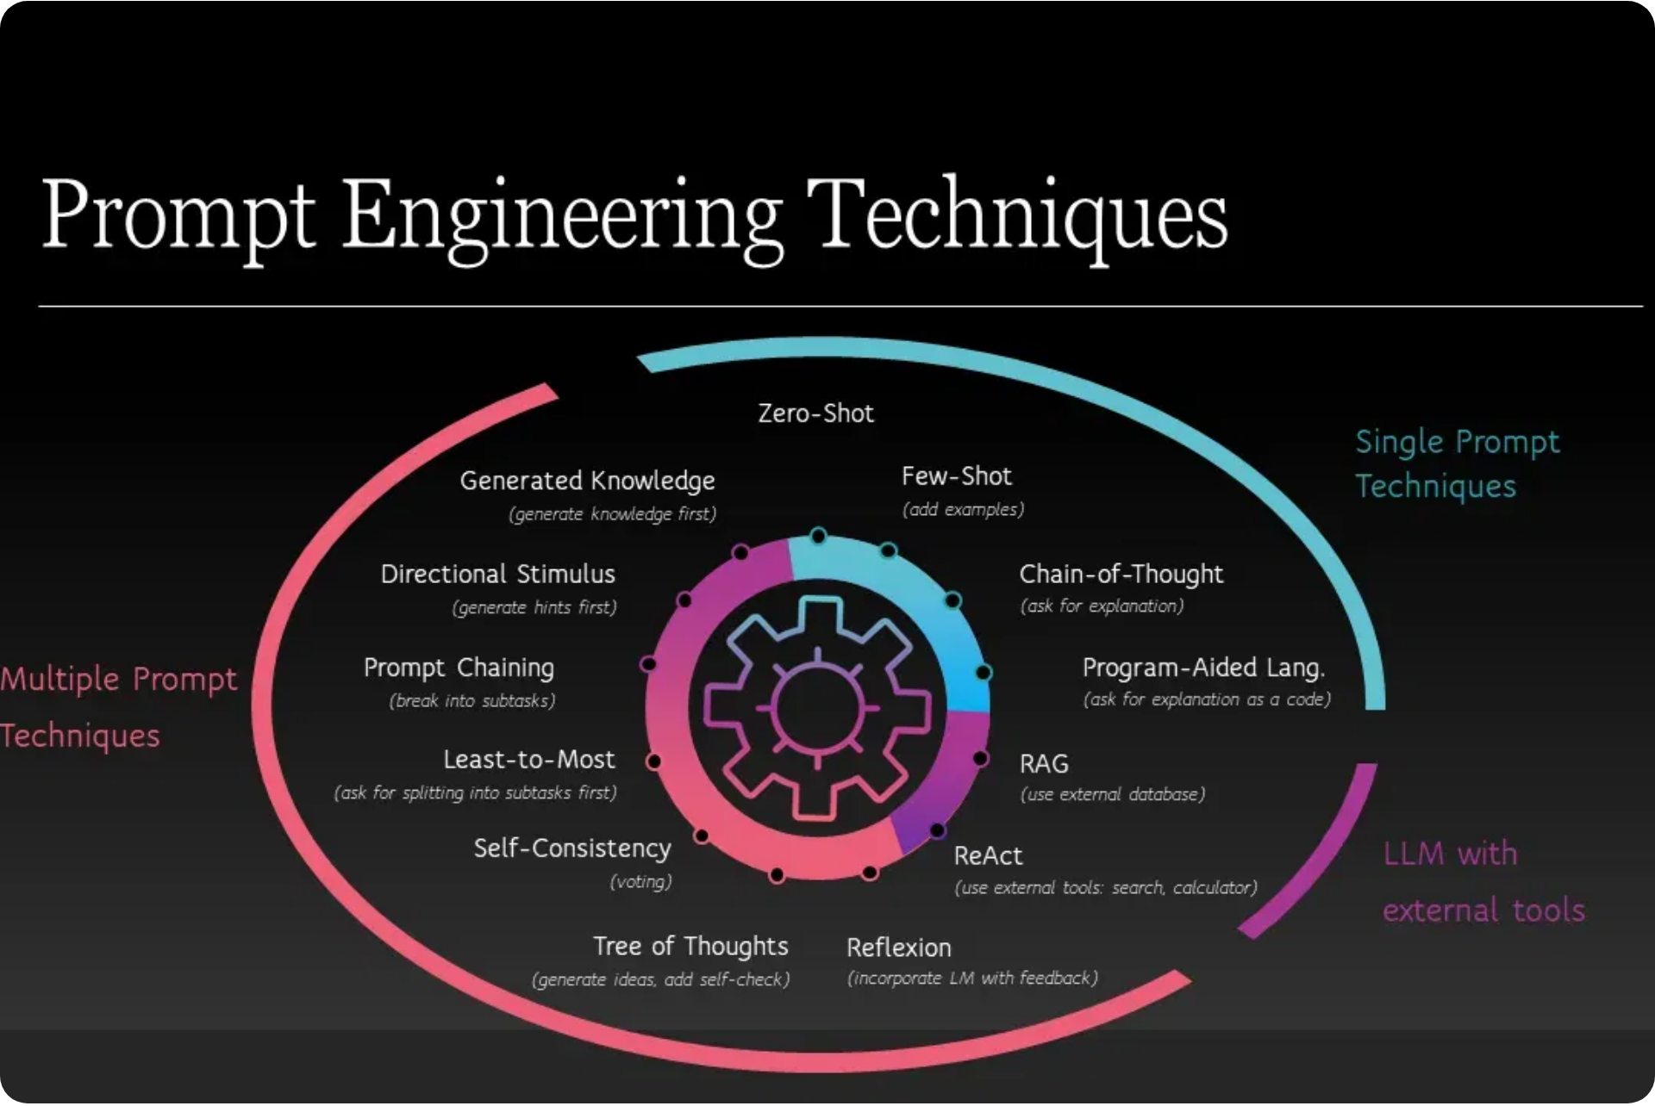
Practical Examples and Case Studies
Before and After Examples
❌ Before:
Explain quantum computing.
✓ After:
Explain quantum computing to a high school student in 3-4 paragraphs. Include an analogy that makes the concept easier to understand, and highlight 2-3 potential future applications.
Common Pitfalls to Avoid
Being too vague or ambiguous
Overloading with contradictory instructions
Forgetting to specify output format
Assuming model knowledge of recent events
5

Slide 6
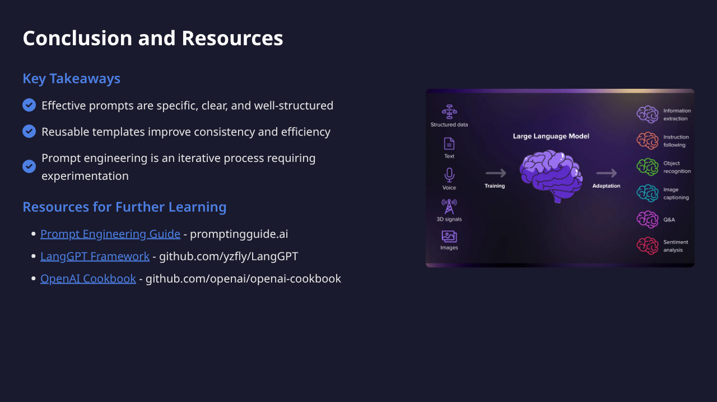
6

