Slide 1
Is Update-frequency and -content connected to App success?
An Analysis of productivity Apps in Google’s Play Store
Applied Project
Minor Digital Science
Tim Jonathan Rupp

Slide 2
Introduction
6 Billion active cell phones in 2021 (Statista, 2021)
Average user had 35 apps installed in 2016 (ThinkwithGoogle, 2016) → today probably significantly more
Google Play offers ~ 2.9 Million apps in July 2021 (Statista, 2021)
Users can rate apps on a star-scale from 1-5 and optionally write a review
App developers can learn how to improve their apps
Users can find out which apps are good and meet their needs

Slide 3
Research Question
Is Update-frequency connected to App success?
(Rating, Sentiment of reviews, Number of Installs)
Are contents of reviews and contents of patch notes connected to app success?
(Rating, Sentiment of reviews, Number of Installs)

Slide 4
Methods - Data Description
Apps: N = 40
Reviews: N = 3,185,528
Patch notes: N = 4595
Date range:
May ‘16 – May’ 21

Slide 5
Methods - Data collection

Slide 6
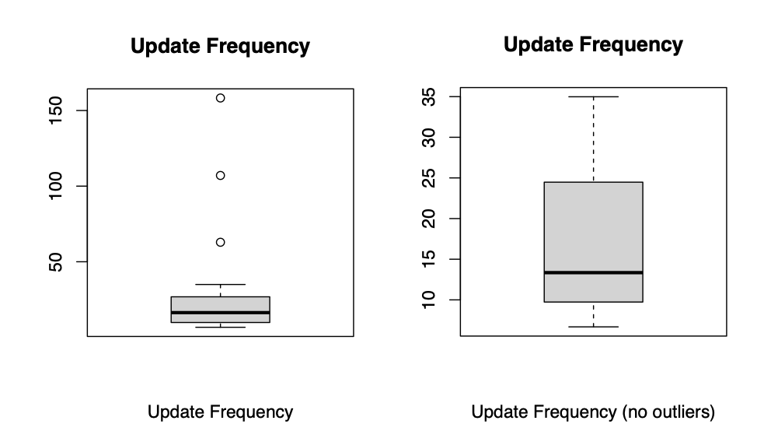
Methods - Data Analysis (update frequency)
(Spearman) Correlation of update frequency on app level (N = 37) with:
Mean rating store
Mean rating reviews
Number of Downloads
Mean Sentiment
Siegel non-parametric regression for significant results
Non-distributed approach
Median of all lines through each point
is calculated
→Median of all Median lines is used as the
regression line

Slide 7
Results – Statistical Analysis (update frequency)

Slide 8
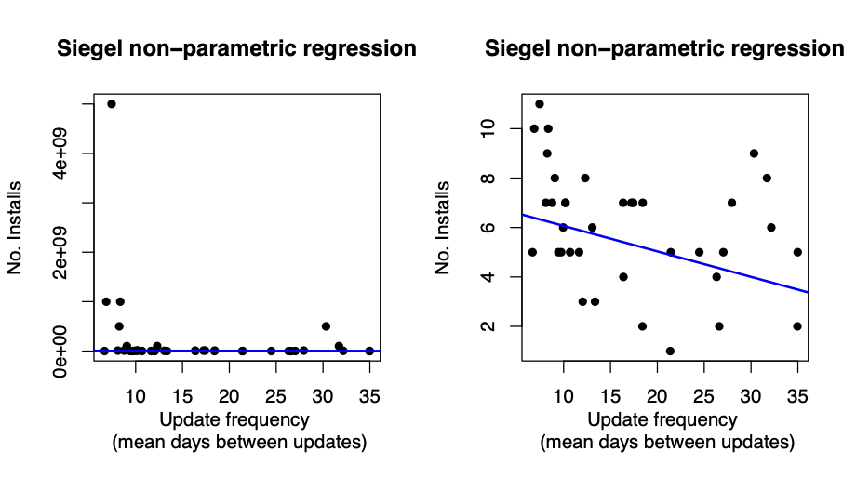
Results – Statistical Analysis (update frequency)
Total installs
Rank of installs
Intercept = 7529153, slope = -116229, p <.001
Intercept = 7.0991, slope = --0.1032, p <.001

Slide 9
Methods – Data Analysis (Reviews & Patch notes)
Topic Modeling (Latent Dirichlet Allocation)
Creation of Dictionary (ID for each unique word or token)
Creation of Bag of words (Count for each token in each document)
Computation of TF-IDF (Term frequency – inverse document frequency)
Number of topic has to be manually selected (depending on coherence and visual inspection of topics)
→ Output: Loadings of the individual reviews on the different topics (Representativeness)
(Pearson) Correlation of Review topics with sentiment and score (review level)
(Pearson) Correlation of Reviews topics with sentiment and score (app level)
(Pearson) Correlation of Patch note topics with sentiment and score (app level)

Slide 10
Results – Statistical Analysis (Reviews)
Topic 1
1: task
2: list
3: time
4: need
5: feature
6: use
7: would
8: get
9: try
10: add
Topic 4
1: good
2: nice
3: excellent
4: complete
5: worth
6: due
7: quite
8: bit
9: fine
10: write

Slide 11
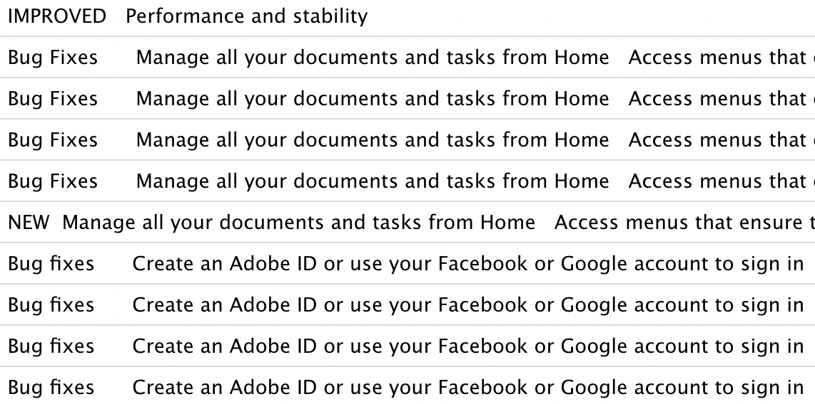
Results – Statistical Analysis (Patchnotes)

Slide 12
Discussion
Only number of installs had a significant correlation with update frequency
Do successful apps have ressources to update more frequently?
Does higher quality of app lead to more installs?
Average rating/sentiment on app level “hides” underlying distribution and variance of reviews/ratings
Should app reviews be trusted in general?
→ Easy to buy good reviews or ”bombard” competitors with bad reviews

Slide 13
Discussion
Review contents:
Positive Correlation of certain Topic and rating/sentiment
→ Not very informative (“good good good”, “very good”, “nice app”)
Negative Correlation of certain Topic and rating/sentiment
→ More informative; missing features, too high costs, unexpected billings
Patch note contents:
Contents not very “research friendly”
→ repetitive and not specific
Corpus with reviews and patch notes could be used for further research

Slide 14
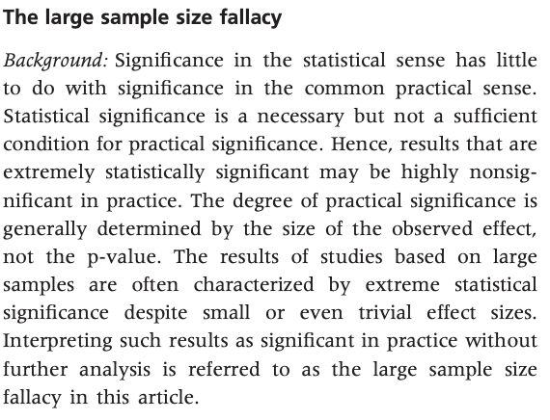
Discussion – Large Sample Size and statistical Analysis
Lantz, 2012

Slide 15
Discussion – Large Sample Size and statistical Analysis
Approach 1: Regression and corresponding effect Size R2
Score ~ Topic 1 explains 9.7% of variance
Sentiment ~ Topic 1 explains 13.4% of variance
Score ~ Topic 4 explains 3.5% of variance
Sentiment ~ Topic 4 explains 17.3% of variance
Approach 2: Creating 10,000 random subsets of N = 100 and compute Pearson’s r
Score x Topic 1: mean r = -.31, times p < .05: 8408
Sentiment x Topic 1: mean r = -.37, times p < .05: 9674
Score x Topic 4: mean r = .18, times p < .05: 4784
Sentiment x Topic 4: mean r = .41, times p < .05: 9901

Slide 16
Sources
Lantz, B. (2012). The large sample size fallacy. Scandinavian Journal of Caring
Sciences, 27(2), 487–492. https://doi.org/10.1111/j.1471-
6712.2012.01052.x
Statista. (2021a, 7. Juli). Smartphone subscriptions worldwide 2016–2026.
https://www.statista.com/statistics/330695/number-of-smartphone
-users-worldwide/
Statista. (2021b, Juli 13). Google Play: number of available apps 2009–2021.
https://www.statista.com/statistics/266210/number-of-available-applications-
in-the-google-play-store/
ThinkwithGoogle. (2020, 3. September). Smartphone Users 22. Think with Google.
https://www.thinkwithgoogle.com/marketing-strategies/app-and-mobile/average
-number-of-apps-on-smartphones/

