Slide 1
OWASP Security TRAINING 2015
May 1, 2015

Slide 2

Consequences of a serious breach?
Blackbaud could make the front page of the WSJ. For all the wrong reasons.
Our company would lose a whole lot of money.
The fundraising ability and therefore the missions of our NPO clients would suffer.
It would seriously damage our clients’ confidence in us and our confidence in ourselves.
It wouldn’t look good on your résumé.

Slide 3
WITH THAT CONTEXT IN MIND…

Slide 4
A5-Security Misconfiguration
Good security requires having a secure configuration defined and deployed for the application, frameworks, application server, web server, database server, and platform.
Secure settings should be defined, implemented, and maintained, as defaults are often insecure.
Additionally, software and dependencies should be kept up to date.
Much of this pertains more to Operations than to R&D, but an understanding of the concepts is essential. Some of it has implications for R&D.

Slide 5
Hardening systems against attack
STRIDE threat modeling (Spoofing Identity, Tampering Data, Repudiation, Information Leak, Denial of Service, Elevation of Privilege).
Change default passwords.
Remove all non-essential software.
Disable test accounts.
Access rights must be explicitly granted by admins, denied by default.
Central patch management and audits process.
Catalog external dependencies and keep them up to date.
Disabling debug logging/messaging.
Generic error messages (don't expose version info, don't allow account enumeration).
Use strong encryption and salt to protect stored sensitive information (passwords).
Don't log sensitive data.
Test for vulnerability.

Slide 6
SPECIFIC Exploits and how to avoid them

Slide 7

A1-Injection (PCI-DSS 6.5.1)
Injection vulnerabilities can allow an attacker to execute arbitrary SQL, LDAP, XPATH or operating system commands on the server.
This can have unfortunate consequences.

Slide 8
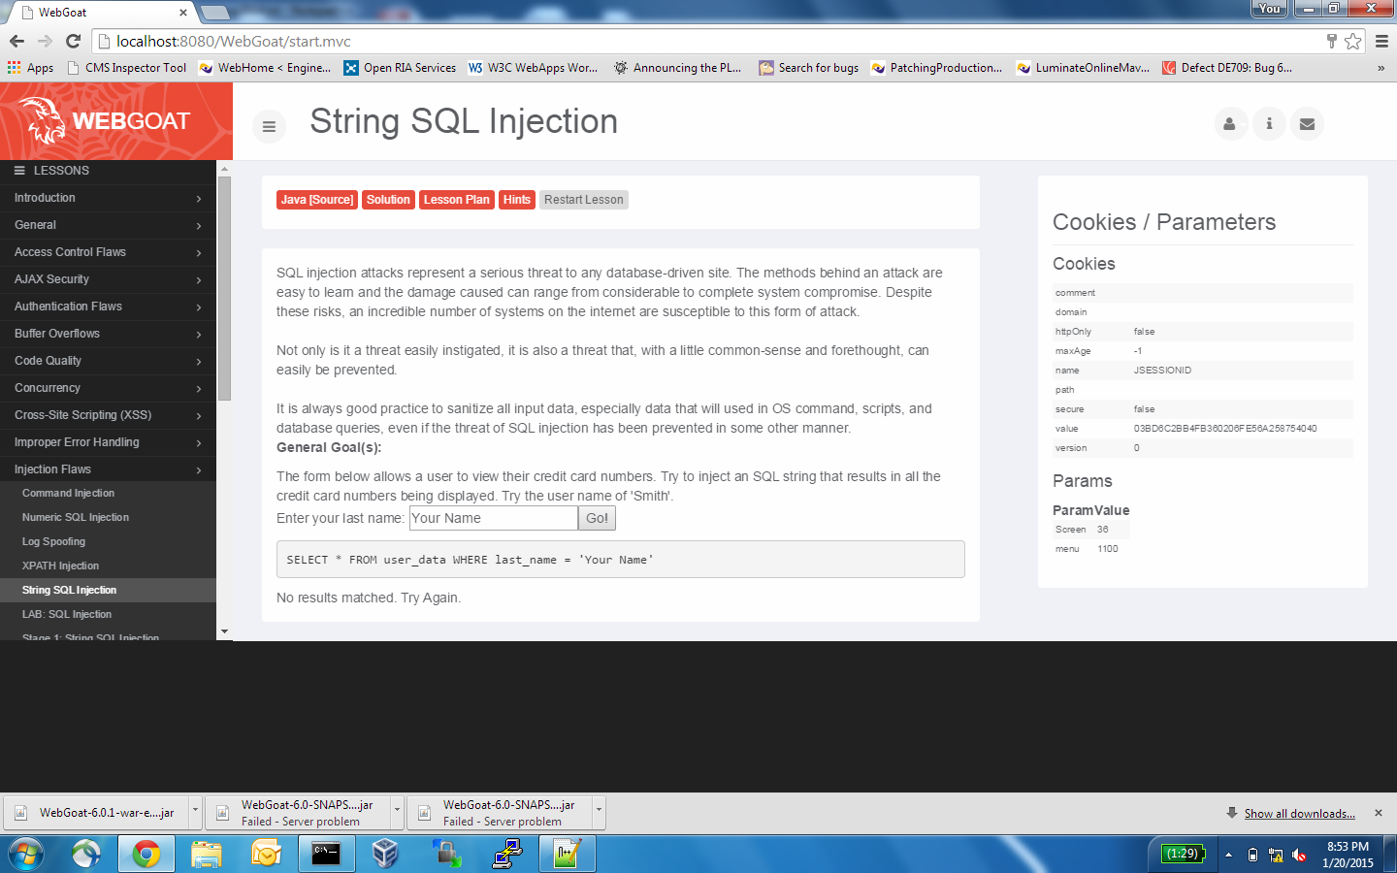

Slide 9
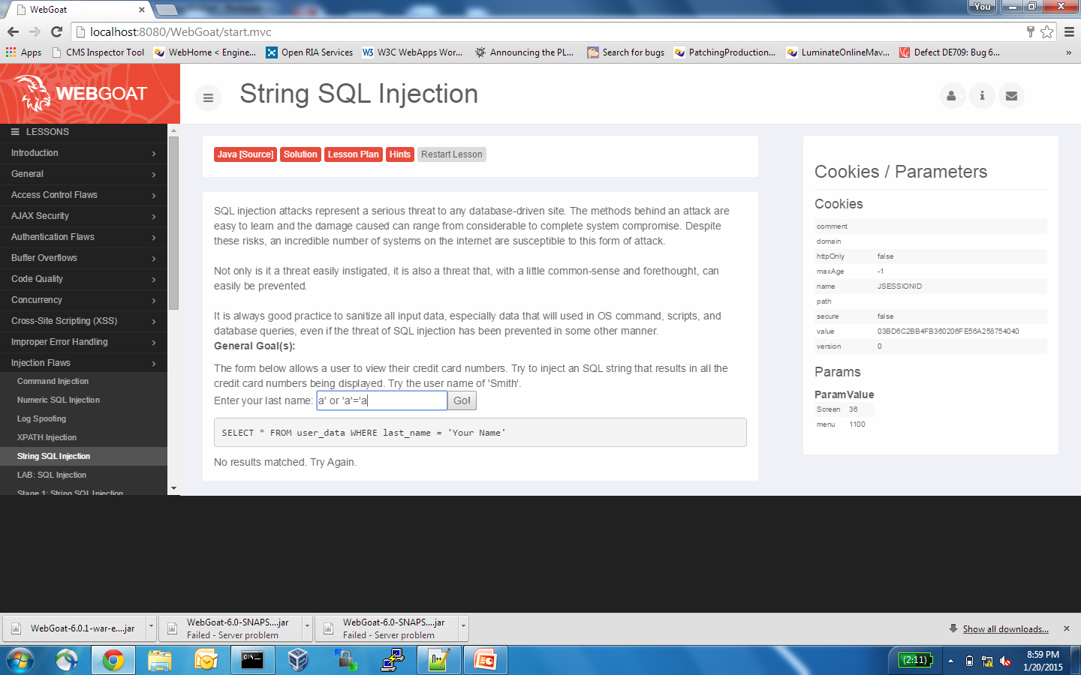

Slide 10
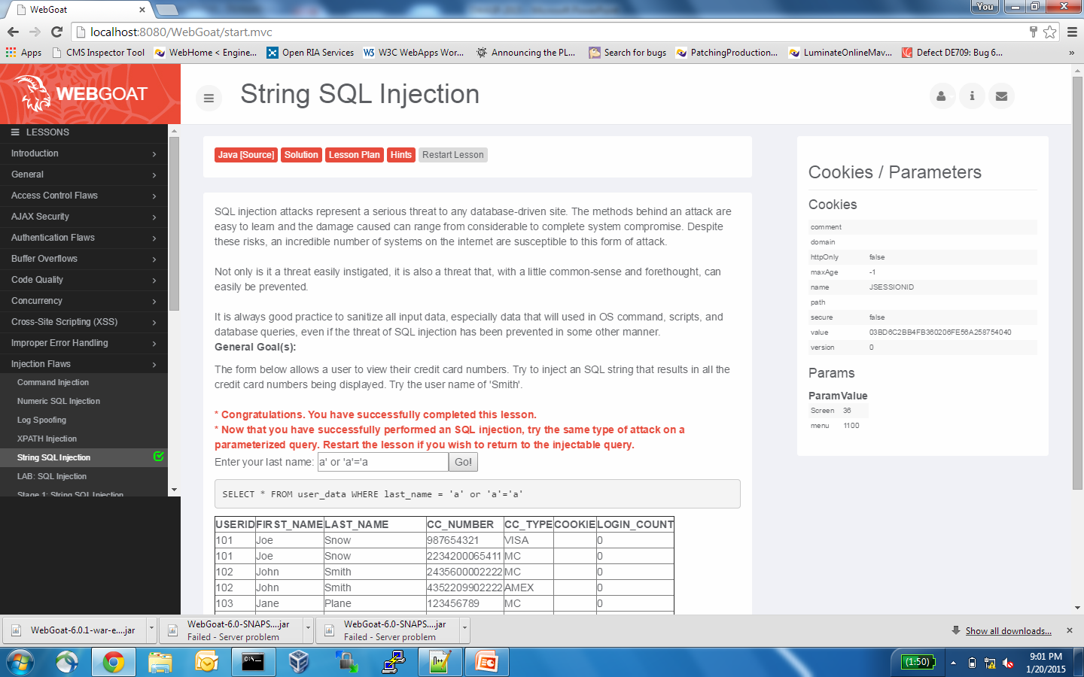

Slide 11


Slide 12
INJECTION: Not just for SQL
When dinosaurs roamed the earth and “dynamic web pages” were made of CGI, command injection was great fun.
Harder to do in these enlightened times, but still possible if you’re sloppy.
Other potential targets for injection include LDAP, XPATH... Anything that can interpret and execute query or command syntax.

Slide 13
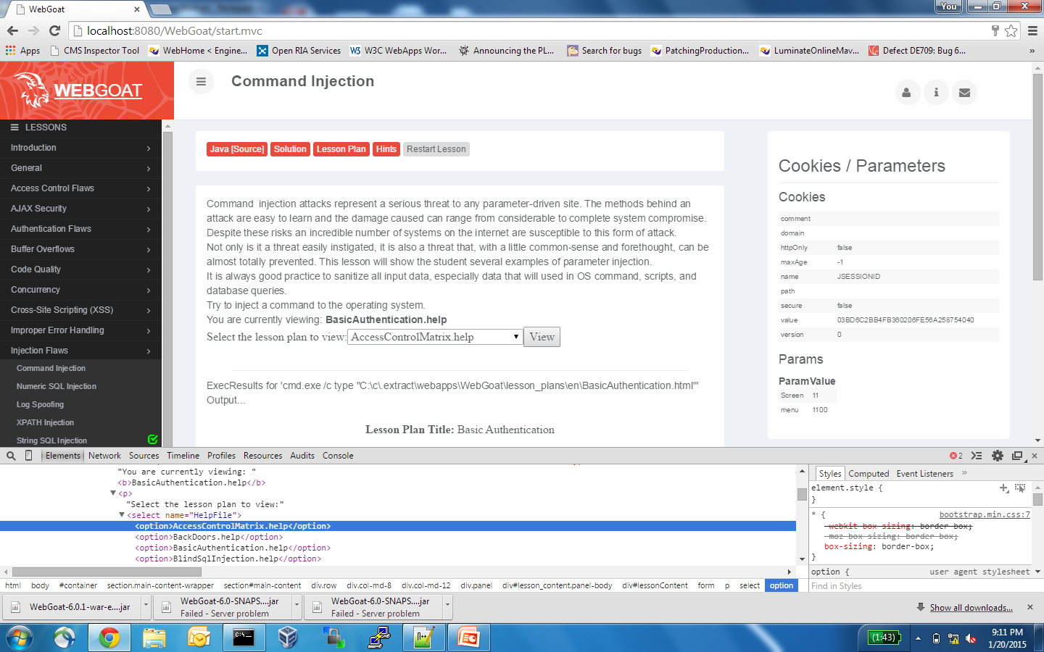

Slide 14
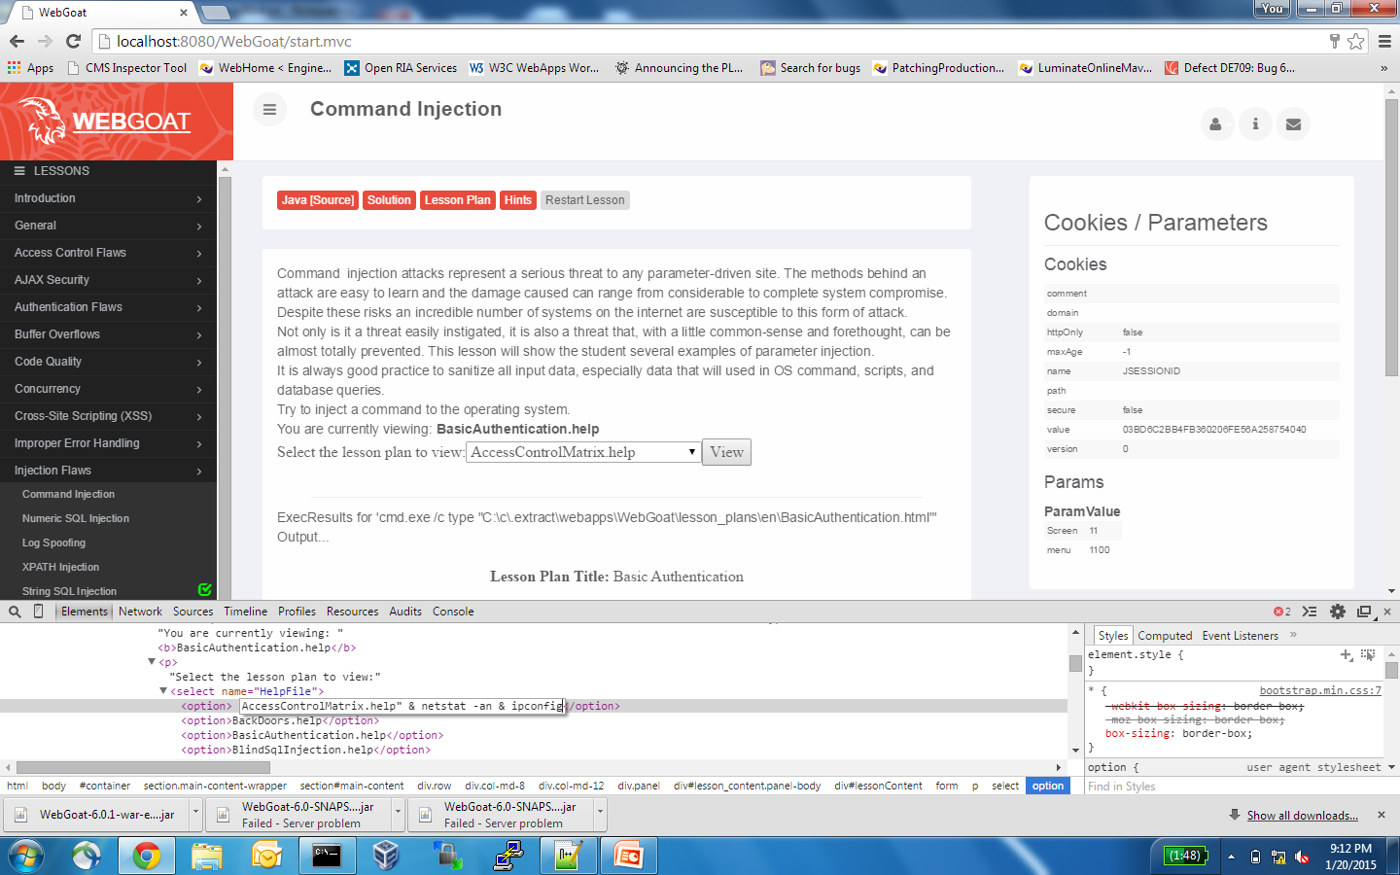

Slide 15
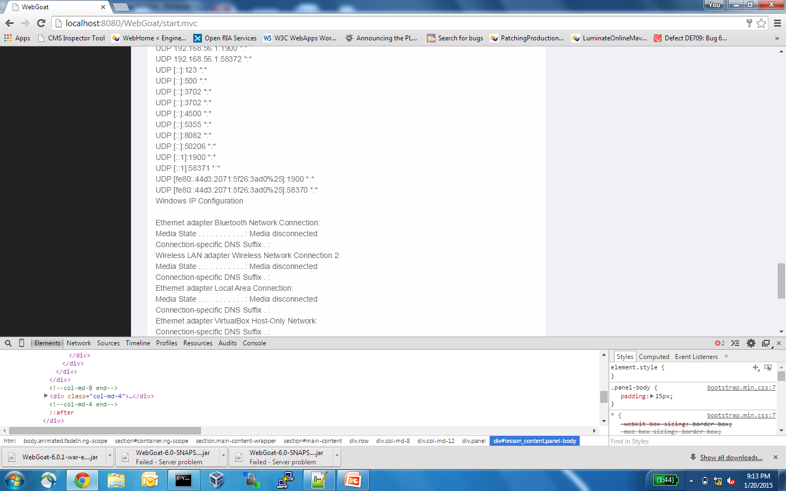

Slide 16
Strategies for Mitigating Injection risk
Be paranoid... they really are out to get you. Distrust all user input.
Validate inputs (e.g. use ESAPI.encoder().encodeForSQL).
JUST DON’T dynamically construct queries or commands with user input:
String query = "SELECT cons_id FROM constituent WHERE member_id ='" + request.getParameter(“member_id") + "'";
USE INSTEAD parameterized SQL queries to avoid any possible confusion between data and SQL commands:
String query = "SELECT cons_id FROM constituent WHERE member_id = ?"; PreparedStatement pstmt = connection.prepareStatement( query ); pstmt.setString( 1, request.getParameter(“member_id") );

Slide 17
A2-Broken Authentication or Session Management (PCI-DSS 6.5.10)
Application functions related to authentication and session management are often not implemented correctly, allowing attackers to compromise passwords, keys, or session tokens, or to exploit other implementation flaws to assume other users’ identities.

Slide 18
SESSION HIJACKING
Access to a valid session token allows an attacker to impersonate another logged-in user.
An attacker may can gain access to a session token by stealing it (i.e. retrieving it from an unencrypted wire packet, URL, or session cookie), or by predicting it.
If the session token is not sufficiently random, it can be predicted.
If the session token is not strongly encrypted, it can be stolen in transit, or from a persisted cookie.
If the user can set their own session cookie, a session fixation attack is possible.

Slide 19
WHAT IS a SESSION FIXATION attack?
The attacker provides a URL with a “valid" session token to the victim.
When the victim clicks the link, the site assigns that session token to identify the victim's session.
When the victim logs in to the site, if the site does not invalidate the session and assign a new one, the attacker can use his session token to impersonate the victim.

Slide 20
GUARDING AGAINST BROKEN AUTHENTICATION / SESSION MANAGEMENT
Ensure you have a reasonable session timeout. This can be set at the app server using container-based-configuration in web.xml, or from code using session.setMaxInactiveInterval(seconds). Best practice is ~15min.
When a user logs in, always invalidate the existing session and issue a new session to prevent session fixation. Never allow users to set their own session IDs.
Don’t expose the session token in a URL or non-secure cookie.
Prevent server cookies from being sent unencrypted via HTTP: cookieConfig.setSecure(true).
When running mixed clear-text and SSL environment, set cookies that are internal to the webapp as "secure".

Slide 21
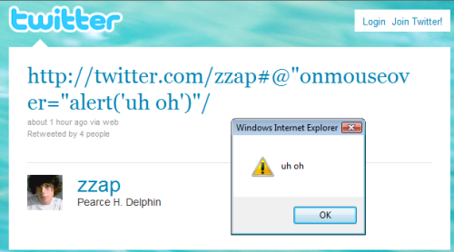
A3-Cross-Site Scripting (XSS) (PCI-DSS 6.5.7)
XSS flaws occur whenever an application takes untrusted data and sends it to a web browser without proper validation or escaping. XSS allows attackers to execute scripts in the victim’s browser which can hijack user sessions, deface web sites, or redirect the user to malicious sites.

Slide 22
MITIGATING XSS
Scrub inputs using regex patters for whitelisting (i.e. only numbers allowed) and blacklisting (i.e. no javascript special characters, html tags allowed) on input.
Whitelist and blacklist are not sufficient by themselves, they must be combined with Output Escaping.
Escape untrusted input before displaying it.
OWASP Java Encoder project https://www.owasp.org/index.php/OWASP_Java_Encoder_Project provides an output escaping library.
Be sure you encode for the proper context. encodeForHtml does no good in a javascript/JSON context, encodeForJavascrip vice-versa.

Slide 23
A8-Cross-Site Request Forgery (CSRF) (PCI-DSS 6.5.9)
A CSRF attack tricks the user into clicking a link while logged in to the site.
This forces a logged-on victim’s browser to send a forged HTTP request, including the victim’s session cookie and any other automatically included authentication information, to a vulnerable web application.
This allows the attacker to force the victim’s browser to generate requests the vulnerable application thinks are legitimate requests from the victim.

Slide 24
HOW CSRF WORKS
CSRF attacks are difficult to detect, since requests come from a legitimate logged-in client.
Typical attack might trigger a purchase, transfer, or profile data tampering.
Blind attack - not used for data theft as the attacker cannot see the response.
Evil site executes a request against the target site, perhaps by embedding the request in an image tag, i.e.
<img src = "https://bankusa.com/transfer?curr=usd&amount=100.00&to_account=008105162304" />
A victim may be tricked by social engineering / phishing into visiting the evil site while logged in to the target site.

Slide 25
PREVENTING CSRF
Where app requests may be subject to CSRF, you can use strong anti-CSRF tokens to ensure that requests are legitimate, since hackers won't be able to successfully predict the token value.
These can also be used to prevent double submission of the same form.
OWASP CSRFGuard library can be used to generate token values https://www.owasp.org/index.php/Category:OWASP_CSRFGuard_Project

Slide 26
A7-Missing Function Level Access Control (PCI-DSS 6.5.8)
Most web applications verify function level access rights before making that functionality visible in the UI. However, applications need to perform the same access control checks on the server when each function is accessed. If requests are not verified, attackers will be able to forge requests in order to access functionality without proper authorization.

Slide 27
IMPLEMENTING FUNCTION LEVEL ACCESS CONTROL
Use role-based access control to ensure that the user has access to the function requested.
Guard against parameter manipulation. (Don’t rely on client-side validation).
An attacker can easily disable validation and change the values of sensitive information in form data or cookies (e.g. "price") submitted by the client.
Key mitigation strategy: don't ask for data you already know.
If you must, you can use a HMAC checksum to verify sensitive parameters passed through the client were not changed.
Concatenate the parameter names and values, hash with a secret key to create a checksum, and require the user to submit the checksum with the data.
Compare the returned parameter and value with the returned key hash to verify that the parameter values were not changed.

Slide 28
A4-Insecure Direct Object References (PCI-DSS 6.5.8)
A direct object reference occurs when a developer exposes a reference to an internal implementation object, such as a file, directory, or database key.
Without an access control check or other protection, attackers can manipulate these references to access unauthorized data.

Slide 29
MITIGATING FORCED BROWSING
By “forced browsing,” an attacker is able to guess unauthorized resource names by entering URLs.
One mitigation approach is to use container-based authorization in web.xml
<security-constraint>
<web-resource-collection>
<url-pattern>
Another option is to use indirect access maps with obfuscated parameters.
Use ESAPI RandomAccessMap class, addDirectReferenc and getInderectReference methods to create inderect access maps.

Slide 30
A6-Sensitive Data Exposure (PCI-DSS 6.5.6, 6.5.4)
Many web applications do not properly protect sensitive data, such as credit cards, tax IDs, and authentication credentials. Attackers may steal or modify such weakly protected data to conduct credit card fraud, identity theft, or other crimes. Sensitive data deserves extra protection such as encryption at rest or in transit, as well as special precautions when exchanged with the browser.

Slide 31
PROTECTING SENSITIVE INFORMATION
Valuable information such as personally-identifying information, account numbers, SSNs, credentials and passwords etc. must never be stored in plain text.
Be especially careful with log files. These get downloaded, copied to archives, etc., and leaks can proliferate. Don’t log data you don’t mean to log. By default, don’t log data.
Use strong encryption libraries / algorithms for sensitive data (not MD5 or DES). Cf. http://MD5decryptor.co.uk
Don't use unsalted crypto storage for passwords. http://splashdata.com/press/worstpasswords2013.htm
HTTPS only for sensitive data. https://codebutler.github.io/firesheep/

Slide 32
PROTECTING SENSITIVE INFORMATION (CONT’D)
Stolen credentials or CC numbers make headlines and cost $ millions.
CC numbers must not be stored.
Passwords must be stored encrypted and salted.
Use Java.Security Javax.Crypto in JCA.
Generate salts with a cryptographically strong generator (not java.math.radom).
The salt value must be stored with the password hash. The salt may be stored in plaintext. The salt is used to create a copy of the hash for comparison when a user supplies his password to authenticate.

Slide 33
PROTECTING SENSITIVE INFORMATION (LAST TOPIC)
Same generic error for bad username, password on login to prevent account enumeration.
Use two-factor authentication for password reset
Guard against brute force attack with account lockout (may be subject to DoS attack, also can permit account enumeration), password complexity (prevent dictionary hacks), increasing delay (discourages brute force attempts without the downside of lockout), or CAPCHA (may introduce ADA compliance issues).

Slide 34
A9-Using Components with Known Vulnerabilities (PCI-DSS 6.5.2)
PCI 6.5.2 regards Buffer Overflow vulnerabilities, “but we use Java...”
Here's a WSDL document for Luminate Online Web Services (CWS): http://secure-bvtframework05.conviocloud.com:8443/1.0/bvtframework501/wsdl
Let's try the URL root: http://secure-bvtframework05.conviocloud.com:8443/1.0/
What's wrong with this error?
This: https://web.nvd.nist.gov/view/vuln/search-results?query=Resin&search_type=all&cves=on
By publishing that we're using Resin v3.1.8, we give an attacker a well-documented set of vulnerabilities to try to exploit.

Slide 35
MITIGATING OLD CRAP RISKS
This is hard, and there are no silver bullets
It’s a significant area of risk, cf. heartbleed, poodle
Don’t advertise vulnerabilities (version numbers) in error messages
Catalog all dependencies
Just because it's open source doesn't mean you need to improve it (cf. TinyMCE, YUI)
Create standard operating procedures for managing patches and upgrades to stack and libraries
Use centralized configuration and patch management in production

Slide 36
A10-Unvalidated Redirects and Forwards
Web applications frequently redirect and forward users to other pages and websites, and use untrusted data to determine the destination pages. Without proper validation, attackers can redirect victims to phishing or malware sites, or use forwards to access unauthorized pages.
NEXTURL and API common parameters redirect, success_redirect, error_redirect are textbook examples.

Slide 37
PREVENTING UNVALIDATED REDIRECTS
Permit redirection only within the site or to whitelisted domains.

Slide 38
RESOURCES and tools
OWASP Top 10 2013 https://www.owasp.org/index.php/Top_10_2013-Top_10 provides a drill-down links from the top-ten summary page to detailed descriptions of each threat with links to cheat sheets, other resources and references.
OWASP WebGoat https://github.com/WebGoat/WebGoat is an intentionally insecure web app that provides tutorials on many types of attack and vulnerability. I recommend the single-package JAR https://webgoat.atlassian.net/builds/browse/WEB-WGM/latestSuccessful
OWASP Zen Attack Proxy (ZAP) tool for automated and manual penetration testing of your app instance. https://www.owasp.org/index.php/OWASP_Zed_Attack_Proxy_Project
Security Compass free OWASP Top 10 Online Training http://securitycompass.com/training/free/course-demos/
OWASP education slide decks on various topics https://www.owasp.org/index.php/Education/Free_Training

