Slide 1
Range minimum Queries / LCA
Kevin Shan

Slide 2
Least Common Ancestor
Finding the lowest ancestor between two nodes
Only Works for Trees
Target complexity is O(N logN) to construct, and O(logN) to query
Vocab:
Ancestor - a node who has a lower depth than another node (Root node is an ancestor of all other nodes)
Tree - An undirected graph where every node is connected, there are no cycles, and there are N-1 edges

Slide 3
Range Minimum Queries
Useful Gold/Platinum concept (Mostly platinum)
Taking the minimum of a range in log(N) time
Being able to update that range quickly in log(N) time as well
Naive solution: O(N^2) - looping through all elements and keeping track of the minimum
This is typically too slow

Slide 4
Segment Tree Review
Used for range queries and updates
Can be used for range minimum queries (is conventionally used for RMQs)
Solid implementation: https://cp-algorithms.com/data_structures/segment_tree.html
BIT / Fenwick technically can be used, but it is very difficult

Slide 5
Variant 1 - Using Range Minimum Queries
Create an array representation of graph
Run a DFS starting from the root note, and store in a vector the nodes you visit
  Also called a Euler Tour
Mark a node down each time you “return” to it
Use a Segment tree to store the depths of each node
  For each segment you will need to store both the minimum depth, along with the node that corresponds with that depth
Use RMQ to find the node with the lowest depth
  Because we “return” to each node, we will only have one node with the lowest depth.

Slide 6
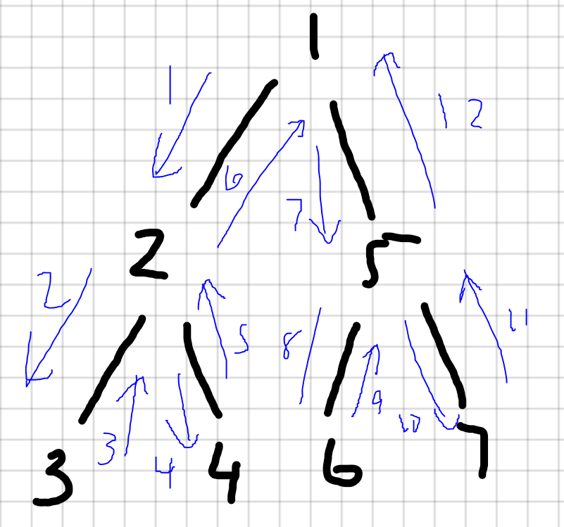
DFS
vector<int> v;
vector<int> adj[N];
void dfs(int x, int p){
v.pb(x);
for(int a:adj[x]){
if(a==p) continue
dfs(a, x);
v.pb(x);
}
}
// v = {1, 2, 3, 2, 4, 2, 1, 5, 6, 5, 7, 5, 1}

Slide 7
Using RMQ:
Nodes:
Depths:
Steps:
Store indices of first occurrence of node
Query with the segment tree the first occurance of both nodes
Return the node with the lowest depth
1 | 2 | 3 | 2 | 4 | 2 | 1 | 5 | 6 | 5 | 7 | 5 | 1
0 | 1 | 2 | 1 | 2 | 1 | 0 | 1 | 2 | 1 | 2 | 1 | 0

Slide 8
Example - LCA of node 3 and 5
Nodes:
Depths:
Steps:
Find first occurrences: Node 3 - 2, Node 5 - 7
Query from 2 to 7
Smallest depth is 0 -- this belongs to node 1
LCA between Node 3 and Node 5 is Node 1
1 | 2 | 3 | 2 | 4 | 2 | 1 | 5 | 6 | 5 | 7 | 5 | 1
0 | 1 | 2 | 1 | 2 | 1 | 0 | 1 | 2 | 1 | 2 | 1 | 0

Slide 9
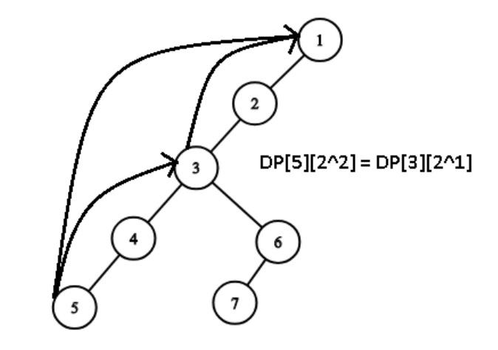
Variant 2 - LCA with Binary Lifting
What is Binary Lifting?
Traversing through a tree in log(N) time
Using powers of 2 to quickly move up the tree
Allows you to quickly find the LCA of two nodes
Standard implementation: https://cp-algorithms.com/graph/lca_binary_lifting.html

Slide 10
LCA with binary lifting implementation
Perform a DFS in the same fashion as the other LCA algorithm
Using Dynamic programming, keep track of an “up” dp
When querying two nodes, first check if one is an ancestor of the other. If one of them is, the answer is obvious
Otherwise, use the “up” array to quickly locate their ancestor in O(logN) time
  Essentially a “binary search” for the first element that is not an ancestor of both

Slide 11
DFS
vector<int> adj[N];
int be[N], end[N], up[N][logN];
int cnt = 1;
void dfs(int x, int p){
be[x] = cnt++;
up[x][0] = p;
for(int i=1; i<=l; i++) up[x][i] =
up[up[x][i-1]][i-1];
for(int i:adj[x]){
if(i!=p)
dfs(i, x);
}
en[x] = cnt;
}
//{1, 2, 3, 3|4, 4|2|5, 6, 6|7, 7|5|1}
//be|en: 1|8 2|5 3|4 4|5 5|8 6|7 7|8

Slide 12
Checking ancestors
bool anc(int u, int v){
// is u an ancestor of v
return be[u]<=be[v] && en[u]>=en[v];
}
//if the start and end of a node is in the range of another node’s start and end, then that node is an ancestor.
//{1, 2, 3, 3|4, 4|2|5, 6, 6|7, 7|5|1}
//be|en: (1)1|8 (2)2|5 (3)3|4 (4)4|5 (5)5|8 (6)6|7 (7)7|8

Slide 13
Finding LCA
int lca(int u, int v){
if (anc(u, v)) return u;
if (anc(v, u)) return v;
for(int i = l; i>=0; i--){
if(!anc(up[u][i], v))
u = up[u][i];
//this works because the jumps get smaller and smaller
}
//above is basically a binary search to find the node under the LCA
return up[u][0];
}

Slide 14
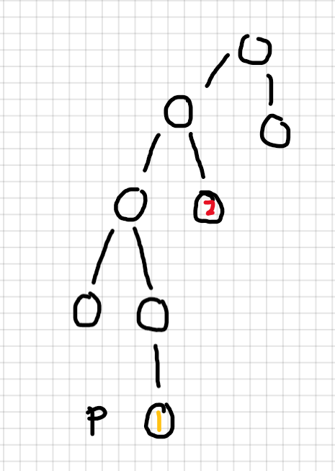
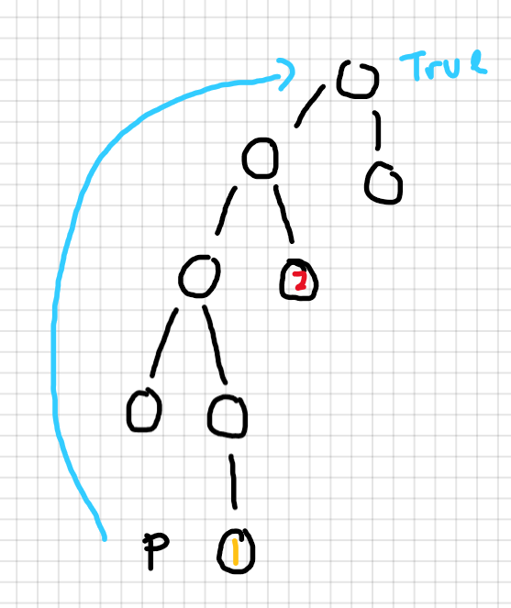
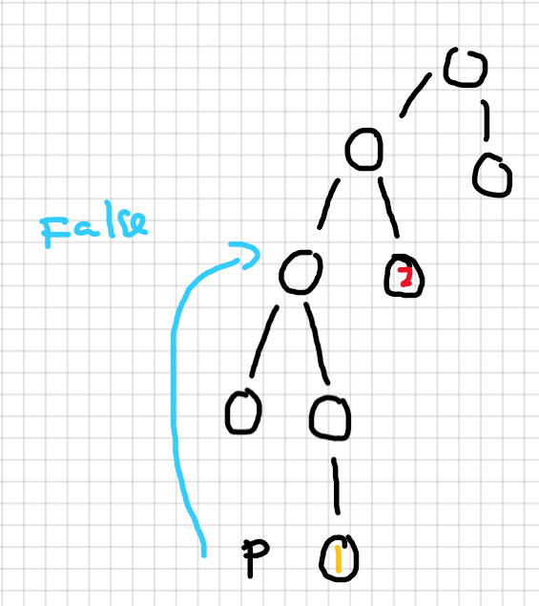
Set up the graph, making sure 1 is not an ancestor of 2, or vice versa. Set up your pointer at one of the nodes.
Check 4 up from the pointer, P. It is an ancestor of the other node, so we don’t move it.
Check 2 up from the pointer. It is not an ancestor of 2, so we will move the pointer up.

Slide 15
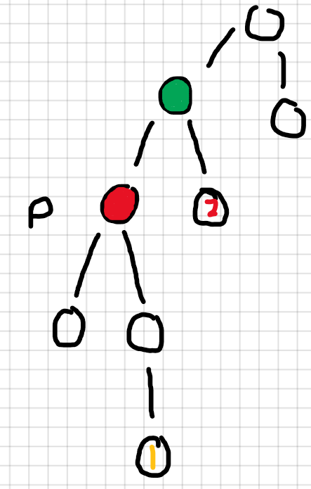
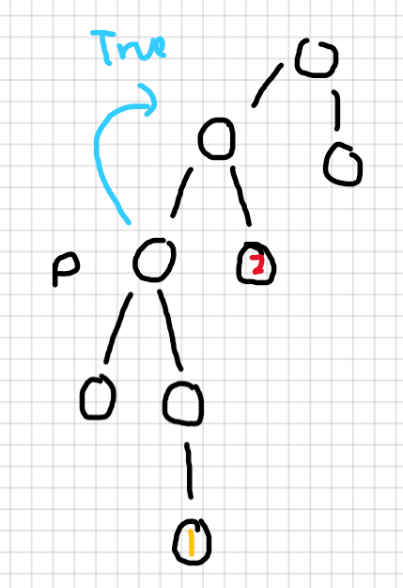
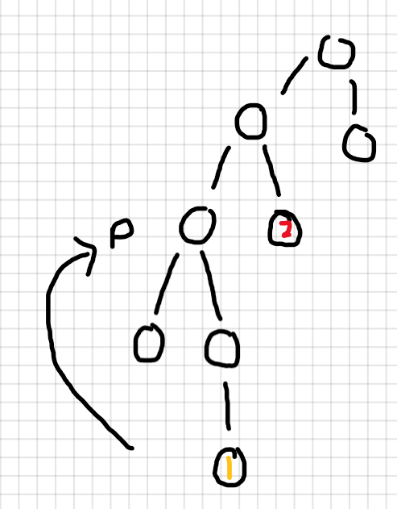
Move the pointer up 2 levels
Check 1 up from the pointer, P. It is an ancestor of the other node, so we don’t move it.
We can no longer move up. Return the parent of the node at the pointer.

Slide 16
Other resources
Problems:
Maxflow: http://www.usaco.org/index.php?page=viewproblem2&cpid=576
Milkvisits: http://www.usaco.org/index.php?page=viewproblem2&cpid=970
Binary Lifting:
https://usaco.guide/plat/bin-jump?lang=cpp
https://usaco.guide/CPH.pdf#page=173
https://codeforces.com/blog/entry/81527

