Slide 1

Machine Learning 2
Tomasz Starakiewicz

Slide 2




Machine learning tasks
Regression
Classification
Notes:
we will look at two problems – predicting a used car listing price and predicting whether someone is diabetic
I must say it was very hard to find a good dataset that was personally interesting to me, but I finally found two

Slide 3
Regression task
Problem
Predict used car price
Why does it matter?
Price seller’s car – avoid underpricing
Identify bargains for the buyer
Data source
Scraped used car listings from UK marketplaces
Notes:
in the first problem, I’m looking at 10,000 UK listings of used cars and trying to predict the price based on the car characteristics
this is quite interesting to me, because such prediction can be useful to both buyers and sellers, to avoid underpricing or to find a good existing price on the market
it’s even more interesting for me because some time ago I was looking for a car and was wondering if I would be able to get some prediction going
we’ll find out

Slide 4
Features available
Target variable
Explanatory variables
Listed price
Production year
Mileage
Vehicle tax
Miles per gallon
Engine size
Transmission
Model
Fuel type
Numeric
Categorical
Notes:
in the dataset we have both numeric and categorical variables, mostly focues on fuel efficiency, age and performance

Slide 5
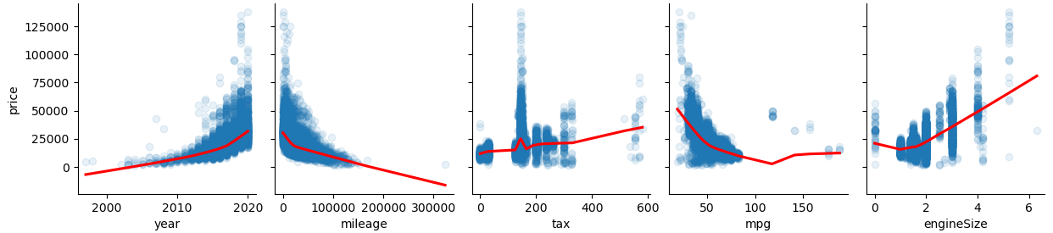
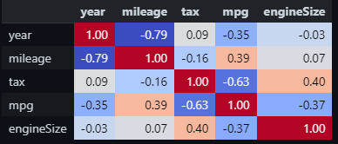
EDA – numeric variables
Notes:
Unsuprisingly: year (of production) is positively correlated with the price- mileage is negatively correlated with the price- engine size is positively correlated with the price
All of these display low to mdeium level of non-linearity around extreme values, so because I will use linear regression as a benchmark, it will definitely reduce the precision

Slide 6
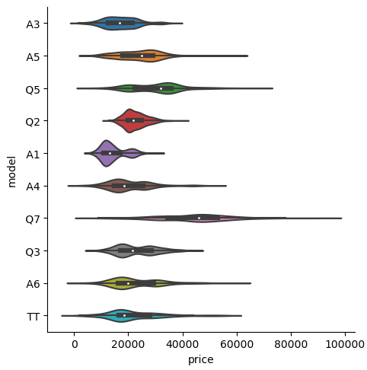
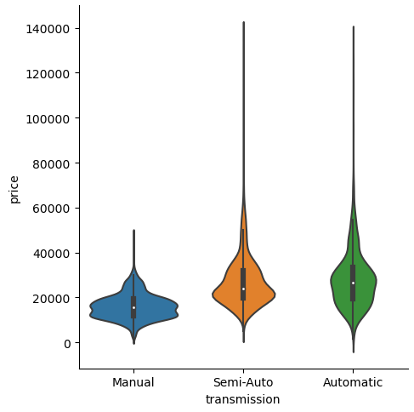
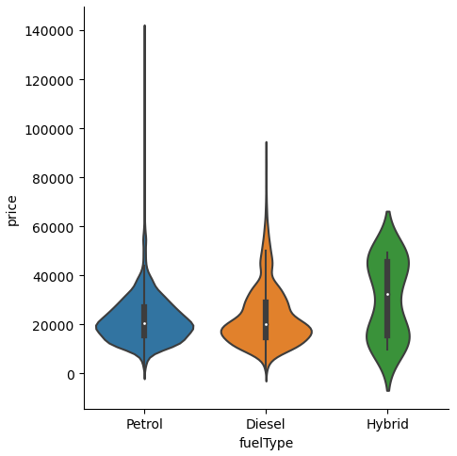
EDA – categorical variables
Notes:
Categorical variables seem informative e.g. automatic cars are positively associated with price, though there is not much difference between petrol and diesel cars in terms of price.
The model types had a high cardinality, so I left only the top 10 models which represented 95% of observations and grouped others. Unsuprisingly the prices vary greatly across model types.

Slide 7
Modelling
Models
Performance metrics
Linear regression
MAPE
Random Forest
MAE
XGBoost
RMSE
Neural network
Notes:
as far as modeling is concerned, I’m using linear regression as a benchmark, and three methods we covered during the classes
Random forecast, XGBoost and neural networks
will asses on Mean Average Percentage Error, but will also look at Mean Absolute Error because it has a very nice tacticle feel, it is how much you would be out of pocket on average due to error
Root Mean Square Error just to see how outliers are impacting across models
Definitely expect XGBoost to perform the best

Slide 8
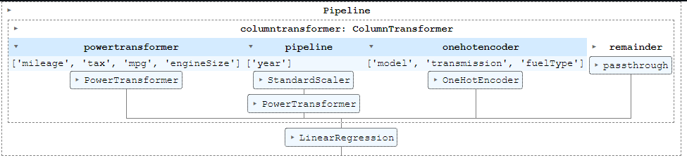

Tuning and validation
Validation
5-fold cross-validation, with transformations trained separately on each split
Hyperparameter tuning
Bayesian optimization with 50 trials
Notes:
at training stage, I’m using 5-fold cross-validation, I’m using the scikit-learn pipelines, so any transformations I’m doing are trained separately on each split, so I’m getting a quite accurate estimate of performance
for linear regression I’m centering and scaling variables with Yeo-Johnson transformation
for random forest and linear regression I’m onehotencoding categorical variables
XGBoost, because I’m using the native API, will handle categories itself
for hyperparameter tuning, I’m using Bayesian optimization instead of standard grid or random search, so each combination of hyperparameters tried is guided by the previous ones. So we pick those combinations that are either maximizing the likelihood we’re gonna get improvement or are very different from the ones we tried so far so we simply don’t know
here you can see the final hyperparameters for random forest and XGBoost

Slide 9
Results
Model | Training score |  |  | Test score
 | MAPE | MAE | RMSE | MAPE | MAE | RMSE
Linear regression | 13.4% | 2,933 | 4,806 | 13.4% | 2,989 | 5,122
Random forest | 7.4% | 1,543 | 2,394 | 6.8% | 1,480 | 2,229
XGBoost | 7.0% | 1,483 | 2,276 | 6.5% | 1,441 | 2,155
Neural network
Notes:
final results are no surprise, linear regression did pretty badly, and XGBoost was the most accurate method, though the difference on test set in absolute terms is not that high
although overall we see that considering the average car cost 22k, the 1.4k error on average is still quite high
however, the interesting thing we should note that test performance is better that cross-validated training score, and this is because the final model was trained on full training data, so it had 25% more observations
this means that we can expect random forest and XGBoost to benefit quite a lot from additional data

Slide 10
Classification task
Problem
Predict diabetics
Why does it matter?
Identify individuals at-risk with limited data (survey responses)
Data source
Behavioral Risk Factor Surveillance System – national survey ran by CDC
Notes:
for the classification task I’m trying to predict if a person is a diabetic based on their responses
based on survey ran by CDC where they call up people with diabetes and healthy people, ask them some questions
which is potentially very impactful, because if we are accurate enough, we can than start screening people who we don’t know if they are diabetics, and potentially for those who are at risk, help them change their lifestyle

Slide 11
Features available
Target variable
Explanatory variables
Diabetes present
BMI
Physical activity
Age
Days of poor mental health
Has health coverage
High blood pressure
High cholesterol
Difficulty walking
Cholesterol was checked
Smoker
Stroke
Is male
Binary
Heart disease
Recent physical activity
Consumes fruit
Didn’t see doctor because of cost
Numeric
Consumes vegetables
Heavy alcohol consumption
General heatlh
Education
Ordinal
Income
Notes:
there are quite a few predictors in here, most of them are binary, but we also have some ordinal variables, based on an arbitrary scale, so we can either treat them as numeric or categorical variables
though of course this would matter only for logistic regression

Slide 12
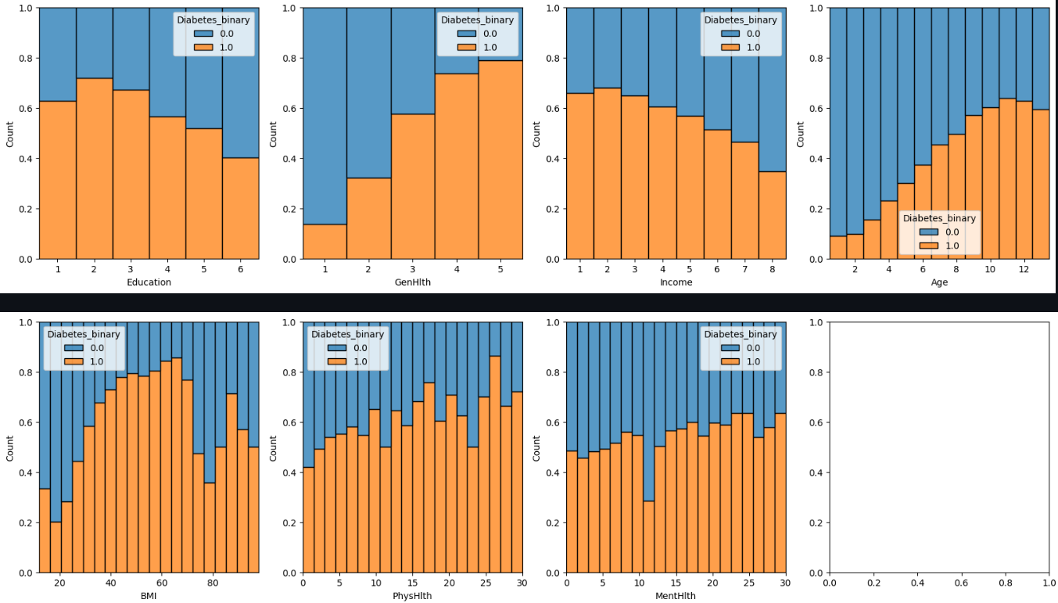
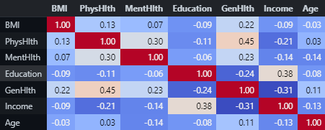
EDA – numeric variables
Notes:
interestingly, we see here that predictors mostly have monotonic association with the target variable
this is of course not decisive, but based on these charts we can say that logistic regression should do pretty well

Slide 13
Modelling
Models
Performance metrics
Logistic regression
AUC
Random Forest
Balanced F1
XGBoost
Neural network
Notes:
to test this, I will use logistic regression as a benchmark and random forest, XGBoost and neural network
this time I will use area under ROC curve
as well as F1 score, so the harmonic mean of precision and recall

Slide 14
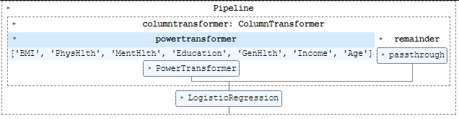
Tuning and validation
Validation
5-fold cross-validation, with transformations trained separately on each split
Hyperparameter tuning
Bayesian optimization with 50 trials
Notes:
same approach to tuning and validation, though this time I don’t need to onehotencode, since all the categorical variables are binary

Slide 15
Results
Model | Training score |  | Test score
 | AUC | F1 | AUC | F1
Logistic regression | 0.823 | 0.749 | 0.826 | 0.756
Random forest | 0.821 | 0.755 | 0.826 | 0.761
XGBoost | 0.827 | 0.760 | 0.819 | 0.756
Neural network
Notes:
and quite surprisingly, it seems we don’t need any of the fancy methods, since logistic regression is either on par, or even outperforms decision trees
I was wondering why, and after a bit of digging I found out that, the questions in the survey are not just some random lifestyle questions, but carefully chosen based on diabetes literature
so this is an interesting learning for me that in those situations where you have a well studied topic with strong expert knowledge on predictros, modern machine learning will not necessarily give you an edge

