Slide 1

Machine Learning
Tomasz Starakiewicz

Slide 2




Machine learning tasks
Regression
Classification

Slide 3
Regression task
Problem
Predict used car price
Why does it matter?
Price seller’s car – avoid underpricing
Identify bargains for the buyer
Data source
Scraped used car listings from UK marketplaces

Slide 4
Features available
Target variable
Explanatory variables
Listed price
Production year
Mileage
Vehicle tax
Miles per gallon
Engine size
Transmission
Model
Fuel type
Numeric
Categorical

Slide 5
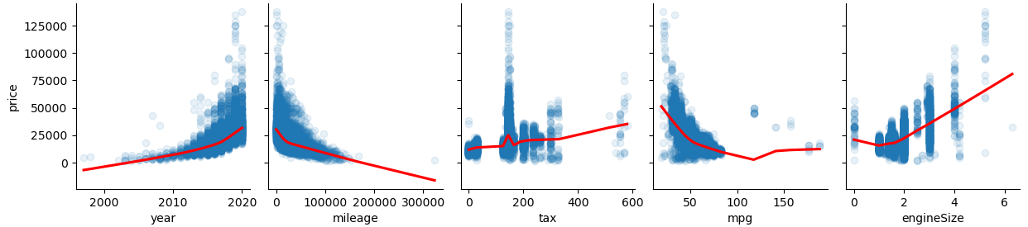
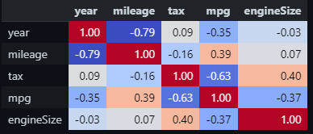
EDA – numeric variables

Slide 6
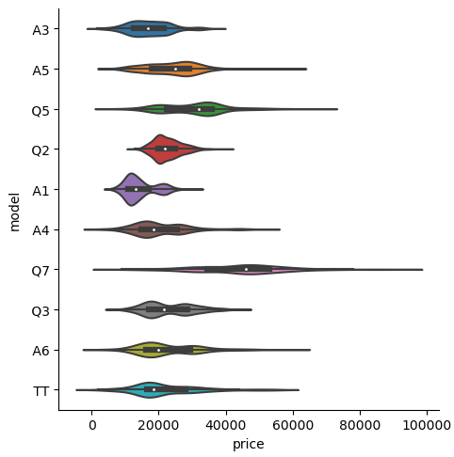
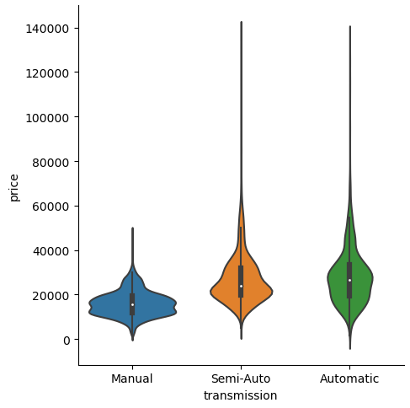
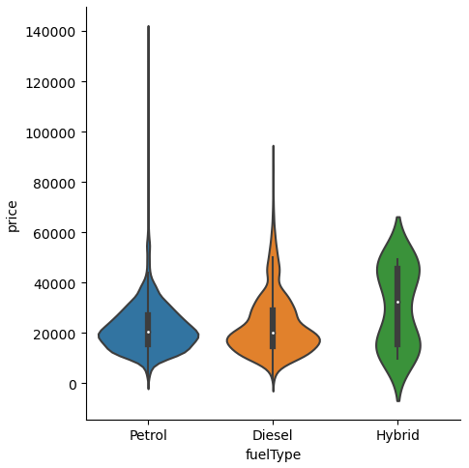
EDA – categorical variables

Slide 7
Modelling
Models
Performance metrics
Linear regression
MAPE
Random Forest
MAE
XGBoost
RMSE
Neural network

Slide 8
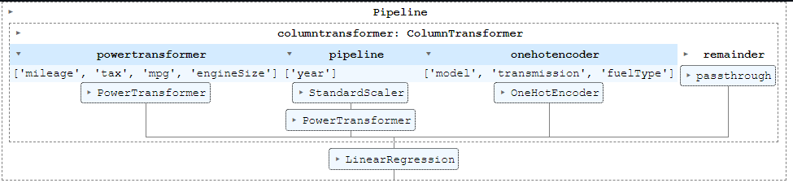

Tuning and validation
Validation
5-fold cross-validation, with transformations trained separately on each split
Hyperparameter tuning
Bayesian optimization with 50 trials

Slide 9
Results
Model | Training score |  |  | Test score
 | MAPE | MAE | RMSE | MAPE | MAE | RMSE
Linear regression | 13.4% | 2,933 | 4,806 | 13.4% | 2,989 | 5,122
Random forest | 7.4% | 1,543 | 2,394 | 6.8% | 1,480 | 2,229
XGBoost | 7.0% | 1,483 | 2,276 | 6.5% | 1,441 | 2,155
Neural network

