Slide 1

Machine Learning
Tomasz Starakiewicz

Slide 2




Machine learning tasks
Regression
Classification

Slide 3
Regression task
Problem
Predict used car price
Why does it matter?
Price seller’s car – avoid underpricing
Identify bargains for the buyer
Data source
Scraped used car listings from UK marketplaces

Slide 4
Features available
Target variable
Explanatory variables
Listed price
Production year
Mileage
Vehicle tax
Miles per gallon
Engine size
Transmission
Model
Fuel type
Numeric
Categorical

Slide 5
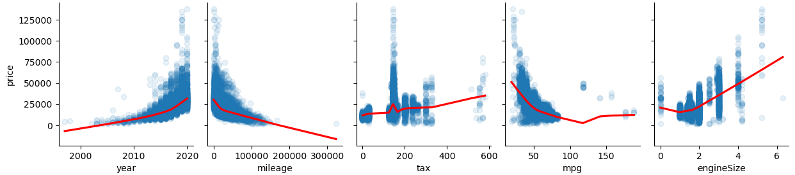
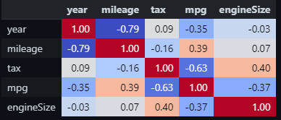
EDA – numeric variables

Slide 6
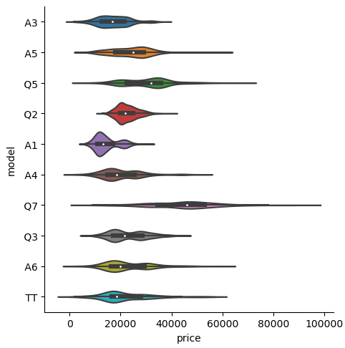
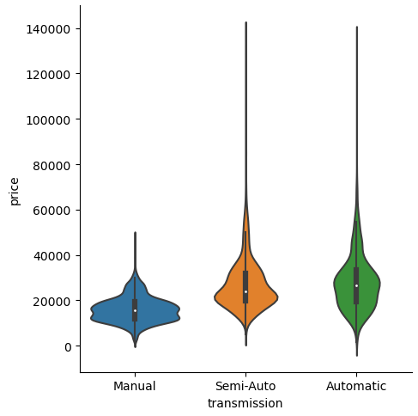
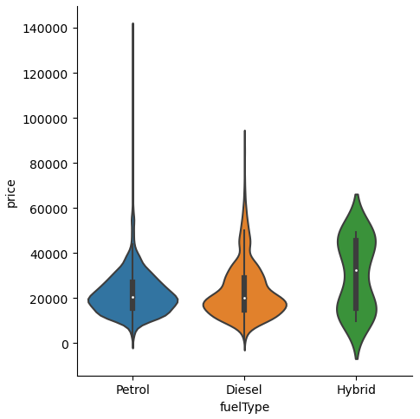
EDA – categorical variables

Slide 7
Modelling
Models
Performance metrics
Linear regression
MAPE
Random Forest
MAE
XGBoost
RMSE
Neural network

Slide 8
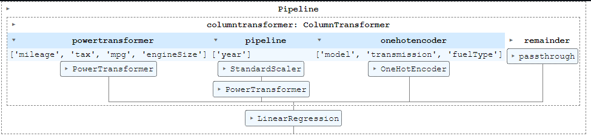
Validation
5-fold cross-validation, with transformations trained separately on each split

Slide 9
Results
Model | Training score |  |  | Test score
 | MAPE | MAE | RMSE | MAPE | MAE | RMSE
Linear regression
Random forest
XGBoost
Neural network

