Slide 1

Machine Learning 2
Tomasz Starakiewicz

Slide 2




Machine learning tasks
Regression
Classification

Slide 3
Regression task
Problem
Predict used car price
Why does it matter?
Price seller’s car – avoid underpricing
Identify bargains for the buyer
Data source
Scraped used car listings from UK marketplaces

Slide 4
Features available
Target variable
Explanatory variables
Listed price
Production year
Mileage
Vehicle tax
Miles per gallon
Engine size
Transmission
Model
Fuel type
Numeric
Categorical

Slide 5
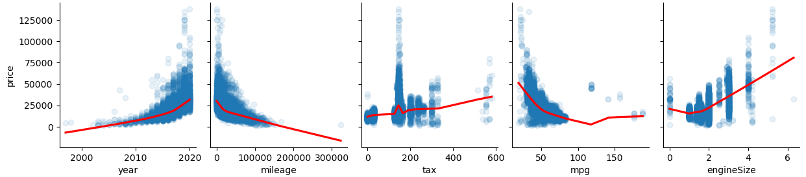
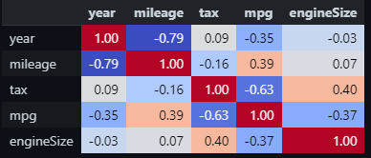
EDA – numeric variables

Slide 6
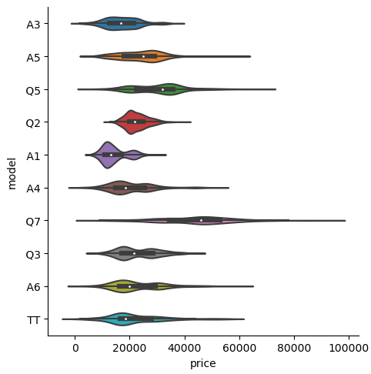
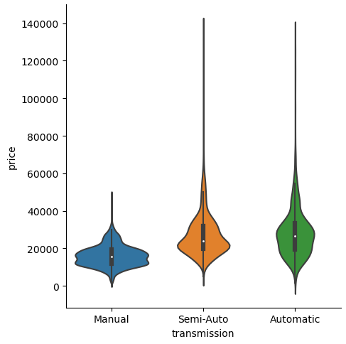
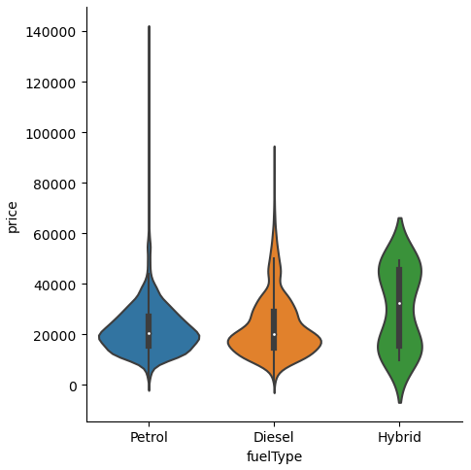
EDA – categorical variables

Slide 7
Modelling
Models
Performance metrics
Linear regression
MAPE
Random Forest
MAE
XGBoost
RMSE
Neural network

Slide 8
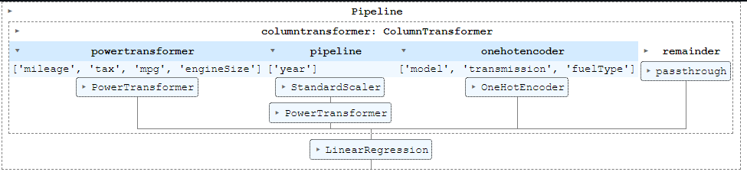

Tuning and validation
Validation
5-fold cross-validation, with transformations trained separately on each split
Hyperparameter tuning
Bayesian optimization with 50 trials

Slide 9
Results
Model | Training score |  |  | Test score
 | MAPE | MAE | RMSE | MAPE | MAE | RMSE
Linear regression | 13.4% | 2,933 | 4,806 | 13.4% | 2,989 | 5,122
Random forest | 7.4% | 1,543 | 2,394 | 6.8% | 1,480 | 2,229
XGBoost | 7.0% | 1,483 | 2,276 | 6.5% | 1,441 | 2,155
Neural network

Slide 10
Classification task
Problem
Predict diabetics
Why does it matter?
Identify individuals at-risk with limited data (survey responses)
Data source
Behavioral Risk Factor Surveillance System – national survey ran by CDC

Slide 11
Features available
Target variable
Explanatory variables
Diabetes present
BMI
Physical activity
Age
Days of poor mental health
Has health coverage
High blood pressure
High cholesterol
Difficulty walking
Cholesterol was checked
Smoker
Stroke
Is male
Binary
Heart disease
Recent physical activity
Consumes fruit
Didn’t see doctor because of cost
Numeric
Consumes vegetables
Heavy alcohol consumption
General heatlh
Education
Ordinal
Income

Slide 12
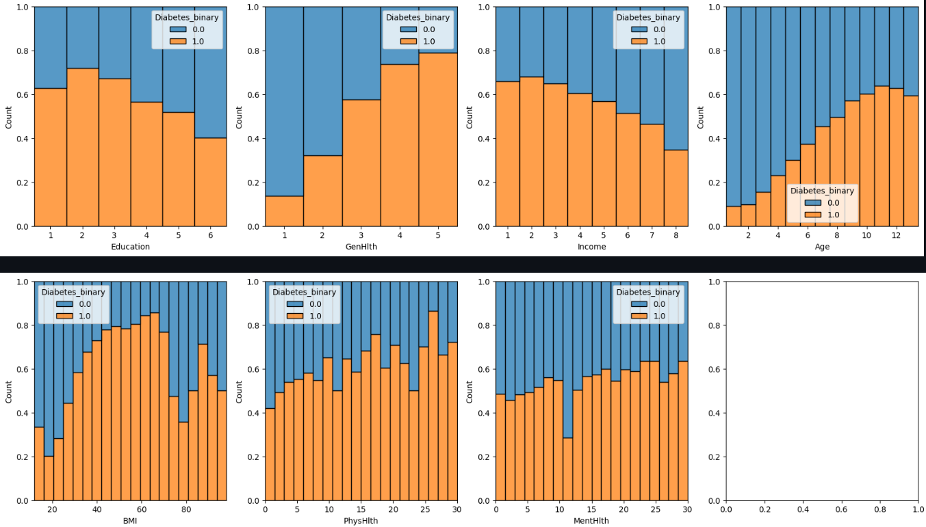
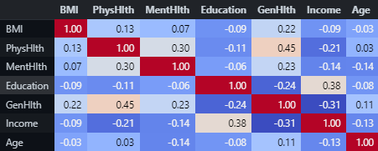
EDA – numeric variables

Slide 13
Modelling
Models
Performance metrics
Logistic regression
AUC
Random Forest
Balanced F1
XGBoost
Neural network

Slide 14
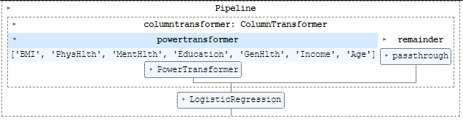
Tuning and validation
Validation
5-fold cross-validation, with transformations trained separately on each split
Hyperparameter tuning
Bayesian optimization with 50 trials

Slide 15
Results
Model | Training score |  | Test score
 | AUC | F1 | AUC | F1
Logistic regression | 0.823 | 0.749 | 0.826 | 0.756
Random forest | 0.821 | 0.755 | 0.826 | 0.761
XGBoost | 0.827 | 0.760 | 0.819 | 0.756
Neural network

