Slide 1


Build a Personalized Online Course Recommender System with Machine Learning
Tim Jhung
July 11, 2025

Slide 2

Outline
Introduction and Background
Exploratory Data Analysis
Content-based Recommender System using Unsupervised Learning
Collaborative-filtering based Recommender System using Supervised learning
Conclusion
Appendix

Slide 3
Introduction
A Massive Open Online Courses (MOOCs) startup, AI Training Room, provides learners across the world with courses to learn leading technologies such as Machine Learning, AI, Data Science, Cloud, App development, etc.
AI Training Room’s machine learning engineering team is working very hard on a recommender system project. The main goal of this project is to improve learners’ learning experience by helping them quickly find new interested courses and better paving their learning paths.
This project is currently at the Proof of Concept (PoC) phase and the main focus at this moment is to explore and compare various machine learning models and find one with the best performance in off-line evaluations.

Slide 4
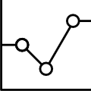
Exploratory Data Analysis

Slide 5
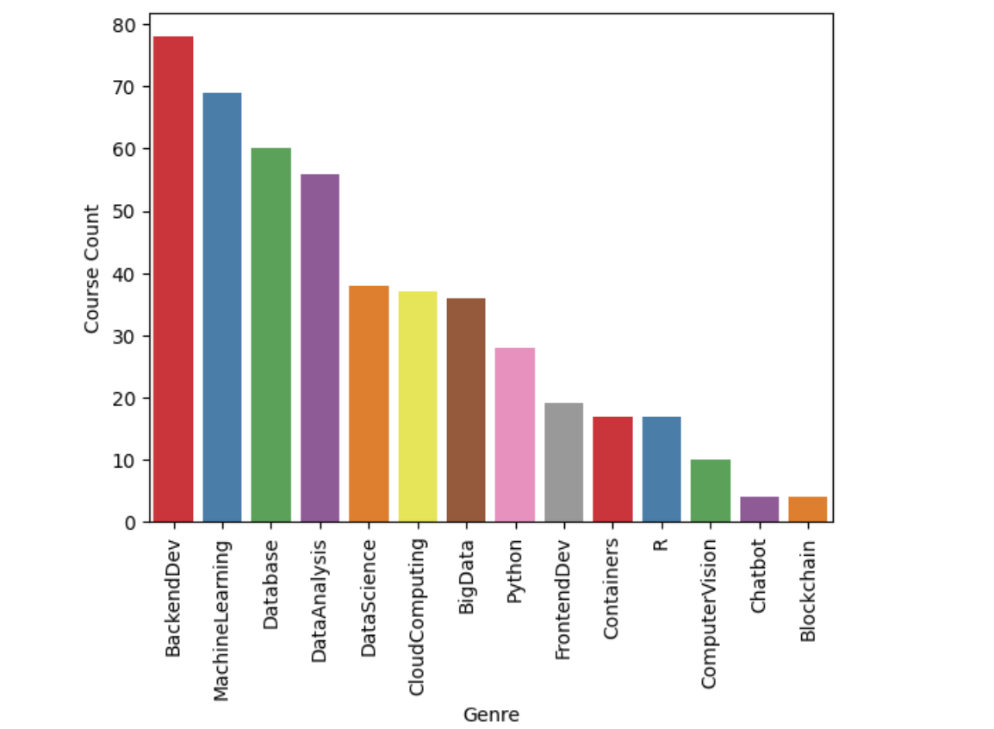
Course counts per genre
Notes:
The graph shows the count for the courses offered by AI Training Room belonging to each genre. The genres are in the order of high to low count going from left to right.

Slide 6
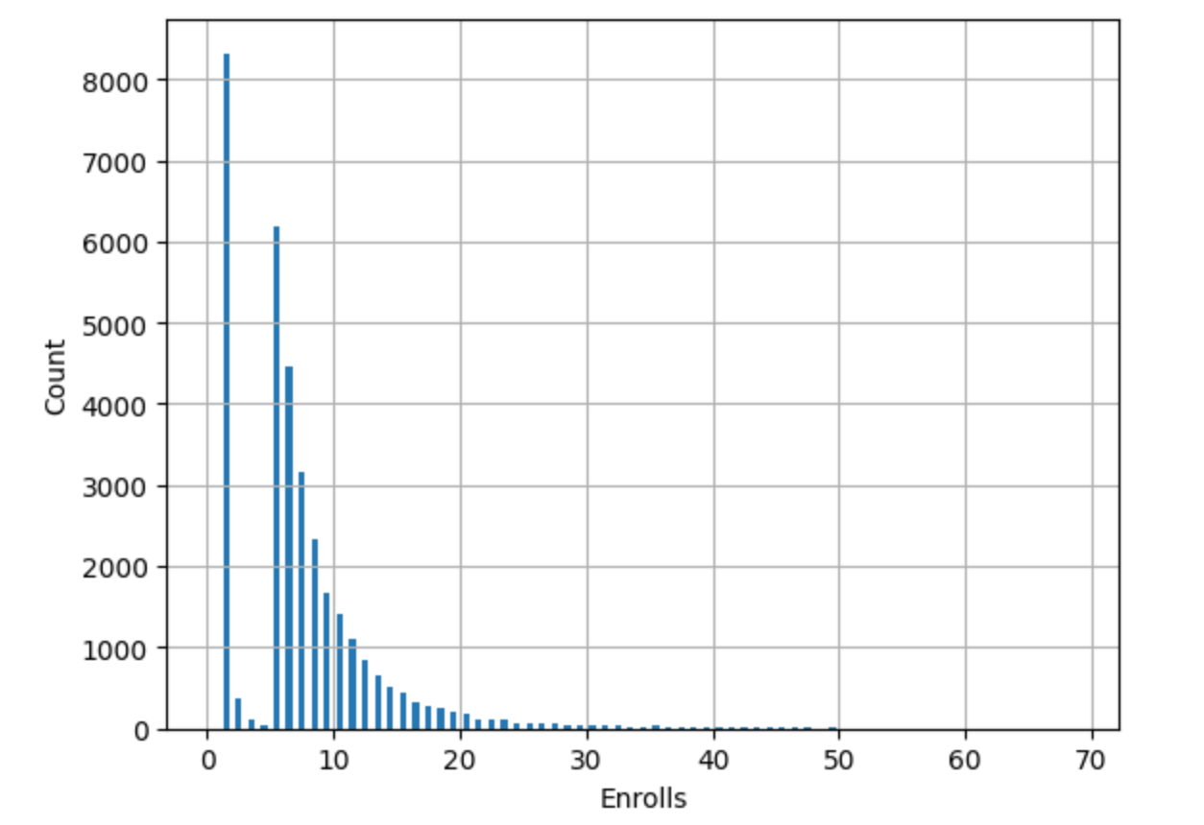
Course enrollment distribution
Notes:
The graph shows the distribution of the number of courses per user enrolled.

Slide 7
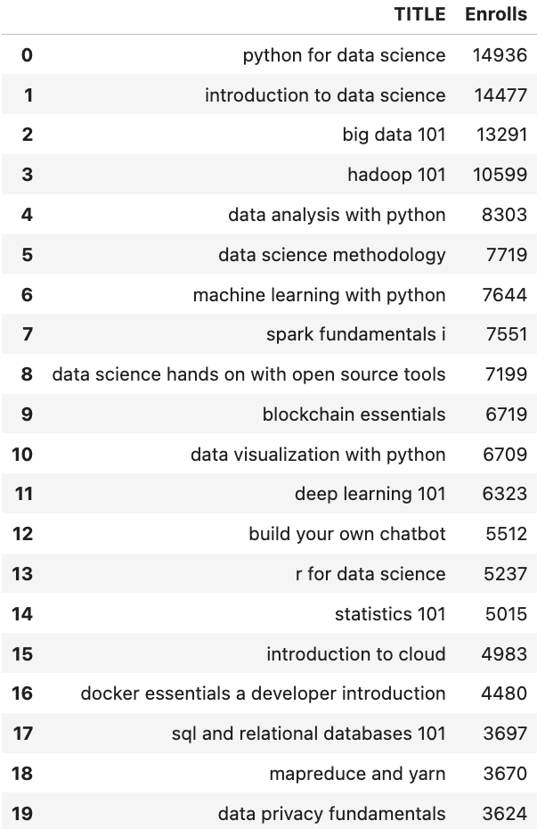
20 most popular courses
Notes:
The list shows the Top 20 most popular courses as measured by enrolls among the courses offered by AI Training Room, in descending order by enrolls.

Slide 8
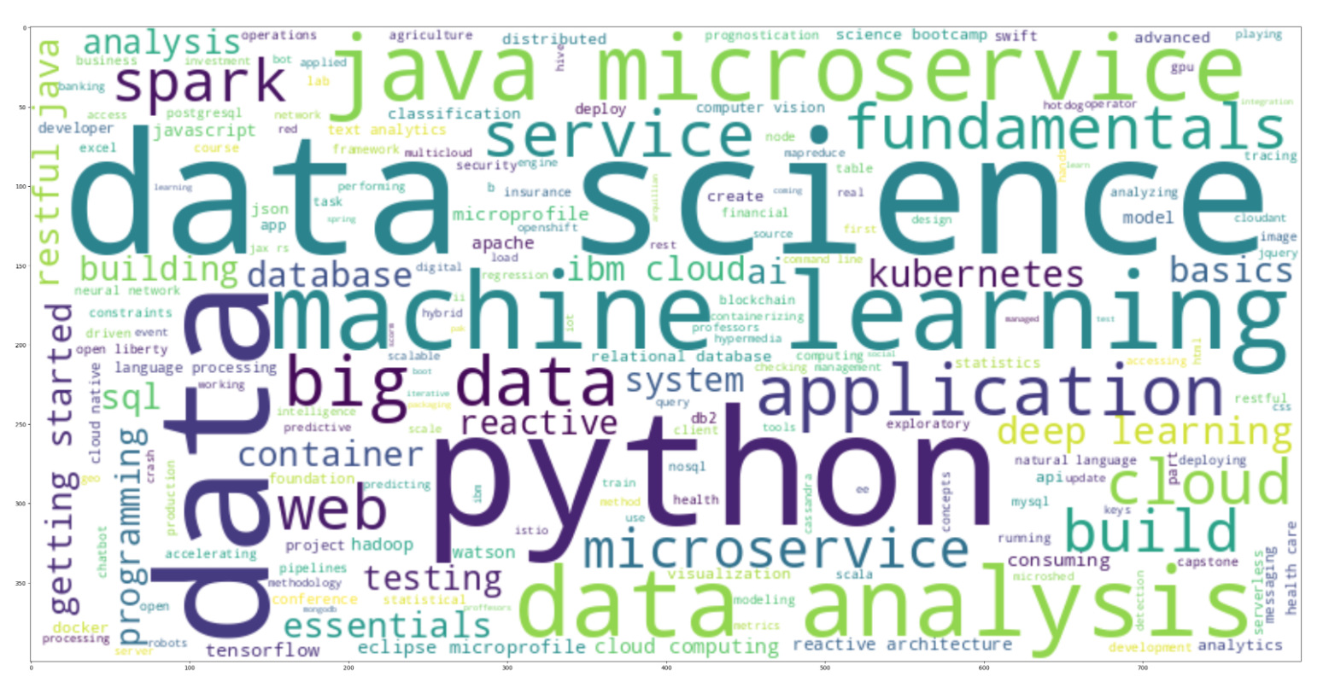
Word cloud of course titles
Notes:
The graphic shows the word cloud generated from course titles AI Training Room courses offered.

Slide 9
Content-based Recommender System using Unsupervised Learning
Cluster2
Cluster1

Slide 10
Flowchart of content-based recommender system using user profile and course genres
Data processing:
Using dot product, generated course interest score matrix using the input data
Using user_genre_interest_score, built recommendation scores for courses not yet taken by user
Input data:
User profile vectors and
Course genre vectors
Genearted dataset:
User_genre interest score
Recommendation Scores
Notes:
The flowchart illustrates the following general steps for content-based recommender system using user profile and course genres:
Build user profile features and course genre features from raw data
Use a computational method such as dot product to build course interest score from user profile features and course genre features
Recommend the course with the highest interest

Slide 11
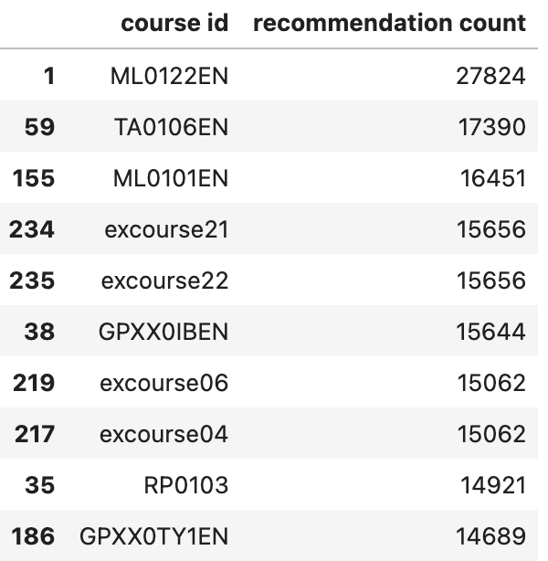
Evaluation results of user profile-based recommender system
Using a recommendation score threshold of 10, the following results have been observed.
On average, 9 new/unseen courses have been recommended per user (in the test user dataset)
Top 10 commonly recommended courses

Slide 12
Flowchart of content-based recommender system using course similarity
Using CSM, aggregated recommended courses for each user from courses not yet taken with similarity above the set threshold
Input data:
Course data
Using BoW, generated course similarity matrix using course title and description
Genearted dataset:
Course similarity matrix (CSM)
Recommendations table
Notes:
The flowchart illustrates the following general steps for content-based recommender system using course similarity:
Build course similarity matrix using BoW features derived from course title and description.
Using a similarity threshold, build a list of recommended courses for each user from the courses the user has not yet enrolled.
Recommend the courses from the list, capping the number of courses to be recommended.

Slide 13
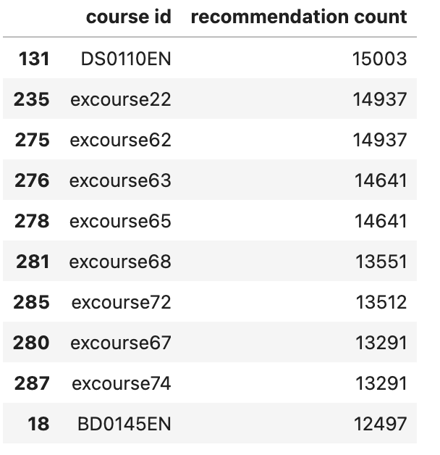
Evaluation results of course similarity based recommender system
Using a similarity score threshold of 0.6, the following results have been observed.
On average, 9 new/unseen courses have been recommended per user (in the test user dataset)
Top-10 commonly recommended courses

Slide 14
Flowchart of clustering-based recommender system
Using clustering and dimensionality reduction, generated popular course list for each user cluster from input data
Using popular course list, aggregated recommended courses for each user from courses not yet taken with similarity above threshold
Genearted dataset: popular course list for each user cluster
Input data:
User profile vectors
Recommendation Scores
Notes:
The flowchart illustrates the following general steps for clustering-based recommender system:
Perform clustering on the user profile feature vectors
Apply PCA (Principle Component Analysis) on user profile feature vectors to reduce dimensions
Perform clustering on the PCA transformed main components
Generate course recommendations based on enrollment history of other members in the group

Slide 15
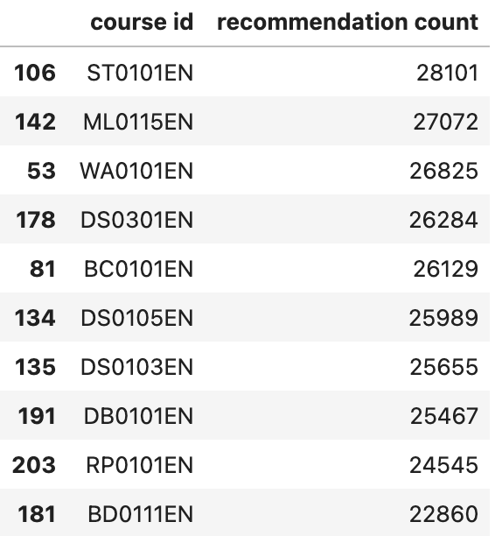
Evaluation results of clustering-based recommender system
Your hyper-parameter settings, such as a score or similarity threshold
Note if you have tried multiple hyper-parameters, you may show your results in a grouped bar chart
On average, 18 new/unseen courses have been recommended per user (in the test user dataset)
Top-10 commonly recommended courses

Slide 16
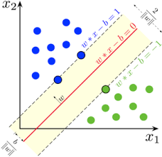
Collaborative-filtering Recommender System using Supervised Learning

Slide 17
Flowchart of KNN based recommender system
For each rating in test dataset, estimated its rating using KNN collaborative filtering equations
Input data:
User course enrollment history
Built a similarity matrix for each pair of users
Generated dataset: similarity matrix
For each user, find its k nearest neighbors in the similarity matrix
Test user ratings estimate
Notes:
The flowchart illustrates the following general steps for KNN based recommender system:
Calculate the similarity between two users using their course enrollment history
Build a similarity matrix for each pair of users with the training dataset
For each user, find its k nearest neighbors in the similarity matrix
For each rating in the test dataset, estimate its rating using the KNN collaborative filtering equations
Calculate RMSE for the entire test dataset

Slide 18
Flowchart of NMF based recommender system
For each rating in test dataset, estimated its rating using the dot product of matrix U and matrix I
Input data:
User-item interaction matrix
Decomposed user-item interaction matrix by factoring
Genearted dataset:
Factor matrix U and I
Estimated Ratings
Notes:
The flowchart illustrates the following general steps for NMF based recommender system:
Use the NMF() class provided by sklearn to decompose the original user-item interaction matrix
For each rating in the test dataset, estimate its rating using the dot product of matrix U and matrix I
Calculate RMSE for the entire test dataset

Slide 19
Flowchart of Neural Network Embedding based recommender system
Built a neural network model with embeddings.
Trained and tested the model using the transformed input.
Transformed user ratings data into a matrix with one hot encoded users and items as features and rating as label
Input data:
User ratings
Genearted dataset: Encoded data
Model for rating prediction
Notes:
The flowchart illustrates the following general steps for Neural Network Embedding based recommender system:
Prepare user ratings input data by transforming it into a matrix with one hot encoded users and items as features and rating as label
Build a neural network model with embeddings and train and test the model using the prepared input.
Calculate RMSE for the entire test dataset

Slide 20
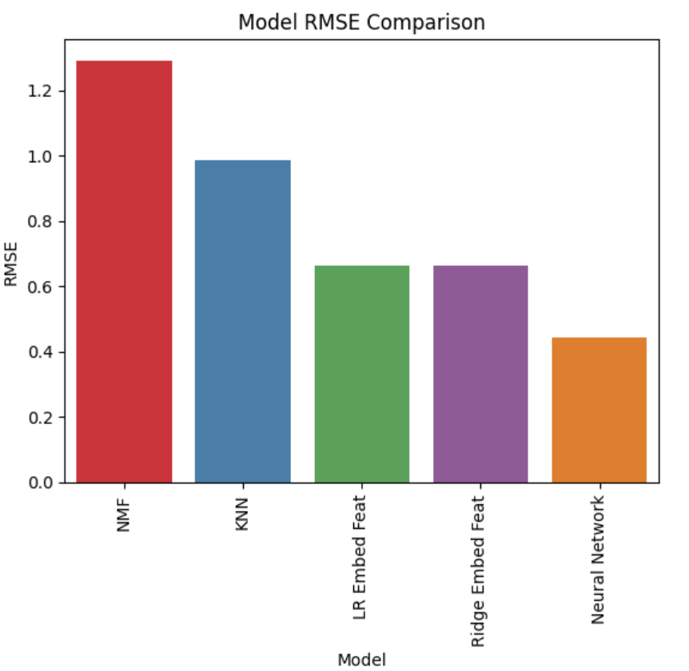
Compare the performance of collaborative-filtering models
Notes:
The graph shows the rmse from the various collaborative filtering models tried. The models are listed in order of decreasing error going from left to right.
Neural Network model performed the best with rmse slightly above 0.4.

Slide 21
Conclusions
Among the different models tested, a neural network (NN) showed the best performance for course rating prediction as measured by root mean squared error.
As a neural network model does not make assumptions about features, using NN model could also obviate the need for manual feature selection in model building which could be an advantage.
If additional resource and time allow, further exploration of regression based or classification based models using embedding features from NN model might improve performance as those models build on the embedding layer weights from NN model.
Based on the PoC, it is recommended that AI Training Room ML engineering team pursue utilizing NN model in its course recommendation system project.

Slide 22
Appendix
Exploratory Data Analysis notebook in github
Content-based recommender system using user profile and course genres notebook in github
content-based recommender system using course similarity notebook in github
clustering-based recommender system notebook in github
KNN based recommender system notebook in github
NMF based recommender system notebook in github
Neural Network Embedding based recommender system notebook in github

