Slide 1

Members
Party History Learning & Examination System
崔振浩 2053776
孟香帆 1952493
卢嘉霖 2050633

Slide 2

CONTENTS
01.Introduction
03.Database Design
02.System Architecture
04.Other Technics

Slide 3

01
Introduction

Slide 4

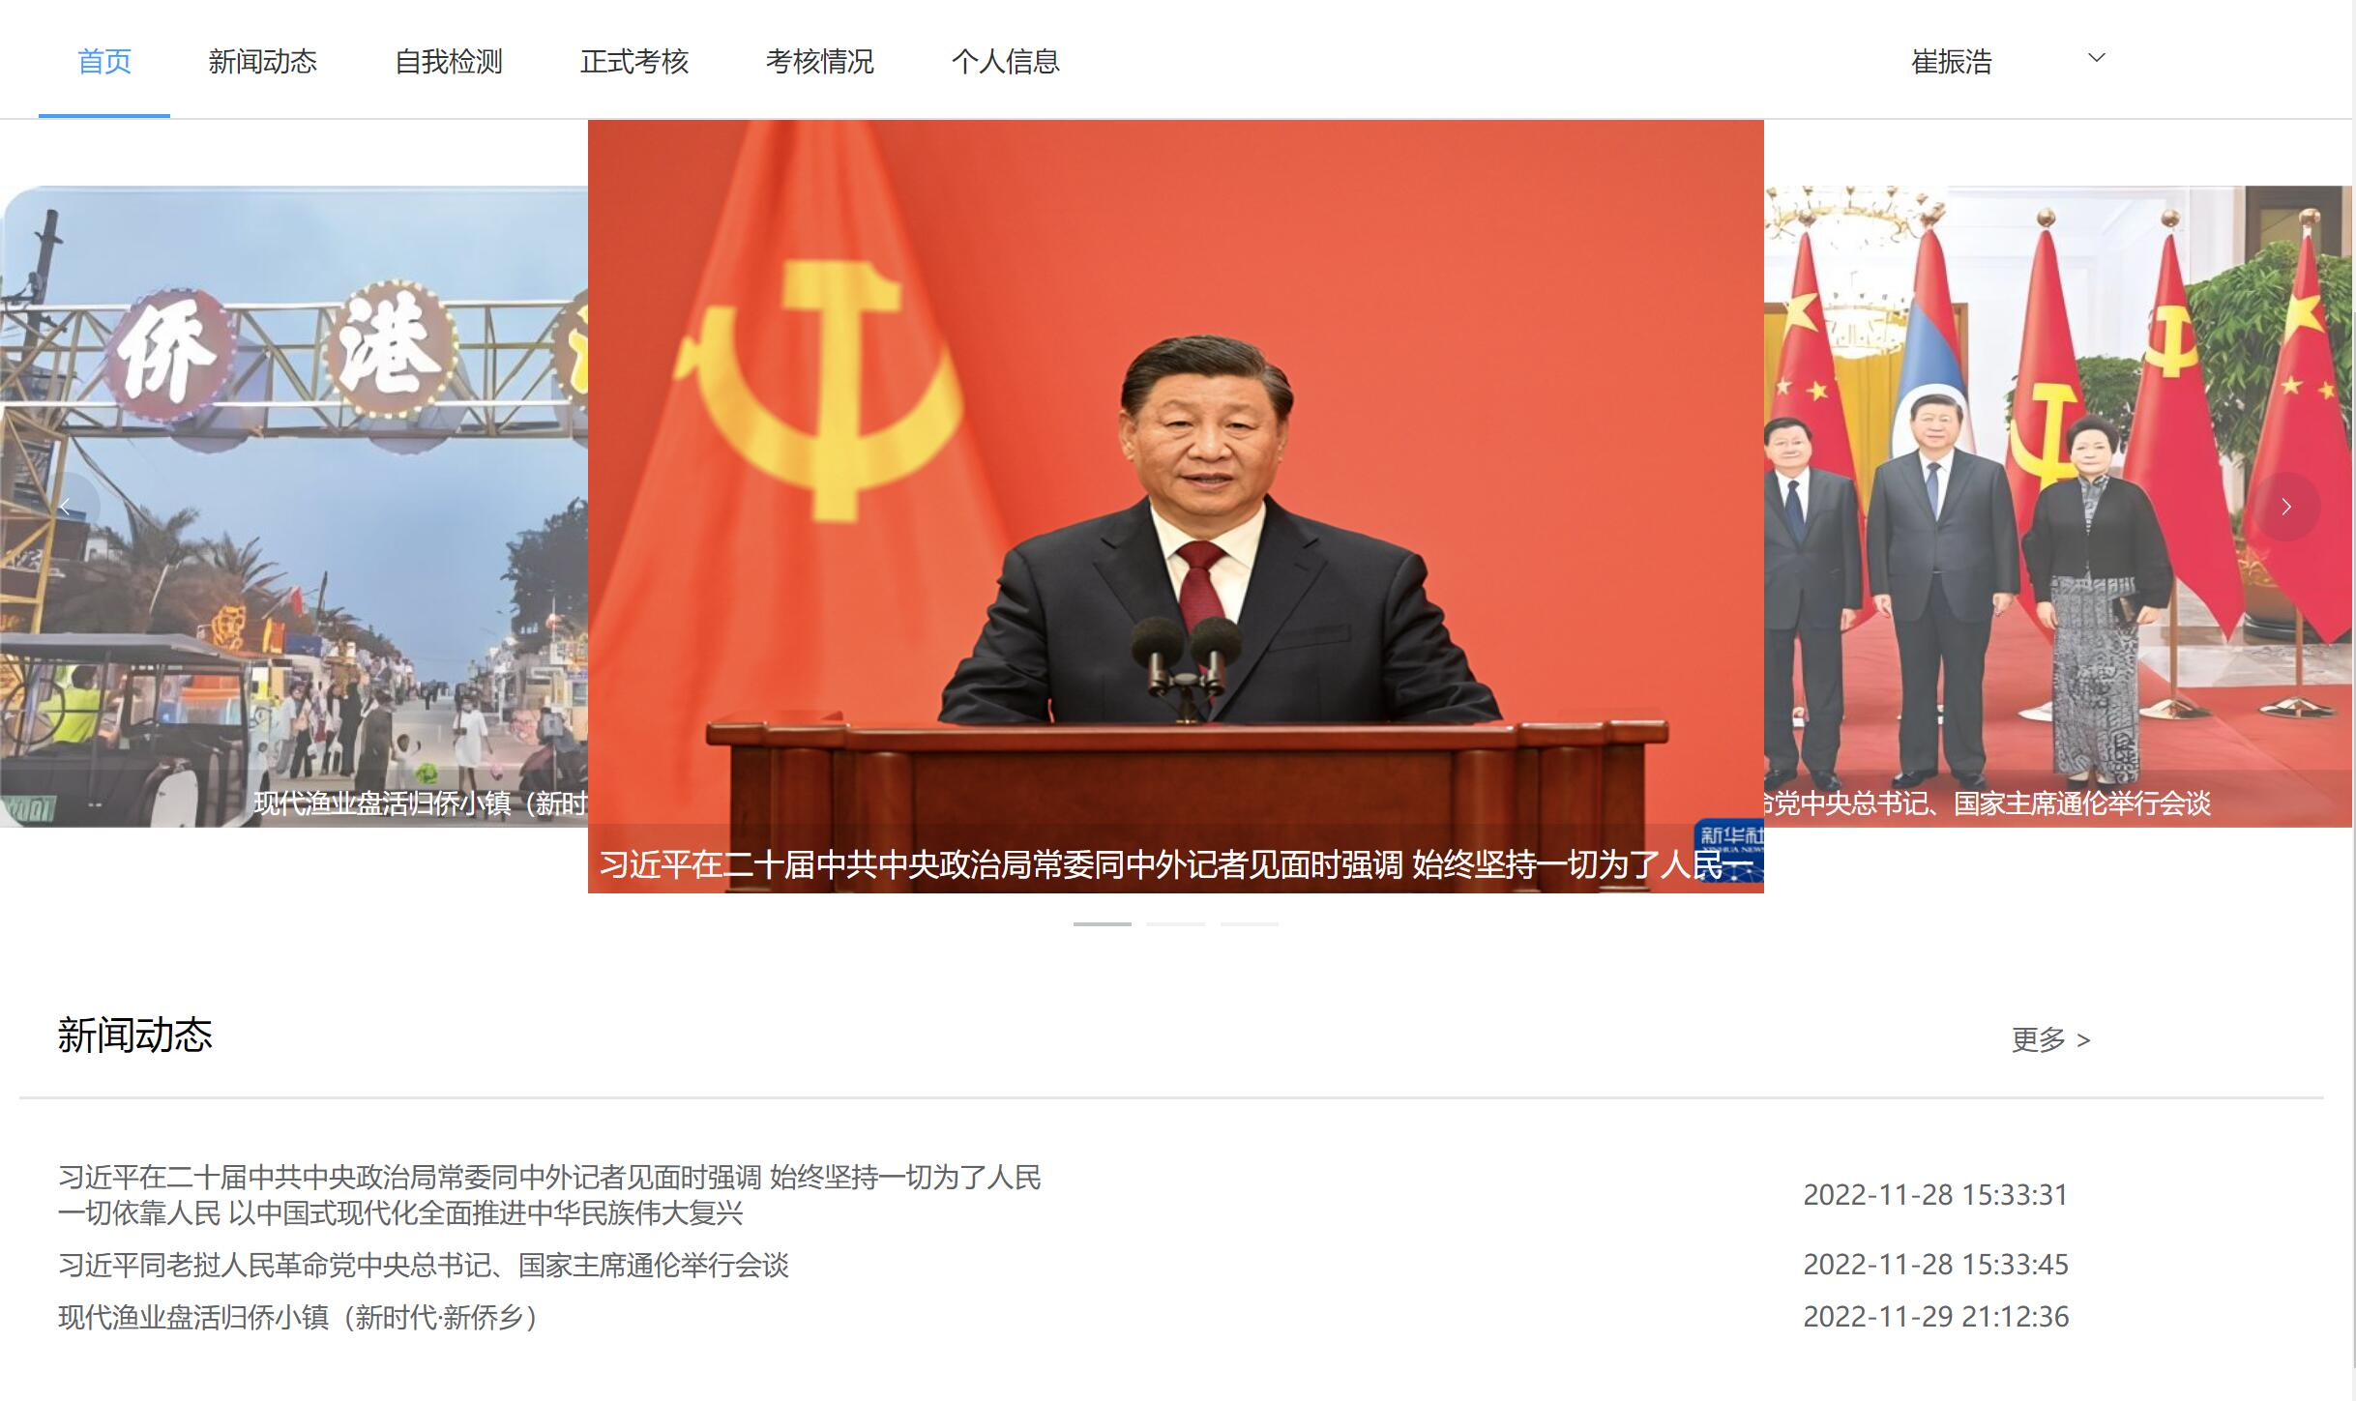
Overview
Functionalities implemented
- Basic log-in
- Reading and pushing articles on the home page.
- Taking tests and examinations.
- Editting and deploying papers.
- Personnel management.

Slide 5
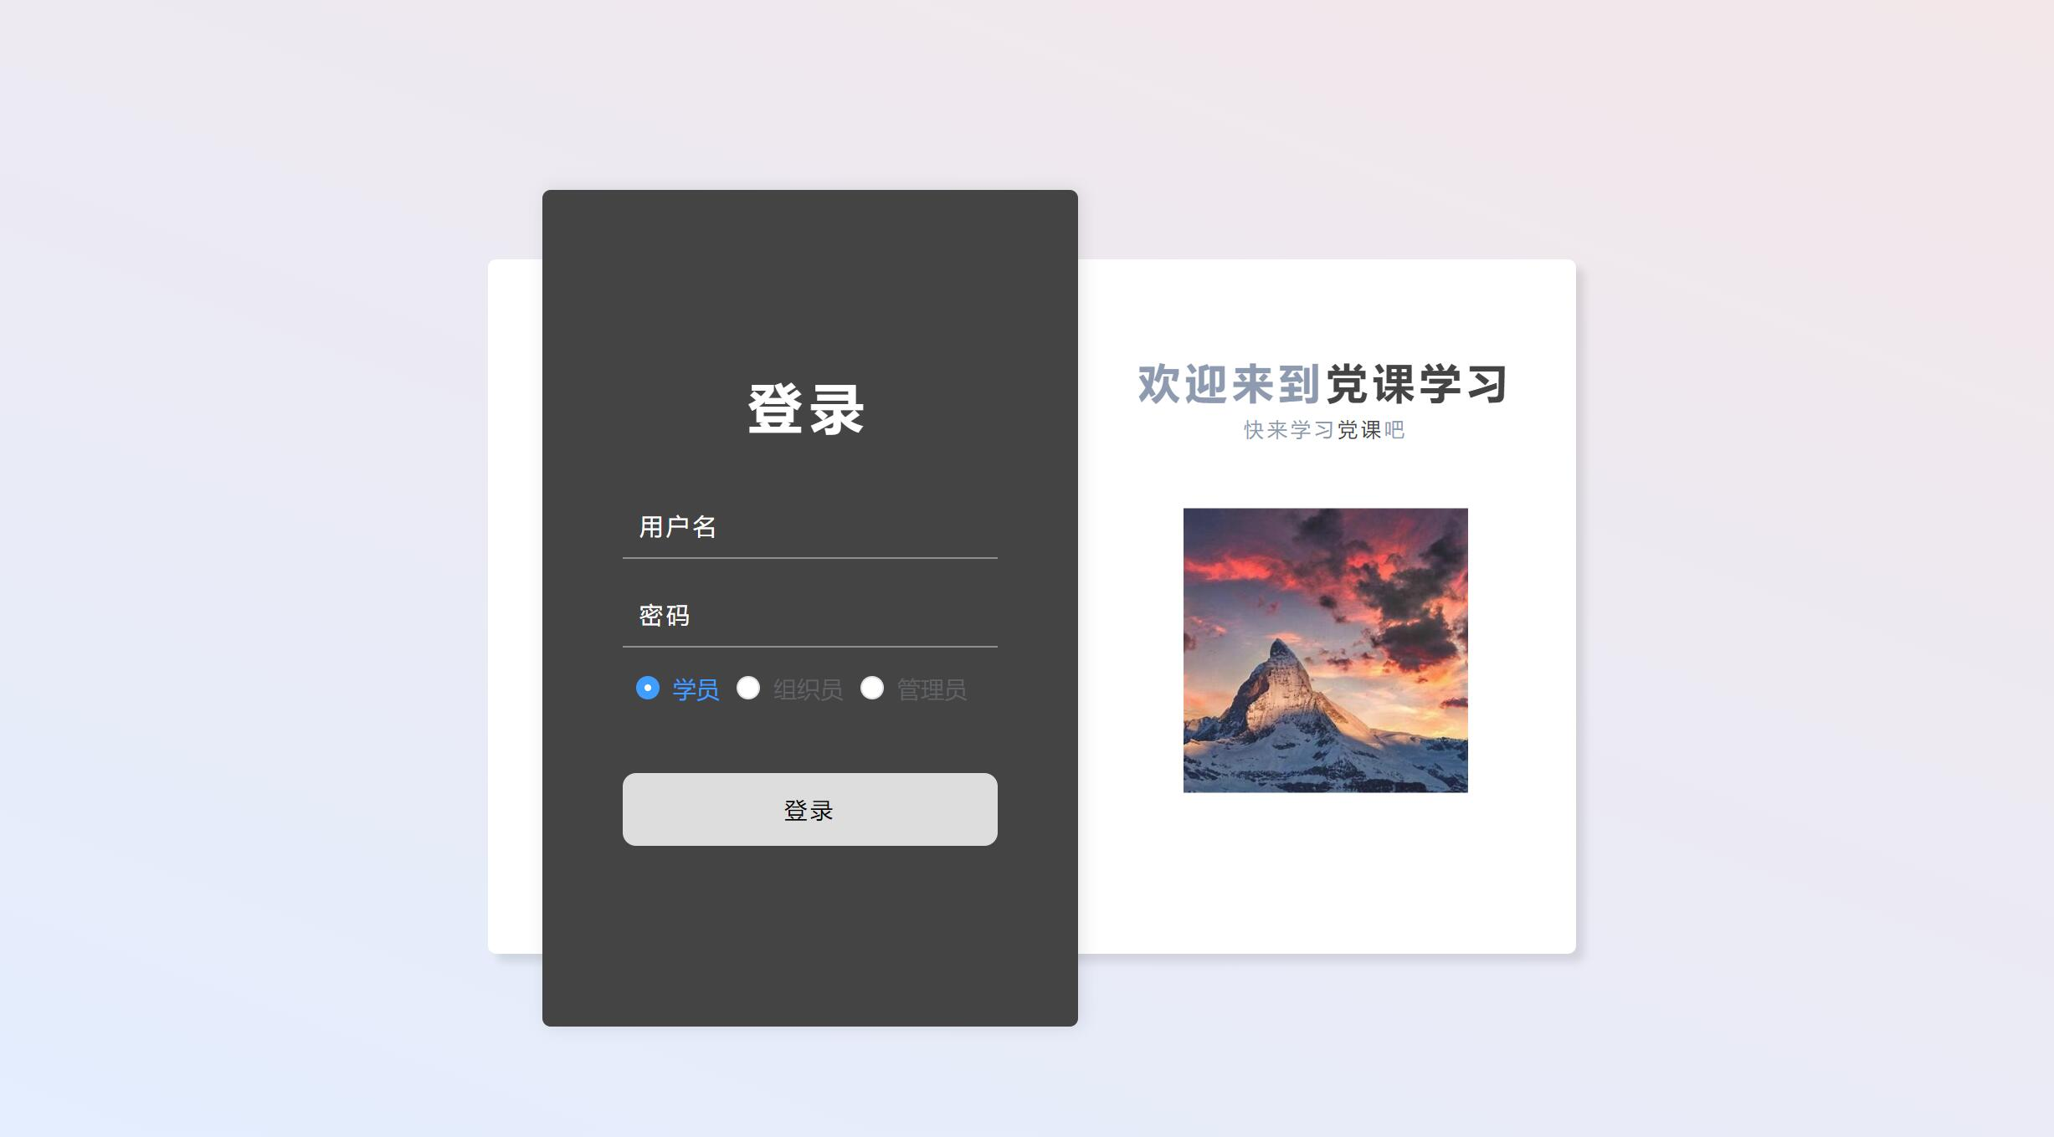
Basic log-in
- Logging in with account and password stored in database
- Account types include student, faculty, and administrators.

Slide 6
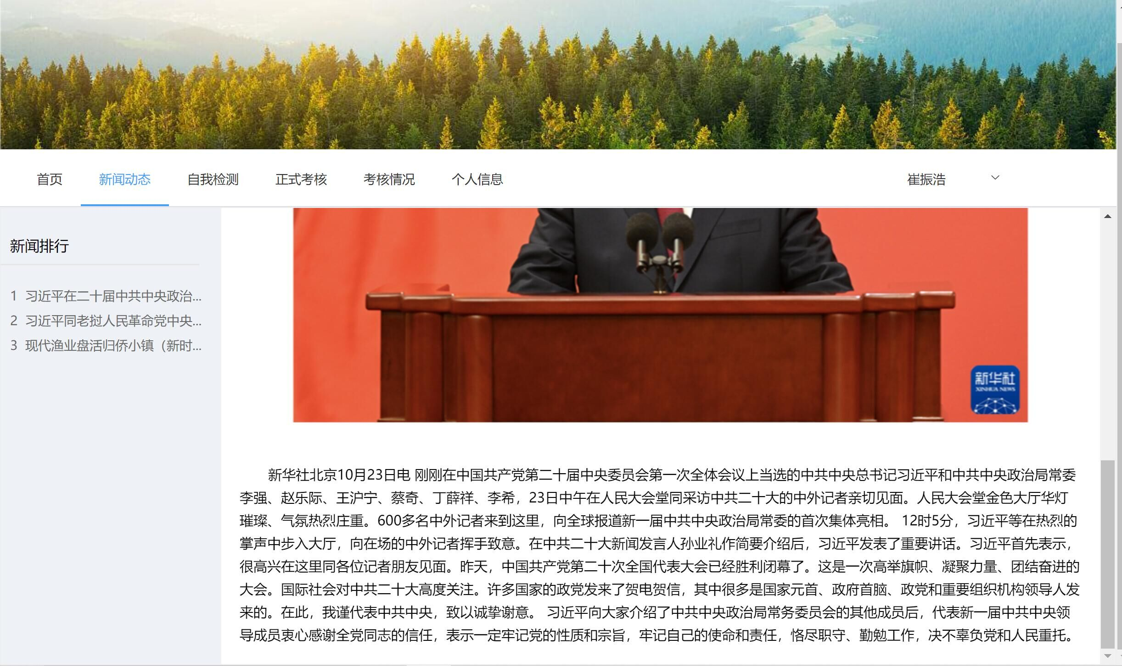
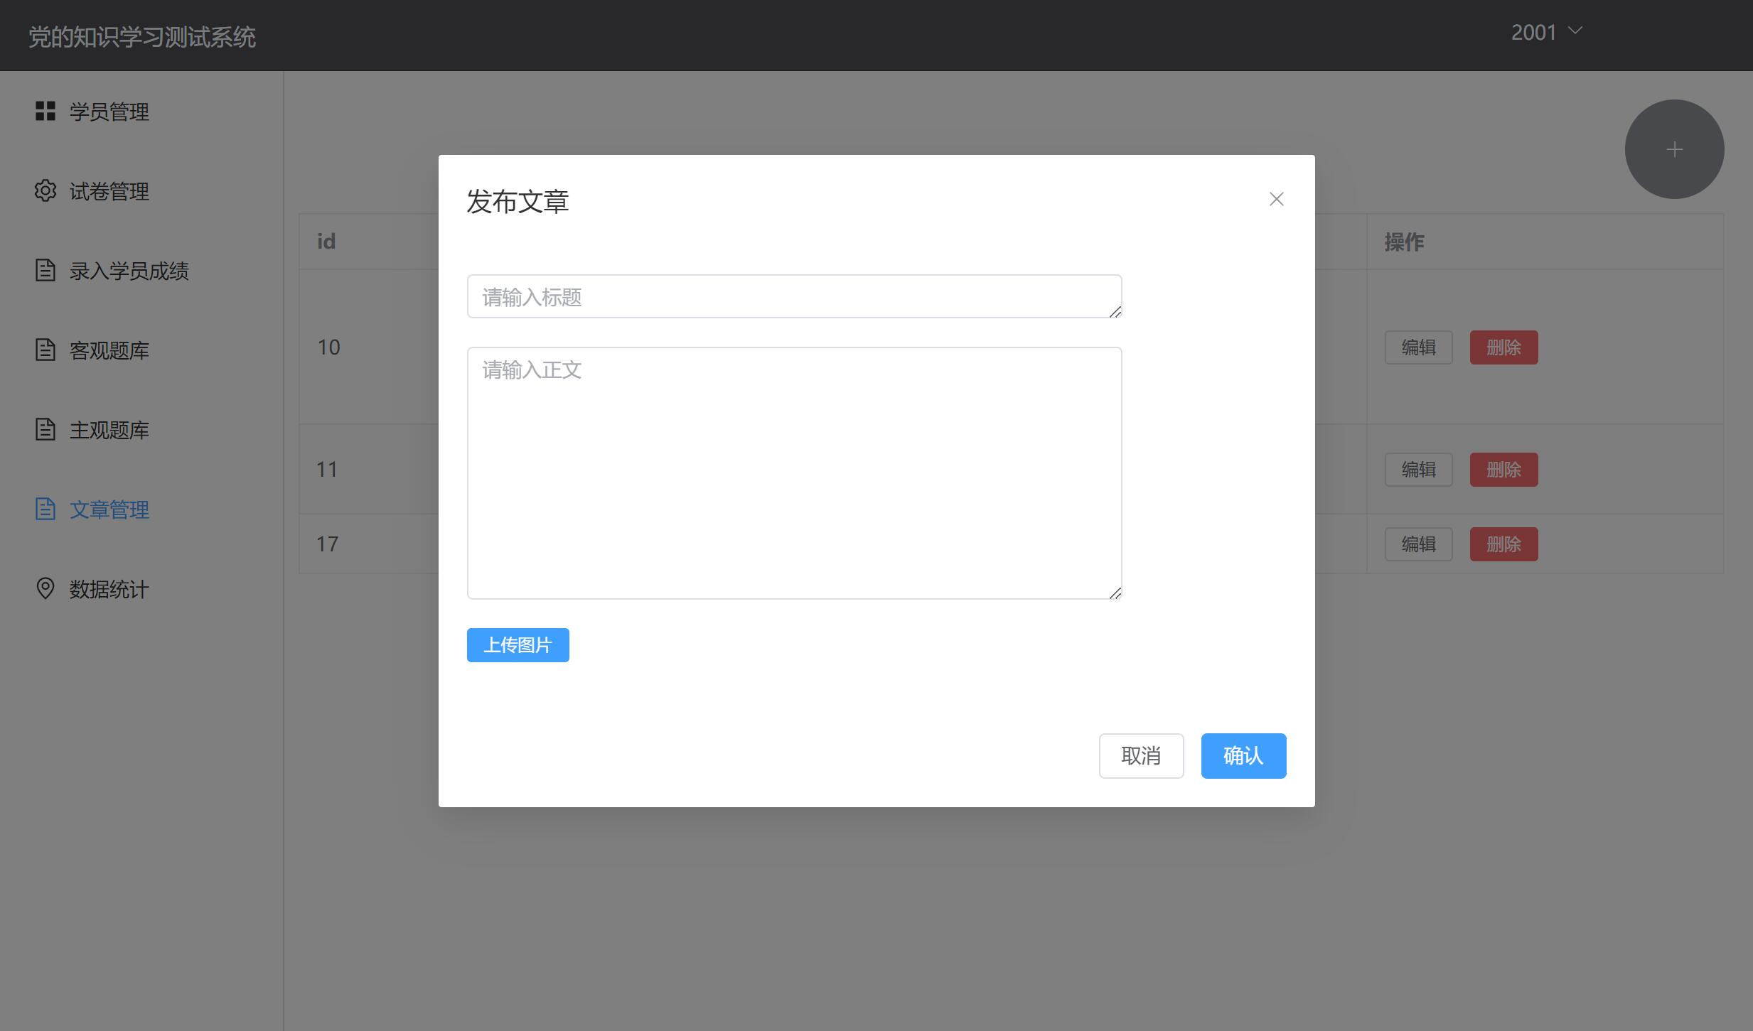
Reading and pushing articles
- Article reading for student users.
- Article edittings and pushing for faculty users.

Slide 7
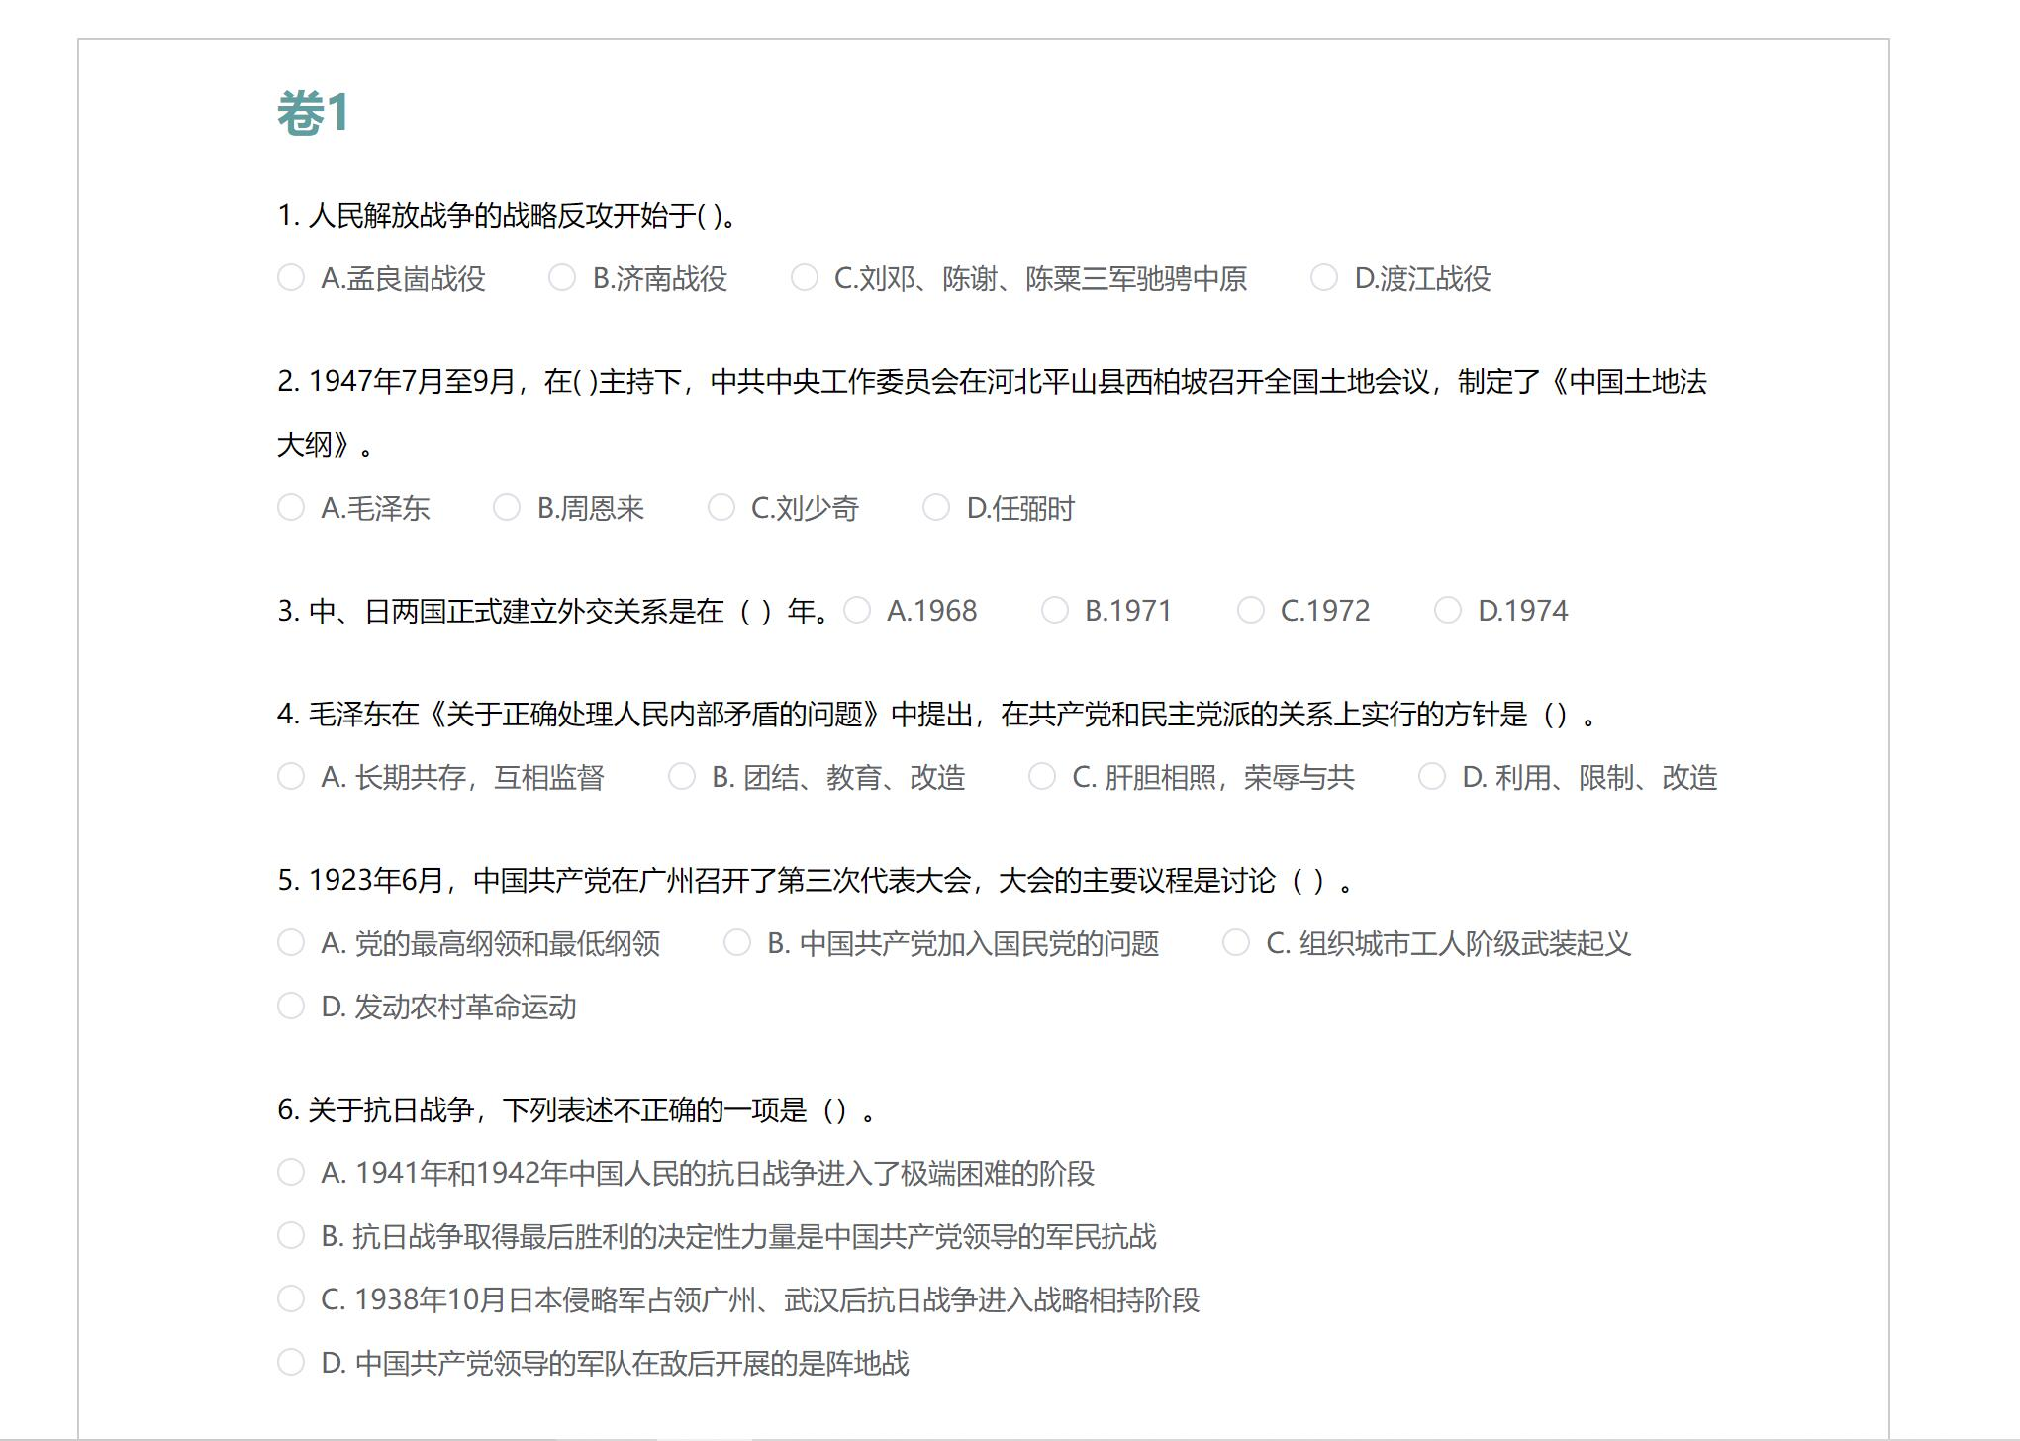
Taking tests and examinations
- Tests for practice.
- Formal examinations record grades.

Slide 8
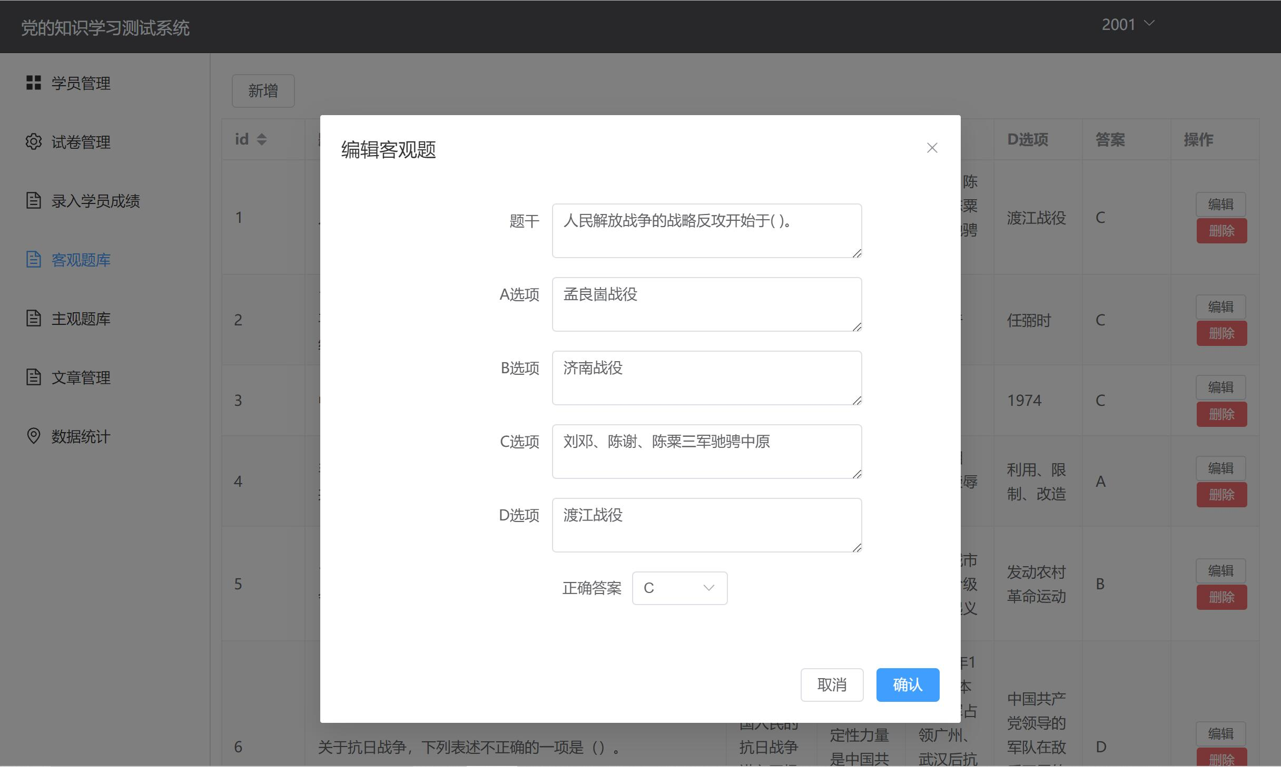
Editting and deploying papers
- Designed for faculty to generate papers.

Slide 9
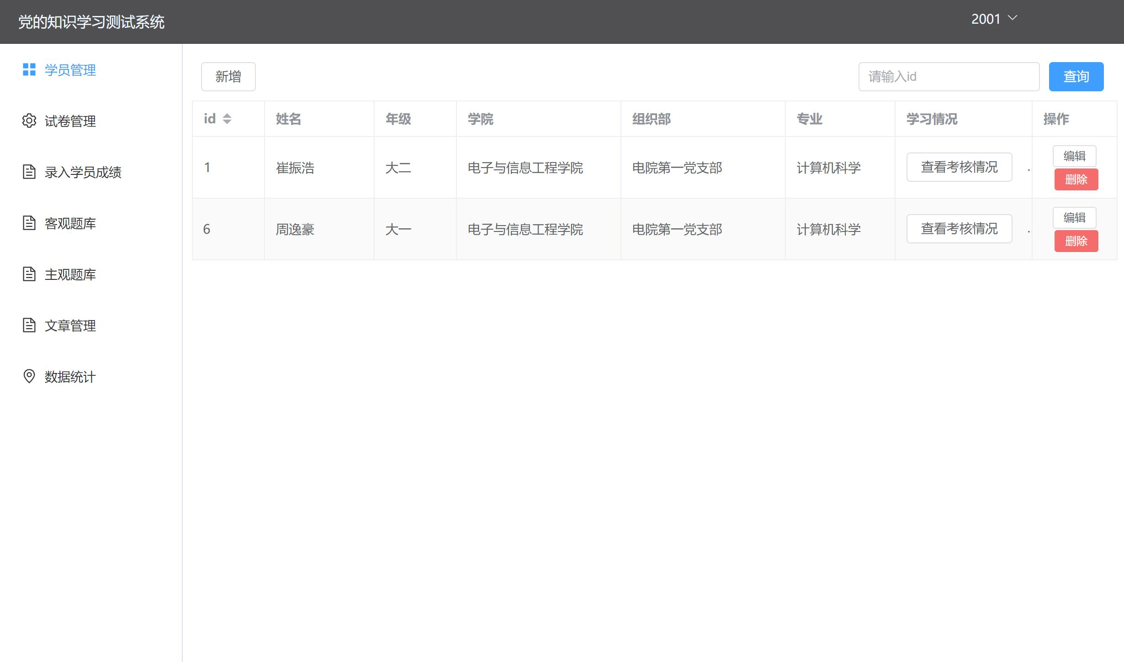
Personnel management
- Faculty manage students.
- Administrator manage faculty and students.

Slide 10
Division of labor
崔振浩 Users management & part of front-end design
孟香帆 Article management & part of front-end design
卢嘉霖 Paper management & database design

Slide 11
02
System Architecture

Slide 12
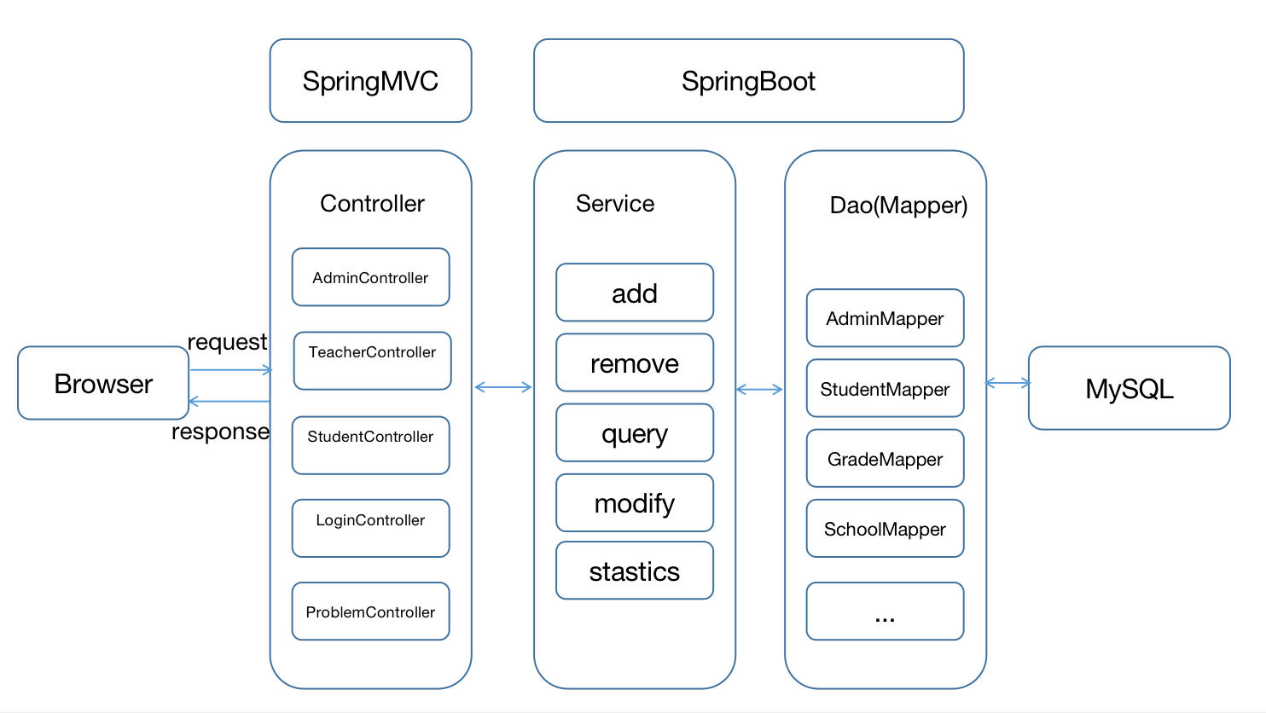
System architecture
Front page : Vue & elementUI
Page hopping : Vue-router
Connection between view and controllers : Axios
Back-end : SpringBoot &
Java language

Slide 13
Component design
The Presentation Tier
The Business Logic Tier
The presentation tier
The business logic tier
The data storage tier
The database
The Data StorageTier
The Database

Slide 14
03
Database Design

Slide 15
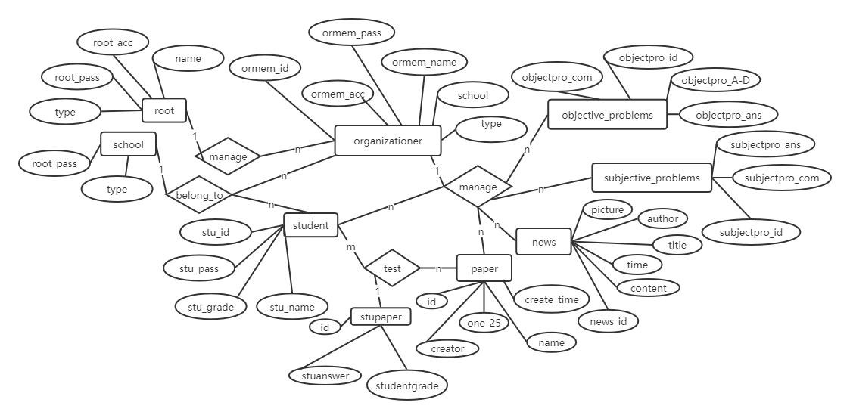
Database Design

Slide 16
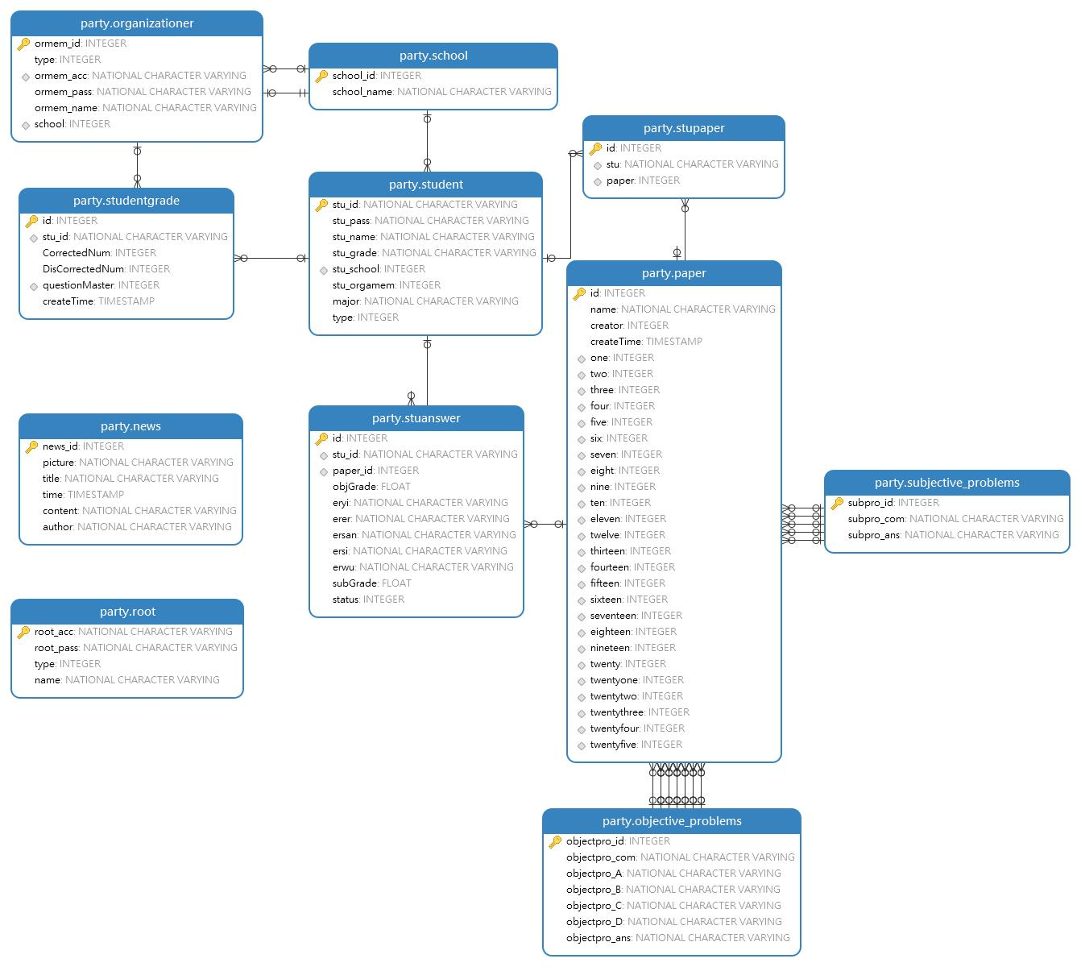
Database Design
Tables in the database:

Slide 17
04
Other Technics

Slide 18
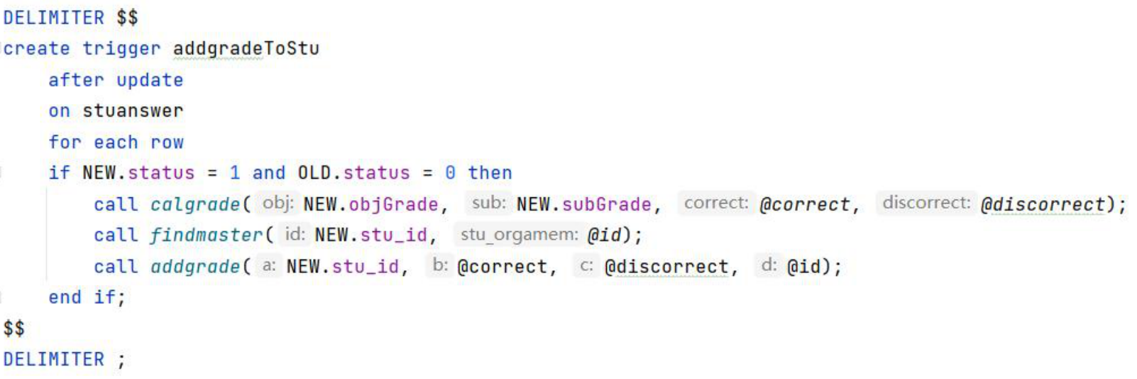
Other Technics
The project utilized trigger to implement score calculating, score recoring and many other functionalities.
Score entry trigger

Slide 19
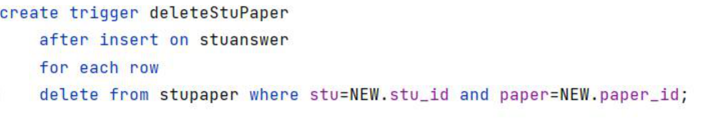
Other Technics
The project utilized trigger to implement score calculating, score recoring and many other functionalities.
Score deleting trigger

Slide 20
05
Demonstration

Slide 21
Thanks

