Slide 1
Kaldi Introduction
Ying shen
School of software engineering
Tongji university

Slide 2
Install Kaldi on Linux
Download kaldi package from https://github.com/kaldi-asr/kaldi or use git command:
git clone https://github.com/kaldi-asr/kaldi
To build the toolkit: see ./INSTALL or following the steps listed below
Step1: Go to tools dir:
cd tools
extras/check_dependencies.sh
make
If there are more than one CPU on your computer, “make” command can be replaced by “make –j 2”
NB: all depended packages listed in the result should be installed, e.g. sudo apt-get subversion,automake,autoconf,libtool,g++,zlib,libatal,wget, until “check_dependencies.sh: ok” appears.

Slide 3
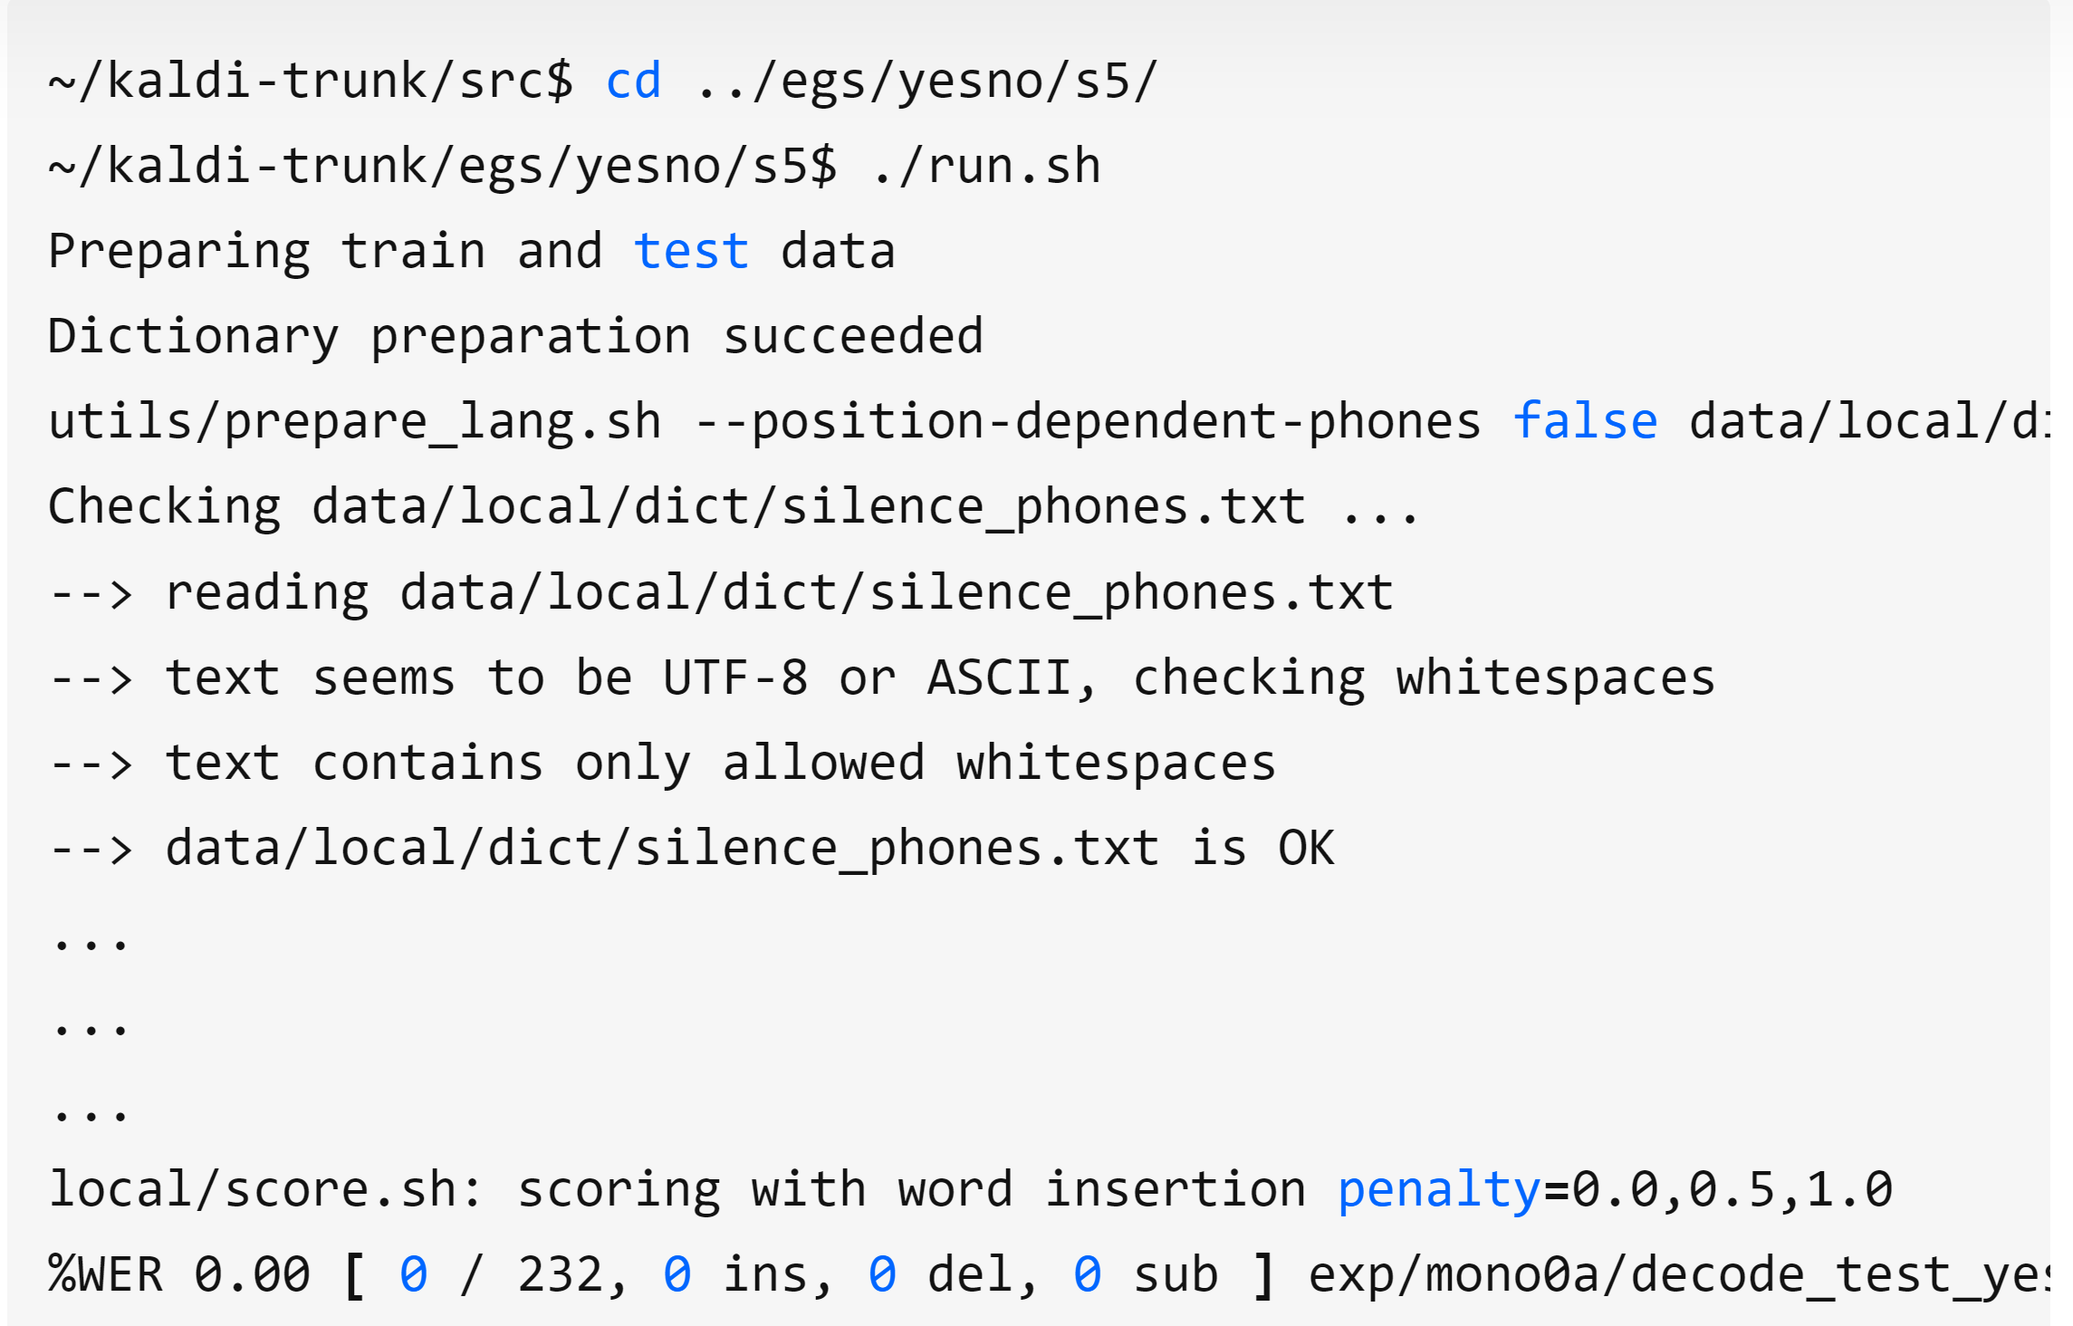
Installation in Linux environment
Step 2: Go to src dir:
cd src
./configure --shared
make depend -j 2
make -j 2
Test yesno example
cd egs/yesno/s5
./run.sh

Slide 4
Run thchs30 example
Download thchs30 from https://www.openslr.org/18/
Extract data_thchs30.tar.gz and resource.gz to a dir (e.g. /home/yhy/thchs30) and take down the path
Go to egs/thchs30 dir
cd egs/thchs30/s5
Modify cmd.sh under egs/thchs30 dir
#export train_cmd=queue.pl
#export decode_cmd="queue.pl --mem 4G"
#export mkgraph_cmd="queue.pl --mem 8G"
#export cuda_cmd="queue.pl --gpu 1“
export train_cmd=run.pl
export decode_cmd="run.pl --mem 4G"
export mkgraph_cmd="run.pl --mem 8G"
export cuda_cmd="run.pl --gpu 1"

Slide 5
Run thchs30 example
Modify run.sh under egs/thchs30 dir
#n=4 #parallel jobs
n=2 #parallel jobs
#thchs=/nfs/public/materials/data/thchs30-openslr
thchs=/home/yhy/thchs30
Path to your own directory

Slide 6
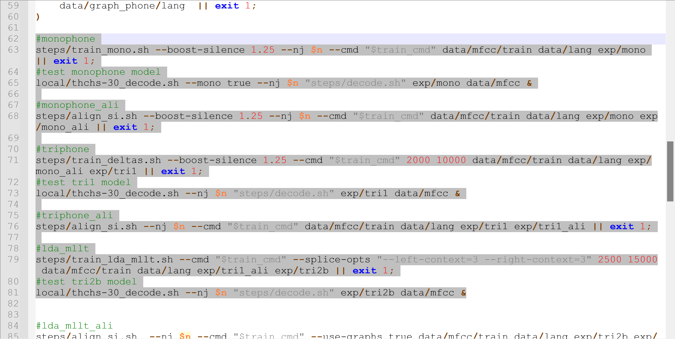
Run thchs30 example
Test thchs30 example:
./run.sh
It will take a long time to train the models
You can test these four models and comment the rest tests in run.sh

Slide 7
Reference
Kaldi help doc: https://kaldi-asr.org/doc/

Slide 8
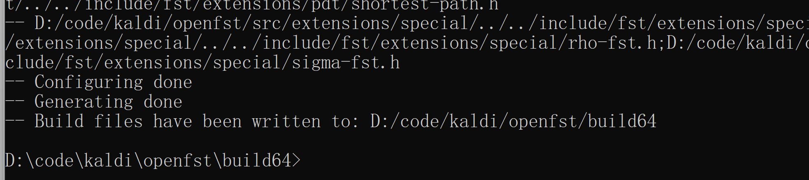
Install Kaldi on Windows
Download kaldi package from https://github.com/kaldi-asr/kaldi
(Refer to INSTALL.md under kaldi/windows dir)
Install git, cmake and activeperl on your PC beforehand
Open a command window
Install openfst
openfst dir is already contained in kaldi. Go to openfst dir: $cd openfst/build64
delete CMakeCache.txt and run: $ cmake -G "Visual Studio 15 2017 Win64" ../

Slide 9
Install Kaldi on Windows
Install openfst (Cont.)
In the directory ‘build64’, find the file ‘openfst.sln’ and open it using Visual Studio 17.
Compiling PortAudio
Download PortAudio from http://www.portaudio.com/download.html and extract the folder
In command window, navigate to the portaudio directory and type: $ cmake -G "Visual Studio 15 2017 Win64"
CMake will generate a portaudio.sln in the directory. Open it
Right click portaudio_static->Properties->C/C++->Code Generation->Runtime Library Change from Multi-Threaded Debug (/MTd) to Multi-threaded Debug DLL (/MDd)
Build

Slide 10
Install Kaldi on Windows
Compiling Kaldi
Download OpenBLAS binary packages:
(kaldi)/tools$ curl -L -O http://sourceforge.net/projects/openblas/files/v0.2.14/OpenBLAS-v0.2.14-Win64-int32.zip
(kaldi)/tools$ curl -L -O http://sourceforge.net/projects/openblas/files/v0.2.14/mingw64_dll.zip
(kaldi)/tools$ unzip OpenBLAS-v0.2.14-Win64-int32.zip
(kaldi)/tools$ unzip mingw64_dll.zip

Slide 11
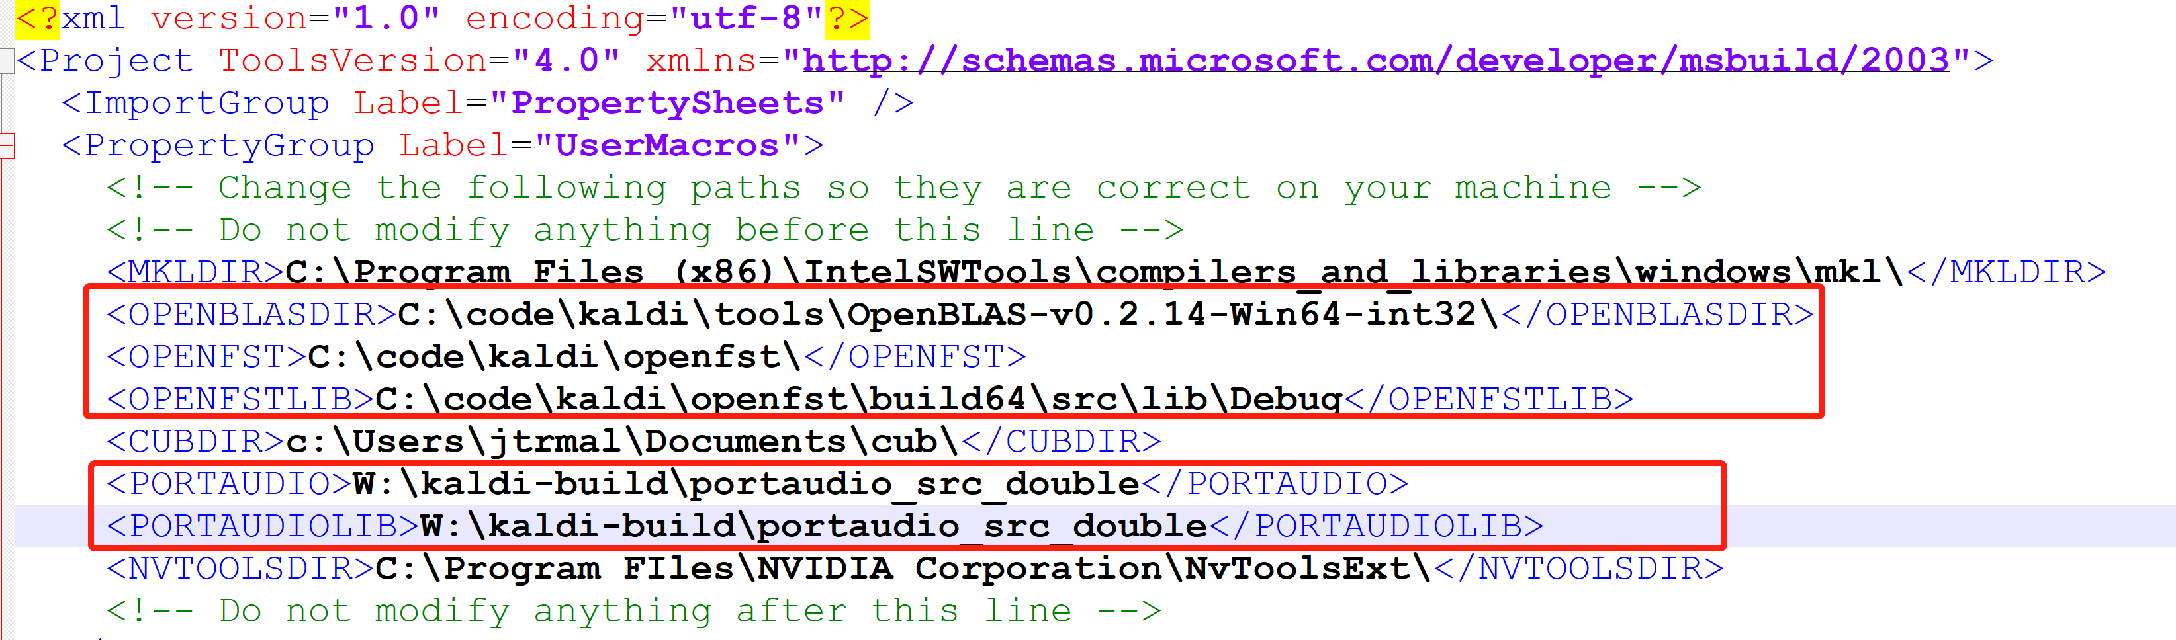
Install Kaldi on Windows
Compiling Kaldi (Cont.)
Enter the `(kaldi)/windows` directory
(kaldi)/$ cd windows
(kaldi)/windows $ pwd
Rename `variables.props.dev` to `variables.props`. Then modify the file `variables.props` to reflect the correct paths, using your favorite text editor.

Slide 12
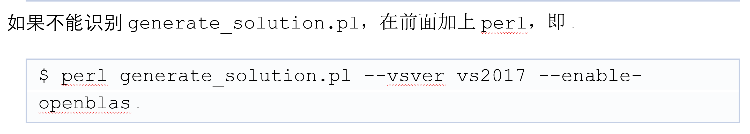
Install Kaldi on Windows
Compiling Kaldi (Cont.)
In kaldi/windows/, rename the file `kaldiwin_openblas.props` to `kaldiwin.props`
In command window, type: $ generate_solution.pl --vsver vs2017 --enable-openblas
then type: $ get_version.pl
Open the generated solution that was created in a subfolder (kaldi)/kaldiwin_vs<version>_<blas-library> in the visual studio and switch to **Debug|x64** (or **Release|x64**) and build.
Notes:
编译会遇到找不到portaudio.h的错误，参考文件“Windows下安装Kaldi.docx”中“4. PortAudio的更新及编译”部分解决该错误（或者参考文章https://blog.csdn.net/qq_25867649/article/details/78356474）：

Slide 13
Assignment 3
1. Install Kaldi;
2. Run yesno and THCHS-30 examples;
3. Record a segment of your own speech and recognize its contents using the trained (THCHS-30) models.
hint: use online-gmm-decode-faster, online2-wav-gmm-latgen-faster or nnet-latgen-faster
4. (Optional) You can also try the AISHELL model (which can be directly downloaded from https://www.openslr.org/33/) provided by AISHELL company
Report
1. The process of Kaldi installation;
2. The results of running yesno and THCHS-30 examples;
3. The recognition results of your speech.

