Slide 1
Web Service and SOA Final Presentation
Group potatoni

Slide 2
Agenda
Introduction
Architecture
Implementation
Demo
Q & A

Slide 3
Introduction
Selling second-hand books by only ISBN
Searching and buying some books
Offline deal with E-mail contact

Slide 4

Architecture
iOS APP
Application Layer
Processors
Processor Layer
JMS
Internal Services
E-mail System
Service Layer
Database
Persistence Layer

Slide 5
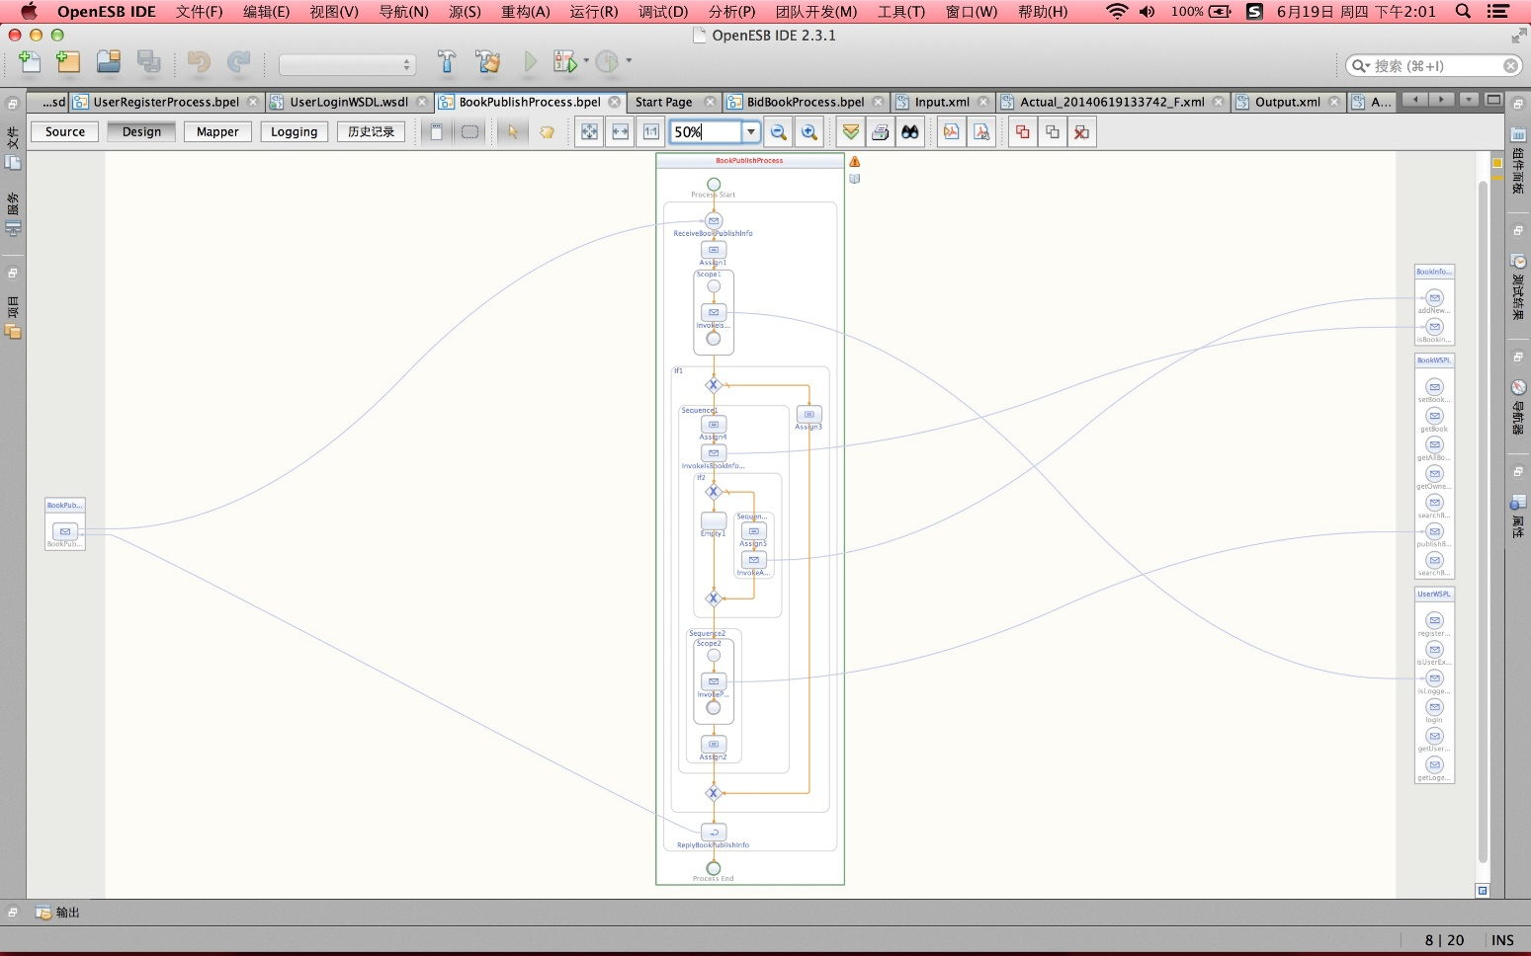
Implementation

Slide 6
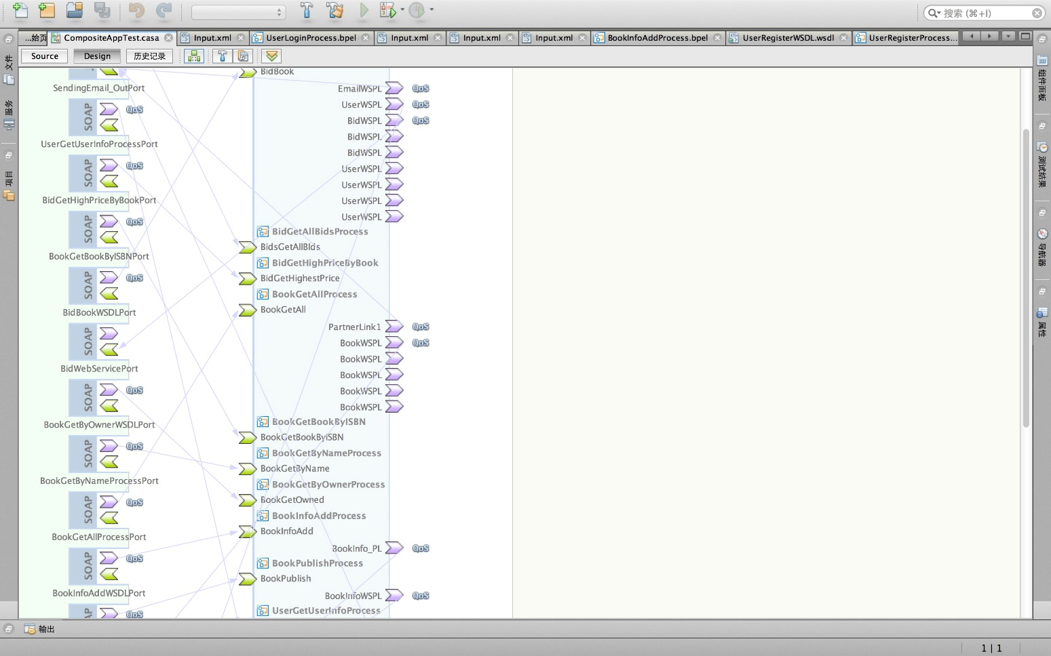
Implementation

Slide 7
Implementation
Tools recommendation
http://www.jsonschema2pojo.org/
https://code.google.com/p/google-gson/
JAXB

Slide 8
Demo
iOS APP

Slide 9
Summary
Q & A

Slide 10
Thank you！

