Slide 1

FinTechathon
GFS R2P Platform Project
DevFins team --- Victor & Barbara
Our project is Global Finance Service Requisition to Payment Platform, it focuses on resolving invoice verification and vendor payment processing for Accounting Operation team in GFS China.
Hello and Welcome to this session. It is my honor to present this project here. My team is called DevFins, I would tell you what’s the DevFins in the last.
Notes:
Hello and Welcome to this session. It is my honor to present this project here. My team is called DevFins, I would tell you what’s the DevFins in the last.
Our project is Global Finance Service Requisition to Payment Platform, it focuses on resolving invoice verification and vendor payment processing for Accounting Operation team in GFS China.

Slide 2





Communication
Manual Operation
No e-form Application
Manual Risk
Currently the biggest problems they are facing are massive manual operations, communication with stakeholders, a lack of an unique e-form application and
risk of manual mistakes.
Notes:
Currently the biggest problems they are facing are massive manual operations, communication with stakeholders, a lack of an unique e-form application and risk of manual mistakes.

Slide 3





LOW EFFICIENCY
MANUAL MISTAKE
INFORMATION ISOLATION
The current process is that AO(Accounting Operation) staff receives paper invoices from vendors who need reimbursement, and then manually need to input invoice information into registration tables to track and verify their correctness.
During the whole process, AO staff is working manually within low efficiency and always facing the risk of manual mistakes and information isolation. It means what you think is not the same as I think, the information is not matched between us.
Then they need to reject incorrect invoice requests and communicate with related stakeholders via email or the phone.
For correct invoices, AO staff will copy them manually and start towards the next payment process.
Notes:
The current process is that AO(Accounting Operation) staff receives paper invoices from vendors who need reimbursement, and then manually need to input invoice information into registration tables to track and verify their correctness.
Then they need to reject incorrect invoice requests and communicate with related stakeholders via email or the phone.
For correct invoices, AO staff will copy them manually and start towards the next payment process.
During the whole process, AO staff is working manually within low efficiency and always facing the risk of manual mistakes and
information isolation. It means what you think is not the same as I think, the information is not matched between us.

Slide 4
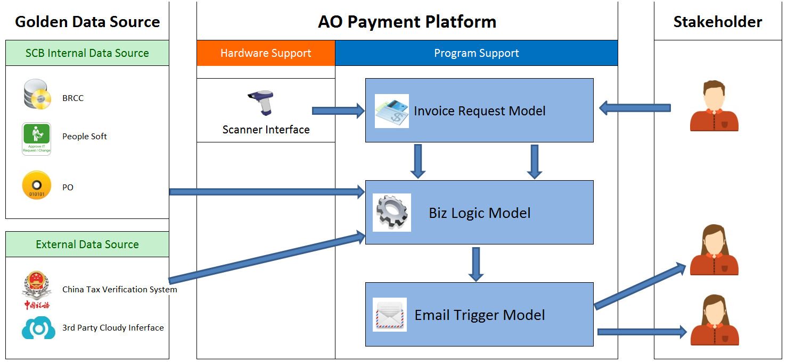
Regarding our designed solution, we provide a payment platform to resolve those problems. Our target is to make each process automatic, improve efficiency and reduce manual risk to zero.
Notes:
Regarding our designed solution, we provide a payment platform to resolve those problems. Our target is to make each process automatic, improve efficiency and reduce manual risk to zero.

Slide 5

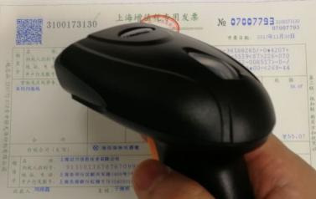
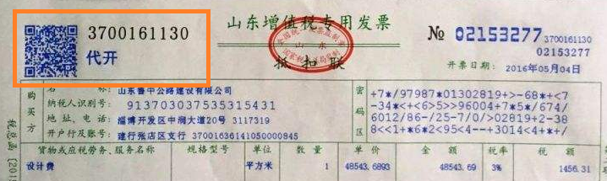
01011011000100
We provide hardware to scan this QR code, so that the invoice information will be imported into system automatically.
In China, each invoice has an unique QR code which includes invoice detail information.
Notes:
In China, each invoice has an unique QR code which includes invoice detail information. We provide hardware to scan this QR code, so that the invoice information will be imported into system automatically.

Slide 6

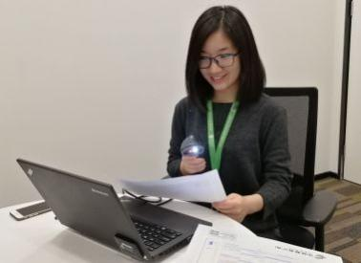




After determining Whether the invoice is effective or not, the system will trigger an email automatically to be sent to the relevant stakeholders.
After applying our new process, the requestor will use a website or mobile app to submit their reimbursement request.
AO staff can use this scanner to scan their invoice QR Code instead of manually typing it and then the invoice information will be auto-imported into our system.
The system will auto-match with Chinese Tax Golden Source to do invoice verification.
Notes:
After applying our new process, the requestor will use a website or mobile app to submit their reimbursement request. AO staff can use this scanner to scan their invoice QR Code instead of manually typing it and then the invoice information will be auto-imported into our system. The system will auto-match with Chinese Tax Golden Source to do invoice verification. After determining Whether the invoice is effective or not, the system will trigger an email automatically to be sent to the relevant stakeholders.

Slide 7




Improve efficiency to 25 times.
Reduce manual risk to zero.
Digital and eco-office
Audit automation
4. Audit automation. Everything is saved in a database, so we can search and check the invoice history easily for the end of year audit, as well as generate accounting reports. If still using paper invoices, it would be a huge job to look for one invoice from thousands that are periodically received.
3. Digital and eco-office. There is no paper request in our new system. All the data is changed to an electronic form and saved into our database. So we can save paper costs, printing costs, as well as time costs. The time estimation is more than 150 hours to save each month for AO and Trade department.
2. Reduce manual risk to Zero. After applying this system, there is no manual operation at all, so we can say that's 100% risk free.
After applying this new system, the benefit is
1. Improve efficiency to 25 times. AO staff needs at least 25 seconds to input an invoice information at least. After using our scanner, it will take less than 1 second to complete all the processes.
Notes:
After applying this new system, the benefit is
1. Improve efficiency to 25 times. AO staff needs at least 25 seconds to input an invoice at least. After using our scanner, it will take less than 1 second to complete all the processes.
2. Reduce manual risk to zero. After applying this system, there is no manual operation at all, so we can say that's 100% risk free.
3. Digital and eco-office. There is no paper request in our new system. All the data is changed to an electronic form and saved into our database so we can save paper costs, printing costs, as well as time costs. The time estimation is more than 150 hours to save each month for AO and Trade department.
4. Audit automation. Everything is saved in a database, so we can search and check the invoice history easily for the end of year audit, as well as generate accounting reports. If still using paper invoices, it would be a huge job to look for one invoice from thousands that are periodically received.

Slide 8
DevFins
Development
Finance
Simpler
Faster
Better
That's all for our project summary. Please remember our team name - DevFins. It is Development plus Finance. Our team target is to make Financial operation Simpler, Faster and Better and that's exactly what we've done.
Our team target is to make Financial operation Simpler, Faster and Better.
Notes:
That's all for our project summary. Please remember our team name - DevFins. It is Development plus Finance. Our team target is to make Financial operation Simpler, Faster and Better and that's exactly what we've done. Thank you.

Slide 9
Q & A
technology question: 1464202 Victor
business question: 1441180 Barbara
It is very short presentation, if you are interesting in our project, please OC us for free. For any technique question, please contact Victor. Business question, that is Barbara .
Notes:
It is very short presentation, if you are interesting in our project, please OC us for free. For any technique question, please contact Victor. Business question, that is Barbara .

Slide 10
Demo
Link :
It is supported by Chrome, not IE.
Login:
Requestor role : 1464202 / 123456
Accouting role: 1441180 / 123456
User manual:
After login the system, you can click “HELP” menu to get usage support.
Notes:
This is just one of core functions. For full demo show, please open the link by Chrome.

