Slide 1

FinTechathon
GFS R2P Platform Project
DevFins team --- Victor & Barbara
I come from DevFins team, my project is to focus on resolving invoice verification and vendor payment process for SCB Accounting operation department.
Dear everyone, Welcome to join this session, it is my honor to present our project here.
Notes:
Dear everyone,
Welcome to join this session, it is my honor to present our project here. I come from DevFins team, my project is to focus on resolving invoice verification and vendor payment process for SCB Accounting operation department.

Slide 2





Communication
Manual Operation
No e-form template
Manual Risk
so heave manual operation, communicate with vendor, no unique e-form template and
risk of manual mistake.
Our users are from AO department. The big problem what they are facing is

Slide 3





LOW EFFICIENCY
MANUAL MISTAKE
INFORMATION OF ISOLATION
So far AO staff receives paper invoice from vendor who needs to reimburse, AO staff will manually input invoice information into system and verify its correctness
During the whole process, AO staff is working manually within low efficiency and always facing risk of manual mistake and information of isolation
AO staff needs to reject ineffective invoice request and communicate to related stakeholder by
email / tel
For effective invoice, AO staff will copy invoice manually and start to next payment process.

Slide 4
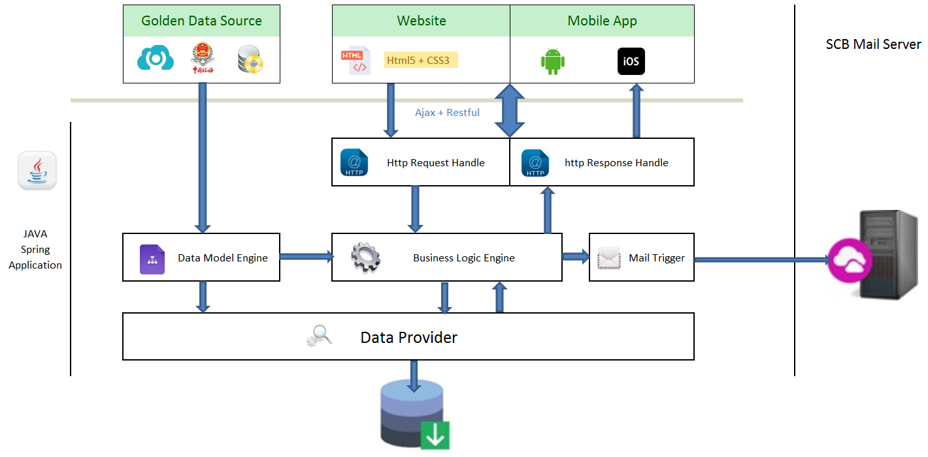
In our new design, we will provide a new payment platform to resolve these problems. Our target is to make everything automatically, improve efficiency and reduce manual risk to Zero.

Slide 5

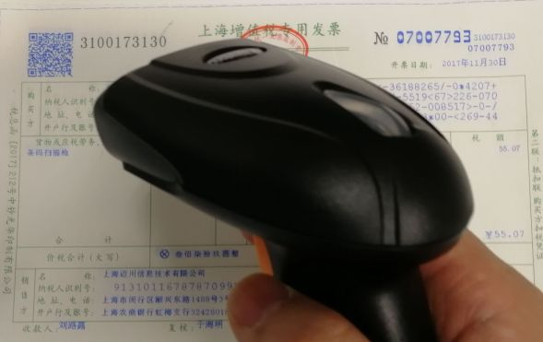
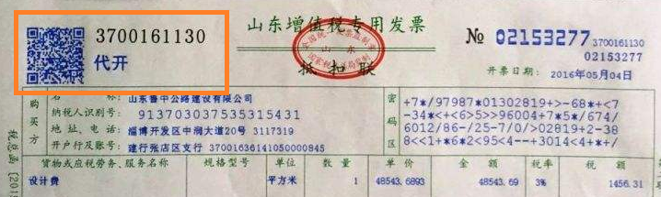
01011011000100
We will provide a hardware to scan invoice information and then the information will be input into system automatically.
In China, each invoice has an unique QR code and it saves all of this invoice information.

Slide 6


In future, the requestor will use website or mobile app to submit his/her reimbursement within the electronic invoice.

Slide 7




Improve 25 multiple efficiency.
Reduce manual risk to Zero.
Digital and eco-office
Audit automation
4. Everything is saving in database, so we can search and check history invoice easily for end of year audit. If it is still paper invoice, it will be a huge job to look for one invoice from thousands of invoices.
3. Digital and eco-office. There is no paper request in new system, every data is changed to electronic form and save into database. So we can save paper cost, print cost as well as time cost.
2. Reduce manual risk to Zero. After applying this system, there is no manual operation at all, so we can say that's 100% safe.
1. Improve 25 multiple efficiency. AO staff needs 25 seconds to input and verify an invoice at least. After using scanner, it will take less than 1 second to complete all processes.
After apply this new system, we can

Slide 8
DevFins
Development
Finance
Simpler
Faster
Better
That's all for our project brief. please remember our team name DevFins. It is Development plus Finance
Our team target is to make Financial operation Simpler, Faster and Better.

