Slide 1

FinTechathon
GFS R2P Platform Project
DevFins team --- Victor & Barbara
Our project is Global Finance Service Requisition to Payment Platform, it focuses on resolving invoice verification and vendor payment processing for Accounting Operation team in GFS China.
Hello and Welcome to this session. It is my honor to present our project here. My team is called DevFins, I would tell you what’s the DevFins in the last.
Notes:
Hello and Welcome to this session. It is my honor to present our project here. My team is called DevFins, I would tell you what’s the DevFins in the last.
Our project is Global Finance Service Requisition to Payment Platform, it focuses on resolving invoice verification and vendor payment processing for Accounting Operation team in GFS China.

Slide 2





Communication
Manual Operation
No e-form Application
Manual Risk
Currently the biggest problems they are facing are unnecessarily heavy manual data input and
checking tasks, communication with stakeholders, a lack of a unique e-form application and
risk of manual mistakes.
Notes:
Currently the biggest problems they are facing are unnecessarily heavy manual data input and checking tasks, communication with stakeholders, a lack of a unique e-form application and risk of manual mistakes.

Slide 3





LOW EFFICIENCY
MANUAL MISTAKE
INFORMATION ISOLATION
The current process is that AO(Accounting Operation) staff receives paper invoices from vendors who need reimbursement, and then manually need to input invoice information into registration tables to track and verify their correctness.
They then need to reject incorrect invoice requests and communicate with related stakeholders via email or the phone.
During the whole process, AO staff is working manually within low efficiency and always facing the risk of manual mistakes and issues with information availability and clarity.
For correct invoices, AO staff will copy them manually and start towards the next payment process.
Notes:
The current process is that AO(Accounting Operation) staff receives paper invoices from vendors who need reimbursement, and then manually need to input invoice information into registration tables to track and verify their correctness.
They then need to reject incorrect invoice requests and communicate with related stakeholders via email or the phone.
For correct invoices, AO staff will copy them manually and start towards the next payment process.
During the whole process, AO staff are working manually within low efficiency and always facing the risk of manual mistakes and
issues with information availability and clarity.

Slide 4
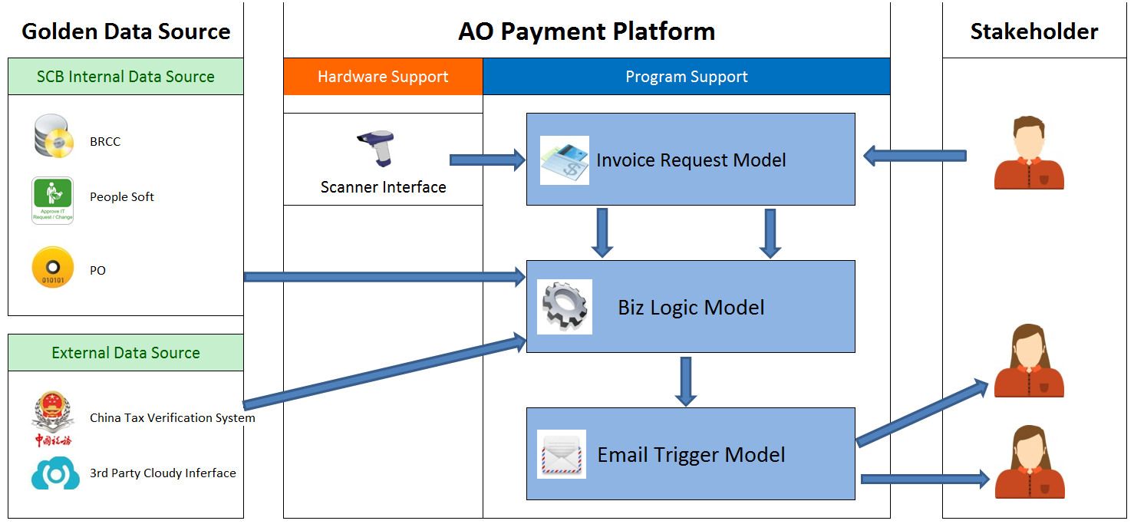
Regarding our designed solution, we provide a payment platform to resolve those problems. Our target is to make each process automatic, improve efficiency and reduce manual risk to zero.
Notes:
Regarding our designed solution, we provide a payment platform to resolve those problems. Our target is to make each process automatic, improve efficiency and reduce manual risk to zero.

Slide 5

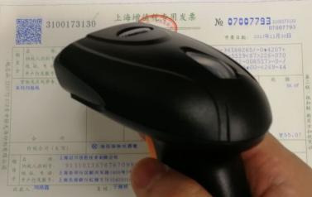
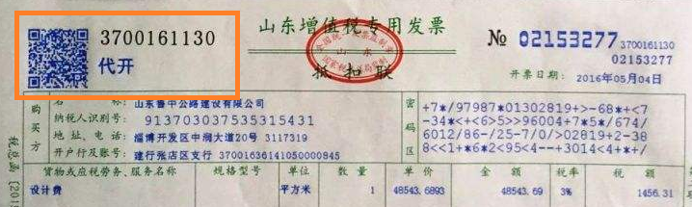
01011011000100
We provide hardware to scan this QR code, so that the invoice information will be imported into system automatically.
In China, each invoice has an unique QR code which includes invoice detail information.
Notes:
We provide hardware to scan this QR code, so that the invoice information will be imported into system automatically.

Slide 6

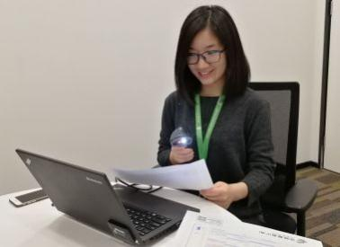




After determining Whether the invoice is effective or not, the system will trigger an email to automatically be sent to the relevant stakeholders.
After applying our new process, the requestor will use a website or mobile app to submit their reimbursement request using their electronic device.
AO staff can use this scanner to scan their invoice QR Code instead of manually typing it and then the invoice information will auto-import into our system.
The system will auto-match with Chinese Tax Golden Source to do invoice verification.
Notes:
After applying our new process, the requestor will use a website or mobile app to submit their reimbursement request using their electronic device. AO staff can use this scanner to scan their invoice QR Code instead of manually typing it and then the invoice information will auto-import into our system. The system will auto-match with China's Tax Golden Source to do invoice verification. After determining Whether the invoice is effective or not, the system will trigger an email to automatically be sent to the relevant stakeholders.

Slide 7




Improve 25 multiple efficiency.
Reduce manual risk to Zero.
Digital and eco-office
Audit automation
4. Audit automation. Everything is saving in database, so we can search and check history invoice easily for end of year audit as well as generate accounting report. If it is still using paper invoice, it will be a huge job to look for one invoice from thousands of invoices.
2. Reduce manual risk to Zero. After applying this system, there is no manual operation at all, so we can say that's 100% safe.
After apply this new system, we can
1. Improve 25 multiple efficiency. AO staff needs 25 seconds to input and verify an invoice at least. After using scanner, it will take less than 1 second to complete all processes.
3. Digital and eco-office. There is no paper request in new system, every data is changed to electronic form and save into database. So we can save paper cost, print cost as well as time cost.
Notes:
After apply this new system, we can
1. Improve 25 multiple efficiency. AO staff needs 25 seconds to input and verify an invoice at least. After using scanner, it will take less than 1 second to complete all processes.
2. Reduce manual risk to Zero. After applying this system, there is no manual operation at all, so we can say that's 100% safe.
3. Digital and eco-office. There is no paper request in new system, every data is changed to electronic form and save into database. So we can save paper cost, print cost as well as time cost.
4. Audit automation. Everything is saving in database, so we can search and check history invoice easily for end of year audit as well as generate accounting report. If it is still using paper invoice, it will be a huge job to look for one invoice from thousands of invoices.

Slide 8
DevFins
Development
Finance
Simpler
Faster
Better
That's all for our project summary. Please remember our team name - DevFins. It is Development plus Finance. Our team target is to make Financial operation Simpler, Faster and Better and that's exactly what we've done.
Our team target is to make Financial operation Simpler, Faster and Better.
Notes:
That's all for our project summary. Please remember our team name - DevFins. It is Development plus Finance. Our team target is to make Financial operation Simpler, Faster and Better and that's exactly what we've done. Thank you.

Slide 9
Q & A
technology question: 1464202 Victor
business question: 1441180 Barbara
It is very short presentation, if you are interesting in our project, please OC us for free. For any technique question, please contact Victor. Business question, that is Barbara .

