Slide 1




Accessible Home Cybersecurity Kit
Sarah Maughan, Skyler Guard, Tyler Vander Mooren
EGR 333W
12/7/2025

Slide 2

The Problem: Vulnerable Home Networks

Slide 3
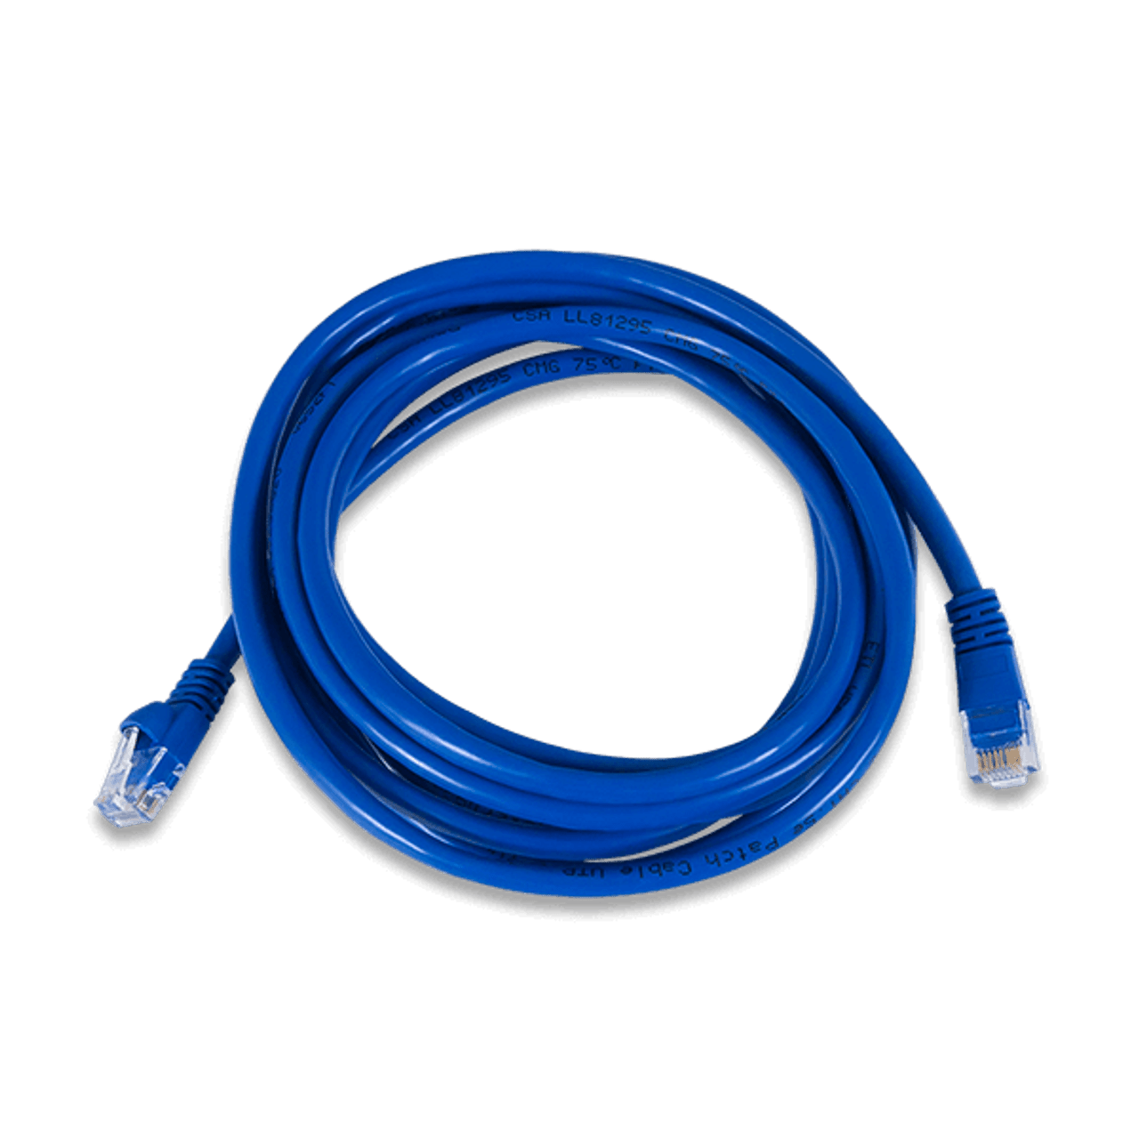
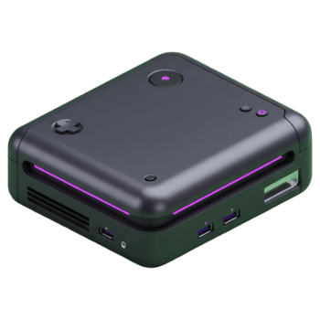
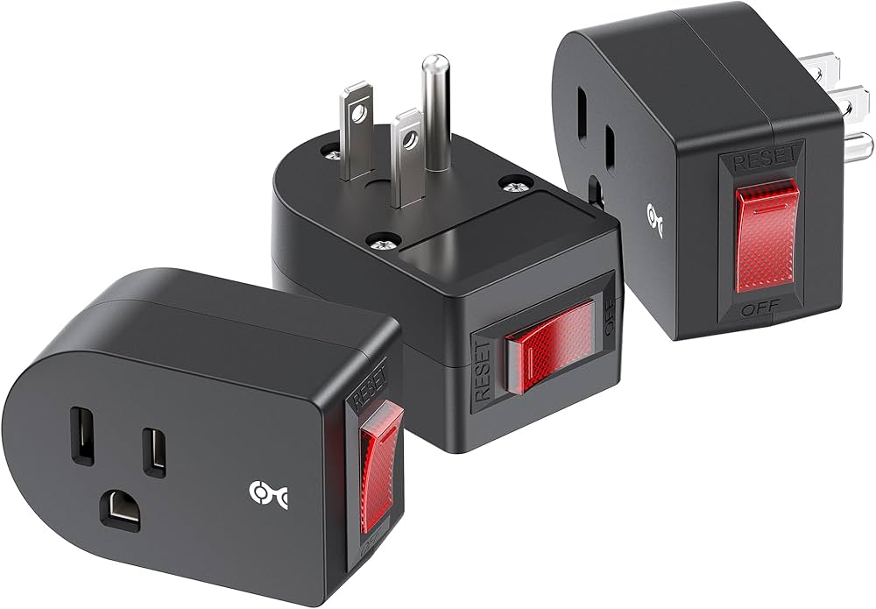

Accessible Home Cybersecurity Kit: Overview
Accessible, user-centric, and low-cost system designed to bring comprehensive cybersecurity to home networks.
Consists of a physical hardware ‘hub’ that filters network traffic and performs vulnerability tests, as well as accessories like camera covers.
Addresses ‘weakest-link’ problem in home cybersecurity.

Slide 4
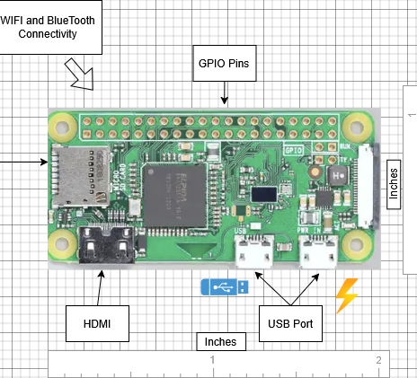
Accessible Home Cybersecurity Kit: Hardware Overview
Raspberry Pi Zero W
Includes wifi adaptor and and ethernet port
GPIO for expansion
Lightweight, Small and inexpensive
Connects to home devices via home router

Slide 5
Accessible Home Cybersecurity Kit: Components
Home Security Hub (HSH) - plug-and-play device built using a Raspberry Pi Zero W that provides integrated home cybersecurity via:
Network filtering - filters incoming and
outgoing packets for devices on the home network to block suspicious traffic.
Vulnerability testing - performs penetration tests across home devices to identify vulnerabilities
Dashboard - user-friendly mobile application where users view security reports and vulnerability alerts from the HSH, with guided tutorials for improving security. Users also use the dashboard to reconfigure HSH settings.
Security Accessories - camera stickers and outlet switches allow users physical control over their devices to protect their privacy.
Dashboard
information about vulnerabilities
alerts, summaries, and tutorials
configuration updates
User
queries &
configuration updates
HSH
(Vulnerability Detection)
response
penetration test
HSH
(Network Filtering System)
perform password and security updates
Home Devices
packets
packets
External Networks

Slide 6

Accessible Home Cybersecurity Kit: Fundamental Principles
Comprehensive Cyber Protection: the HSH provides a layer of cyber security (by filtering IoT packets and testing for vulnerabilities) for every device in the network
Unnecessary = Unwanted: Don’t leave a connection or vulnerability (such as an internet port or webcam) available if it is not useful to the user. The HSH filters external traffic to prevent malware, the physical accessories restrain cameras and devices to protect privacy.
Involve the User: The user understands best which functionality they actually use and what is unnecessary. Meanwhile, the dashboard shows the user why and how to integrate security best practices like strong and unique passwords.

Slide 7
Conclusion
Cybersecurity tools must be
Comprehensive
Affordable
Accessible
Our kit addresses this and provides
Targeted feedback
Customizable protection
Cybersecurity Education
Thank you for your time.
Notes:
Comprehensive / don’t leave weak links to be exploited

Slide 8
Works Cited
[1] F. Breitinger, J. Ricci, I. Baggilli, “Survey Results on Adults and Cybersecurity Education”, Education and Information Technologies, vol 24, pp 231-249, Jul 2019, doi: 10.1007/s10639-018-9765-8
[2] Netgear Security Team, “The 2024 IoT Security Landscape Report - NETGEAR”, Netgear.com, https://www.netgear.com/hub/network/2024-iot-threat-report/ (accessed Dec. 7, 2025).
[3] “What is a Raspberry Pi?,” Opensource.com, 2012. https://opensource.com/resources/raspberry-pi (accessed Nov. 14, 2025).
[4] Fortinet, “What is IoT Security?,” Fortinet, 2022. https://www.fortinet.com/resources/cyberglossary/iot-security
[5] K. Y. Najmi, M. A. AlZain, M. Masud, N. Z. Jhanjhi, J. Al-Amri, and M. Baz, “A survey on security threats and countermeasures in IoT to achieve users confidentiality and reliability ,” Materials Today: Proceedings, vol. 44, 2021, https://doi.org/10.1016/j.matpr.2021.03.417.
[6] A. Slonopas, “IoT Cybersecurity: Strengthening Defenses against Threats | American Public University,” www.apu.apus.edu. https://www.apu.apus.edu/area-of-study/information-technology/resources/iot-cybersecurity-strengthening-defenses-against-threats (accessed Nov. 13, 2025).

