Slide 1
EDMS – Employee Data Management System
CS 312 Group Project
Team Members:
1. Tyler Vander Mooren

Slide 2

Agenda
01
Problem Statement & Idea
02
Project Components
03
Phase - 1 and Phase - 2 Deliverables
04
Challenges and Solutions
05
Project Demo

Slide 3

Problem Statement & Idea
Organizations require a secure system to manage employee data, with distinct role-based access for admins and employees. Admins should have full control over all employee records, while employees can only view and edit their own profiles.
Develop a comprehensive Employee Database Management System using the PERN stack (PostgreSQL, Express, React, Node.js). The system will feature user authentication, role-based access control (admin and employee), and CRUD operations for managing employee records.

Slide 4

Project Components
Authentication and Role-Based Access:
Admins log in to manage all employee records.
Employees log in to view and edit their profiles.
User Interface (React Frontend):
Dashboard: Displays key statistics for both admins and employees.
Employee List (Admin View): Admins view all employee records in a table format.
Employee Profile (Employee View): Employees can edit their personal information.
Add Employee Form (Admin Only): Admins can add new employees with mandatory fields.
Manage Employee Records:
Edit Record: Admins can edit any employee's details; employees can edit only their own record.
Delete Record: Only admins can delete records, and this action requires a confirmation prompt.
Search and Filter Functionality:
Search Bar: Admins can search by name or ID; employees search within their profile.
Sort Functionality: Admins can sort records by various criteria.
Local Storage Integration and Data Persistence:
PostgreSQL stores employee records; local storage tracks user sessions for role-based functionality.

Slide 5
Phase – 1 Deliverables
Set up GitHub Repo and Development Environment (Node, PostgreSQL).
Create PostgreSQL schema for employee records.
Implement user authentication routes (sign up / sign in).
Set up Express backend and test routes with Postman.
Develop React components: Login, Signup, Dashboard skeletons.

Slide 6
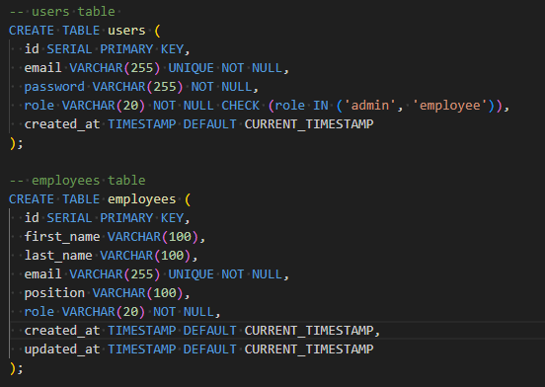

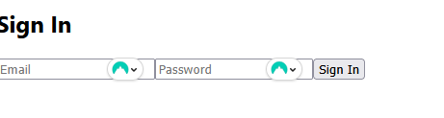
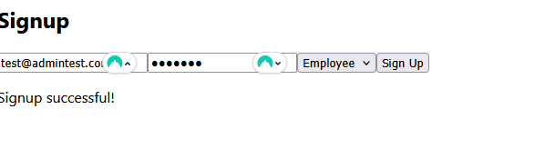
Phase – 1 Deliverables Contd.

Slide 7
Phase – 2 Deliverables
Implement role-based access logic.
Complete CRUD functionality (frontend + backend).
Build employee list and profile views.
Add search, filter, and sort functionality for admins.
Finalize styling, test UX, and write project documentation.

Slide 8
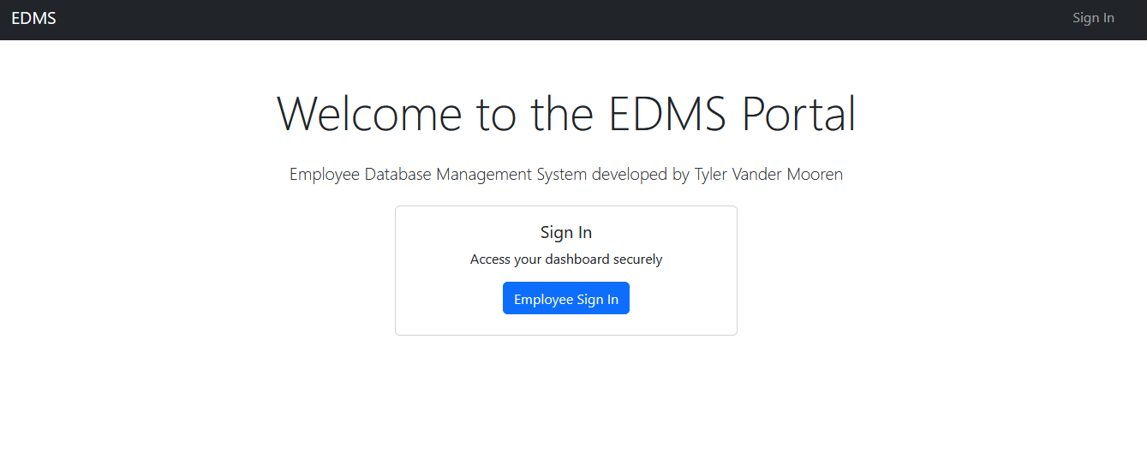
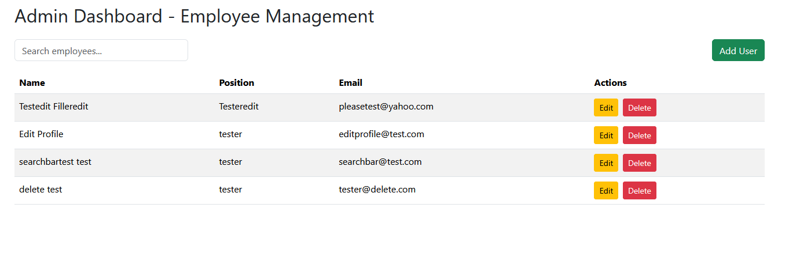
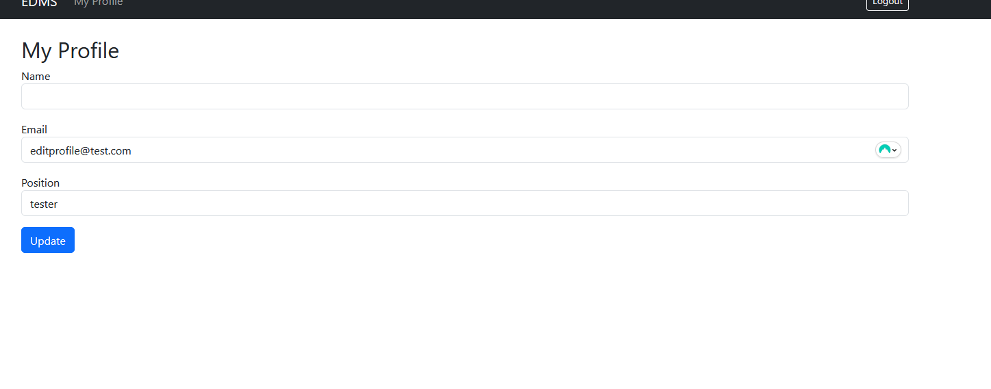
Phase – 2 Deliverables Contd.

Slide 9
Challenges & Solutions
<<Challenge-1>> Integrating role-based access control to restrict signup functionality to admin users only, while managing sessions securely.
Solution: Implemented middleware checks (isLoggedIn and isAdmin) on backend routes to enforce role-based access and used secure sessions with proper cookie handling. Also updated frontend routing to reflect permissions.
<<Challenge-2>> Managing employee data schema inconsistencies between frontend forms and backend PostgreSQL tables led to insertion errors.
Solution: Conducted a detailed schema review and refactored backend queries and frontend form fields to align with the database schema, removing unnecessary fields like phone and department to prevent errors.
<<Challenge-3>> Missing express.json() caused req.body to be undefined during POST requests
Solution: Added the express.json() middleware before all route definitions in server.js to correctly parse JSON bodies, allowing proper access to req.body.

Slide 10
Challenges & Solutions Contd.
<<Challenge-4>> Postman tests initially failed because the backend was not running or misconfigured
Solution: Forgot to start the backend server before making requests. Once realized, launched the Express server using Node and verified routes were listening properly.
<<Challenge-5>> Syncing frontend API calls with backend endpoints caused 404 errors due to mismatched route URLs or ports.
Solution: Standardized all API endpoints to use a common base URL with withCredentials enabled for cookies. Reviewed and aligned frontend route calls with backend routes to fix errors.

Slide 11

Project Demonstration

