Slide 1
Array Review, Random numbers, Work on Project 1
CPSC 2320 L4
2020-10-01

Slide 2
Exercise
Create an array of 100 integers and fill the array with 1’s

Slide 3
Harder Exercise
Create a 10x10 matrix (a 2d array) and fill it with 1’s

Slide 4
Another Hard Exercise
Create a 5x5 identity matrix (1’s along the diagonal, 0’s everywhere else)
matrix[0][0] = 1
matrix[1][1] = 1
matrix[0][1] = 0
matrix[3][4] = 0;
etc…

Slide 5
(Continued)
Loop over every element of the array and print it

Slide 6
Exercise
Create an array of 100 random numbers
???

Slide 7
(Pseudo) Random Numbers In C++
Use the rand() function
#include <stdlib.h>
Returns an integer between 0 and RAND_MAX
RAND_MAX is some large integer

Slide 8
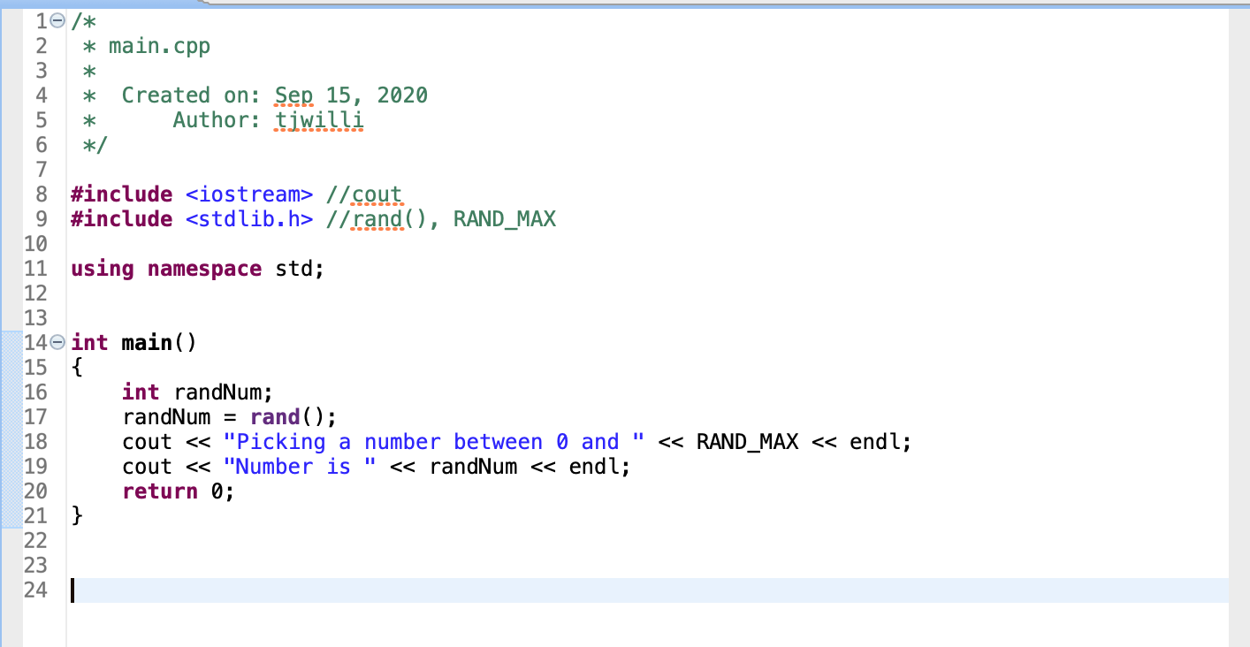

Slide 9
Rand() and SRAND()
Use srand( int ) to set the seed for rand()

Slide 10
SRAND()
Picking a good seed
Use the current time!
#include <time.h>
int numseconds = time(NULL)
srand(numseconds)

Slide 11
Exercise
Create an array of 100 random numbers

Slide 12
Exercise
Create an array of 100 random numbers between 0 and 1

Slide 13
Exercise
Write a function to calculate the average (the mean) of an array, and use it to find the mean of your random array

Slide 14
Project 1
Tanks!
Link to project

