Slide 1
Unit Tests, CHaracters
CPSC 2320 L6
2020-10-22

Slide 2
Quick vector review
Work on part 1 of your lab
Compile your code on your machine

Slide 3
Compiling your code
Use a text editor (you can still use the website if you want)
Give Notepad++ a try https://drive.google.com/file/d/1d_u0QnrQXeGIm2z-ZclvlSd14_HHz_b1/view?usp=sharing

Slide 4
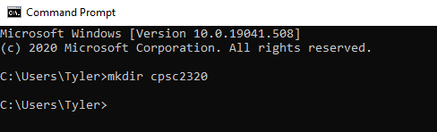
Make a folder called cpsc2320

Slide 5
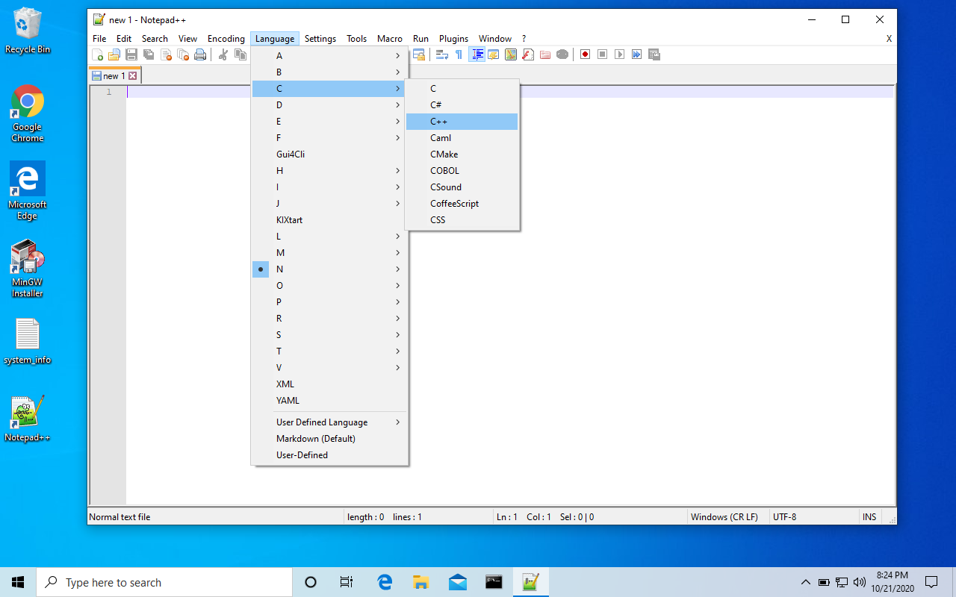
Optional: set Notepad++ for
C++ coding

Slide 6
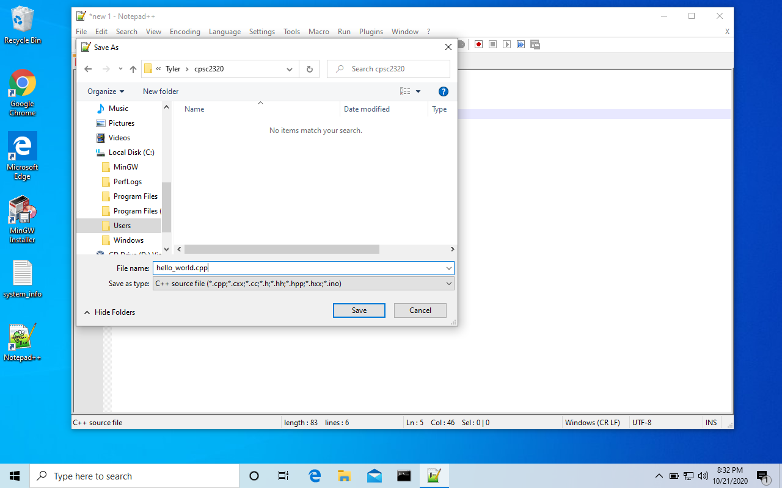
Local Disk→Users→<name>→cpsc2320
<filename>.cpp

Slide 7
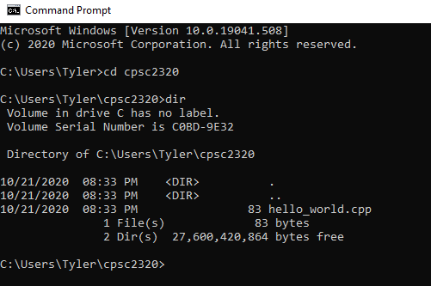

Slide 8
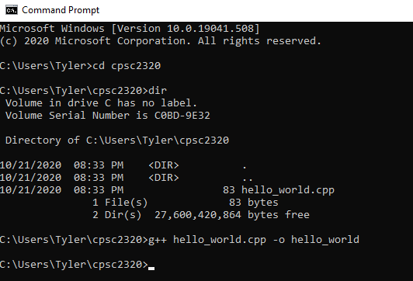
g++ <filename> -o <name of executable>
Creates hello_world.exe

Slide 9
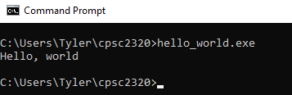
Run the code

Slide 10
Quick vector review
Work on part 1 of your lab
Compile your code on your machine

Slide 11
Testing your code
Does my code work?
How do I check?
Check that the output is what it should be
Do the calculation yourself for a few known values, then check

Slide 12
Example from project 1
bool check_hit_enemy_correct(
double my_x, double my_y, double enemy_x, double enemy_y, double velocity, double angle)
check_hit_enemy(0,0,10,10,45,45) = true
check_hit_enemy(0,0,10,10,45,20) = false
check_hit_enemy(-100,100,100,100,10,20) = false
check_hit_enemy(-100,100,100,100,75,10) = true
check_hit_enemy(-100,0,100,-100,90,-20) = true
etc…

Slide 13
Unit tests: Write code to test your code!
Unit tests are a way of automatically testing code in pieces (known as units), in a systematic, repeatable way.
We have been testing our programs by manually entering values at the prompt, and then manually examining the output to see if it’s correct.
When we change something in the code, we need to repeat all the old tests.
This is tedious and repetitive.
This is the sort of thing that computers are great at doing!
We can write code to perform all of our tests for a “unit”, and then run that code (whenever we want) to verify that everything is working correctly.

Slide 14
Unit testing: assert()
#include <assert.h>
Function definition (already included in <assert.h>) void assert(int expression);
Behavior:
If the expression is 0, the assertion will FAIL, the program will print an assertion error, and the program will abort (quit).
If the expression is nonzero, the assertion will pass, and execution will continue (silently -- you are not praised when you succeed).

Slide 15
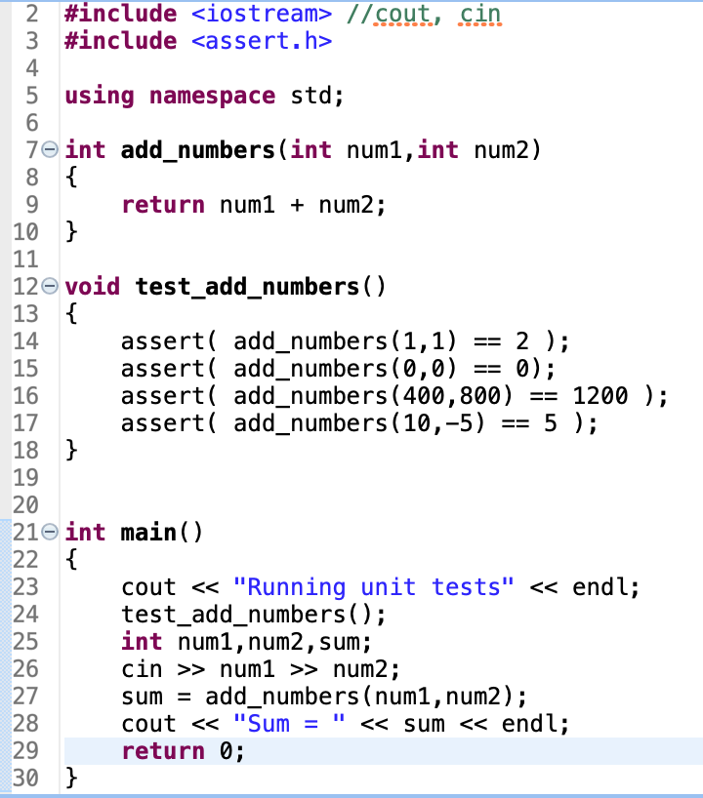
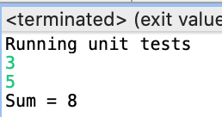
Example

Slide 16
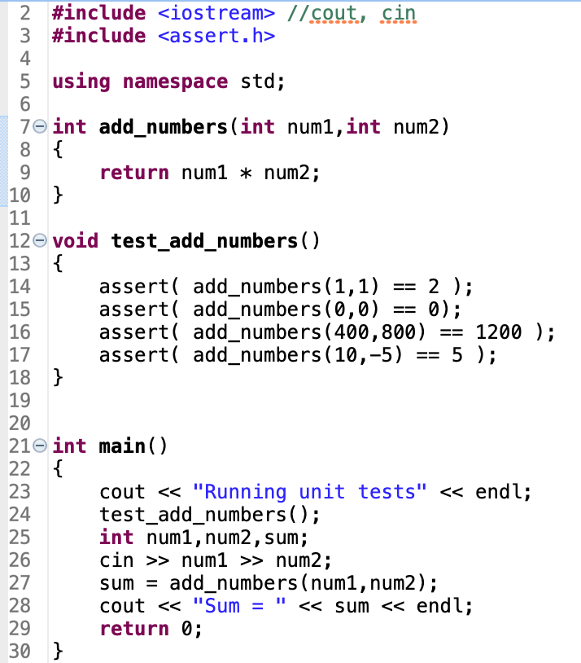

Slide 18
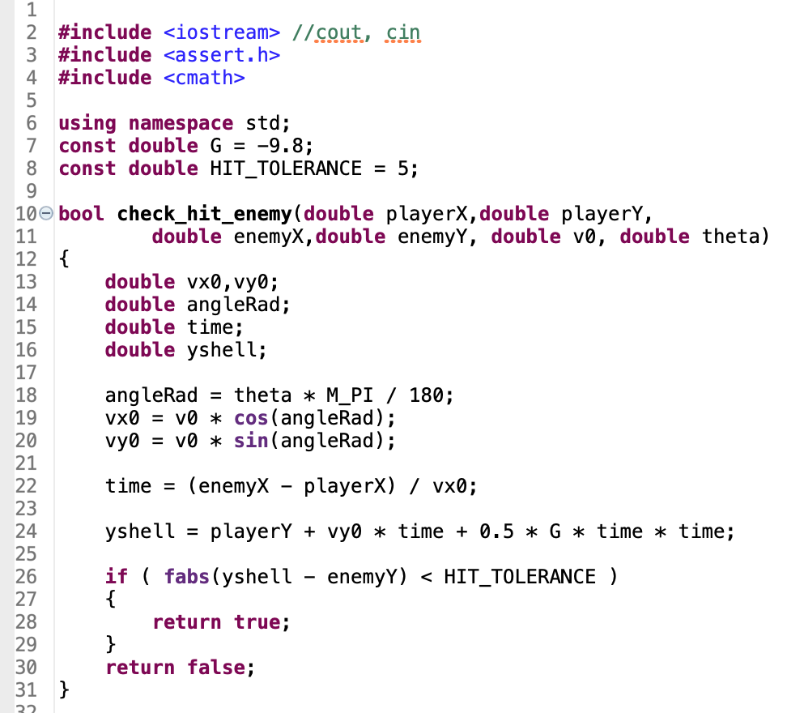
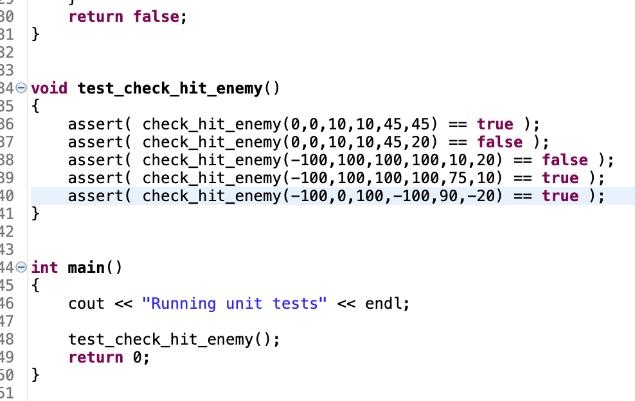

Slide 19
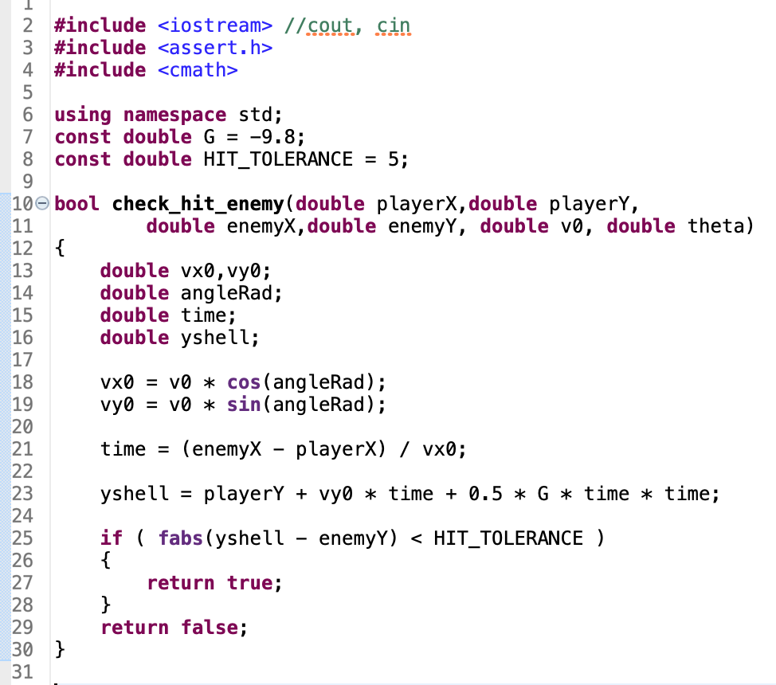
Missing deg to rad conversion

Slide 21
Unit Testing: choosing test cases
What values should we choose to test?
Valid values:
minimum, maximum, middle (or more than one middle if the function is rapidly varying)
Invalid values (and are errors handled appropriately?):
one less than the minimum, one more than the maximum
Other values to ensure all if/else branches are executed.

Slide 22
Unit Testing: the problem with == doubles
It is dangerous to use the equality comparison operator, ==, with a double.
doubles are not exact, by definition
two doubles, equal in all except their last decimal place, will be shown to be not equal by ==
Solution: see if two doubles are "close enough"
subtract the two numbers you want to compare
see if the difference is less than an EPSILON, that is defined as a constant variable

Slide 23
Unit Testing: the problem with == doubles
Example assert() statement:
const double EPSILON = 0.00001; // "close enough" ... assert(fabs(3.14159 - my_pi()) <= EPSILON);
The value for EPSILON will depend on what you are testing, and what your tolerance for rounding error is.

Slide 24
Unit testing lab
Work on part 2 of your lab
Compile your code on your machine

Slide 25
A new (to us) C++ Data type: CHAR
Used to store single characters
a-z, A-Z, 0-9, +, $, @, ? etc…
char var = ’y’
Need single quotes

Slide 26
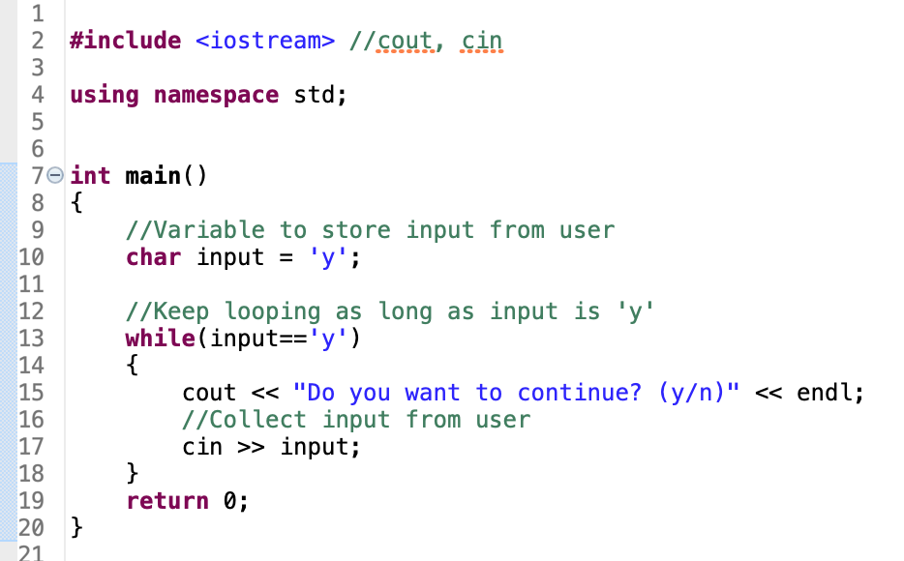
Small Example

Slide 27
Character arrays
Just like any other built in data type, we can construct an array of characters
char greeting[] = {’h’, ‘e’, ‘l’, ‘l’, ‘o’};

Slide 28
Character arrays
Special array initialization for char arrays:
char greeting[] = “hello”;

Slide 29
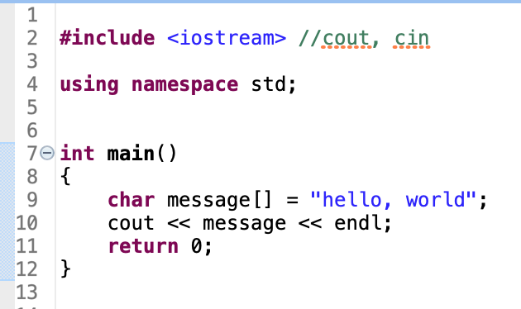
Example
Unlike arrays of other data types, cout will print the entire character array

Slide 30
Homework
Finish Lab 4

