Slide 1
Files and Strings
CPSC 2320 L7
2020-10-29

Slide 2
Read/write text files
New objects
ifstream and ofstream
ifstream used to read from files
ofstream used to write to files
#include <fstream> to access these objects

Slide 3
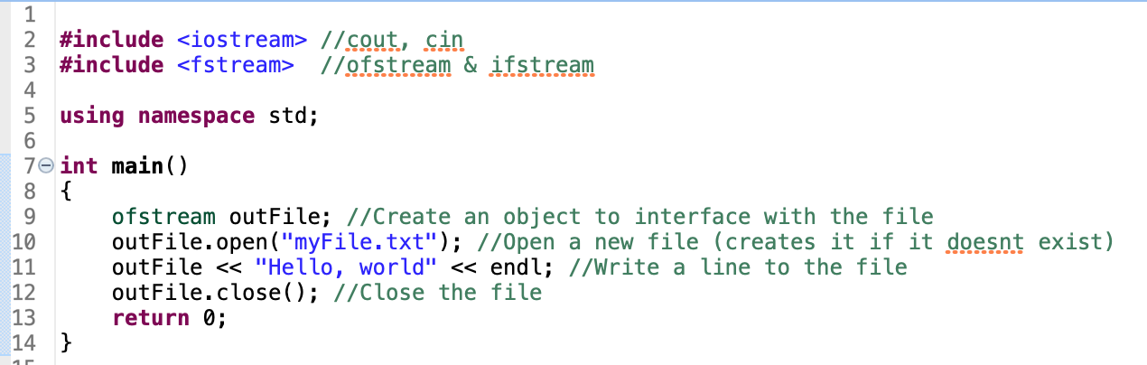
A simple example

Slide 4
A simple Example
Create an object of type ofstream to handle the file
Create a new file named “myFile.txt”
ofstream outFile;
outFile.open("myFile.txt");
outFile << "Hello, world" << endl;
outFile.close();
Write to the file (works like cout)
Make sure you close the file!

Slide 5
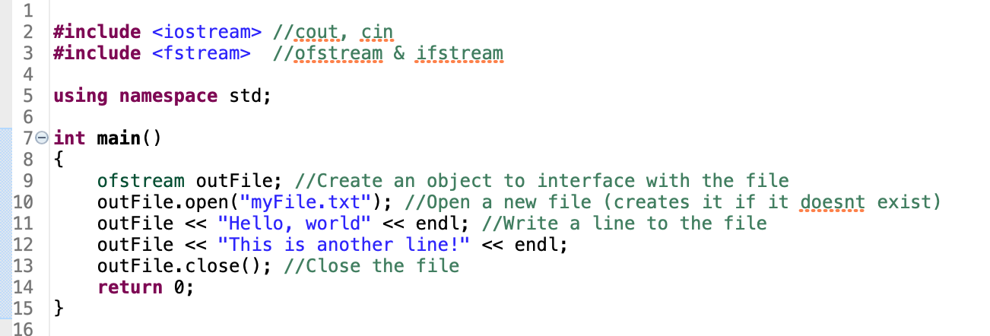
A simple example

Slide 6
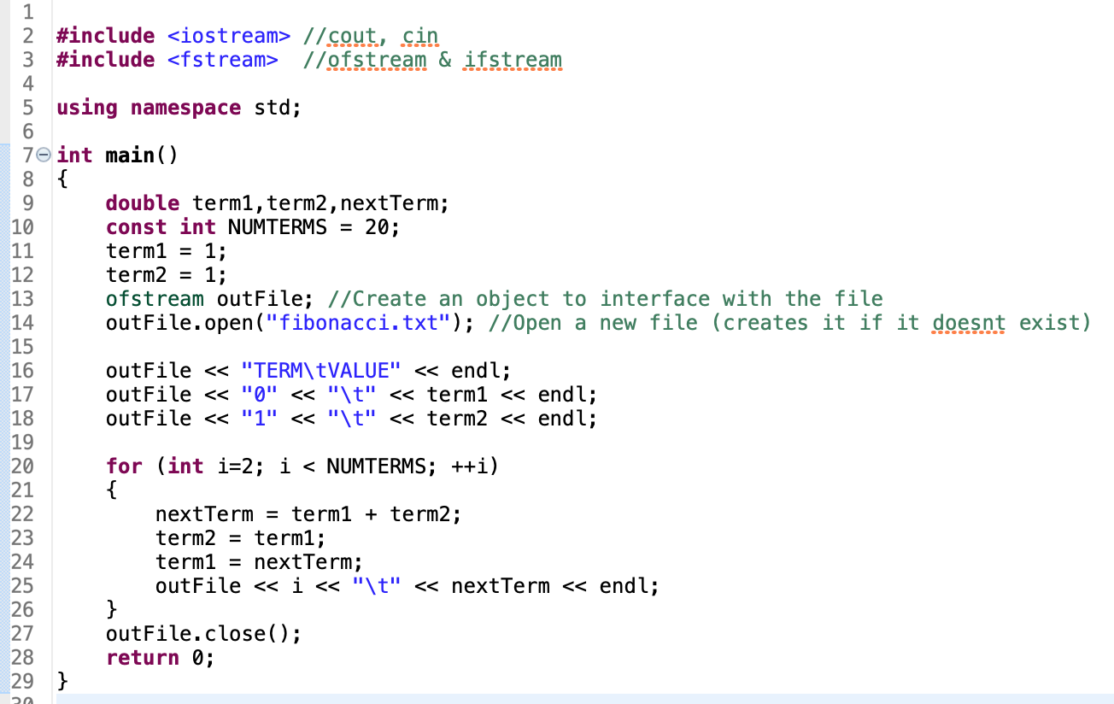
\t = tab

Slide 7
Choosing a filename
Keep it simple and explanatory
Use a file extension to indicate it’s a text file
“.txt” is common
“.dat” (short for .data) is also common
NO WHITESPACE IN FILENAMES
Use underscores instead
“My Data.dat”→”my_data.dat”

Slide 8
Try it!
Write the message “Hello, World!” to a file

Slide 9
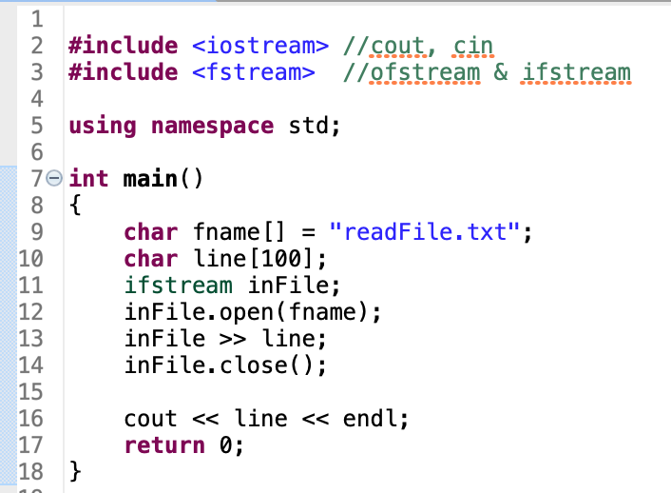
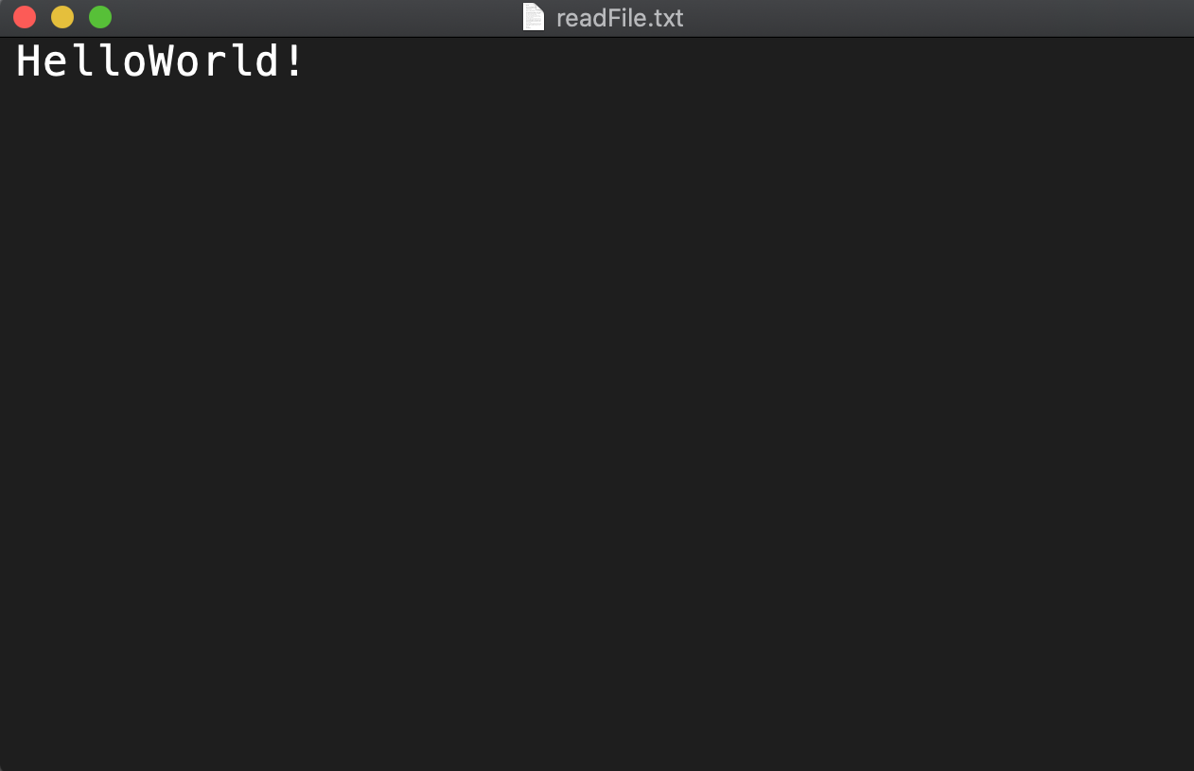
Reading files

Slide 10
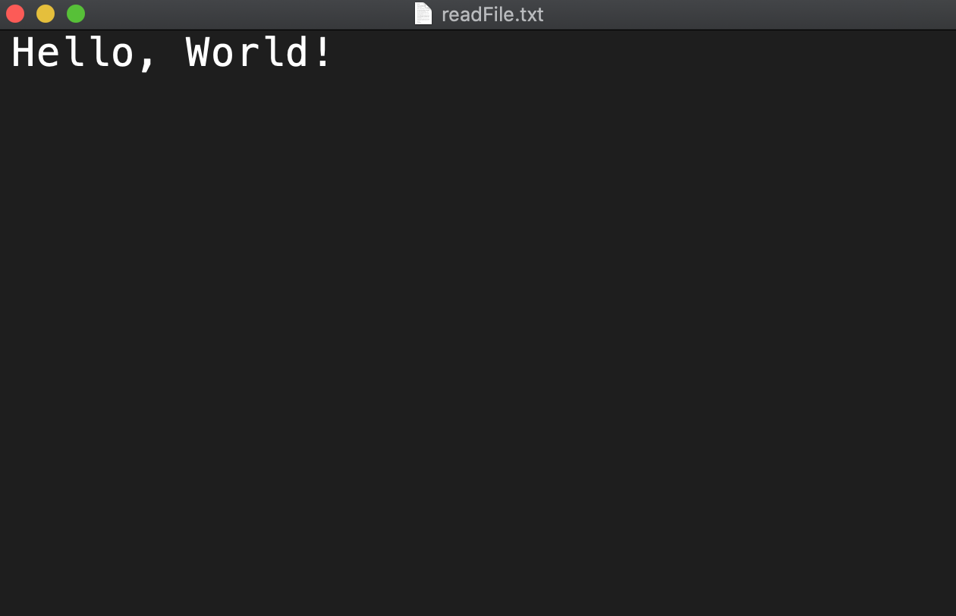
Reading files
Prints “Hello,”

Slide 11
“>>” operator stops at first whitespace
Better solution: getline()
Requires a string

Slide 12
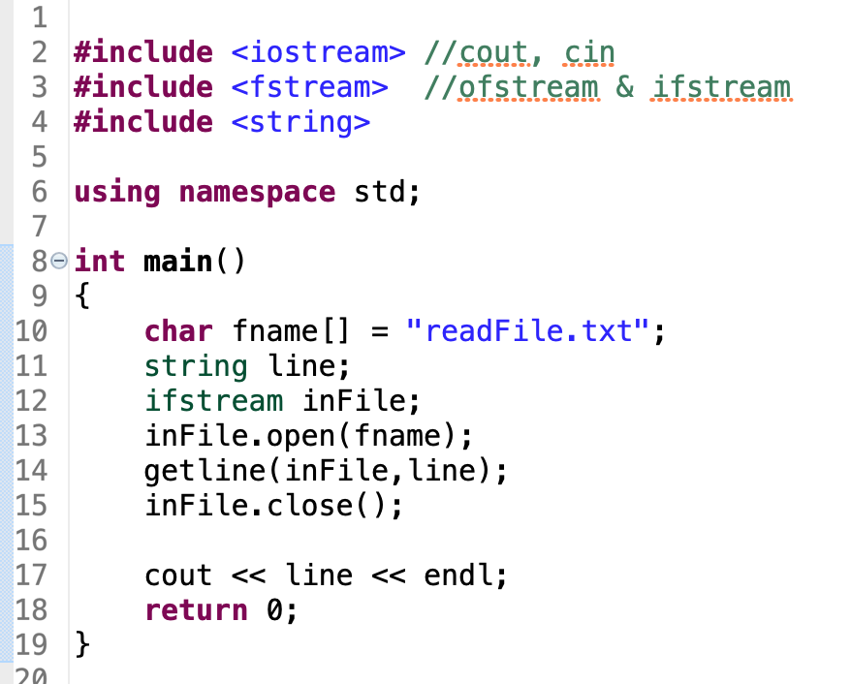
#include string
Prints “Hello, World!”

Slide 13
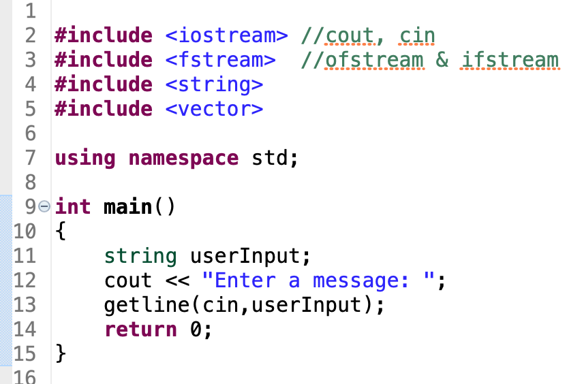
Getline
Can also use getline to replace cin

Slide 14
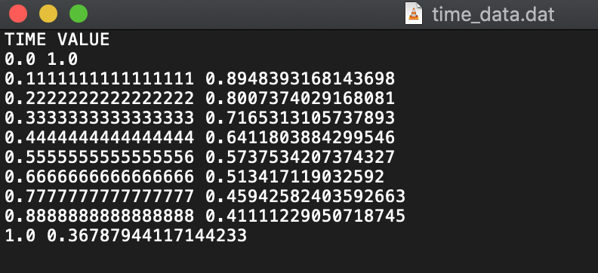
Looping over an input File
Suppose our input looks like this
Want to read all values and store in vectors
Solution: while loop using file.eof()
(end of file)

Slide 15
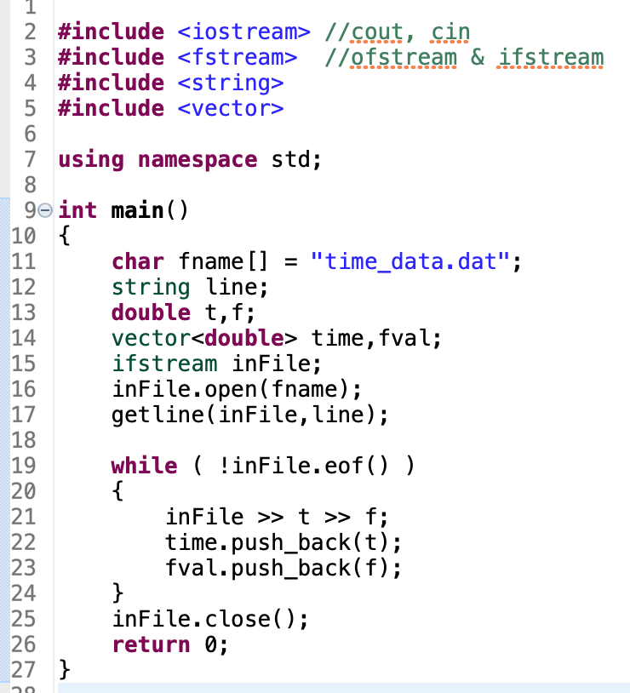
Read the header lines into a string

Slide 16
If the file doesn’t exist, file.open(“filename”) will not give an error
We need to check if the file opened properly
Use file.fail()

Slide 17
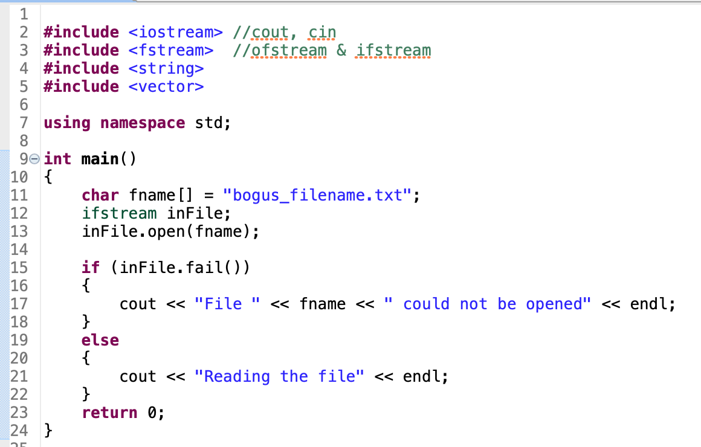

Slide 18
Work on Lab

Slide 19
Overview of Strings
C++ implements strings (a sequence of characters) as an object.
It is a member of the Standard Template Library (STL).
Need to include the library:
#include <string> using namespace std;

Slide 20
Declaring a string
Declare an empty string
string name = “”;
Declare and initialize a string
string schoolName = “Anderson”;
Value can be overwritten, like any datatype
schoolName = “Anderson University”;

Slide 21
Built in String methods
[]: access an individual letter (like an array)
cout << name[1] << endl;
.length() and .size(): number of characters in the string
cout << “There are “ << name.length() << “letters in the word << name <<endl;
.substr(position,length): return a substring of length “length” starting at position
cout << name.substr(1,3) << endl;

Slide 22
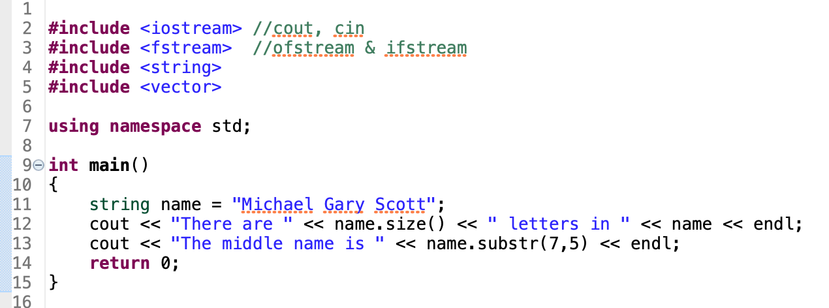
Examples
Output:
There are 18 letters in Michael Gary Scott
The middle name is Gary

Slide 23
Parsing strings
Parse string to double:
stod(string)
Parse string to int:
stoi(string)

Slide 24
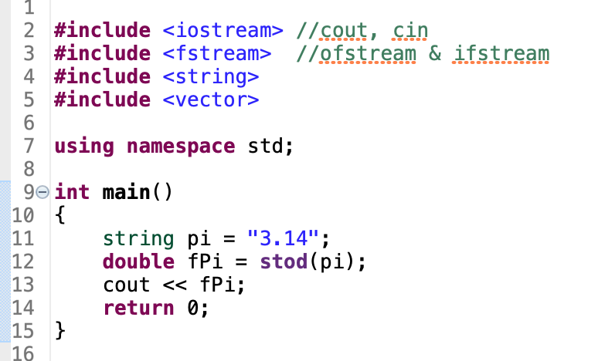

Slide 25
Parsing Strings
If we have a string consisting of two numbers separated by a space

Slide 26
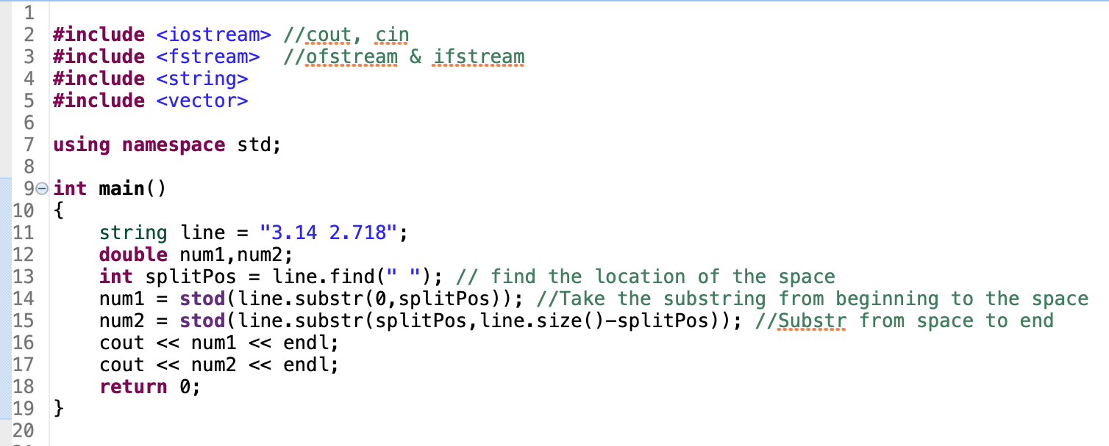
Parsing Strings

Slide 27
String Concatenation
We can add strings together
string word1 = “Hello”;
string word2 = “World”;
string message = word1 + “, “ + word2;
The concatenation operator, +, joins two strings together, but will not automatically convert an integer (or other variable) to a string when the + operator is used.
The <string> library to_string() can be used:
str1 = str2 + to_string(42);

