Slide 1
Error Handling and Debugging
CPSC 2320 L8
2020-11-05

Slide 2
The Stages of Program Development
Identify and understand the problem
Plan your solution
Code the solution
Check the results

Slide 3
The Stages of Program Development
Identify and understand the problem
Plan your solution
Code the solution
Check the results
This is the step we usually call “programming”
But it’s all important!

Slide 4
Understand the problem
What are you being asked to do?
Could you explain the problem to somebody else?
What are the inputs and outputs?
How would you (hypothetically) approach the problem if you couldn’t use a computer?

Slide 5
Understand the problem: Example Hw3
What are you being asked to do?
Reformat the data within a file
Inputs and Outputs
We are given a data file, and we will produce another file
Without a computer, we could do this manually
Read each line and copy the numbers in the line to another file

Slide 6
Plan Your Solution
Hardest step
Break task down into steps and describe (in plain English) how to accomplish each step
Write this down BEFORE you write any code!
A well-planned program should be easy to code

Slide 7
Plan Your Solution
Are there any decisions being made by your program?
Will need an if statement
Anything happening many times?
Will need to use loops
for or while? Up to you!

Slide 8
Plan Your Solution
What variables do you need?
What data types do you need?
What are the data types of your inputs?
Which data types logically suit the situation?
can I have a decimal number of array elements?
What happens if I divide two integers?

Slide 9
Plan Your Solution
What data structures do you need?
Do I need to store elements for later use?
Arrays, vectors, etc

Slide 10
Plan Your solution: (Example HW3)
Open a data file to read
Read each line of the file
Extract the two numbers from the line
Write those two numbers to another file

Slide 11
Plan Your solution: (Example HW3)
Open a data file to read
Read each line of the file
We will need a loop to do this
Extract the two numbers from the line
Use string.find() and string.substr()
Write those two numbers to another file
We’ll need an output file, make sure we open this with the input file at step 1

Slide 12
Plan Your solution: (Example HW3)
We need a string or char[] for this
Open a data file to read
Read each line of the file
We will need a loop to do this
Extract the two numbers from the line
Use string.find() and string.substr()
Write those two numbers to another file
We’ll need an output file, make sure we open this with the input file at step 1
Will want two numerical variables (int or double?)

Slide 13
Code the solution
Translate each step of your plan into computer code
Write this code one “logical unit” at a time

Slide 14
Code the solution: Example HW3
“Open a data file to read”
Write this code, including the check for fail(), then compile and make sure it works!
“Read each line of the file”
Write your loop to read the file line-by-line
print the contents to make sure it works before proceeding

Slide 15
Code the solution: Example HW3
“Extract the two numbers from the line”
Can convert string to double using stod
Data can’t have non-numerical characters in it
Use string functionality to extract just the numerical characters
Check that these functions work as expected! (unit tests!)
“Write those two numbers to another file”
outfile << t << value

Slide 16
Debugging
Unless you are perfect, you will occasionally run into some errors while writing your program
Some errors are easier to fix than others!

Slide 17
Types of Errors
Error | Description | Example
Syntax Errors | Error in the way the code is written Caught by compiler | Missing semicolon Extra/missing parenthesis Use of undeclared variable
Runtime Errors | Program successfully translates into machine code Error encountered while program is being run Program “crashes” | Divide by 0 sqrt(-1) stod(“five”)
Logical Errors | Program compiles and runs as coded Outputs are not what they should be | a+b instead of a*b if(a=5) instead of if(a==5)

Slide 18
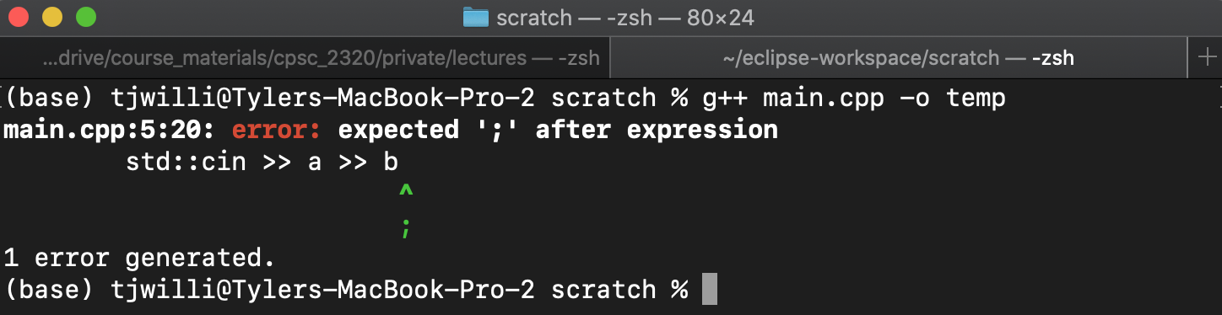
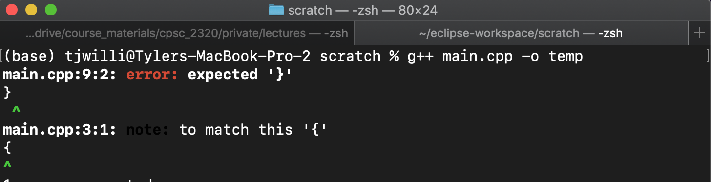
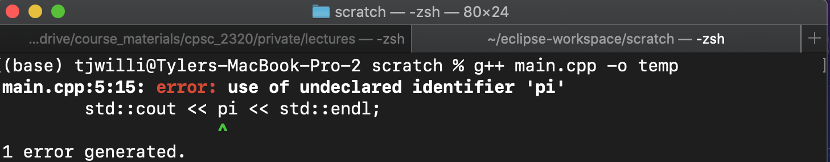
Tracking Down Errors: Syntax Errors
Syntax errors
These are pretty easy
The compiler will find them and even point them out to you
Program cannot run if it contains a syntax error

Slide 19
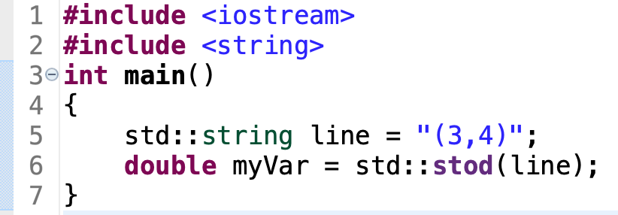
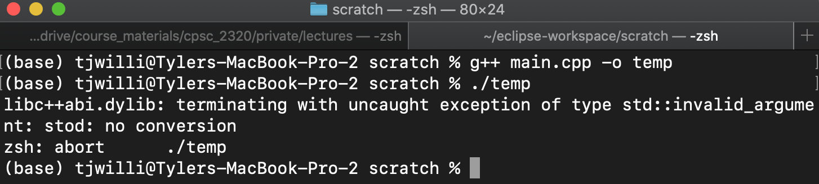
Tracking Down Errors: RunTime Errors
Runtime errors
Can be a bit harder to track down
C++ message range in helpfulness
Might require “debugging”

Slide 20
If debugging is the process of removing software bugs, then programming must be the process of putting them in.
--Edsger W. Dijkstra

Slide 21
Debugging
The process of finding and eliminating “bugs” from a computer program
A “bug” is anything that produces undesired behavior in the program

Slide 22
The most effective debugging tool is still careful thought, coupled with judiciously placed print statements.
--Brian Kernighan

Slide 23
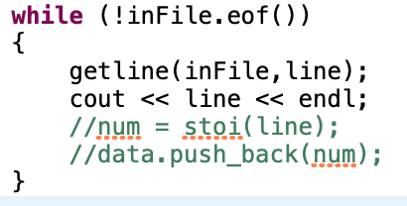
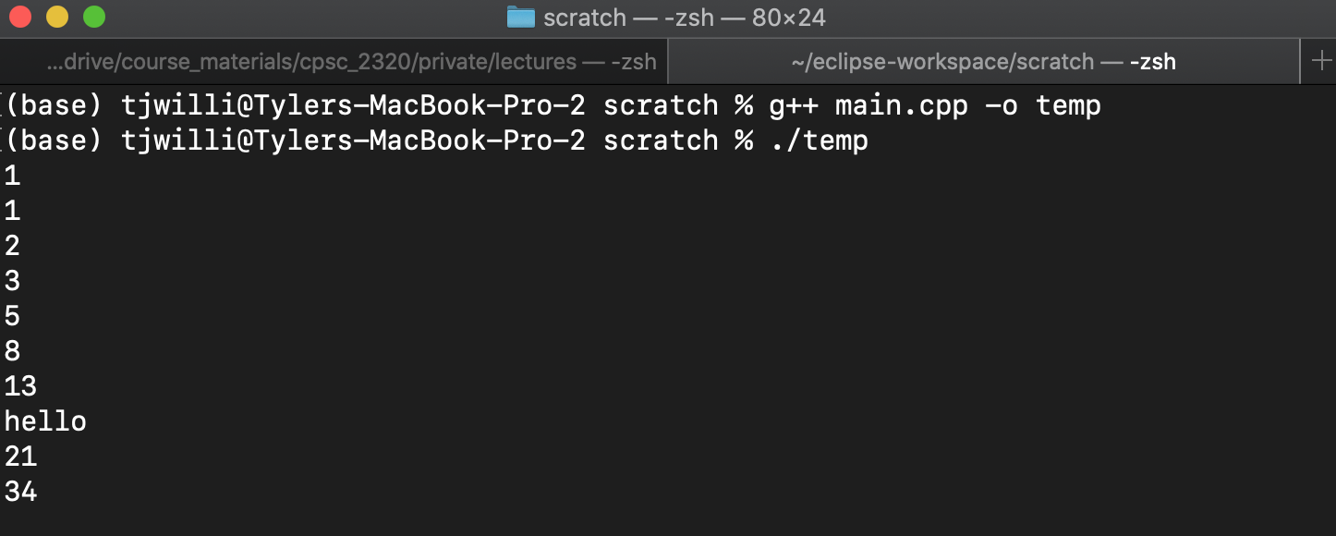
Debugging
Best way to debug: lots of cout statements

Slide 24
Tracking Down Errors: Logical Errors
These are the hardest errors to track down
Our program compiles and runs, but doesn't give us the output we expected
Unit tests help us discover that the error exists
How do we find it?

Slide 25
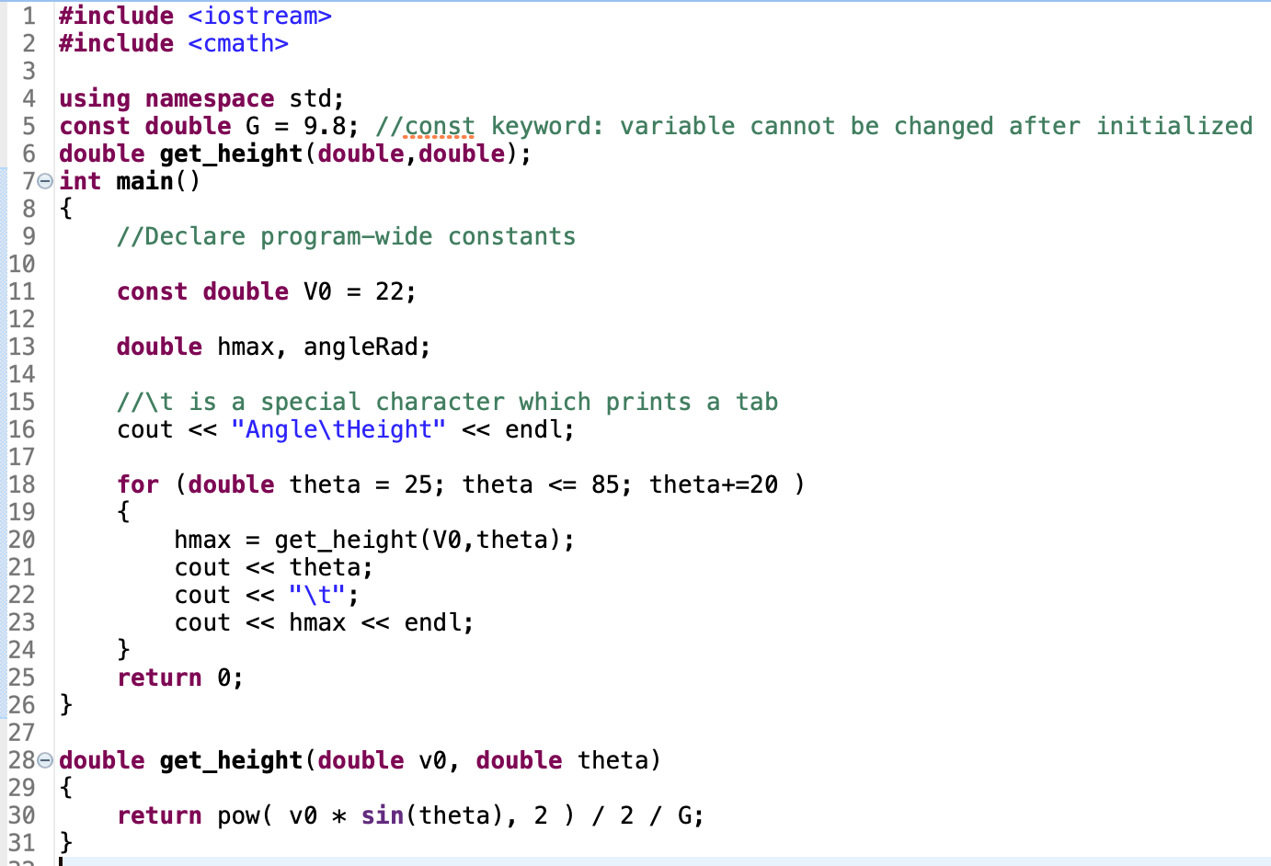
Example

Slide 26
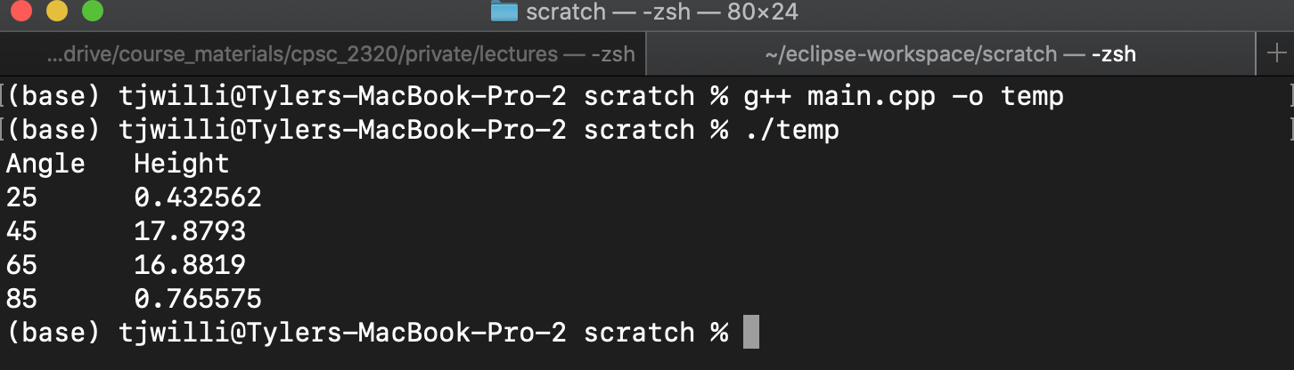
Example
Not right!

Slide 27
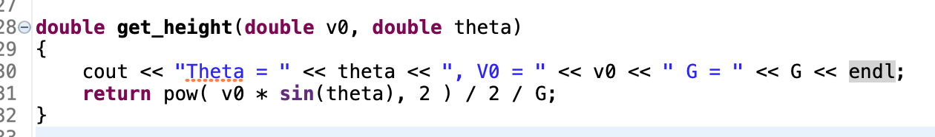
Example
Add some print statements!

Slide 28
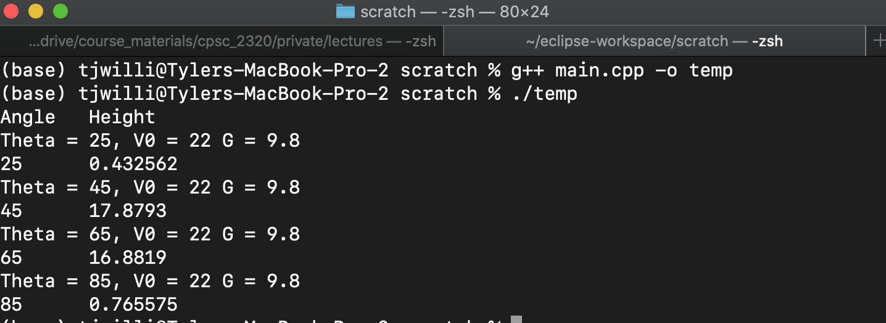
Example
Do calculation by hand with same numbers, and find the error

Slide 29
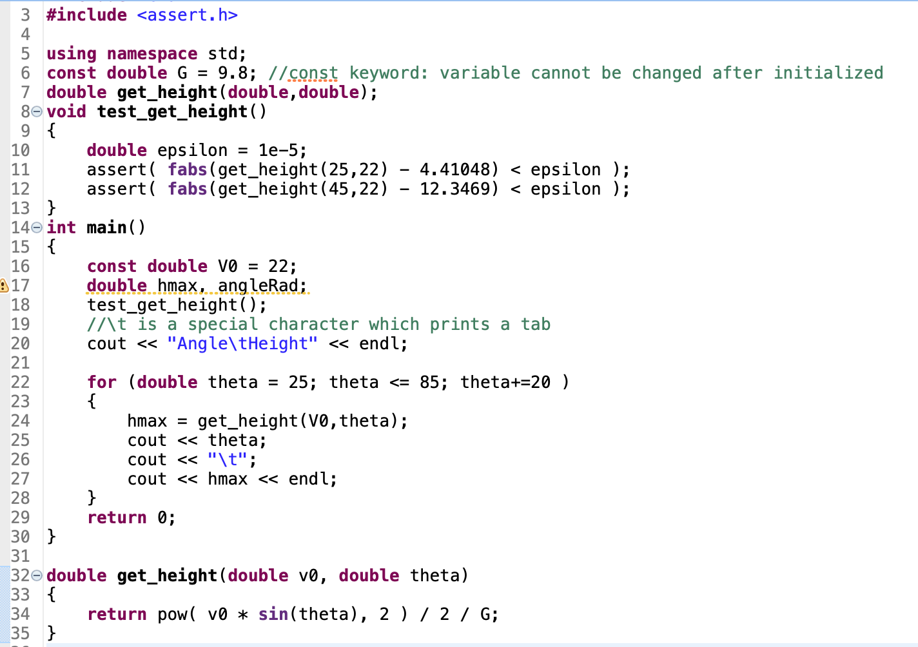
Example
Another reason for unit tets!

Slide 30
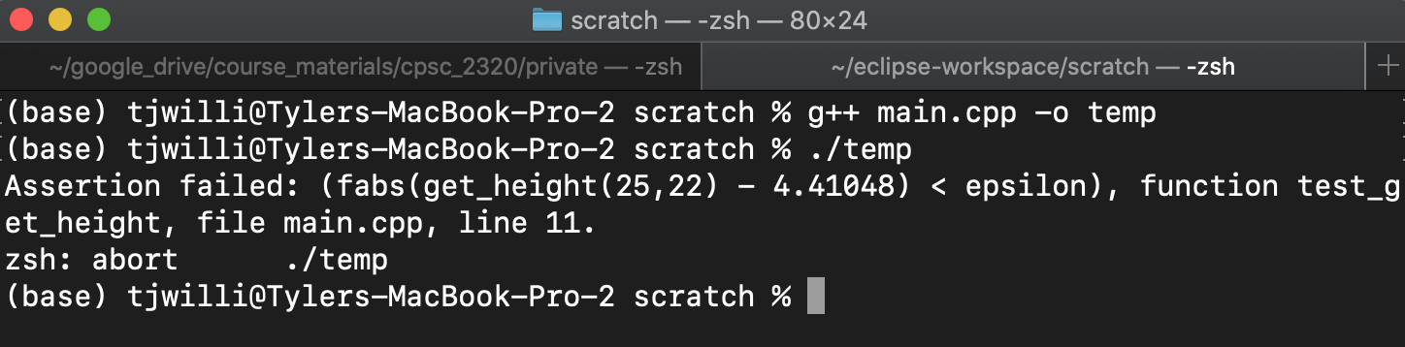
Example

