Slide 1
Vectors
CPSC 2320 L5
2020-10-15

Slide 2
Review of arrays
What is an array?
An ordered “list” of variables of a single data type, accessible by element number
Arrays are:
Composed of a single data type
Fixed size

Slide 3
Limitations of arrays
Fixed size
Cannot “append” to the back of an array
Does not contain size information
If we pass an array to a function, we also need to pass the size!

Slide 4
Vector: An array with more power
A vector is an object
An object is a grouping of data and functions that act on the data, in a way that protects the data and provides useful functionality

Slide 5
Vector: An array with more power
Vectors are:
Composed of a single data type
not fixed size
Vector objects come with their own functions, such as:
vector.size() //Returns the number of elements in the vector
vector.push_back() //Adds a new element to the back of the vector
vector.pop_back() //Removes last element of the vector
vector.clear() //Removes all elements from the vector

Slide 6
Vectors in C++ are similar to python lists
C++ vector | Python list
vector.size() | len(list)
vector.push_back() | list.append()
vector.pop_back() | list.pop()
vector.clear() | list.clear()

Slide 7
Vectors
Vectors are declared in 3 different ways.
Specify the initial number of elements: vector<double> firstVector(10); // 10 doubles vector<int> myVector(12); // 12 ints
Specify the initial number of elements, and initialize them all to one value: vector<int> intVector(5, -1); // 5 values, all -1
Create an empty vector: vector<double> letterVector; // 0 elements

Slide 8
Vector Methods
.size(): report the number of elements in the vector
cout << firstVector.size();
.push_back(value): create a new element at the end of the array, set it equal to value.
firstVector.push_back(1.2);

Slide 9
Vector methods
.pop_back(): remove the last element of the vector. Does not return the value of that element. firstVector.pop_back();
.clear(): remove all elements of the vector. firstVector.clear();
[ ]: access an element of the vector firstVector[3] = 4.5; cout << firstVector[12];

Slide 10
To Use A Vector:
#include <vector>
std::vector<double> myVec; //Vectors live in std
using namespace std;

Slide 11
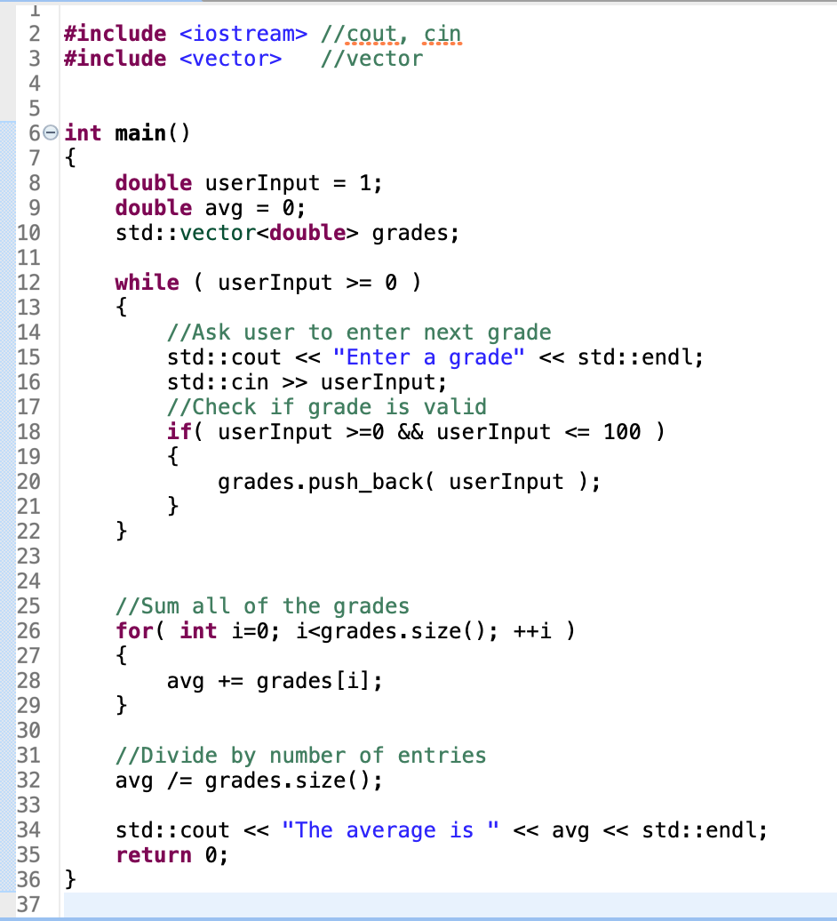

Slide 12
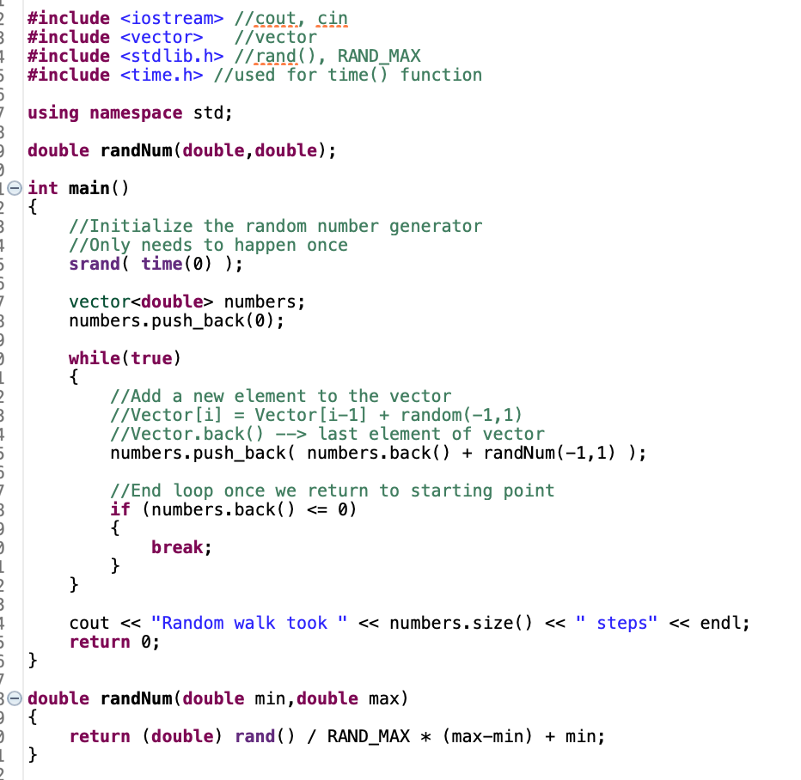

Slide 13
Vectors
We can pass vectors to functions
Pass by value is default, just like doubles, ints, etc

Slide 14
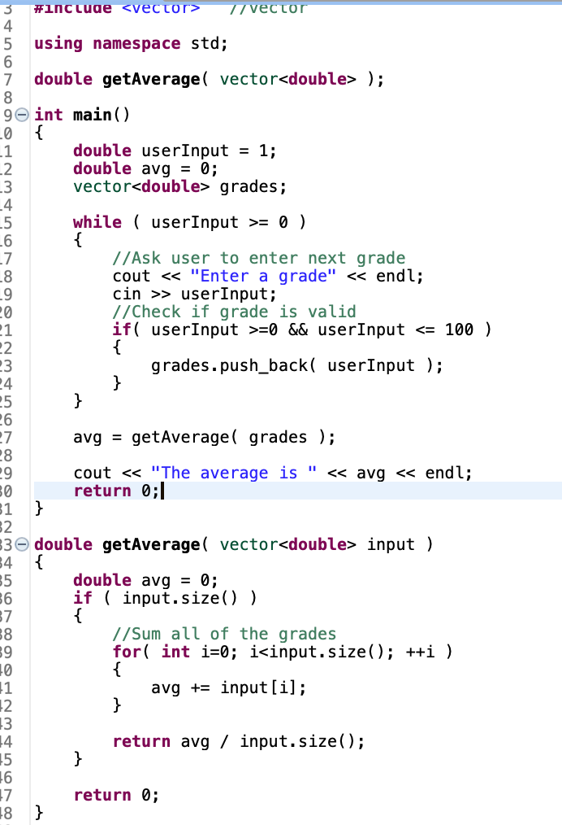

Slide 15
Vectors
Pass by value can be slow and inefficient for large vectors
Pass by reference is better

Slide 16
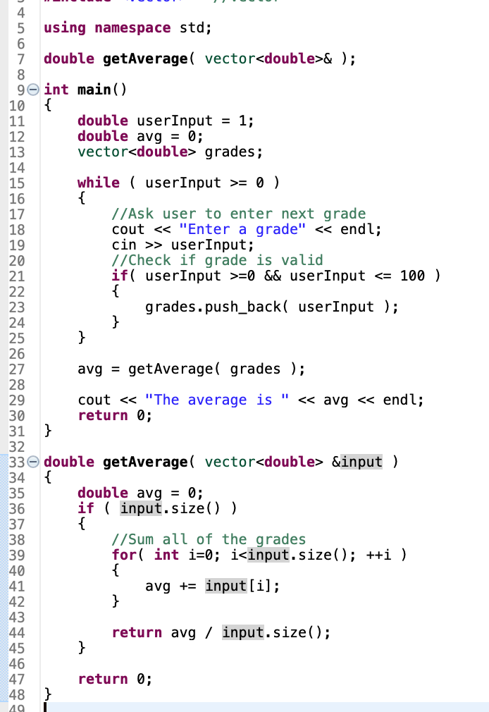

Slide 17
Vectors
Pass by reference allows the function to modify the original vector!
Not always what we want
Workaround: use const
This passes the reference to the original vector, but does not allow its contents to be modified

Slide 18
