Slide 1
OBJECTS AND USER-DEFINED TYPES
CPSC 2320 L9
2020-11-19

Slide 2
C++ DATA TYPES
Data types/structures we have encountered so far:

Slide 3
C++ DATA TYPES
Data types/structures we have encountered so far:
doubles, ints, floats, chars
arrays
vectors, strings

Slide 4
vectors and strings have added functionality
vector.size(), string.substr(i,w), string.find(“c”), vector.pop_back()…
These are all functions that are ”attached” to the variable
We call these datatypes “objects”
An object is a grouping of data and functions that act on that data

Slide 5
OBJECT ORIENTED PROGRAMMING
Up to this point, we have focused on procedural programming
In procedural programming the focus is on writing functions or procedures which operate on data
In object-oriented programming the focus is on the creation of objects which contain both data and functionality together.

Slide 6
EXAMPLE: STRING
A string object consists of some data (the characters that you assign to it) as well as some helpful functions that operate specifically on that data
Access these functions directly from the object using the “dot” operator

Slide 7
EXAMPLE: STRING
myString
Data:
h
e
l
l
o
0
1
2
3
4
string myString = “hello”;
myString.size(): 5
myString.find(“e”): 1
myString.substr(3,1): “lo”

Slide 8
USER DEFINED DATA TYPES
We can create our own types of objects!
An object consists of a collection of variables and functions that act on those variables

Slide 9
EXAMPLE
We want an object to represent a 3D vector in cartesian coordinates
Data: x,y,z
Some useful functions that operate on the data:
magnitude() //length of the vector
toSpherical() //convert to spherical coordinates
direction() // return the direction of the vector (the unit vector)
etc…

Slide 10
EXAMPLE
CartesianVector myVector(3,4,5);
double len = myVector.magnitude(); //sqrt(x^2+y^2+z^2)
cout << “The magnitude of the vector is “ << len << endl;
Output: The magnitude of the vector is 7.07107
vector<double> unitVec = myVector.direction();
vector<double> sphericalVec = myVector.toSpherical();
vector<double> cylinderVec = myVector.toCylindrical();

Slide 11
ANOTHER EXAMPLE
A class to represent a car
Data: make, model, color, year, mileage, etc…
Functions: addMiles(number of new miles), etc…

Slide 12
EXAMPLE
Mileage
Car myCar(“Ford”,”Mustang”,”Red”,2020,54000);
myCar.printSummary();
Output: I am a Red, 2020 Ford Mustang with 54,000 miles
myCar.setColor(“Blue”);
myCar.addMiles(12000);
myCar.printSummary();
Output: I am a Blue, 2020 Ford Mustang with 66,000 miles
cout << myCar.mileage << endl; //66000

Slide 13
CLASSES
How do we do this?
Use a C++ “class”
A class defines all of the variables and functions that comprise the data type
What variables contain the data?
What functions operate on this data?

Slide 14
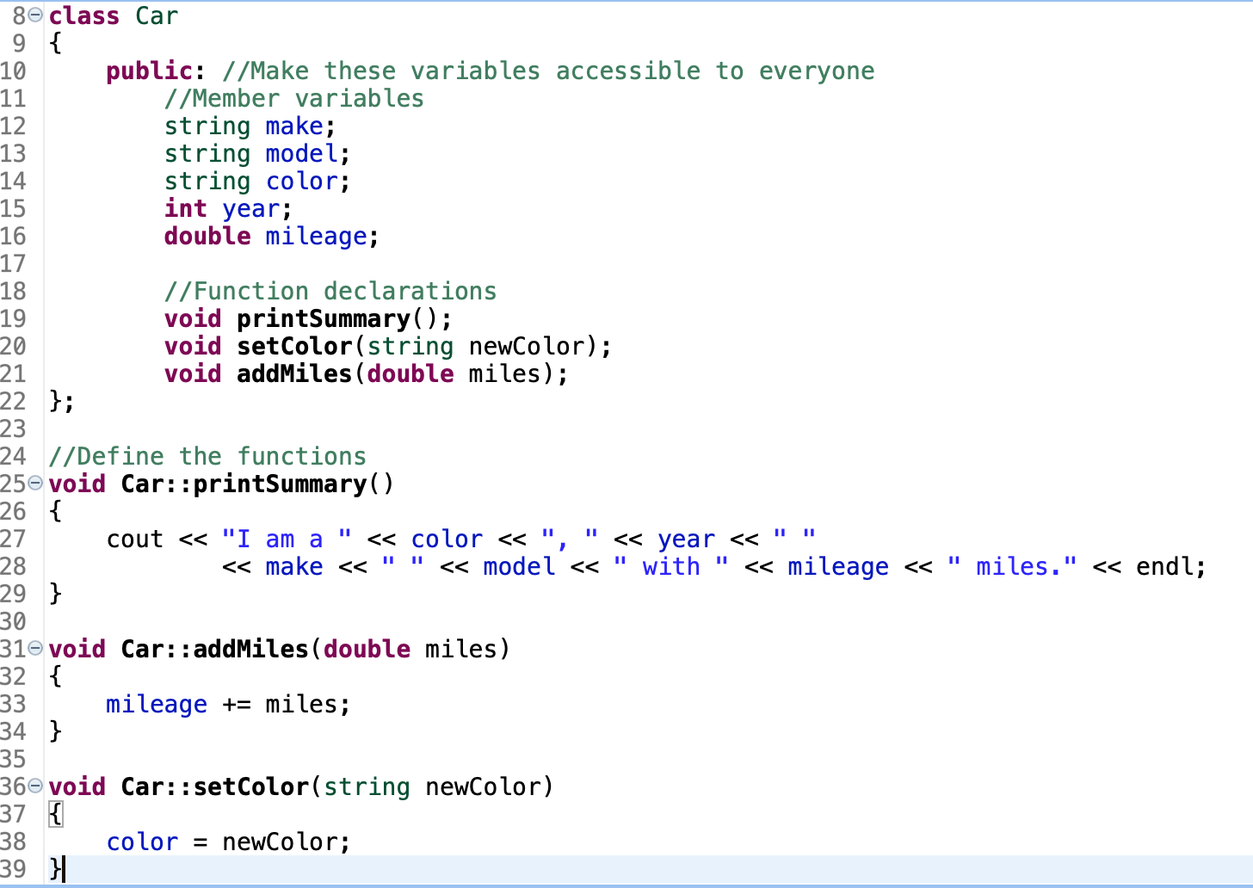
AN EXAMPLE CLASS: CAR

Slide 15
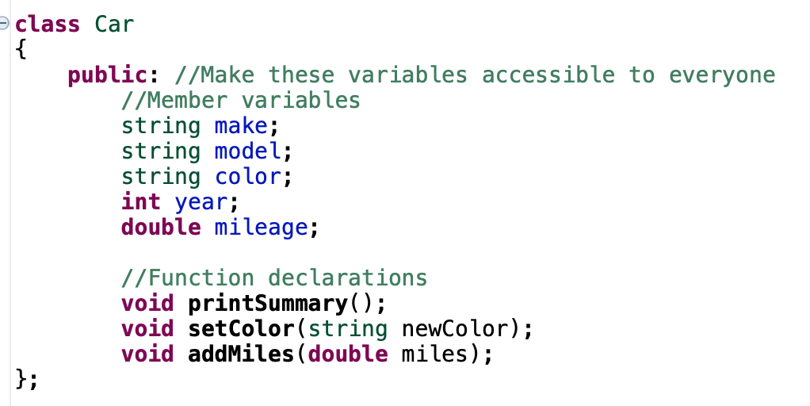
AN EXAMPLE CLASS: CAR
Class name
Declare all variables and functions

Slide 16
AN EXAMPLE CLASS: CAR
Variables declared here are called “member variables” because they are “members” of the class

Slide 17
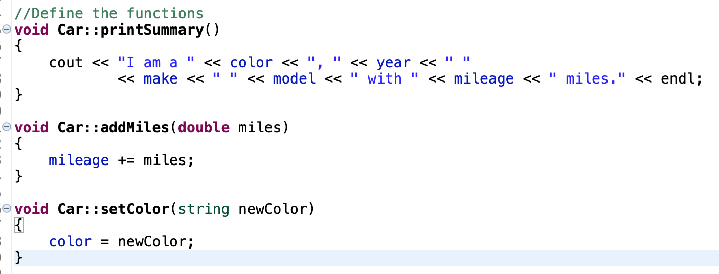
Implementation: what does the class do?
Define the functions
Can only define functions declared in the class definition “member functions”

Slide 18
Unlike normal variables, member variables are in scope inside of member functions, even without being passed as arguments!

Slide 19
CLASS SYNTAX
class ClassName
{
public: //We will discuss what this means later
//Variable and function declarations
};
//Implementation (function definitions)
void ClassName::print()
{
cout << “Hello world” << endl;
}

Slide 20
CLASS INSTANTIATION
Now that we’ve defined the Car class, let’s use it

Slide 21
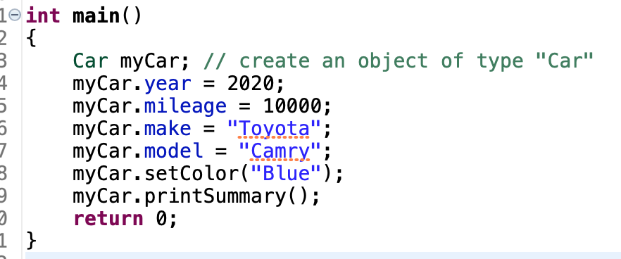
USING THE CAR CLASS
Output: I am a Blue, 2020 Toyota Camry with 10000 miles.

Slide 22
LINE BY LINE
Create a variable of type Car named myCar
myCar is now an object
An object is an instance of a class
Car myCar;

Slide 23
LINE BY LINE
class (only one)
class Car
An object is an instance of a class
Can have many instances, but only one class
Car car1;
color = “Red”
Model = “Mustang”
Make = “Ford”
Mileage = 15000
Year = 2020
Car car2;
color = “Gold”
Model = “Malibu”
Make = “Chevy”
Mileage = 160000
Year = 2009
Car car3;
color = “Blue”
Model = “Tacoma”
Make = “Toyota”
Mileage = 28000
1st instance
2nd instance
3rd instance

Slide 24
LINE BY LINE
Use the “dot” operator to access the public member variables of a function
object.variableName = “”;
These can be assigned to or printed/used
myCar.year = 2020;
myCar.mileage = 10000;
myCar.make = “Toyota”;
myCar.model = “Camry”;

Slide 25
LINE BY LINE
Dot operator is also used to access member functions
myCar.setColor(“Blue”);
myCar.printSummary();

Slide 26
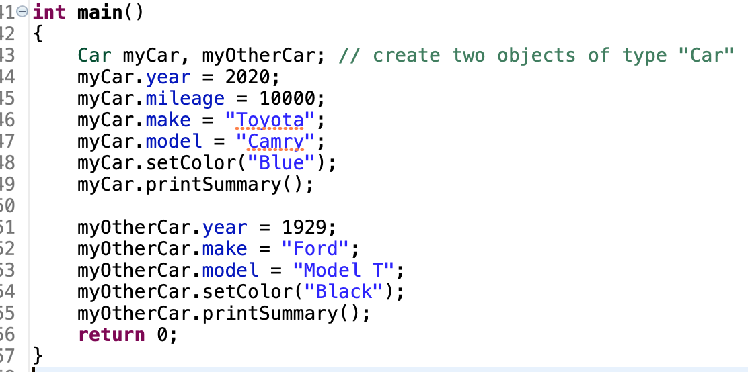
MULTIPLE INSTANCES

Slide 27
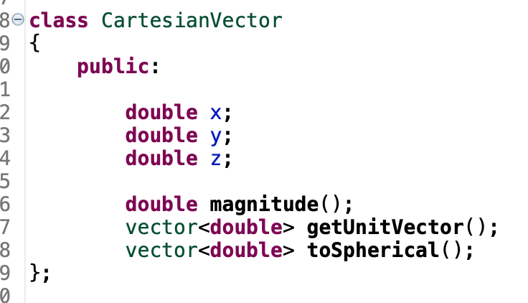
ANOTHER EXAMPLE

Slide 28
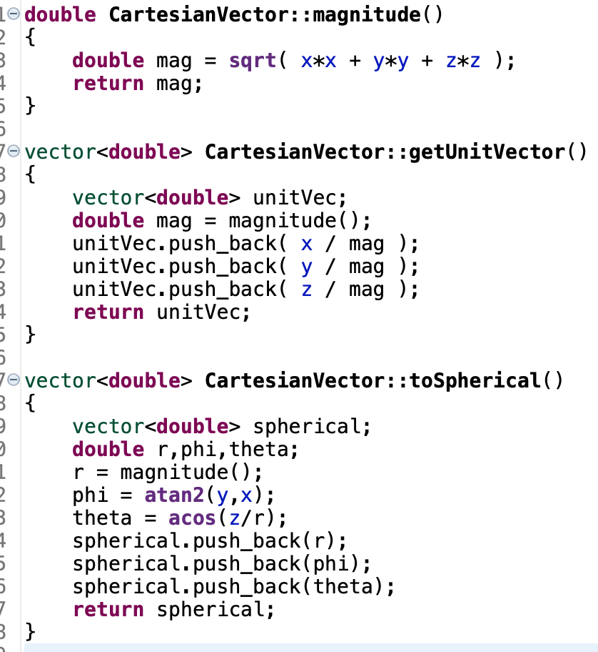
ANOTHER EXAMPLE

Slide 29
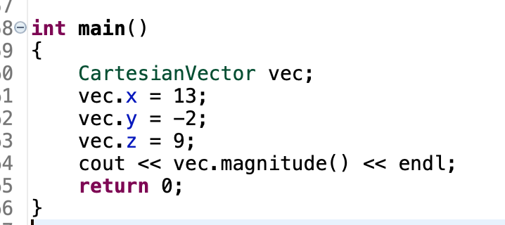
USAGE

Slide 30
CLASS CONSTRUCTORS
Instead of:
CartesianVector vector;
vector.x = x;
vector.y = y;
vector.z = z;
We would like to do:
CartesianVector vector(x,y,z);

Slide 31
CLASS CONSTRUCTORS
We can do this by adding a special member function in the class definition called the “constructor”
Has the same name as the class, and has no type (not even void)

Slide 32
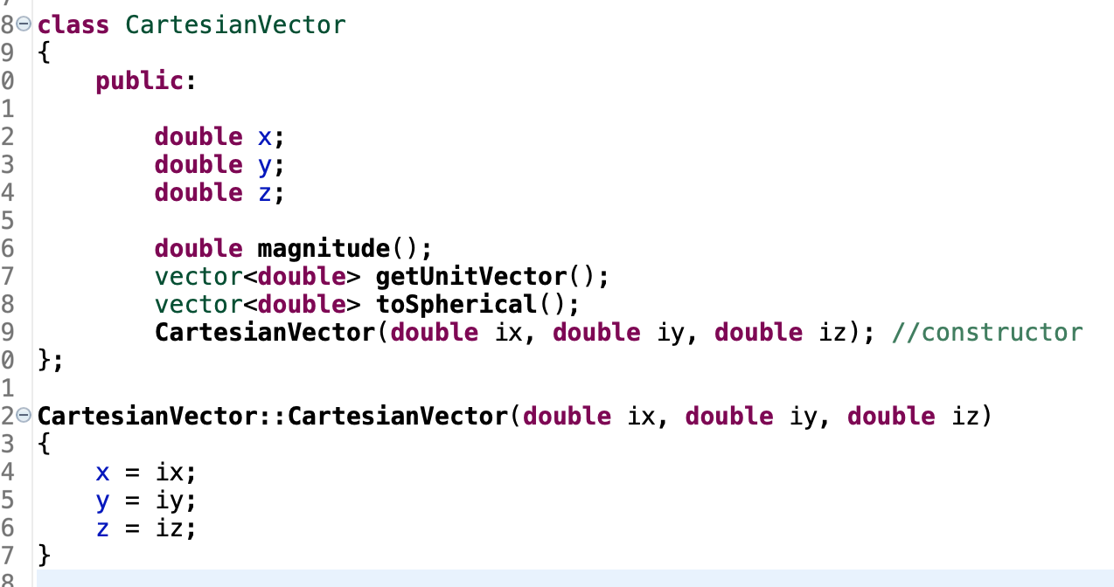
Constructor declaration
Constructor definition

Slide 33
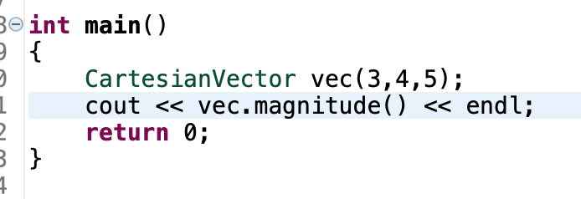
Arguments passed to constructor

Slide 34
Work on lab

Slide 35
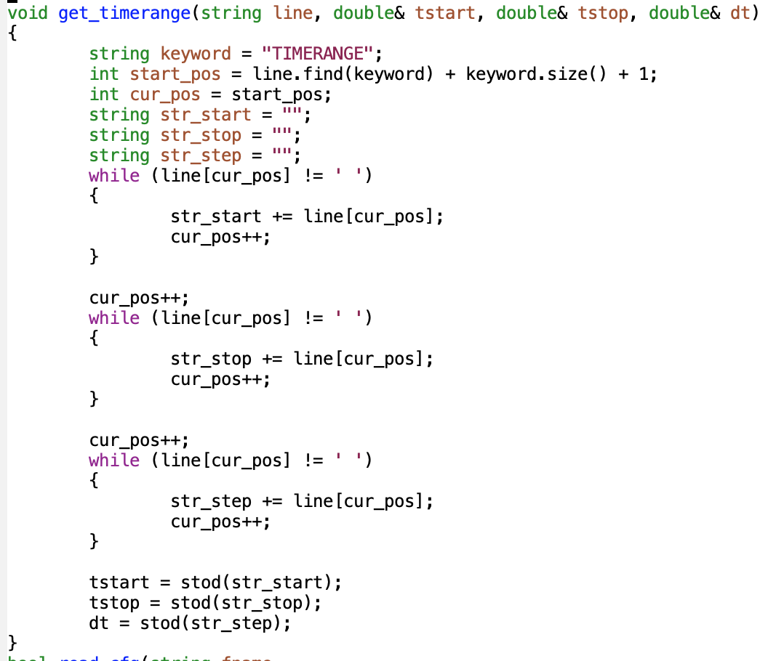
HOMEWORK HELP
Here is my “get_timerange” function
If you use it, you must add comments to explain how it works!

