Slide 1
Installing Python (And MU)

Slide 2
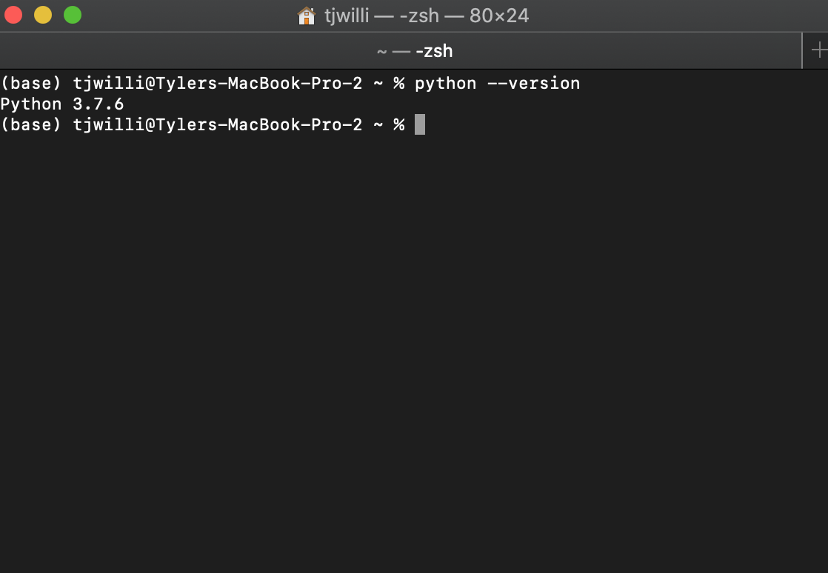
Installing Python
Do you already have it?
Open a command prompt and type “python --version”
Anything 3.5 or higher is OK
If you see a “command not found” message, you don’t have python installed

Slide 3
Installing Python
If you have python version >= 3.5, you’re good, sit tight for now
If you don’t have python installed go to python.org/downloads and download the latest version for your operating system
If you do have python installed but the version number is < 3.5, inform your instructor

Slide 4
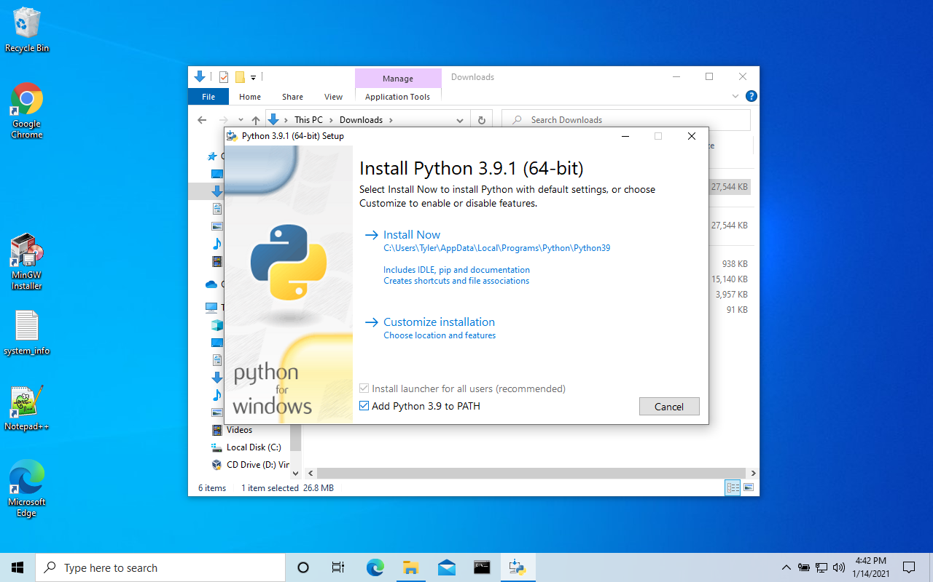
Installing python
The downloaded file will run an interactive installation program
When given the option, be sure to check the box next to ”add Python 3.9 to PATH”
If on Windows, take note of the installation location (so I can help you if you have issues later)

Slide 5
Checking the installation
When the installation is finished open a new terminal or command prompt and type the “python --version” command again to verify that the installation was succesful

Slide 6
Install MU (IDE)
Mu is a simple IDE (integrated development environment) that we can use to write python code
Like Microsoft Word, but for programming instead of word processing

Slide 7
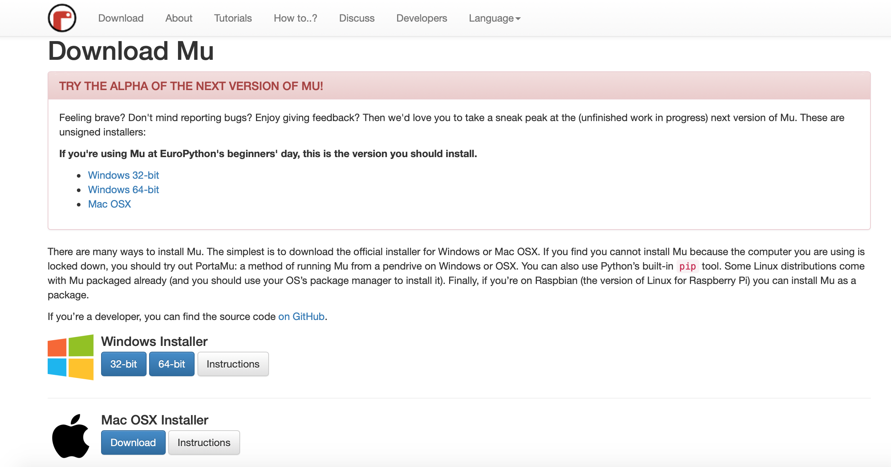
Install MU IDE
Go to: https://codewith.mu/en/download
Download the version for your operating system and install
Do not download the alpha version

Slide 9

An example: Calculating interest
$$A=P{\left(1+\frac{r}{100}\right)}^{n}$$
P = initial amount (principal)
r = interest rate (in %)
n = # of years
A = final amount

Slide 10
An example: Calculating interest
$$A=P{\left(1+\frac{r}{100}\right)}^{n}$$
Try: P=100, r=5, n=7

Slide 11

An example: Calculating interest
$$A=100{\left(1+\frac{5}{100}\right)}^{7}$$
Order of operations: PEMDAS
Parenthesis
Exponents
Multiplication/Division
Addition/Subtraction

Slide 12
An example: Calculating interest
$$A=100{\left(1+0.05\right)}^{7}$$
Order of operations: PEMDAS
Parenthesis
Exponents
Multiplication/Division
Addition/Subtraction

Slide 13
An example: Calculating interest
$$A=100{\left(1.05\right)}^{7}$$
Order of operations: PEMDAS
Parenthesis
Exponents
Multiplication/Division
Addition/Subtraction

Slide 14
An example: Calculating interest
$$A=100{\left(1.05\right)}^{7}$$
Order of operations: PEMDAS
Parenthesis
Exponents
Multiplication/Division
Addition/Subtraction

Slide 15
An example: Calculating interest
$$A=100×\text{1.407}…$$
Order of operations: PEMDAS
Parenthesis
Exponents
Multiplication/Division
Addition/Subtraction

Slide 16
An example: Calculating interest
$$A=140.7…$$
Order of operations: PEMDAS
Parenthesis
Exponents
Multiplication/Division
Addition/Subtraction

Slide 17
Try it yourself!
Write some code to print out the surface area of a cylinder:
$$A=2πr^{2}+2πrh$$
Use r=5 cm, h=15 cm

Slide 18

Calculate the 1D gravitational force between two objects
$$F=G\frac{Mm}{{\left(r_{1}−r_{2}\right)}^{2}}$$
Use M = 10 kg, m = 2 kg, r1 = 20 m, r2 = 40 m, $G=7×{10}^{−11}$

