Slide 1
Let’s write a program!
We want to write a program to calculate sin(x)

Slide 2

Python program to (approximate) Sin(x)
Skipping over the details, note that the function sin(x) can be expressed via an infinite series:
$$\sin\left(x\right)=x−\frac{x^{3}}{3!}+\frac{x^{5}}{5!}−\frac{x7}{7!}+\frac{x^{9}}{9!}+…$$
Where $5!=(5)(4)(3)(2)(1)$
So $n!=\left(n\right)\left(n−1\right)\left(n−2\right)(…)$

Slide 3
Break down into steps
Figure out how to calculate a factorial (n!)
Write a loop to calculate consecutive terms of the series
Add all the terms together

Slide 4
Step 1: Factorial

Slide 5

Step 2: Series terms
What is the pattern?
$$\sin\left(x\right)=x−\frac{x^{3}}{3!}+\frac{x^{5}}{5!}−\frac{x7}{7!}+\frac{x^{9}}{9!}+…$$
Loop over odd numbers!

Slide 6
Step 3: Sum the terms
How do we add all of the terms together?
Create a new variable that starts at 0 and add one term to it each loop

Slide 7
Notes:
Now write the code

Slide 8
That’s it!
We now have a working program to calculate sin(x)
Try it out!
Try a few angles with different numbers of terms

Slide 9
Example program
The user provides two force vectors (magnitude and angle) and the program adds them together

Slide 10
Example Input
“What is the magnitude of the first force (in Newtons?)”: 200
“What angle does the first force make with the positive x-axis (in degrees)?”: 57
“What is the magnitude of the second force (in Newtons?)”: 150
“What angle does the first force make with the positive x-axis (in degrees)?”: 120

Slide 11

Example Input
$$\vec{F}=\left|\vec{F}\right|<\cos{θ},\sin{θ}>$$

Slide 12

Example Input
$${\vec{F}}_{1}=<\left|{\vec{F}}_{1}\right|\cos{θ_{1}},\left|{\vec{F}}_{1}\right|\sin{θ_{1}}>$$
$${\vec{F}}_{2}=<\left|{\vec{F}}_{2}\right|\cos{θ_{2}},\left|{\vec{F}}_{2}\right|\sin{θ_{2}}>$$
${\vec{F}}_{3}={\vec{F}}_{1}$+${\vec{F}}_{2}=<\left|{\vec{F}}_{1}\right|\cos{θ_{1}}+\left|{\vec{F}}_{2}\right|\cos{θ_{2}},\left|{\vec{F}}_{1}\right|\sin{θ_{1}+\left|{\vec{F}}_{2}\right|\sin{θ_{2}}}>$

Slide 13

COS(X) Code
$$\cos{x}=1−\frac{x^{2}}{2!}+\frac{x^{4}}{4!}−\frac{x^{6}}{6!}+…$$

Slide 14
Let’s write it

Slide 15
IT works! But it could be improved…
For such a simple program, it’s pretty long and complicated
A lot of our code was just copied and pasted!

Slide 16
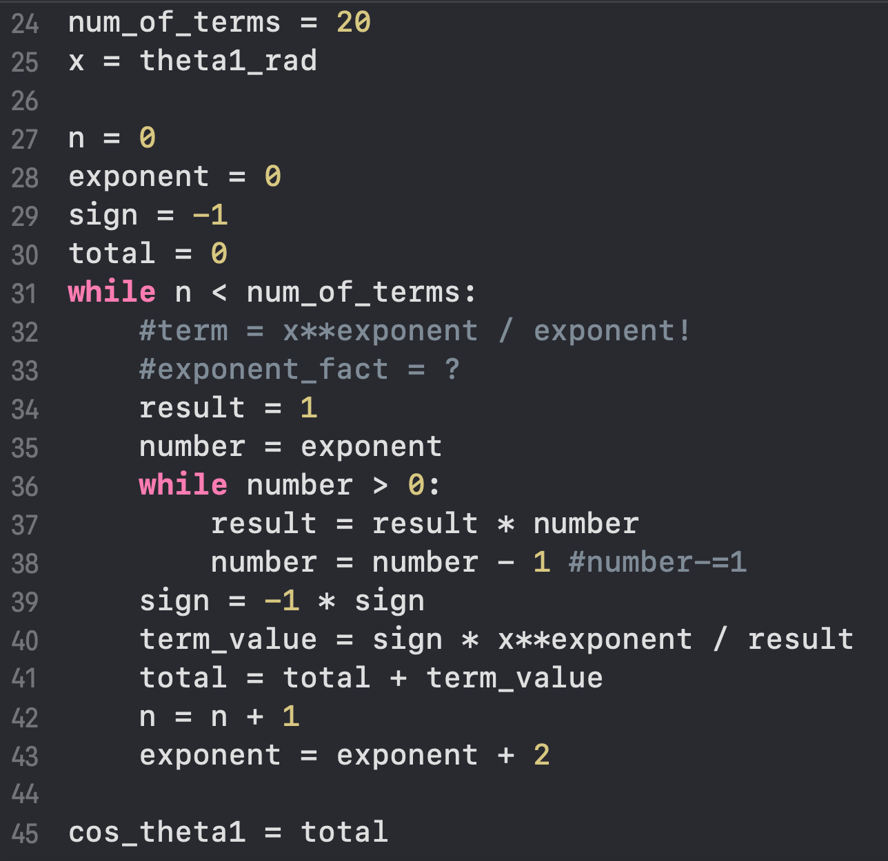
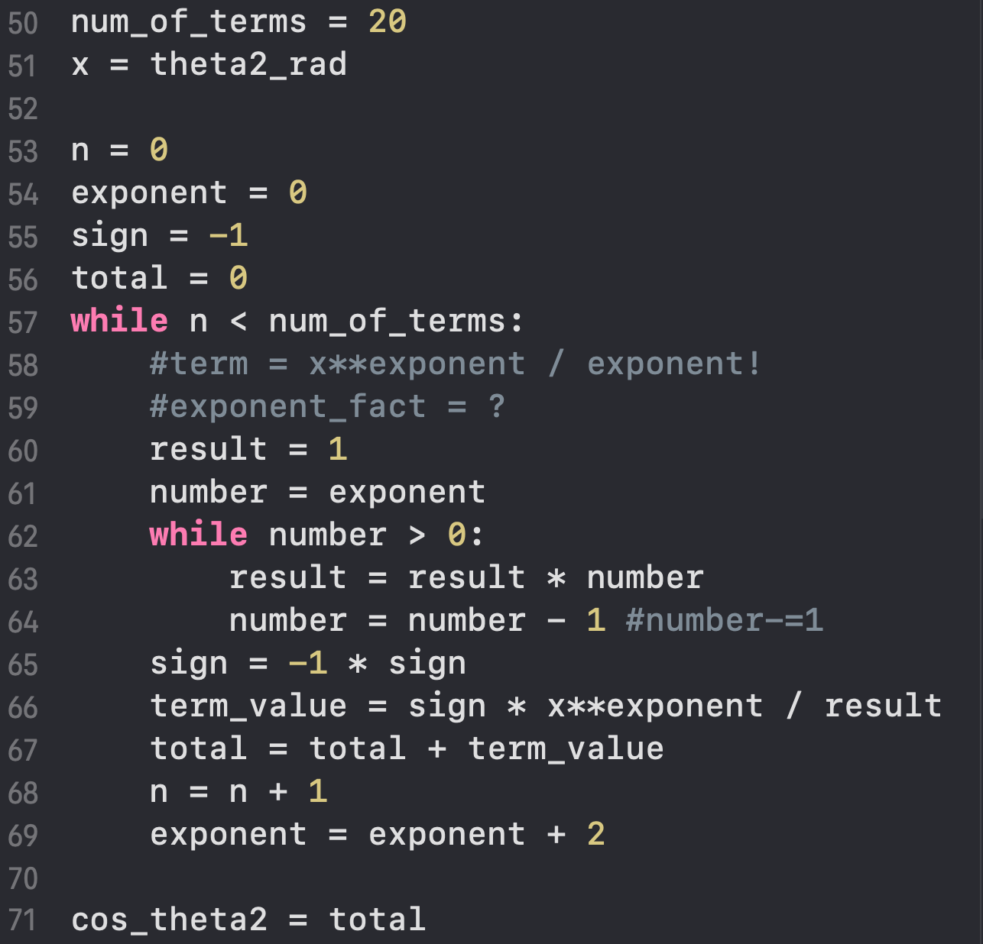

Slide 18
Can we make this code simpler?
Is there a way to just write these lines one time, but have them run whenever we want?

Slide 19
FUnctions
The answer in Python (and most languages) is something called a function
Think of a function as a program within the program

Slide 20
Example
name = input(“What’s your name? “)
if name == “Alice”:
print(“Greetings!”)
print(“How are you today?”)
elif name == “Steve”::
print(“Greetings!”)
print(“How are you today?”)

Slide 21
Example
Greetings
print(“Greetings!”)
print(“How are you today?”)
name = input(“What’s your name? “)
if name == “Alice”:
run “Greetings”
elif name == “Steve”::
run “Greetings”

Slide 22
This is (essentially) what a function is!
def greetings():
print(“Greetings!”)
print(“How are you today?”)
name = input(“What’s your name? “)
if name == “Alice”:
greetings()
elif name == “Steve”::
greetings()

Slide 23
Breakdown
def greetings():
print(“Greetings!”)
print(“How are you today?”)
name = input(“What’s your name? “)
if name == “Alice”:
greetings()
elif name == “Steve”::
greetings()
This is called the function definition (hence the def)

Slide 24
Breakdown
def greetings():
print(“Greetings!”)
print(“How are you today?”)
name = input(“What’s your name? “)
if name == “Alice”:
greetings()
elif name == “Steve”::
greetings()
This is a function call. The code defined earlier is actually run here

Slide 25
Functions alter flow of control
Start here, print “Hello!” like normal
print(“Hello!”)
def greetings():
print(“Greetings!”)
print(“How are you today?”)
name = input(“What’s your name? “)
if name == “Alice”:
greetings()
elif name == “Steve”::
greetings()

Slide 26
Functions alter flow of control
Empty line, do nothing
print(“Hello!”)
def greetings():
print(“Greetings!”)
print(“How are you today?”)
name = input(“What’s your name? “)
if name == “Alice”:
greetings()
elif name == “Steve”::
greetings()

Slide 27
Functions alter flow of control
print(“Hello!”)
def greetings():
print(“Greetings!”)
print(“How are you today?”)
name = input(“What’s your name? “)
if name == “Alice”:
greetings()
elif name == “Steve”::
greetings()
When Python sees def, it saves the subsequent block of code for later and labels it with the name “greetings”.

Slide 28
Functions alter flow of control
print(“Hello!”)
def greetings():
print(“Greetings!”)
print(“How are you today?”)
name = input(“What’s your name? “)
if name == “Alice”:
greetings()
elif name == “Steve”::
greetings()
This code is not run now. Nothing is printed yet.

Slide 29
Functions alter flow of control
print(“Hello!”)
def greetings():
print(“Greetings!”)
print(“How are you today?”)
name = input(“What’s your name? “)
if name == “Alice”:
greetings()
elif name == “Steve”::
greetings()
This code is not run now. Nothing is printed yet.

Slide 30
Functions alter flow of control
print(“Hello!”)
def greetings():
print(“Greetings!”)
print(“How are you today?”)
name = input(“What’s your name? “)
if name == “Alice”:
greetings()
elif name == “Steve”::
greetings()

Slide 31
Functions alter flow of control
print(“Hello!”)
def greetings():
print(“Greetings!”)
print(“How are you today?”)
name = input(“What’s your name? “)
if name == “Alice”:
greetings()
elif name == “Steve”::
greetings()

Slide 32
Functions alter flow of control
print(“Hello!”)
def greetings():
print(“Greetings!”)
print(“How are you today?”)
name = input(“What’s your name? “)
if name == “Alice”:
greetings()
elif name == “Steve”::
greetings()
The () tells Python that you want to run the code inside of a function. It looks for defined functions with the name “greetings”

Slide 33
Functions alter flow of control
print(“Hello!”)
def greetings():
print(“Greetings!”)
print(“How are you today?”)
name = input(“What’s your name? “)
if name == “Alice”:
greetings()
elif name == “Steve”::
greetings()
The “greetings” function is found, and the associated code is now executed. The program prints(“Greetings”)

Slide 34
Functions alter flow of control
print(“Hello!”)
def greetings():
print(“Greetings!”)
print(“How are you today?”)
name = input(“What’s your name? “)
if name == “Alice”:
greetings()
elif name == “Steve”::
greetings()
The program prints(“How are you today?”)

Slide 35
Functions alter flow of control
print(“Hello!”)
def greetings():
print(“Greetings!”)
print(“How are you today?”)
name = input(“What’s your name? “)
if name == “Alice”:
greetings()
elif name == “Steve”::
greetings()
Reach end of function. Move back to where it was called.

Slide 36
Functions alter flow of control
print(“Hello!”)
def greetings():
print(“Greetings!”)
print(“How are you today?”)
name = input(“What’s your name? “)
if name == “Alice”:
greetings()
elif name == “Steve”::
greetings()
When function finishes, proceed to the next line as usual

Slide 37
Anatomy of a function definition
def function_name():
statement 1
statement 2
another statement

Slide 38
Anatomy of a function definition
Any name used to “label” the function and call it later. Normal variable naming rules apply.
A set of empty parentheses (we’ll see why soon!)
Reserved keyword used for defining functions
def function_name():
statement 1
statement 2
another statement
A colon

Slide 39
Anatomy of a function definition
Any name used to “label” the function and call it later. Normal variable naming rules apply.
A set of empty parentheses (we’ll see why soon!)
Reserved keyword used for defining functions
def function_name():
statement 1
statement 2
another statement
A colon
An indented block of code (just like if or while)

Slide 40
Anatomy of a function definition
Any name used to “label” the function and call it later. Normal variable naming rules apply.
A set of empty parentheses (we’ll see why soon!)
Reserved keyword used for defining functions
def function_name():
statement 1
statement 2
another statement
A colon
An indented block of code (just like if or while)
The next line in the program that matches the indentation of the function signifies the end of the definition (this statement is not included in the function!)

Slide 41
Anatomy of a function Call
function_name()

Slide 42
Anatomy of a function Call
function_name()
Pretty straightforward. To run the code defined in the “function_name” function, just write the name of the function followed by a pair of parentheses

Slide 43
Try IT!
Use a function to write a ”hello world” program

Slide 44
Sending arguments To functions
def greetings(name):
print(“Greetings, ” + name)
print(“How are you today?”)
name = input(“What’s your name? “)
if name == “Alice”:
greetings(“Alice”)
elif name == “Steve”::
greetings(“Steve”)

Slide 45
Sending arguments To functions
def greetings(name):
print(“Greetings, ” + name)
print(“How are you today?”)
name = input(“What’s your name? “)
if name == “Alice”:
greetings(“Alice”)
elif name == “Steve”::
greetings(“Steve”)

Slide 46
Sending arguments To functions
def greetings(name):
print(“Greetings, ” + name)
print(“How are you today?”)
name = input(“What’s your name? “)
if name == “Alice”:
greetings(“Alice”)
elif name == “Steve”::
greetings(“Steve”)
Create a new variable name = “Alice”, and then run the function block

Slide 47
Sending arguments To functions
def greetings(name):
print(“Greetings, ” + name)
print(“How are you today?”)
name = input(“What’s your name? “)
if name == “Alice”:
greetings(“Alice”)
elif name == “Steve”::
greetings(“Steve”)
Create a new variable name = “Steve”, and then run the function block

Slide 48
Function Arguments
greetings(“Alice”)
“Alice” is an argument that is passed to the function

Slide 49
Function Parameters
def greetings(name):
print(“Greetings, ” + name)
print(“How are you today?”)
name is a parameter used in the function definition
name does not have any value until the function is called with an argument
When a function is called with arguments, the arguments are stored in the parameters

Slide 50
Passing multiple arguments
def add_numbers(num1,num2):
print(“The sum is: “,num1 + num2)
add_numbers(3,4)
#will print “The sum is 7”

Slide 51
Passing multiple arguments
def add_numbers(num1,num2):
print(“The sum is: “,num1 + num2)
add_numbers(3,4)
#will print “The sum is 7”
num1 = 3
num2 = 4

Slide 52
Passing multiple arguments
def add_numbers(num1,num2):
print(“The sum is: “,num1 + num2)
add_numbers(3,4)
#will print “The sum is 7”
num1 = 3
num2 = 4
Note: Order matters. Arguments must be passed in the same order as the parameters they will assigned to

Slide 53
Passing multiple arguments
def divide_numbers(num1,num2):
print(“The result is: “,num1 / num2)
divide_numbers(10,2)
#will print “The result is 5”
num1 = 10
num2 = 2
Note: Order matters. Arguments must be passed in the same order as the parameters they will assigned to

Slide 54
Passing multiple arguments
def divide_numbers(num1,num2):
print(“The result is: “,num1 / num2)
divide_numbers(2,10)
#will print “The result is 0.2”
num1 = 2
num2 = 10
Note: Order matters. Arguments must be passed in the same order as the parameters they will assigned to

