Slide 1
Welcome to ENGR 2310

Slide 2
Course overview
Introduction to computer programming
Numerical problem solving and data analysis
Advanced topics

Slide 4
What is computer programming?
A computer “program” is a set of instructions given to a computer
Calculate 27 x 13
Print out the first 1,000 numbers of the Fibonacci sequence
Factor a quadratic expression
Modern computer programs are written in human-readable languages and then translated into “machine code”
Any problem that you can write a list of steps to solve can be done by a computer

Slide 5
Programming languages
A programming language is a set of rules that govern how to write computer instructions that the computer is able to read
Much like the English language: words must be formed in a particular way, and sentences must be composed of words in a particular order
If you don’t follow the rules of the English language, an English speaker won’t be able to understand you
The job of the programming language is to translate the instructions you give it into language the computer understands (0’s and 1’s)
There are MANY different languages, each one focuses on different things

Slide 6
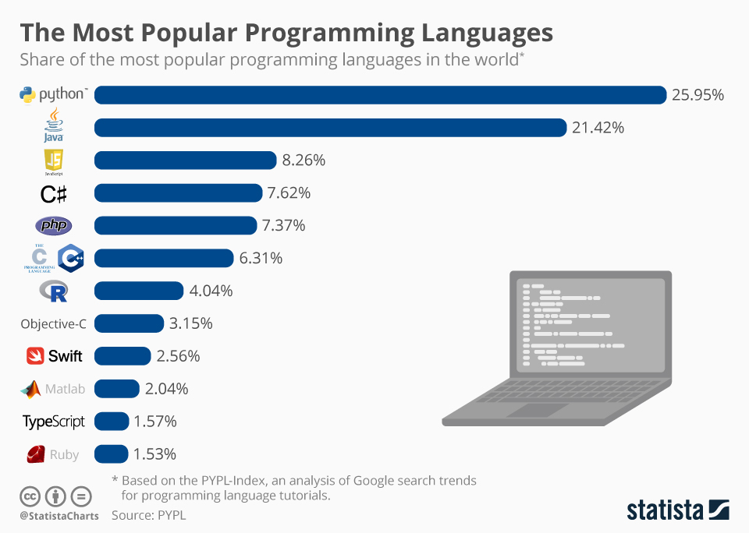
Programming languages
C++: Faster execution times but harder to program
MatLab: specifically designed for mathematical programming and data analysis; not open source
Python: easy to learn, widely used (lots of available packages), not as fast as other languages

Slide 7

Python
We will work with Python in this class
Once you learn your first language, others will come easier!

Slide 8
Simple Python examples

