Slide 1
Some odds and ends before we proceed

Slide 2
Some odds and ends before we proceed
A series of seemingly random and unconnected features of python and programming in general that have not yet made Their way into lecture but are nonetheless important for you to know

Slide 3
More details on functions
Best practices (style, organization, and variable usage)
Modules (importing code from external files)
Avoiding trouble with floating point comparisons

Slide 4
A Note on functions
We can see the value of any variable from inside of a function (as long as the variable was created before the function call)
So why do we need function arguments?

Slide 5
why couldn’t we write code like this?
def add_numbers():
return num1 + num2
num1 = 3
num2 = 5
total = add_numbers()
print(total)

Slide 6
why couldn’t we write code like this?
def add_numbers():
return num1 + num2
num1 = 3
num2 = 5
total = add_numbers()
print(total)
This code does work, but it’s not advisable
We have to re-assign num1 and num2 every time we call the function
We always have to use variables named num1 and num2
It’s harder for someone reading your code to tell what it’s doing

Slide 7
A Note on functions
On the other hand, we want to avoid unnecessary function parameters
If a variable will stay the same throughout most of the program, we don’t need a dedicated function parameter for it
There is no need to make the value of pi a function parameter; we know pi will be constant

Slide 8
Example
#Newton’s constant
G = 6.7e-11
def grav_force(m1,m2,r):
force = G * m1 * m2 / r**2
return force

Slide 9
Constants
Variables like this, that won’t change throughout the program are called constants
Best practice with constants:
Indicated by all caps variable names
Created at beginning of program
These aren’t any different from normal variables
You can change them, but you shouldn’t

Slide 10
Best Programming PRactices
It’s best to put all of our code inside of functions
Write all of the usual functions you need
Then put your actual program in it’s own function, traditionally called main()
At the very end of the file, simply call main() to run your code

Slide 11
Sample File organization
Header comments
Program-wide constants
Functions
main (definition)
main() (call)
Notes:
Show sum_forces_new

Slide 12
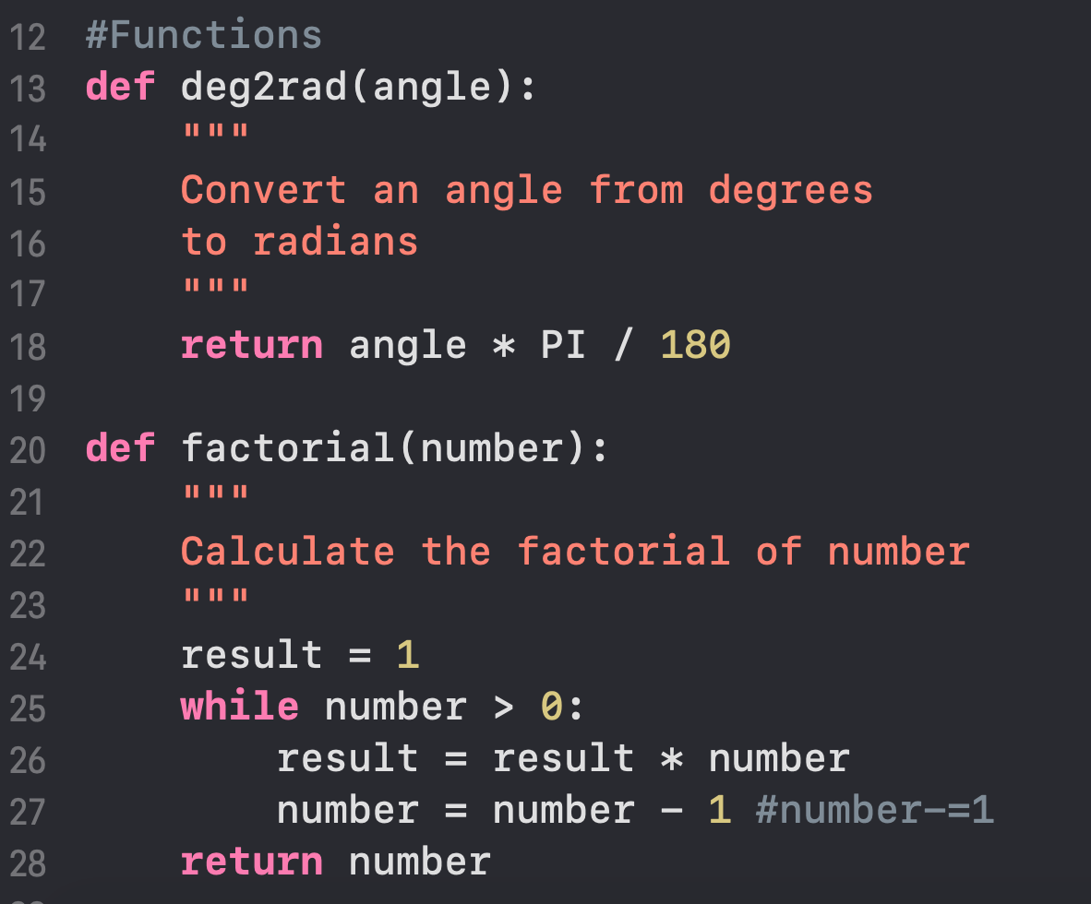
Doc Strings

Slide 13
Doc strings
Similar to string variables (name = ”Jim”), we can use triple quotes (“””) to write multi-line strings
variable = “””Hello,
this is a string
“””

Slide 14
Doc strings
This is not frequently useful, but it has become traditional in the Python community to use them as multi-line comments at the beginning of functions
These are called “documentation strings” and are used to describe the purpose and basic logic of the function

Slide 15
def calc_area(radius):
“””
A function to calculate the surface area of a disk with a given radius
“””
area = PI * radius**2
return area

Slide 16
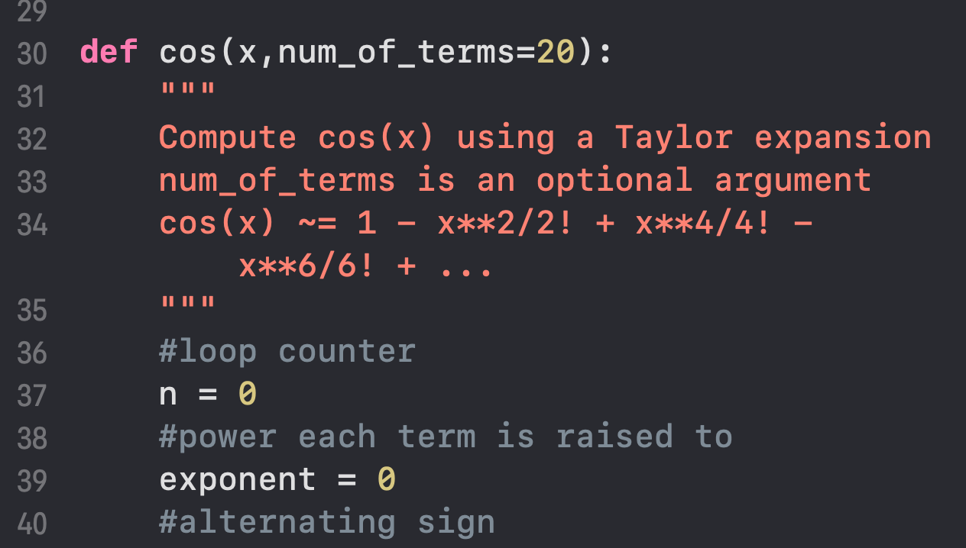
Keyword arguments

Slide 17
Keyword arguments
A keyword argument is an “optional” argument
If the user doesn’t specify a value for the function parameter, a default value will be used

Slide 18
Example
def print_greeting(name=“Sam”):
print(“Hello,”,name)
print_greetings()
print_greetings(name=“Frodo”)
“Hello, Sam”
“Hello, Frodo”

Slide 19
When to use Keyword arguments
If you want to have the option to specify an argument, but don’t want to be forced to supply an argument

Slide 20
Another Example
def calc_area(r1,r2=0):
“””
Calculate the area of an ellipse with radii r1 and r2. If r2 is 0, then the disk is circular with radius r1
“””
if r2 != 0:
return PI * r1 * r2
else:
return PI * r1**2

Slide 21
Another Example
def calc_area(r2=0,r1):
“””
Calculate the area of an ellipse with radii r1 and r2. If r2 is 0, then the disk is circular with radius r1
“””
if r2 != 0:
return PI * r1 * r2
else:
return PI * r1**2

Slide 22
Another Example
def calc_area(r2=0,r1):
“””
Calculate the area of an ellipse with radii r1 and r2. If r2 is 0, then the disk is circular with radius r1
“””
if r2 != 0:
return PI * r1 * r2
else:
return PI * r1**2
Keyword parameters must come after all “normal” parameters

Slide 23
“Readability”
Good code should be (at least) two things
Correct
Relatively easy for other programmers to follow
The easier your code is to follow, the more readable it is

Slide 24
How to write readable code
Use logical variable and function names
Write comments to explain potentially confusing aspects of your code
Organize your code (functions are your friend!)

Slide 25
Bad Example
var1 = 6.7e-11
var2 = 6.0e24
var3 = 1.2e23
var4 = 6.4e6
var5 = var1 * var2 * var3 / var4**2
print(“Result is”,var5)

Slide 26
Good Example
#Newton’s constant
G = 6.7e-11
def grav_force(m1,m2,r):
“””Calculate the gravitational force between two bodies with
masses m1 and m2, separated by a distance r”””
return G * m1 * m1 / r**2
earth_mass = 6.0e24
moon_mass = 1.2e23
earth_radius= 6.4e6
force = grav_force(earth_mass,moon_mass,earth_radius)
print(“Result is”,force)

Slide 27
Good Example
#Newton’s constant
G = 6.7e-11
def grav_force(m1,m2,r):
“””Calculate the gravitational force between two bodies with
masses m1 and m2, separated by a distance r”””
return G * m1 * m1 / r**2
earth_mass = 6.0e24
moon_mass = 1.2e23
earth_radius= 6.4e6
force = grav_force(earth_mass,moon_mass,earth_radius)
print(“Result is”,force)
The variable names make their purpose obvious, so we don’t need to explain them with a comment

Slide 28
Modules
Another way to organize your code is to store your functions in a separate file, called a module
In your actual program file, you can then tell Python to read all of the functions in this file, so that you can use them like you could any other function

Slide 29
USING Modules
Create the module file “module_name.py” in the same folder as your main program code
From your program file “main_program.py”, use an import statement to access the functions inside of the module
Use the dot “.” operator to access functions and variables inside of the module
import module_name #omit the .py
module_name.do_something()

Slide 30
How does this work?
What this really does:
The import statement instructs Python to read the imported file
Any code in that file is executed, but it should be just function definitions and variable creations
All of those functions and variables are stored in the modules namespace
We access items in the modules namespace via module_name.item

Slide 31
Example
Module (area.py)
Main program (main.py)
#area.py
PI = 3.14
def calc_area(radius):
return PI * radius**2
#main.py
import area
r = float(input(“Radius?”))
a = area.calc_area(r)
print(“Area is”,a)

Slide 32
Example
Global Namespace
#main.py
import area
r = float(input(“Radius?”))
a = area.calc_area(r)
print(“Area is”,a)

Slide 33
Example
Global Namespace
#main.py
import area
r = float(input(“Radius?”))
a = area.calc_area(r)
print(“Area is”,a)

Slide 34
Example
#main.py
import area
r = float(input(“Radius?”))
a = area.calc_area(r)
print(“Area is”,a)
Global Namespace

Slide 35
Example
#area.py
PI = 3.14
def calc_area(radius):
return PI * radius**2
“Area” namespace
PI
calc_area
#main.py
import area
r = float(input(“Radius?”))
a = area.calc_area(r)
print(“Area is”,a)
Global Namespace

Slide 36
Example
“Area” namespace
PI
calc_area
#main.py
import area
r = float(input(“Radius?”))
a = area.calc_area(r)
print(“Area is”,a)
Global Namespace
area

Slide 37
Example
“Area” namespace
PI
calc_area
#main.py
import area
r = float(input(“Radius?”))
a = area.calc_area(r)
print(“Area is”,a)
Global Namespace
area
r

Slide 38
Example
“Area” namespace
PI
calc_area
#main.py
import area
r = float(input(“Radius?”))
a = area.calc_area(r)
print(“Area is”,a)
Global Namespace
area
r
a

Slide 39
Python Standard Modules
Our programs aren’t really long or complex enough to require us to write our own modules
I wanted you to see how modules work, because a large number of them are built in as a part of your Python installation
These are stored in pre-determined folders where your Python installation is, so Python knows where to find them even though they aren’t in your local folder

Slide 40
Commonly used modules
datetime: functions to help keep track of dates and times
logging: a module to allow your program to keep detailed records of what it is doing
math: common math functions beyond simple arithmetic
os: a module to interact with your operating system (create and move files, folders, etc)
random: Generate pseudorandom numbers with various common distributions.
sys: System-specific parameters and functions
time: Keep track of how long a process takes
Many, many more! (https://docs.python.org/3/py-modindex.html)

Slide 41
The MATH Module
https://docs.python.org/3/library/math.html

Slide 42
The Time module
https://docs.python.org/3/library/time.html

Slide 43
The Time module
import time
N = 10000
total = 0
tstart = time.time() #Seconds since January 1, 1970, 00:00:00 (UTC)
for i in range(N):
total = total + I
tstop = time.time()
duration = tstop – tstart
print(“Loop took”,duration,”seconds!”)

Slide 44
The Random module
https://docs.python.org/3/library/random.html

Slide 45
The Random module
#Program to simulate rolling a die
import random
result = random.randint(0,6) #random integer N such that 0<= N <= 6
print(“The die landed on”,result)

Slide 46
The Random module
random.uniform(a,b): Return a random floating point number N such that a <= N <= b for a <= b and b <= N <= a for b < a.
random.gauss(mu,sigma): Return a random floating point number drawn from a gaussian distribution with mean mu and std dev sigma

Slide 47
Using Modules
We will discover more modules and how to use them as we proceed through the course
There are many, many more modules available to download, we will work with some of these soon!
For now, you may use the standard Python modules for any lab or homework, unless I specifically state otherwise

Slide 48
Importing Modules
Header comments
Program-wide constants
Functions
main (definition)
main() (call)

Slide 49
Importing Modules
Header comments
import modules
Any and all import statements should be placed just after the header comments and just before the rest of the program
Program-wide constants
Functions
main (definition)
main() (call)

Slide 50
Floating Point Equality
Try the following program:
a = 1.0 / 3.0
b = 0.1 / 0.3
if (a==b):
print(“Hooray!”)
else:
print(“a and b are not equal”)

Slide 51
Floating Point Equality
Why does this happen?
Computers can only store numbers with finite precision (an irrational or repeating decimal has to get cut off somewhere)
In binary, numbers like 0.1 are infinitely repeating: 0.0001100110011001100110011001100110011001100110011...
Even if the number is rational we can only store a certain number of decimal points
Depends on your machine, on mine it is 15 significant digits

Slide 52
Floating Point Equality
The upshot of this is that it is dangerous to test floating point numbers for equality using the == operator
Even if the two numbers should be the same, algebraically, they may be very slightly different
Even a difference in the 15th decimal place will cause the == operator to evaluate False

Slide 53

Example
Take the equation for electric force:
$$F=k\frac{q_{1}q_{2}}{r^{2}}$$
Algebraically, we know that if we double each charge, and double r, we will get the same force
Let’s demonstrate this computationally

Slide 54
Example
#Coulomb’s constant
k = 9e-9
def elec_force(q1,q2,r):
force = k * q1 * q2 / r**2
return force
f1 = elec_force(1e-6,1e-6,0.1)
f2 = elec_force(5e-6,5e-6,0.5)
if f1 == f2:
print(“The forces are equal”)
else:
print(“The forces are not equal”)

Slide 55

Floating Point Equality
The workaround is to write a statement that doesn’t use ==
If:
$$a=b$$
Then:
$$a−b=0$$

Slide 56

Floating Point Equality
Computationally
If:
$a−b$ is a very small number
Then, for all intents and purposes:
$$a=b$$

Slide 57
Floating Point Equality
What counts as “a very small number?”
It depends on the situation
Usually something like 10^-5 will work

Slide 58

Floating Point Equality
So now we can say that two variables a and b are said to be equal if:
$$a−b< ε$$
Where $ε$ is a small number like 10^-5
Problem: what if a = 10 and b = 30? a-b=-20, which is less than 10^-5!
We should use absolute value
Two variables are equal if:
$$\left|a−b\right|<ε$$

Slide 59
Example
import math
#Coulomb’s constant
k = 9e-9
eps = 1e-5
def elec_force(q1,q2,r):
force = k * q1 * q2 / r**2
return force
f1 = elec_force(1e-6,1e-6,0.1)
f2 = elec_force(5e-6,5e-6,0.5)
if math.fabs(f1-f2) < eps:
print(“The forces are equal”)
else:
print(“The forces are not equal”)

Slide 60
Floating Point Equality
What if our numbers are really large?
v1 = 0.1**2 * 1e14
v2 = (1/100) * 1e14
math.fabs(v1 – v2) = 0.000244140625
This corresponds to a small error in 15th significant digit, but because the absolute difference is less than 1e-5, we say the numbers are not equal

Slide 61
Floating Point Equality
What if our numbers are really small?
v1 = 2e-9
v2 = 4e-9
math.fabs(v1 – v2) = 2e-9
v2 is twice the value of v1, but since the absolute difference is less than 1e-5, we say they are equal

Slide 62
Floating Point Equality
Solution: look not at the absolute error, but the relative error
eps = 1e-5
diff = math.fabs(a-b)
rel_err1 = math.fabs(diff/a)
rel_err2 = math.fabs(diff/b)
if rel_err1 < eps and rel_err2 < eps:
print(“Numbers are equal!”)

Slide 63
Floating Point Equality
You will use this code frequently, so it’s best to turn it into a function

Slide 64
Floating Point Equality
import math
def is_equal(a,b,eps=1e-5):
diff = math.fabs(a-b)
rel_err1 = math.fabs(diff/a)
rel_err2 = math.fabs(diff/b)
if rel_err1 < eps and rel_err2 < eps:
return True
else:
return False

